Slide 1

Walmart Sales Forecasting
Vaishali Maheshwari
MSDS 692

Slide 2

Project Overview
Explore the two data sets for 45 Walmart stores and weekly sales data.
Find the impact of holidays on the sales of the store.
Holiday weeks (Christmas, Thanksgiving, Super Bowl and Labour Day) impact.
Other features impacting sales across Walmart
Stores with maximum sales.
Monthly sales analysis.
Feature engineering
Predict future sales using machine learning algorithms.
Feature scaling.
Final Dashboards.

Slide 3

Walmart Dataset details
Walmart Sales data is downloaded from from “https://data.world/tommywilczek/walmart”. I have taken a dataset with 500K records.
Two datasets are:-
Data set with details for 45 Walmart stores.
weekly sales data across these stores and departments.
Joined these datasets based on store ID to get all the features.
Data set is for years 2010 to 2012.
Field details:-
Store id, Size and type of stores.
Temperature, Fuel Price, Weekly sales, Date, Holiday, Department, 5 Markdowns, CPI, and unemployment.

Slide 4
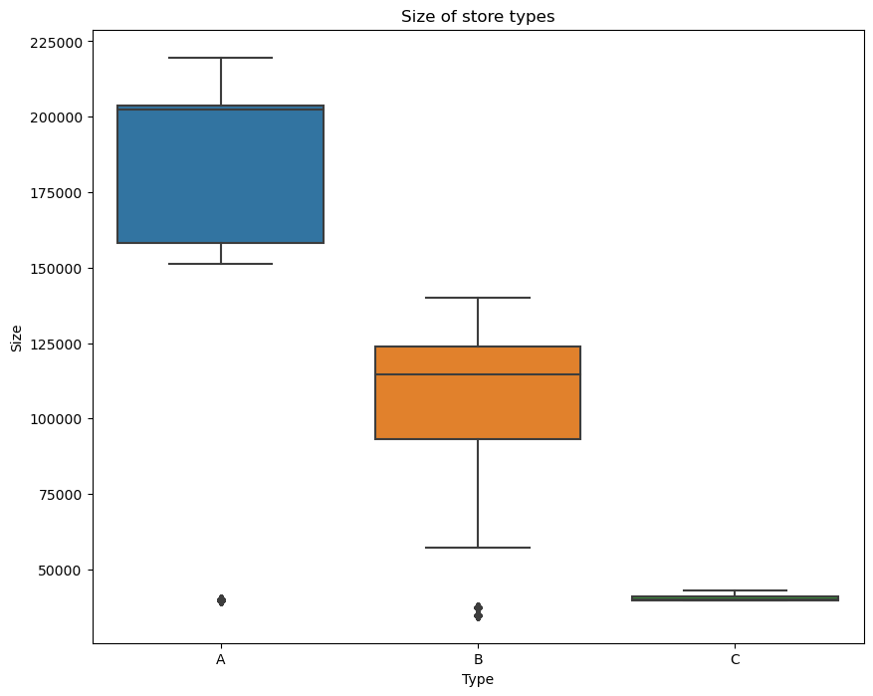
Exploratory Data Analysis Store Type
Three types of stores are considered in the data that are Type A, Type B and Type C.
Type A stores are most big.
Type B are medium-sized stores and type C are small-scale stores for Walmart.
Sales recorded for each store type are in sync to the size of the store.
Type A has recorded the highest sales of more than 4300 M.
Type B stores have more than 2000M sales.
Type C stores have the lowest total sales of less than 500M.

Slide 5
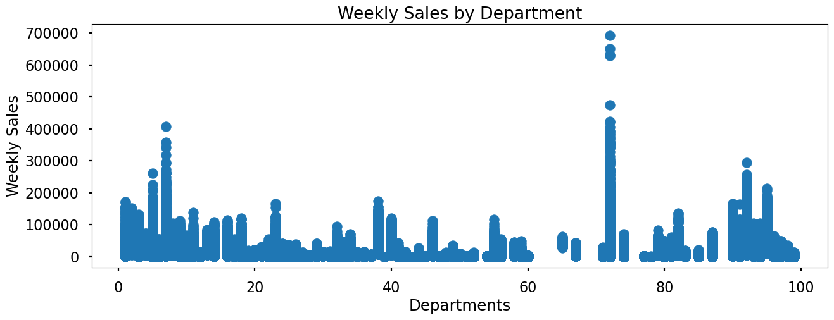
Weekly sales by Department
We have 81 unique departments across the dataset.
Department 75 have recorded the highest total sales of around 700K.
Department 7 is the one with the next highest sales of more than 400K.

Slide 6
Total Sales by Stores
The dataset has a total of 45 stores numbered from 1 to 45.
Store number 20 has recorded the maximum sales of around 300M followed by store number 4.
Other stores who have top most sales are 14, 13, 2, 10, 27, 6, 1 and 39.

Slide 7
Seasonal Impacts based on temperature
The highest sales occur for most store types between the range of 40 to 80 degrees Fahrenheit.
Observation is pleasant weather encourages higher sales.
Sales are relatively lower for very low and very high temperatures but seem to be adequately high for favourable climate conditions.

Slide 8
Impact Of Unemployment on Sales
For all the store types we see a visible decrease in sales when the unemployment index is higher than 11.
However, the average sales for Type C stores are not impacted much with an unemployment index of 11 when compared to the overall sales.
We observe a significant drop in sales for store types A and B when the unemployment index increases.
We observe ambiguity in data here, when unemployment index is 8 and 9 stores A and B have recorded highest sales.

Slide 9
Impact of Fuel Price On Sales
A decrease in sales is observed when fuel price is higher than 4.25 dollars.
Sales are higher when the fuel price ranges between 2.75 to 3.75 dollars for store types, A and B.
We don’t observe any direct relation between sales and fuel prices.

Slide 10
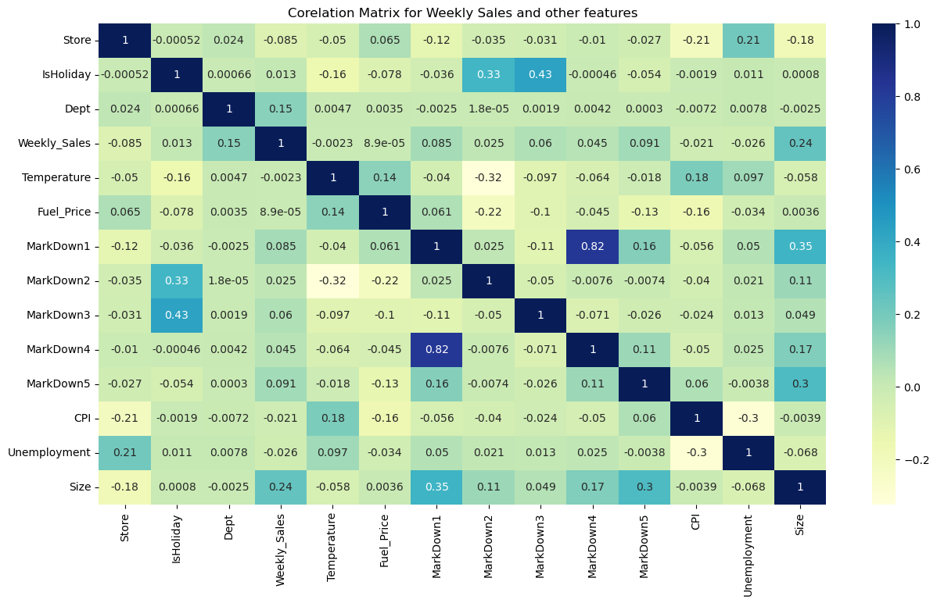
Corelation Matrix for Weekly sales and other features
Department and IsHoliday flag has a maximum dependency on the Weekly Sales values.
The size of the store also has impact which is as expected.
MarkDown1 and MarkDown5 have no direct impact on the Weekly Sales.
Fuel Price, Temperature and CPI have the least correlation with the Weekly Sales hence they are not important while predicting the sales.

Slide 11
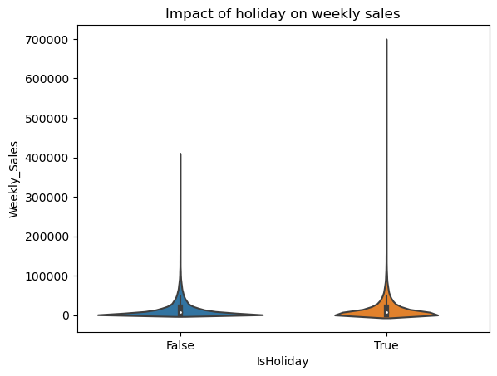
Holiday impact
Holidays have higher weekly sales than the rest of the year combined.
We have 13 days marked as holiday in the dataset.
We will split these holidays to super bowl, Labor Day, Thanksgiving and Christmas to analyze further.

Slide 12
Data Clean Up
Deleted the unnamed columns that were not required for analysis.
Records with weekly sales less than 0 were removed.
Temperature outliers are identified but can be ignored.
Markdown columns have null values.
A new column was created as a markdown sum.
Imputed all the 5 markdown missing fields with the mean of the available column values.
Any remaining null values are replaced with zero.

Slide 13
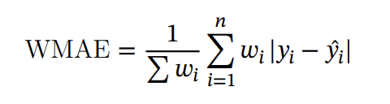
Accuracy Measure/technique
Weighted Mean Absolute error
where
• 𝑛 is the number of rows --> In our case test data number of records
• 𝑦̂ 𝑖 is the predicted sales
• 𝑦𝑖 is the actual sales
• 𝑤𝑖 are weights
Considering 𝑤eight = 5 if the week is a holiday week and 1 otherwise

Slide 14

Base Model- Linear regression
Split the data into test and train datasets based on date range.
The ratio I have used is 80% for test and 20% for train data.
Test data have records till date April 20th 2012.
Train data have records starting from April 20th 2012 till December 2012.
First, we used a hardcoded model, K-Mean regressor.
WMAE Train data = 15383.02
WMAE Test date = 15288.6
Results from Linear regression Mean

Slide 15
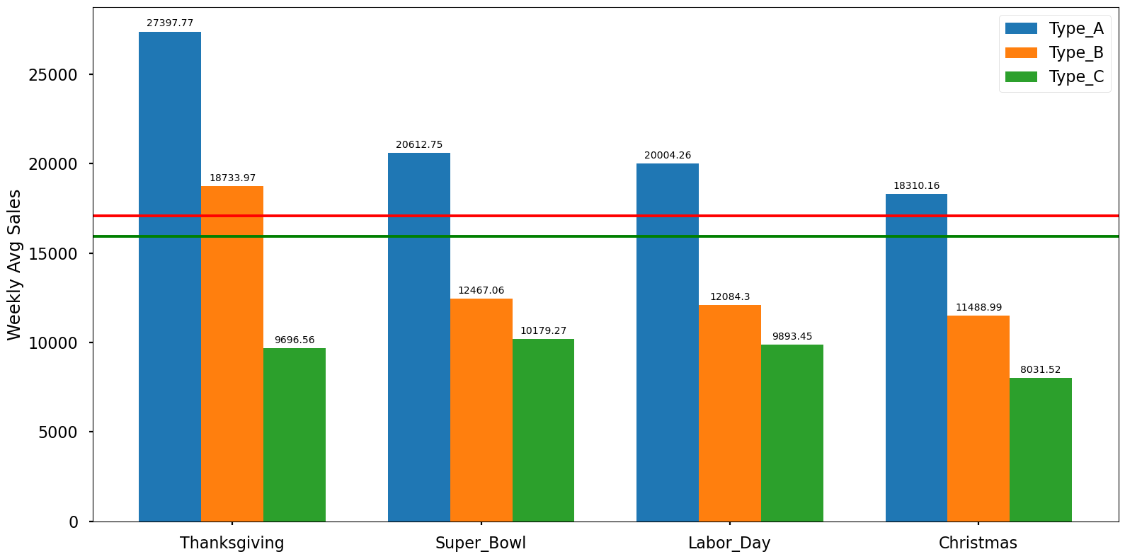
Feature Engineering
Considering four holiday weeks in the data, added the columns for super_bowl, Thanksgiving, Labor_Day and Christmas.
Highest Sales are observed during Thanksgiving for store type A and B. Store A average sale is more than 25K and store B have around 18.5K.
Holiday average sales are 17K
Non-Holiday average sale is 15.5 K

Slide 16

Feature engineering
Split the date field to get more insights about monthly or yearly sales.
Added the column Holiday_month to explore the sales. The holiday months marked are February, September, November and December.
Days left for Thanksgiving and Christmas.
Numeric column scaling from range 0,1.
Encoded categorical columns like Type and IsHoliday to numeric using OneHotEncoder.

Slide 17
Store Wise Total and Average Sales
Store Type A observed highest sales in the month of July of more than 417 M.
Store Type B also observed maximum sales in the month of July of 193 M.
Store type C observes almost similar sales throughout the year. However, October recorded maximum of 37M.
Average sales are not impacted by holidays in any month.

Slide 18
Predictions using Machine Learning algorithms with all added features
Gradient Booster seems to be the best algorithm for this data.
It gives the minimum WMAE 2886 for the predicted values.
The second-best model is the Random Forest Regression model.

Slide 19
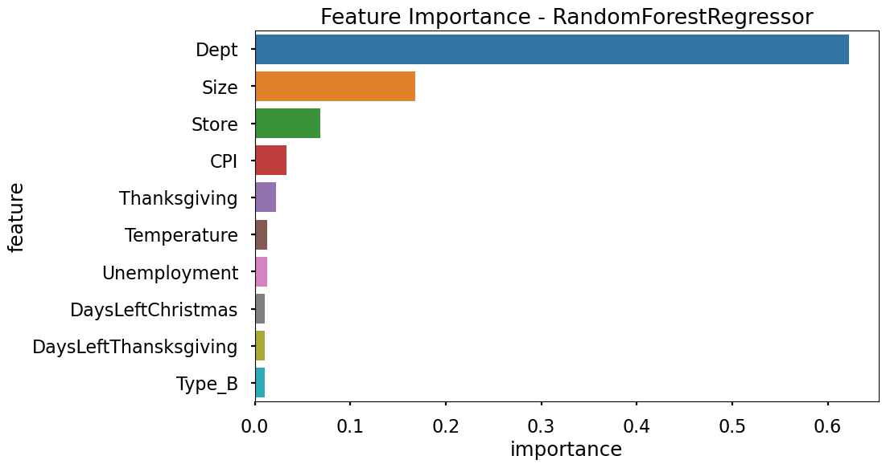

Feature Importance
Thanksgiving, Department, and Size have the maximum importance.
MarkDown1, MarkDown2, MarkDown3, MarkDown4, MarkDown5, and Temperature have the least importance.
We will drop these columns from the training and test data set and train the model again.
Trained random Forest Regression and Gradient Booster algorithm for this new feature set.
Random Forest performs the best with less error loss.

Slide 20
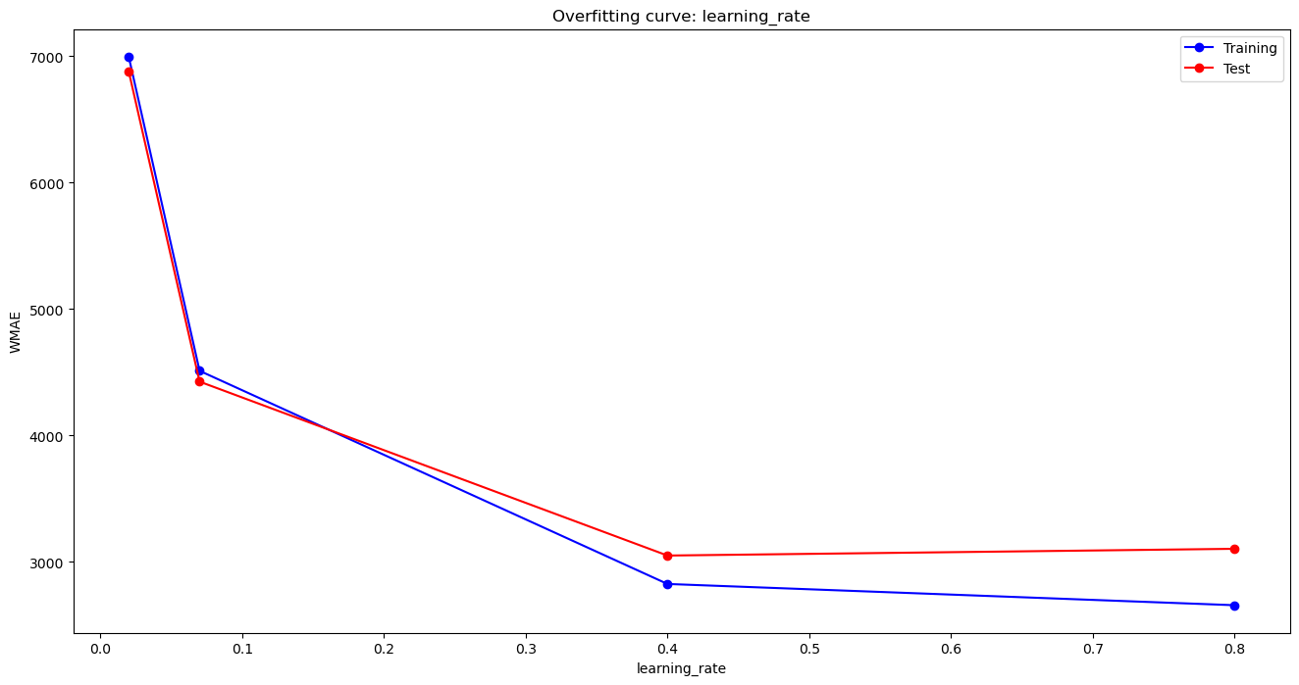
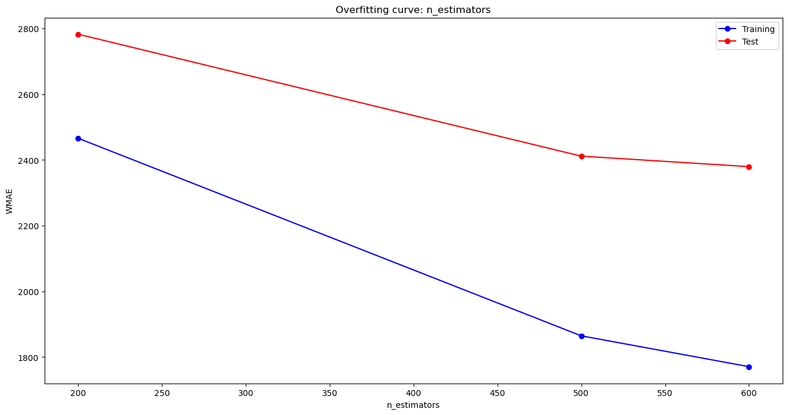
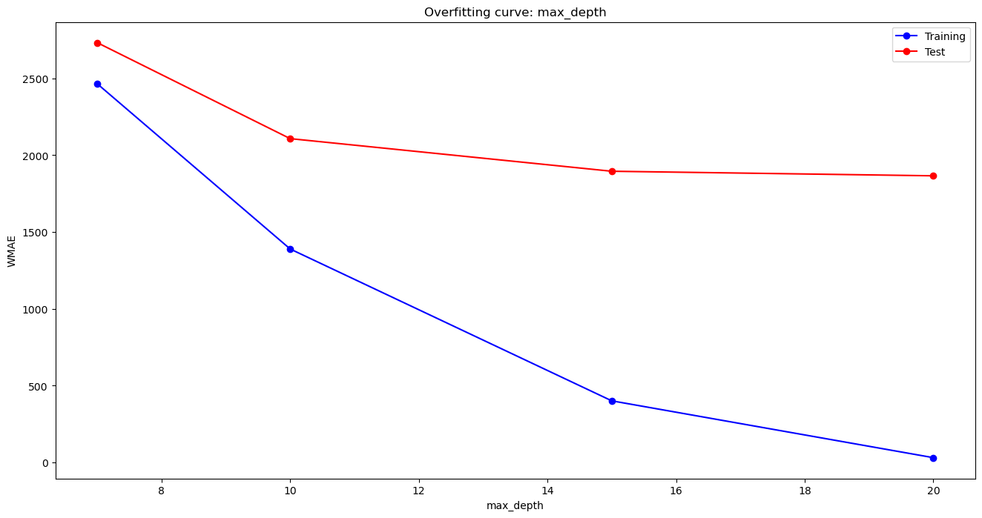
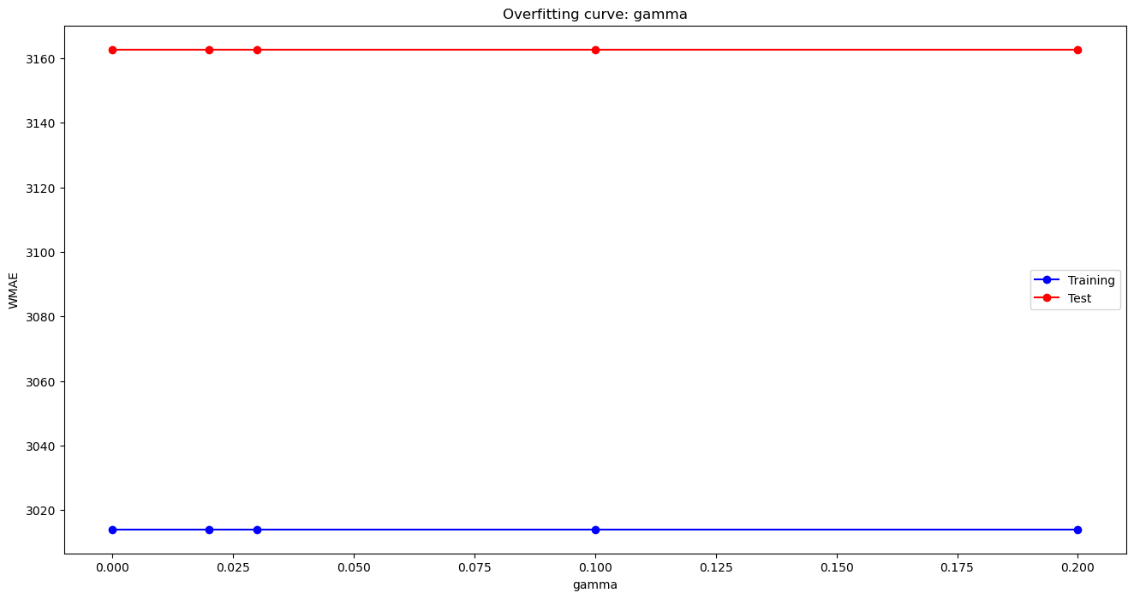
Hypertuning of Parameters
Checked the overfitting curve for four parameters n-estimators, max_depth, learning rate and gamma.
N_estimators value 500 and 600 gives the minimum WMAE.
Minimum WMAE is at max_depth 15.
WMAE is minimum at learning rate 0.4
The gamma hypertuning parameter makes no difference to the WMAE so we will avoid this.

Slide 21

Final Model Trained – Gradient Booster
Parameters used after Hypertuning:-
n_estimators = 500
max_depth = 15
Learning_rate = 0.4
Features are taken after removing the unimportant columns.
Error loss with Training set → 12.58
Error Loss with Test Data → 1915.64
WMAE → 1909.18 which is the minimum of all the model tried.

Slide 22
Dashboard
The top 3 stores with the highest sales are 20, 4 and 14.
Department 92 has observed the highest sales across all three types of stores.
2011 has the maximum sales.
May, October, November and December months see a spike.
November holidays record the highest sales. Probably around Thanksgiving.

Slide 23

Conclusions
Store size is a great factor that affects sales; the bigger the store, the higher the sales. Store A still has the highest sales, followed by stores B and C.
Stores 20,4 and 14 have the highest sales for Type A, and stores 10, 23 and 18 have the highest sales for Type B.
Departments 95, 92 and 38 generate the highest revenue for Walmart across all the sizes of stores. The stores with these departments will result in higher sales.
Sales are the highest during the holiday season (in November and December month).
Extreme hot and cold weather has a profound impact on sales and pleasant weather encourages higher sales.
The gradient Booster model gave the minimum error loss and we achieved the WMAE of 1909.18.
Average sales predicted is around 15K which is almost similar to the average of actual data.

Slide 24

Thank you

