Slide 1
What is Arrays?
An array stores multiple values in one single variable:"
An array is a special variable, which can hold more than one value at a time.

Slide 2
Array:Syntax
$number=array()
OR
$number=[]
If you have a list of items (a list of student names, for example), storing the students in single variables could look like this:
$student_name=array("Amit", "Raj", "Dhiraj", "Shyam");

Slide 3
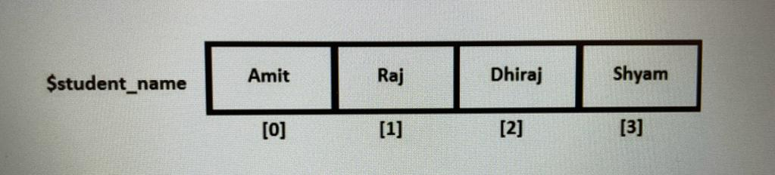
Below diagram will make the concept of array very clear to you. It shows the order in which values are assigned to the items getting added to the array.
$student_name=array("Amit", "Raj", "Dhiraj", "Shyam");

Slide 4
PHP Array Types
There are 3 types of array in PHP.
Indexed Array
Associative Array
Multidimensional Array

Slide 5
PHP Indexed Arrays
There are two ways to create indexed arrays:
The index can be assigned automatically (index always starts at 0), like this:
$cars = array("Volvo", "BMW", "Toyota");
or the index can be assigned manually:
$cars[0] = "Volvo";
$cars[1] = "BMW";
$cars[2] = "Toyota";

Slide 6
PHP Associative Arrays
Associative arrays are arrays that use named keys that you assign to them.
There are two ways to create an associative array:
$age = array("Peter"=>"35", "Ben"=>"37", "Joe"=>"43");
OR
$age['Peter'] = "35";
$age['Ben'] = "37";
$age['Joe'] = "43";

Slide 7
Multidimensional Arrays
In the previous pages, we have described arrays that are a single list of key/value pairs.
However, sometimes you want to store values with more than one key. For this, we have multidimensional arrays.
A multidimensional array is an array containing one or more arrays.

Slide 8
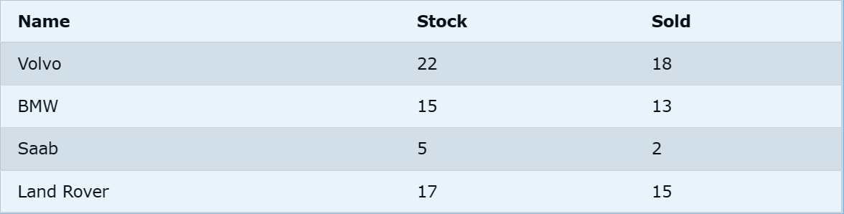
.We can store the data from the table above in a two-dimensional array, like this:
$cars = array (
array("Volvo",22,18),
array("BMW",15,13),
array("Saab",5,2),
array("Land Rover",17,15)
);

Slide 9
Vielen Dank.

