Slide 1
PHP Data Types
Variables can store data of different types, and different data types can do different things.
There are pre-defined, user-defined, and special data types.

Slide 2
PHP: Data Types
String
Integer
Float (floating point numbers - also called double)
Boolean
Array
Object
NULL
Resource

Slide 3
PHP String
A string is a sequence of characters, like "Hello world!".
A string can be any text inside quotes. You can use single or double quotes:
Example
$x = "Hello world!"

Slide 4
PHP Integer
Integers hold only whole numbers including positive and negative numbers, i.e., numbers without fractional part or decimal point
An integer must have at least one digit
An integer must not have a decimal point
An integer can be either positive or negative
Example
$x = 5985;

Slide 5
PHP Float
A float (floating point number) is a number with a decimal point or a number in exponential form.
Example
<?php
$x = 10.365;
var_dump($x); //return the data type and value.
?>

Slide 6
PHP NULL Value
Null is a special data type which can have only one value: NULL.
A variable of data type NULL is a variable that has no value assigned to it.
Tip: If a variable is created without a value, it is automatically assigned a value of NULL.
Example
<?php
$x = "Hello world!";
$x = null;
var_dump($x);
?>

Slide 7
PHP Boolean
A Boolean represents two possible states: TRUE or FALSE.
Booleans are often used in conditional testing. You will learn more about conditional testing in a later chapter of this tutorial.
Example
$x = true;
$y = false;

Slide 8
PHP Array
An array stores multiple values in one single variable.
In the following example $cars is an array. The PHP var_dump() function returns the data type and value:
Example
<?php
$cars = array("Volvo","BMW","Toyota");
var_dump($cars);
?>

Slide 9
PHP Object
Classes and objects are the two main aspects of object-oriented programming.
A class is a template for objects, and an object is an instance of a class.

Slide 10
PHP Resource
In PHP, Resource is a special data type that refers to any external resource.
A resource variable acts as a reference to external source of data such as stream, file, database etc.
A common example of using the resource data type is a database call.
For example, fopen() function opens a disk file and its reference is stored in a resource variable.
<?php
$fp=fopen("test.txt","w");
var_dump($fp);
?>

Slide 11
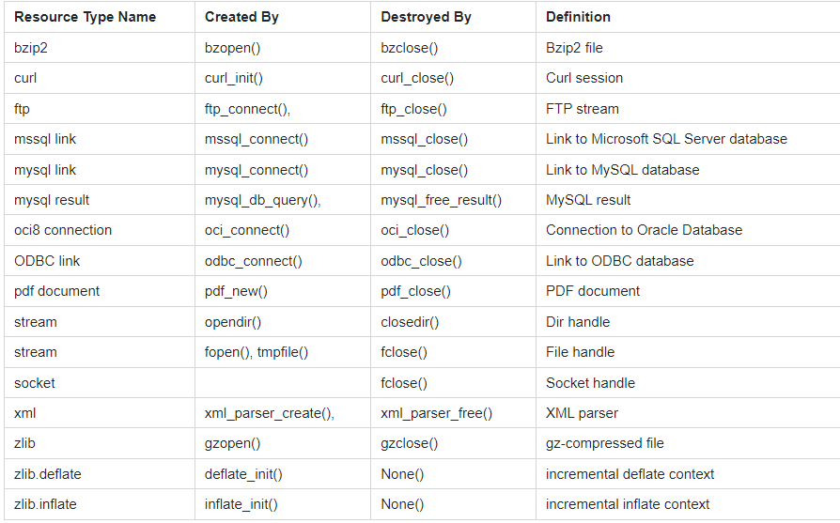
PHP Resource

Slide 12
Vielen Dank.

