Slide 1
PHP Conditional Statements
Conditional statements are used to perform different actions based on different conditions.
Very often when you write code, you want to perform different actions for different conditions.
You can use conditional statements in your code to do this.

Slide 2
PHP: conditional statements Types
1) if statement
2) if...else statements
3) if...elseif...else statements
4) nested if...else statements
5) switch statement

Slide 3
if statement
PHP If statement is the conditional statement you can use when you want to test one condition and execute the code when the test is true.
With the if statement your code only executes only when the condition is true.
Syntax:
if(condition){
//Put your code here to execute if the condition is true.
}

Slide 4
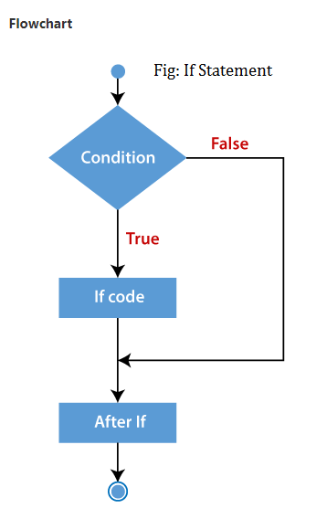
if statement

Slide 5
if...else Statement
PHP If…else statement is the conditional statement you can use when you want to execute one code if the condition is true and the other code if the condition fails.
Syntax:
if (condition){
Put your code here to execute if the condition is true.
}else{
Put your code here to execute if the condition is false.
}

Slide 6
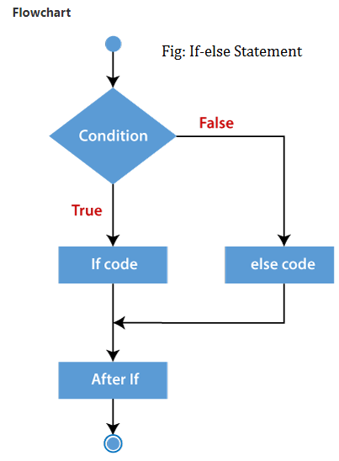
if...else Statement

Slide 7
if...elseif..else Statement
PHP If…elseif…else statement is the conditional statement you can use when you want to perform multiple tests. You can put more than two conditions using this conditional statement.
In a situation where you have several conditions, for example a program to grade students based on their marks with the letters A, B, C, D, F. the if...elseif...else is used for this.
Syntax:
<?php
if(Condition){
    Put your code here to execute if the condition is true.
}elseif(Condition){
    Put your code here to execute if this condition is true.
}else{
    Put your code here to execute if all conditions are false.
}
?>

Slide 8
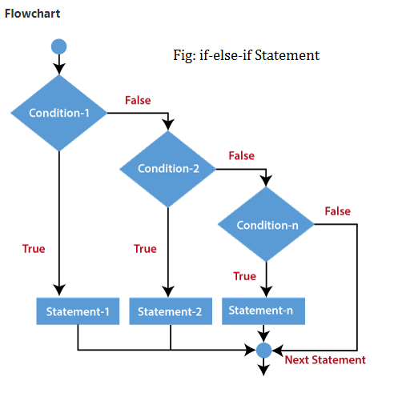
if...elseif..else Statement

Slide 9
Nested if..else Statements
When you find if...else statements inside an if...else statement the statements are nested. With this statement, you can get alternatives results when a condition is true or false.
Syntax:
if (condition 1 )
{
if (condition 2 )
{
// code1 to be executed
}
else
{
// code 2 to be executed
}
}
else
{
// code 4 to be executed
}

Slide 10
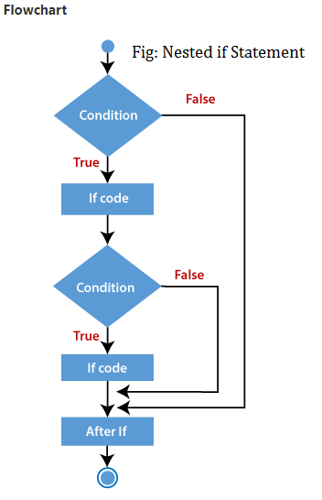
Nested if..else Statements

Slide 11
Switch Statements
The switch statement is used to perform different actions based on different conditions.
Syntax:
switch (n) {
case label1:
code to be executed if n=label1;
break;
case label2:
code to be executed if n=label2;
break;
case label3:
code to be executed if n=label3;
break;
...
default:
code to be executed if n is different from all labels;
}

Slide 12
Vielen Dank.

