Slide 1
PATTERN RECOGNITION
COMP 6731
Fake News/Rumour Detection on Social Media
Presented By :
Simarpreet Singh(40049885)
Prasanth Ambalam Jawaharlal(40042116)
Anil Heggodu Raghavendra(40042818)

Slide 2
What did we do ?
Classifier:
We have designed a Binary Classifier(s) that will predict whether a given tweet is Spam or Non-Spam
DataSet:
We have chosen an High Impact Event “UK RIOT 2011”.
During the Riot lot of Fake News got spread in twitter.
Collected the Tweets over that particular period of time which is used for Training and Testing the Classifier
Implementation : Python Language

Slide 3
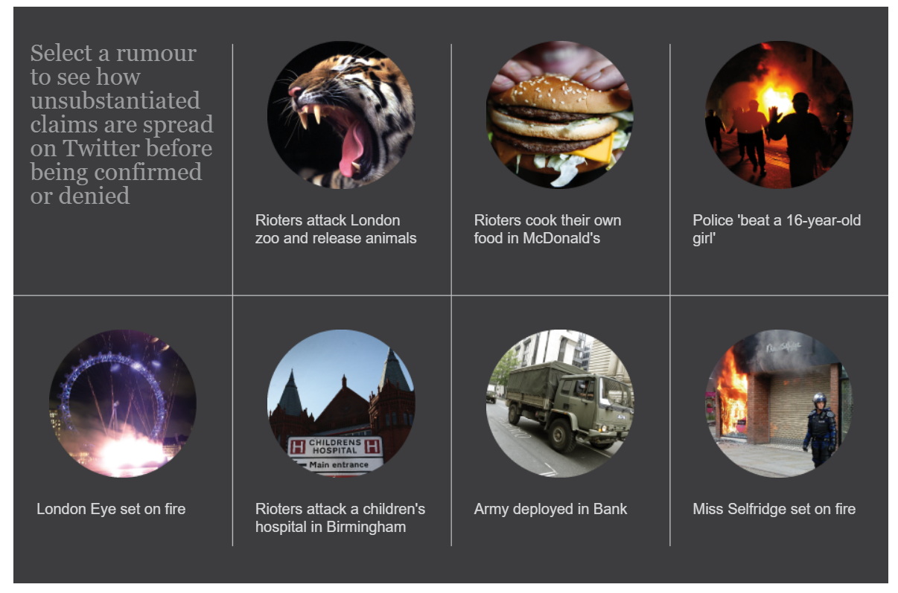
Fake News Facts - UK RIOTS 2011

Slide 4
Pattern Recognition Steps followed..
Data Collection
Data Preprocessing
Feature Extraction /Selection
Modelling
Evaluation & Postprocessing

Slide 5
Data Collection
Collected Raw Data from Twitter by scrapping Tweets for the event ‘UK Riots’
Raw data :
Tweet Text
Tweet Date/Time
Retweets.
Location of Tweet
User Details
No of favourites
How ?
Using the Streaming API and Trends API over a given period of time .
Will give only past 7 days of tweets
Scrape the HTML web page by scrolling infinitely to get the historical tweets

Slide 6
Extracted around 50,000 tweets as rawdata for the month of Aug 2011
The extracted raw data is filtered with the date : Aug 6 to Aug 11 2011.
The filtered raw data corresponds to 10,000 tweets.
We have split the 10,000 filtered tweets into two csv files :
- RawTrainingDataSet.csv
- RawTestDataSet.csv
Data preprocessing, feature selection, feature extraction and data annotations for Training and Test datasets.
The training dataset is used for modelling using SVM/KNN and Naïve Bayes classifier and the model is tested for the test dataset.

Slide 7
Data Annotation :
We manually annotated the raw dataset obtained from scrapping the tweet text into two categories - Spam and non Spam.
The annotations are done based on the rumours that were spread on twitter during the UK riots
We have taken the below article from “The Guardian” as reference for annotating the tweets and categorising them as Spam or Non Spam.
If the tweet is spam, the class is assigned value -1
If the tweet is non spam, the class is assigned value 1

Slide 8
Data Preprocessing
Data Cleaning :
Cleaned Raw Data by removing missing rows from the data.
Changed the datatypes of columns as per our requirement

Slide 9
Continuation….
Selecting only rows with complete values.
At the end of preprocessing, we obtain two cleaned csv files from the raw dataset:-
Training_Cleaned.csv
Test_Cleaned.csv

Slide 10
Feature Extraction/Selection
Features used corresponding to each Tweet :
1) Retweets on each Tweet.
2) Favorites.
3) Length of each Tweet.
4) Number of URL’s in each Tweet.
5) Number of Spam words in each Tweet.
6) Number of Swear Words.
7) Number of Hashtags in each Tweet.
8) Number of @ Mentioned in each Tweet.
9) Sum of all the above features except first three features.

Slide 11
Modelling
We have used below classifiers:-
SVM
K Nearest Neighbours
Naïve Bayes

Slide 12
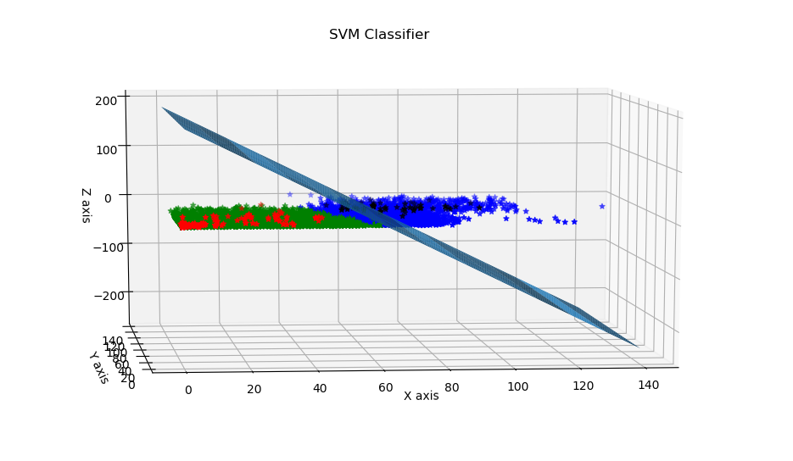
Plot for SVM
Training Data
Red (Non spam)
Black(Spam)
Test Data
Green(Non spam)
Blue(Spam)

Slide 13
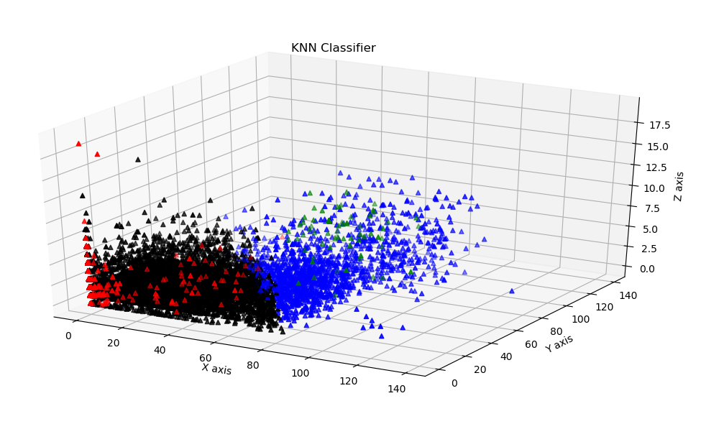
3-Dimensional Plot for KNN
Training Data
Red (Non spam)
Green(Spam)
Test Data
Black(Non spam)
Blue(Spam)

Slide 14
Naive Bayes
Probabilistic classifiers based on applying Bayes' theorem.
Naive Bayes by default uses Gaussian distribution internally, as it classifies data based on every input feature(Retweets, Favorites, New_Feature).
Naive Bayes resulted in an accuracy of 80.15%.

Slide 15
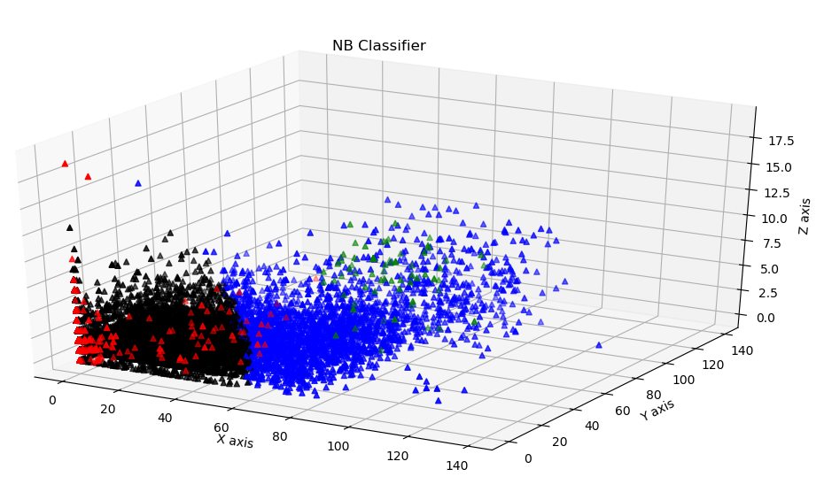
Plots for Naïve Bayes
Training Data
Red (Non spam)
Green(Spam)
Test Data
Black(Non spam)
Blue(Spam)

Slide 16
POST PROCESSING/ CASCADING

Slide 17
Weighted Tweets
FULLY CREDIBLE
Assign Weight
based on Naive Bayes Error rate
PARTIALLY
CREDIBLE
TEST DATA
NAIVE BAYES
PARTIALLY
SPAM
FULLY SPAM

Slide 18
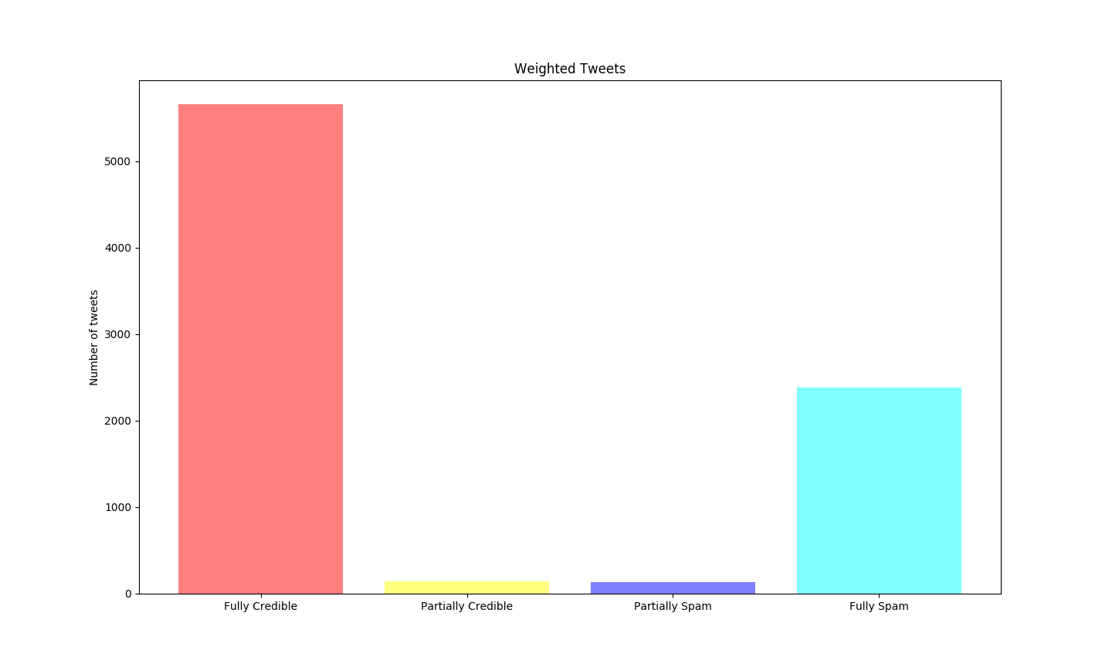
Weighted Tweets (.Continued)

Slide 19
CLASSIFIER BASED ON MAX VOTE
Ronny Reader
TEST DATA
Wendy Writer
SVM
NAIVE BAYES
Abby Author
KNN
MAX
PREDICTED OUTPUT

Slide 20
CASCADED CLASSIFIER
IF ERROR RATE > 20%
NO
TEST DATA
NAIVE BAYES
Use Naive Bayes OUTPUT
YES
MAX OF (SVM, KNN, NB)
PREDICTED OUTPUT

Slide 21
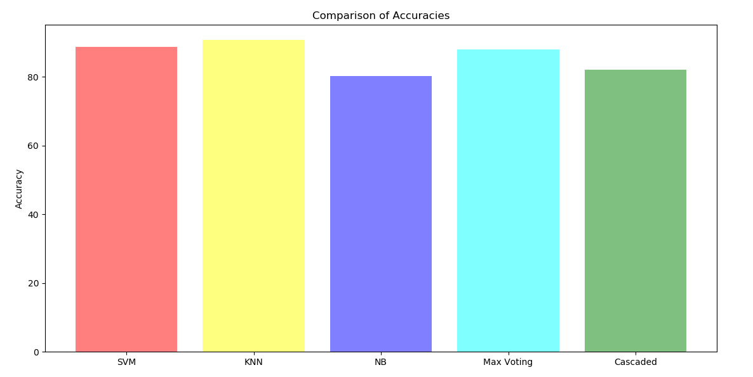
Comparison and Conclusion

Slide 22
References:
Naive Bayes:
http://scikit-learn.org/stable/modules/naive_bayes.html
Support Vector Machine:
http://scikit-learn.org/stable/modules/svm.html
K-Nearest Neighbor:
http://scikit-learn.org/stable/modules/neighbors.html

Slide 23
Thank You

