Slide 1
Industrial Training Seminar
on
“BIG DATA”
Presented By:
Name of Candidate: Vaishali singh
University Roll No. : 21EJIT138
Branch/Class/Section : IT/C1
Submitted To:
MR.ROHIT CHHABRA
Industrial Training Coordinator, IT

Slide 2
CONTENTS
OVERVIEW
WHAT IS DATA ANALYTICS
3. WHAT IS DATABRICKS
4. APACHE SPARK, PY SPARK
5. PROJECT DETAILS (DATA ANALYTICS THROUGH DATABRICKS)
6. CONCLUSION
7. FUTURE SCOPE

Slide 3
OVERVIEW
In this project ,the data I’ve used is from the retail industry. The tool used for this case study is PySpark and Databricks. To work on this, I am using the Databricks Community Edition.
We will gain hands-on experience working with real-world data from the ecommerce industry.
Modern tools like PySpark and Databricks are used to find hidden insights from the data.
Utilizing PySpark’s Dataframe API to perform a variety of transformations and actions, both basic and advanced.
Additionally, graphical representation to enhance our understanding and analysis of the results(Data Visualization).

Slide 4
What is data analytics?
Data analytics is a multidisciplinary field that employs a wide range of analysis techniques, including math, statistics, and computer science, to draw insights from data sets.
Data analytics is a broad term that includes everything from simply analyzing data to theorizing ways of collecting data and creating the frameworks needed to store it.
There are four key types of data analytics that can help an organization make data-driven decisions
At a glance, each of them tells us the following:
Descriptive analytics :tell us what happened.
Diagnostic analytics :tell us why something happened.
Predictive analytics :tell us what will likely happen in the future.
Prescriptive analytics: tell us how to act.

Slide 5
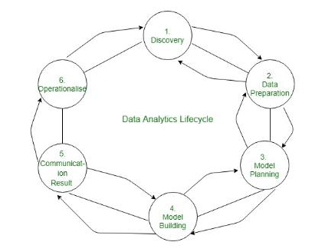

Slide 6
What is Databricks?
Databricks is a unified, open analytics platform for building, deploying, sharing, and maintaining enterprise-grade data, analytics, and AI solutions at scale.
The Databricks Community Edition is the free version of our cloud-based big data platform. Its users can access a micro-cluster as well as a cluster manager and notebook environment
The Databricks platform architecture comprises two primary parts:
The infrastructure used by Databricks to deploy, configure, and manage the platform and services.
The customer-owned infrastructure managed in collaboration by Databricks and your company.

Slide 7
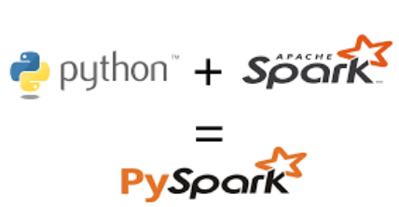
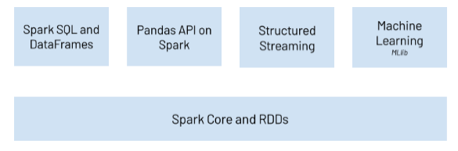
Apache Spark
Azure Databricks is built on Apache Spark and enables data engineers and analysts to run Spark jobs to transform, analyze and visualize data at scale.
Apache Spark is at the heart of the Databricks Platform and is the technology powering compute clusters and SQL warehouses.
PySpark
PySpark is the Python API for Apache Spark. It enables you to perform real-time, large-scale data processing in a distributed environment using Python.
It also provides a PySpark shell for interactively analyzing your data.
PySpark supports all of Spark’s features such as:

Slide 8
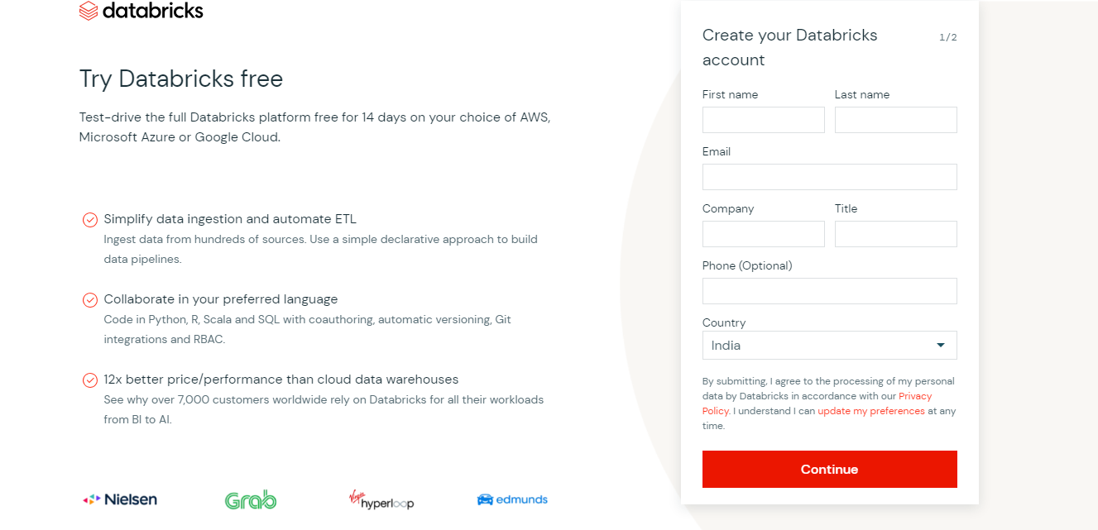
PROJECT DETAILS
DATA ANALYTICS THROUGH DATABRICKS:
STEP 1:
CREATE AN ACCOUNT ON DATABRICKS COMMUNITY EDITION FOR FREE TO PERFORM
DATA ANALYTICS OPERATIONS

Slide 9
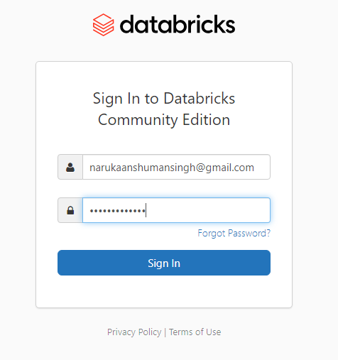
STEP 2:
LOGIN IN AND VERIFY THE ACCOUNT MADE ON DATABRICKS COMMUNITY EDITION.

Slide 10
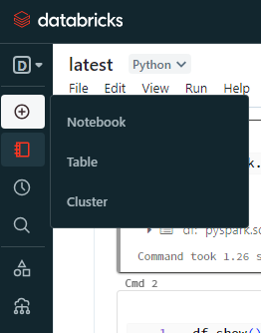
STEP 3:
CREATE A NEW NOTEBOOK BY CLICKING CREATE→NOTEBOOK

Slide 11
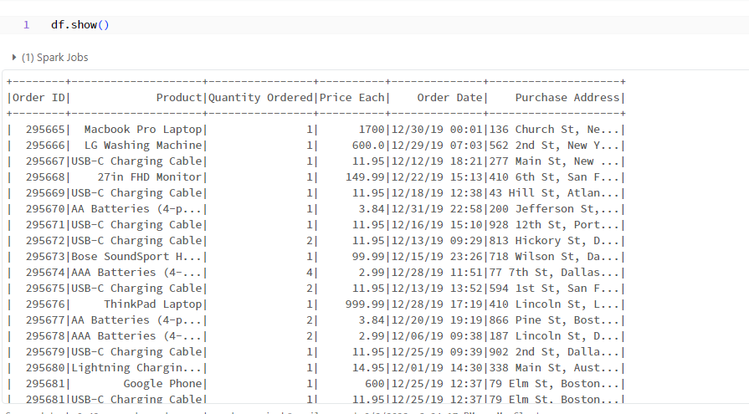
STEP 4: Create a dataframe from the provided dataset file(like csv file).

Slide 12

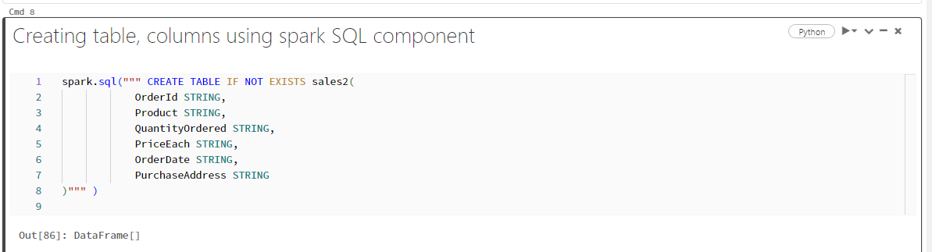
STEP 5:Creating database, table, columns using spark SQL component

Slide 13


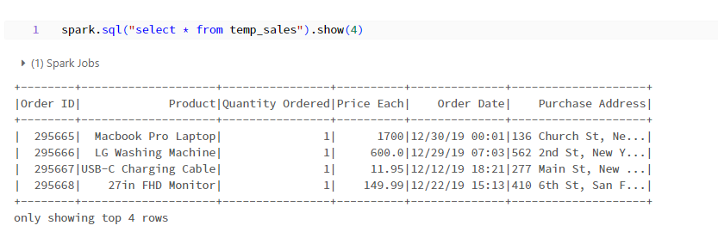
STEP 6: DataFrame can be converted to table for running sql queries.

Slide 14
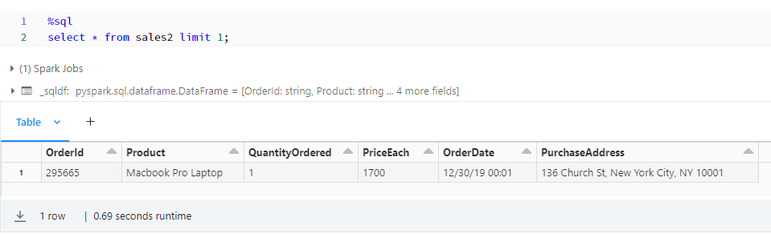
Running sql queries on the table %sql ( magic commands)

Slide 15
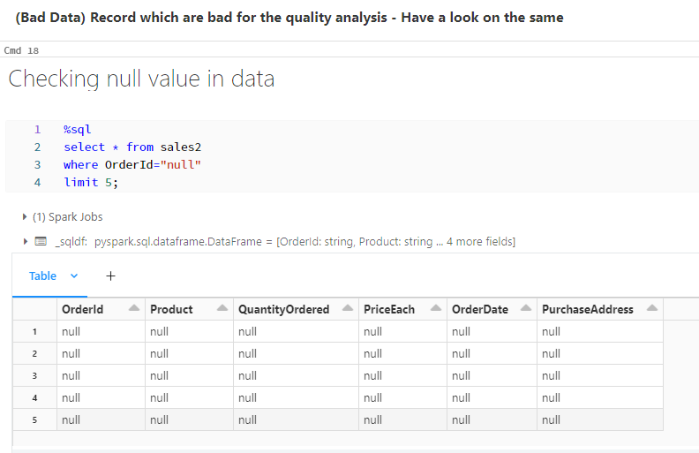
Data Cleansing for the project

Slide 16
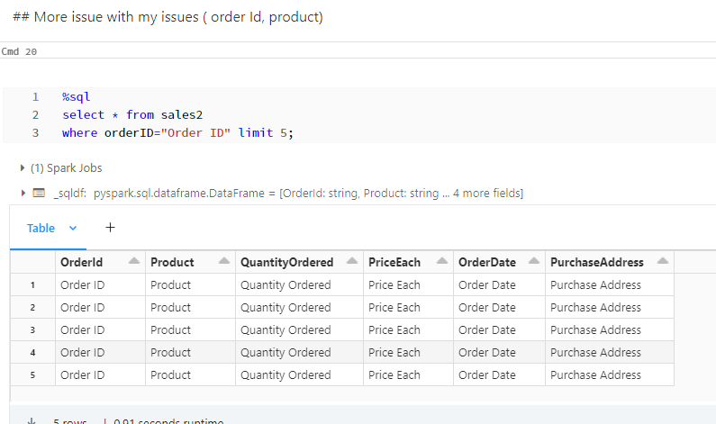
More issues like data redundancy and irrelevant data( order Id, product)

Slide 17
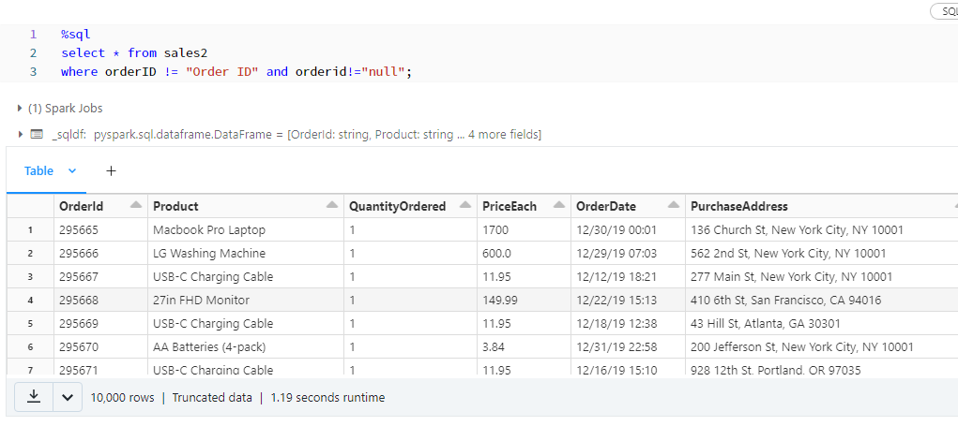
Data cleansing: Way to filter bad data [ Null value, order Id in data]

Slide 18
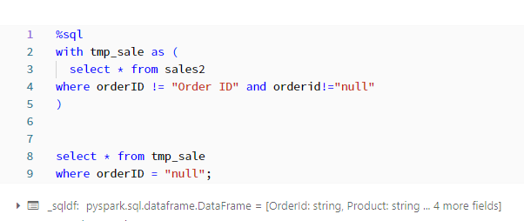
CREATING TEMP table to check whether we get data perfectly or not.

Slide 19
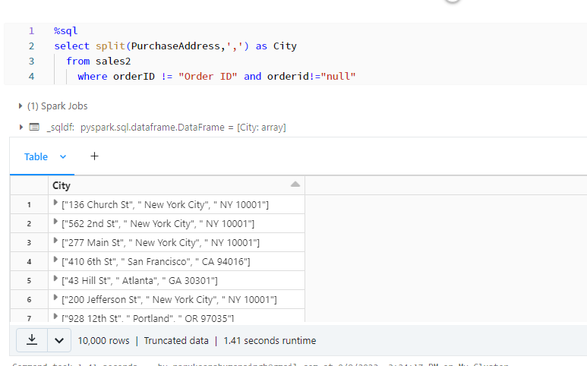
Spliting and checking the columns - With Filter

Slide 20
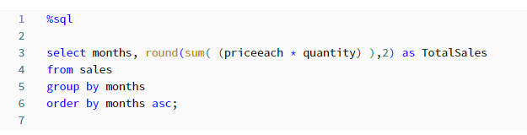
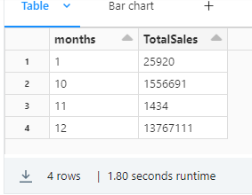
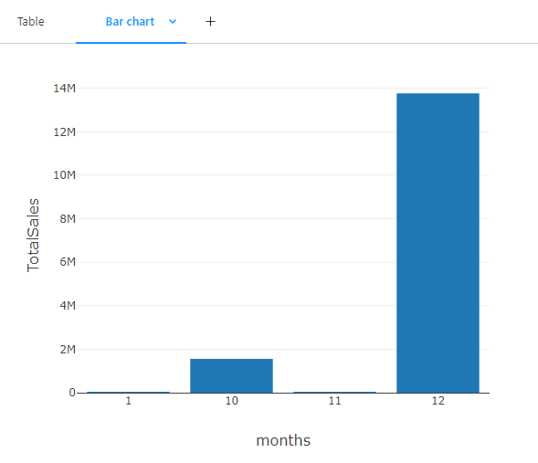
Project Analytics with case scenario:-
Which is the best month of the sales done? [sales=price*quantity ]

Slide 21
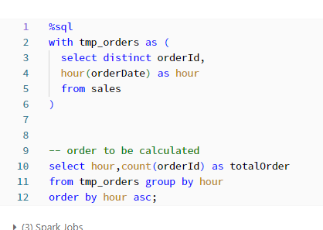
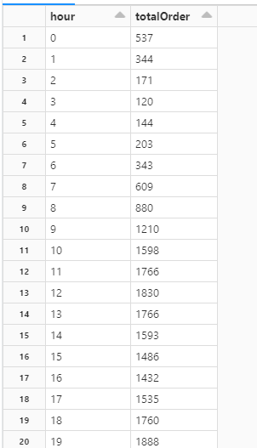
what is best time for the advertisment to maximize the sale of my product

Slide 22
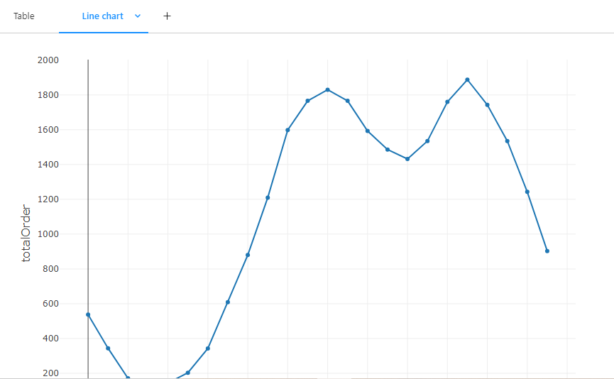
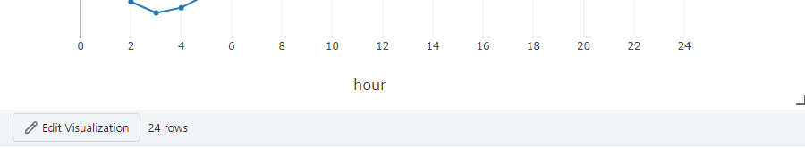

Slide 23
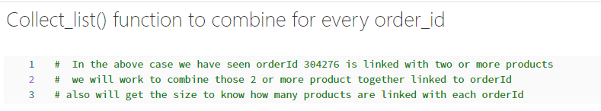
Most often product sold together in State like NY ( we are talking about 2 products at same time)

Slide 24
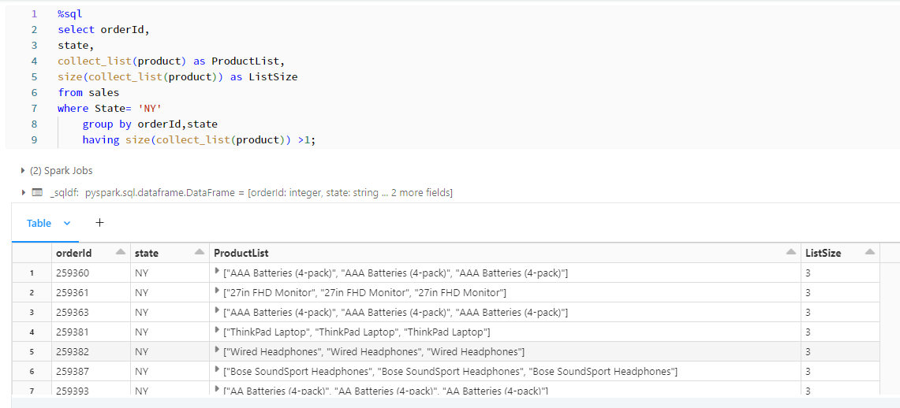

Slide 25
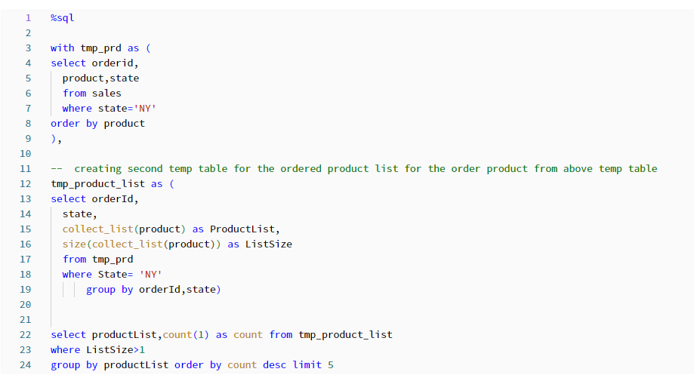

Slide 26
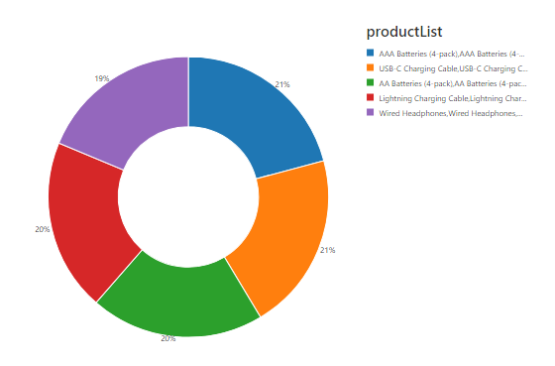

Slide 27
CONCLUSION :
In conclusion, our data analytics project utilizing Databricks, Apache Spark, and PySpark has enabled us to uncover valuable insights and demonstrate the power of these tools in data processing and analysis. Databricks provided a user-friendly and collaborative environment, while Apache Spark's distributed computing capabilities significantly improved our data processing efficiency. Leveraging PySpark allowed us to apply our data analytics skills in a familiar programming language. These skills have practical applications across various industries, underscoring the importance of data-driven decision-making. This project has been a stepping stone in our continuous learning journey, and we're grateful for the guidance from our mentors and team. We're now open to questions and further discussions about our project and the broader field of data analytics.

Slide 28
FUTURE SCOPE :
In the future, our project can explore advanced data cleaning techniques, including machine learning for outlier detection and anomaly handling. Implementing automated data pipelines, enhancing data visualization with dynamic tools, and integrating machine learning for predictive analytics are avenues to consider. Scalability through cloud-based solutions, robust data governance, and collaboration with other data tools can further enhance our project's capabilities. Additionally, a focus on documentation, training, and continuous learning will ensure the project remains adaptable and up-to-date, while feedback and iteration will drive ongoing improvements

Slide 29
THANK YOU

