Slide 1

BIKE SALES DEMAND ANALYSIS DASHBOARD
Presented by Vaishali Luthra (DIGICROME ACADEMY)

Slide 2
DASHBOARD OVERVIEW
• Dataset analyzed from Bike Sharing system
• Dashboard created in Excel using pivot tables and charts
• Includes metrics like total rides, casual / registered users with hourly trends
• Interactive slicers based on period, weekday or weekend, weather, and humidity range

Slide 3
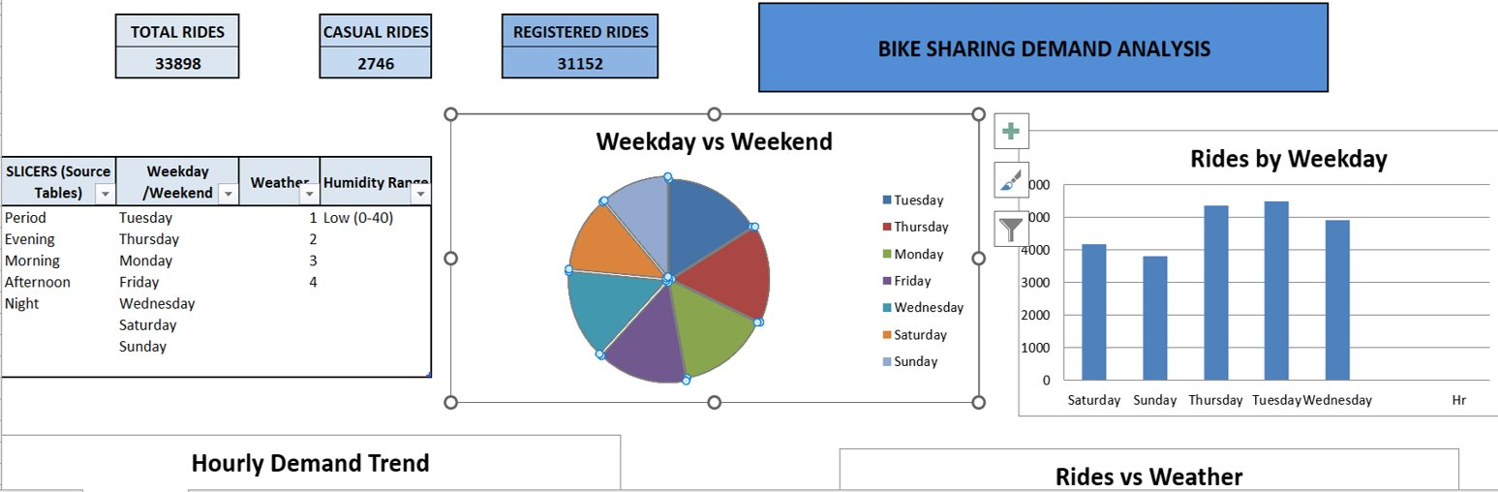
Dashboard - overview-charts

Slide 4
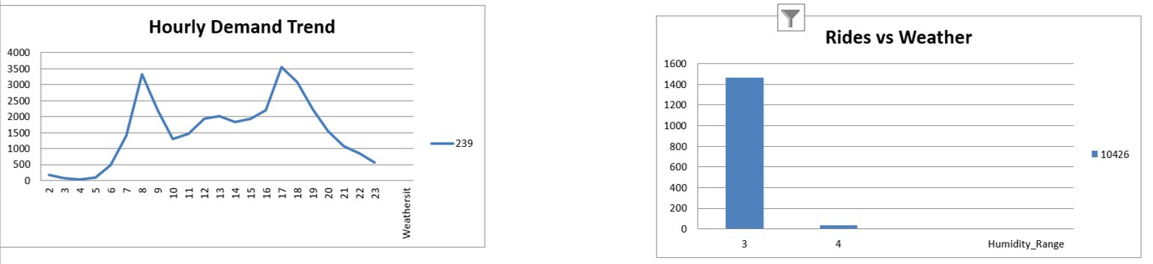
Dashboard - trend and weather analysis

Slide 5
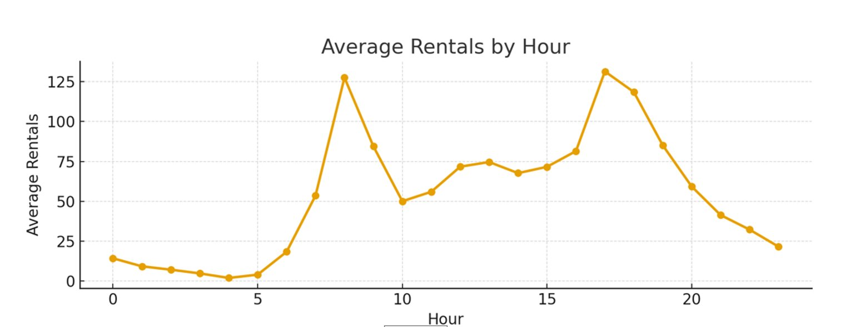
Dashboard - HOURLY RENTAL analysis

Slide 6
Charts Used in the Dashboard
1. Pie Chart – Weekday vs Weekend Ride Distribution
2. Column Chart – Rides by Weekday
3. Line Chart – Hourly Demand Trend
4. Column Chart – Rides vs Weather
5. Line Chart – Average Rentals by Hour

Slide 7
Key Insights from Analysis
Peak demand observed during morning and evening hours.
• Weekdays show higher ride counts compared to weekends.
Weather conditions significantly influence ride volume.
• High humidity correlates with reduced rides.
• Registered users dominate casual rides in total volume.

Slide 8

conclusion
This dashboard provides a comprehensive view of bike-sharing demand trends.
It enables stakeholders to make data-driven decisions for optimizing bike availability,
improving service quality, and planning future infrastructure developments.

Slide 9

Thank you
Presented by Vaishali Luthra (Digicrome Academy)

