Slide 1

Mobile Price Prediction using Machine Learning Feature Extraction & Analysis
A presentation by Vaishali Luthra

Slide 2

Objective & Problem Statement
Objective | To predict prices OF mobile - phone based on their features.
Problem | Mobile prices vary a lot
we need to understand | 1. Which features affect price the most 2. How to estimate price accurately
GOAL | “The goal is to build a model that predicts price and identifies key influencing features.”

Slide 3
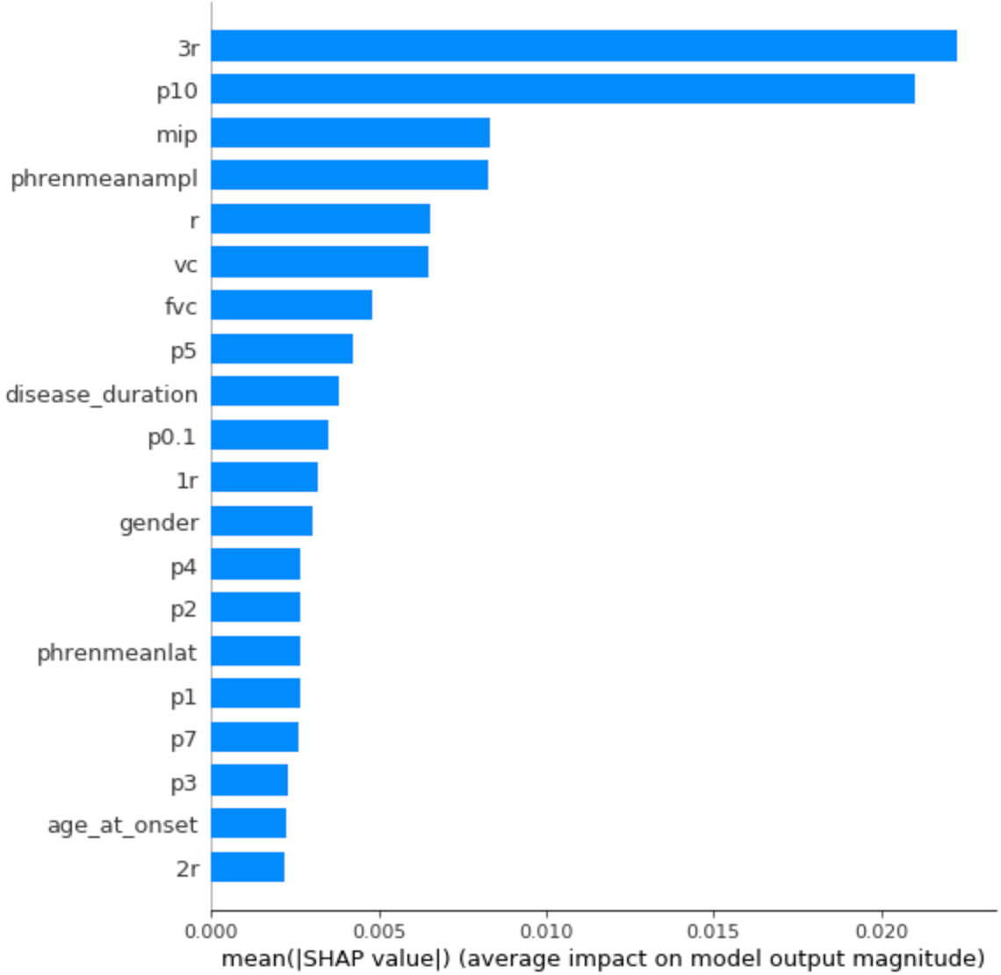
Dataset & Features
Dataset includes | RAM Storage Battery Camera Processor Color & Model
Target | Price
Explanation | these features represent both performance and design aspects of a phone.
GOAL | “The goal is to build a model that predicts price and identifies key influencing features.”

Slide 4

Data Preprocessing
Steps performed:
Handled missing values
Converted categorical data using One-Hot Encoding
Explanation:
“Machine learning models cannot understand text data, so encoding converts it into numerical format.”

Slide 5
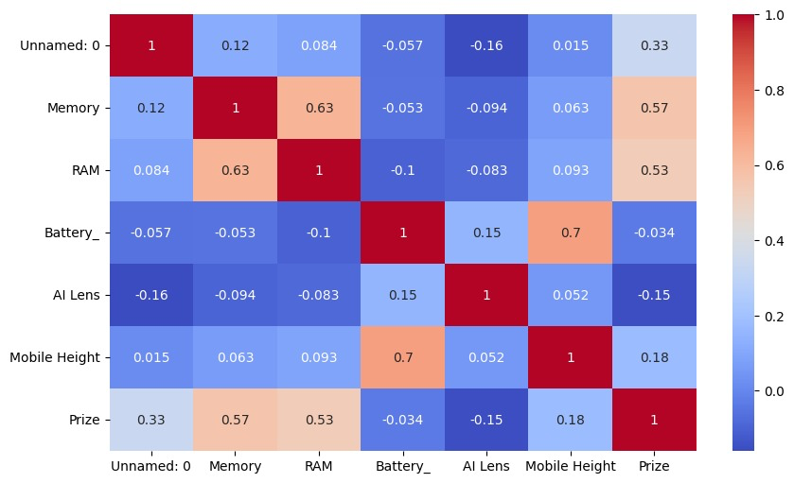
Feature Analysis
What we did
Used correlation heatmap
Explanation
Values close to +1 → strong positive relationship
Values close to 0 → weak relationship
Key Insight
“RAM, Storage, and Processor show strong correlation with price.”

Slide 6

Model Building & Evaluation
Models used
Linear Regression
Random Forest
Evaluation Metrics
MAE(Mean Absolute Error)
RMSE(Root Mean Square Error)
Explanation: “Random Forest performed better because it captures complex patterns in data.”

Slide 7

Results & Insights
Important Features
RAM
Storage
Processor
Camera
Observations
Higher specs → Higher price
Color has minimal impact

Slide 8
Conclusion and recommendation
Conclusion
Model successfully predicts mobile prices
Feature extraction helped identify key factors
💡 Recommendations
Focus pricing on performance features
Highlight processor & camera in marketing

