Slide 1
VIDYA JYOTHI INSTITUTE OF TECHNOLOGY
(Autonomous)
Sign Language To Text And Speech Conversion Using Hand Landmarks
Under the guidance of
Mrs. G.Indira Priyadarshini
Associate Professor
Department of IT
By :Team 23
Alampally Sravani [22911A1269]
Perka Vaishali [22911A12A3]
Tirumalasetti Jyothirmai [22911A12C0]
Uppuleethi Varshitha [22911A12C1]

Slide 2
Abstract:
This project implements a real-time American Sign Language (ASL) recognition system using a webcam-based interface and custom gesture detection logic. The system captures live video input, detects hand landmarks using a pre-trained hand tracking module, and applies a rule-based classification algorithm to identify alphabetic ASL gestures. To enhance usability, the interface includes interactive on-screen buttons for manual control—allowing users to predict individual letters, insert spaces, delete characters, clear text, and convert the generated sentence to speech output. Unlike deep learning-based models, this approach emphasizes fast and interpretable gesture recognition suitable for lightweight deployment. The system demonstrates practical applicability in translating hand gestures into coherent textual sentences, providing an accessible and user-friendly communication aid for the hearing- and speech-impaired.

Slide 3
Introduction
The deaf and hard-of-hearing community often faces communication challenges due to limited public understanding of sign language and a shortage of interpreters. This project aims to bridge that gap by developing a real-time ASL translation system using MediaPipe for hand tracking and OpenCV for image processing. The system recognizes ASL letters and converts them into text and speech, offering an intuitive interface for sentence construction. By integrating text-to-speech, it facilitates smoother communication between ASL users and non-signers. This AI-powered tool promotes inclusivity and can be applied in education, workplaces, and public spaces to enhance social participation.

Slide 4
Introduction
Problem Statement
The inability of most people to understand sign language creates a significant communication barrier for the deaf and hard-of-hearing community, especially in everyday interactions. Relying on interpreters or written communication limits spontaneity and accessibility, often leading to social exclusion. Despite the availability of assistive technologies, many existing systems require expensive hardware, internet connectivity, or complex machine learning models, making them impractical for widespread use. There is a need for a low-cost, real-time, and user-friendly solution that can accurately interpret American Sign Language (ASL) and convert it into both text and speech to facilitate inclusive communication without relying on external support.

Slide 5
Objectives
To develop a real-time ASL letter recognition system using MediaPipe hand tracking and OpenCV image processing with at least 90% accuracy for core ASL alphabet gestures.
To create an intuitive user interface with interactive controls for sentence construction, including prediction confirmation, space insertion, and text editing functions.
To implement text-to-speech conversion functionality that vocalizes recognized ASL letters and constructed sentences for audible feedback.
To optimize the system's performance to process at least 15 frames per second on standard hardware for smooth real-time interaction.
To design the application with accessibility features that accommodate both ASL users and non-signers in various lighting and background conditions.

Slide 6
Literature Review
Key Findings from Previous Research
Image processing techniques achieved up to 96% accuracy (e.g., grayscale, thresholding, BLOB).
CNN-based models delivered ~95% accuracy using only webcams.
Real-time performance is achievable with lightweight tools like MediaPipe & OpenCV.
Adaptive systems improve over time, accommodating user variations.
Webcam-based solutions are viable, cost-effective, and scalable.
Gaps in Existing Solutions
Dependence on costly hardware (e.g., gloves, depth sensors).
High sensitivity to environment: lighting, backgrounds, and occlusion.
Complex models require large data, long training, and high compute power.
Incomplete systems – many lack text-to-speech or full sentence support.
Need for internet/cloud access in some systems limits rural usability.

Slide 7
Methodology
Overview of Approach:
Capture real-time video using webcam (OpenCV).
Detect 21 hand landmarks using MediaPipe Hands module.
Apply rule-based logic to identify ASL alphabets from hand geometry.
Append recognized letters to form sentences.
Convert sentences to speech using pyttsx3.
Enable interaction through GUI buttons: Predict, Space, Clear, Delete, Speak
Key Techniques / Tools Used:
Software: Python 3.7+, OpenCV, MediaPipe, pyttsx3
Models: Rule-based recognition (no training needed)
Hardware: Standard webcam, basic laptop/PC (Intel i3 or above)

Slide 8
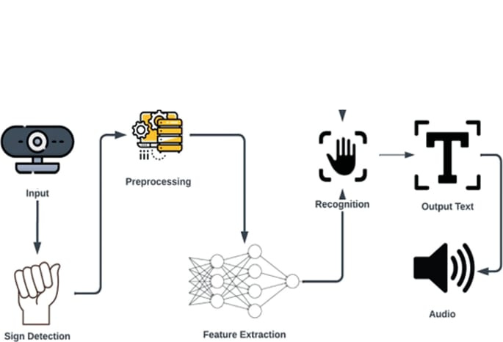
System Design
.

Slide 9
Implementation
Key Steps
Captured webcam feed using OpenCV and preprocessed each frame.
Detected 21 hand landmarks in real time using MediaPipe.
Developed rule-based logic to classify static ASL letters.
Built sentence construction logic to append recognized letters.
Enabled mouse-based GUI interaction for Predict, Clear, Space, Delete, Speak.
Integrated pyttsx3 for offline text-to-speech output

Slide 10
Implementation
Technologies / Tools Used:
Language: Python 3.7+
Libraries: OpenCV, MediaPipe, pyttsx3
IDE: VS Code / Jupyter Notebook
Platform: Windows/Linux (Offline Compatible)
Challenges Faced:
Ensuring accurate hand detection under varied lighting conditions.
Designing robust logic for similar-looking ASL gestures.
Maintaining real-time performance without using GPUs.
Creating a user-friendly GUI using OpenCV drawing tools.

Slide 11
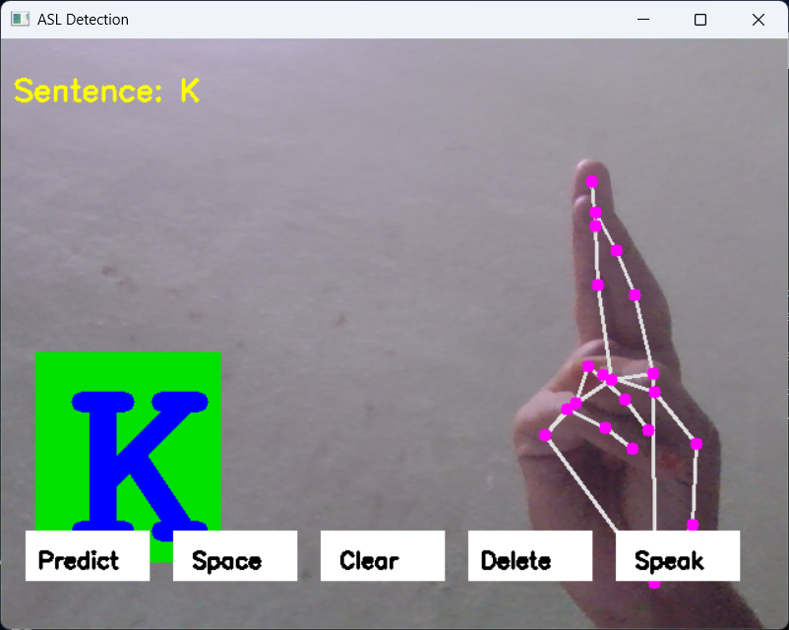
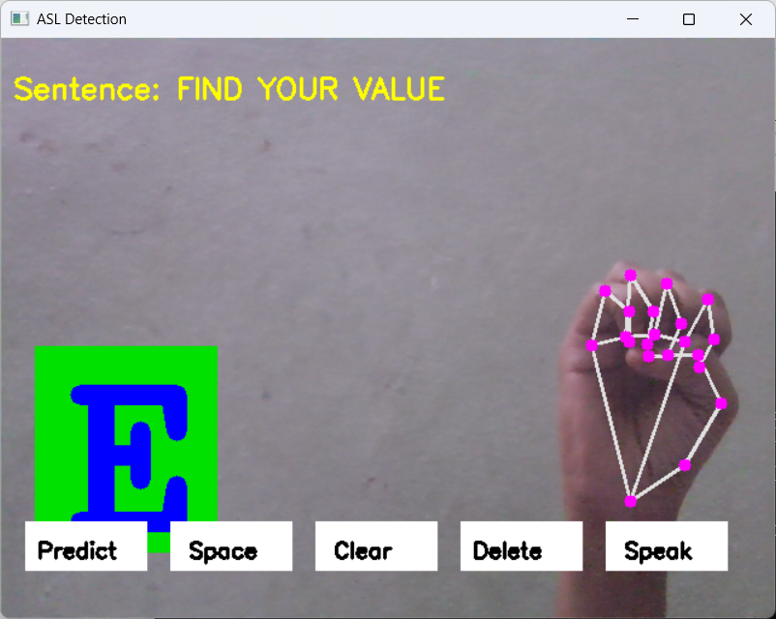
Results

Slide 12
Conclusion
The proposed system offers a cost-effective, vision-based solution for real-time sign language interpretation, using only a webcam. By eliminating the need for wearable sensors, it becomes highly accessible. With Media Pipe and CNN, the system ensures high accuracy even in varied environments. This bridges the communication gap between the deaf/mute community and the hearing population, promoting inclusivity. It's particularly useful in educational institutions, workplaces, public services, and homes. The system overcomes key challenges faced by sensor-based systems. It also lays a strong foundation for future improvements and wider adoption

Slide 13
Future Scope
Regional Language Support: Include signs from regional and cultural variations in sign language to make the system more inclusive across different communities.
Mobile Application Development: Create a lightweight, real-time mobile app version that users can carry and use anywhere, making the system more portable and practical.
Facial Expression & Body Movement Integration: Since sign language also includes facial cues and body posture, integrating these features using computer vision can significantly improve the contextual accuracy of the system.

Slide 14
Acknowledgments
We sincerely thank our guide Mrs. G. Indira Priyadarshini for her continuous support and mentorship.
Gratitude to Dr. A. Obulesu, HOD of IT Department for encouragement and facilities.
Appreciation to our college management and principal Dr. A. Srujana for infrastructure support.
Thanks to our families and peers for their unwavering encouragement

Slide 15
💐 Thank You 💐

