Slide 1
Problem Statement
Every year a lot of companies hire a number of employees.
The companies invest time and money in training those employees, not just this but there are training programs within the companies for their existing employees as well.
The aim of these programs is to increase the effectiveness of their employees.
But how to use HR Analytics in this?

Slide 2
Background of the Domain Problem
HR Analytics
Human resource analytics (HR analytics) is an area in the field of analytics that refers to applying analytic processes to the human resource department of an organization in the hope of improving employee performance and therefore getting a better return on investment.
HR analytics does not just deal with gathering data on employee efficiency. Instead, it aims to provide insight into each process by gathering data and then using it to make relevant decisions about how to improve these processes.
Attrition in HR
Attrition in human resources refers to the gradual loss of employees overtime.
In general, relatively high attrition is problematic for companies. HR professionals often assume a leadership role in designing company compensation programs, work culture, and motivation systems that help the organization retain top employees.

Slide 3
A major problem in high employee attrition is its cost to an organization.
Job postings, hiring processes, paperwork, and new hire training are some of the common expenses of losing employees and replacing them.
Additionally, regular employee turnover prohibits your organization from increasing its collective knowledge base and experience over time.
This is especially concerning if your business is customer-facing, as customers often prefer to interact with familiar people.
Errors and issues are more likely if you constantly have new workers.

Slide 4
Charts Requirement
Attrition by Gender: The HR department faces challenges in understanding the attrition patterns based on gender, making it difficult to identify any gender-related disparities and implement targeted strategies.
Department-wise Attrition: The HR department lacks visualization to showcase attrition rates across different departments. This hinders their ability to identify departments with higher attrition rates and address any underlying issues or concerns effectively.
Number of Employees by age Group: The HR department requires visual representations to analyze the distribution of employees across various age groups. This helps in assessing workforce demographics, identifying any age-related gaps or imbalances, and implementation targeted HR policies or programs.

Slide 5
Job Satisfaction Ratings: The HR department lacks visualizations to represent job satisfaction ratings, hindering their ability to measure employee engagement and overall job satisfaction levels effectively.
Education Field-wise Attrition: The HR department requires visual representation to analyze attrition rates based on education fields. This helps identify specific education backgrounds that may be associated with higher attrition, enabling the organization to tailor retention strategies accordingly.
Attrition Rate by Gender for Different Age Groups: The HR department lacks visualizations that display attrition rates based on gender and different age groups. This makes it challenging to identify any age and gender-related attrition trends, preventing the organization from implementing targeted retention strategies for specific employee segments.

Slide 6
KPI’s Requirement
The HR department is responsible for monitoring and managing various aspects of employee data to ensure the organization maintain a healthy workforce. However, there is a lack of clear performance indicators to track and analyse key HR metrics.
Therefore, there is a need to design and implement a set of KPI’s to address the following points:
1. Employee count:
The HR department lacks visibility into the total number of employees, making it challenging to assess workforce size and plan for future growth or downsizing effectively.
2. Attrition Count:
The organization lacks a standardized method to track employee attrition, resulting in incomplete and unreliable data on the number of employees who left the organization.
+

Slide 7
3. Attrition Rate:
Without a clear measure of attrition rate, the organisation cannot assess the overall turnover level or compare it with industry benchmarks, hindering the ability to gauge employee satisfaction and engagement.
4. Active Employees:
The organization lacks a mechanism to differentiate between active and inactive employees, leading to difficulties in accurately assessing the current workforce’s productivity and capacity.
5. Average Age:
The HR department lacks visibility into the average age of employees, making it difficult to evaluate workforce demographics, succession planning, and the organization’s ability to attract and retain younger talent.

Slide 8
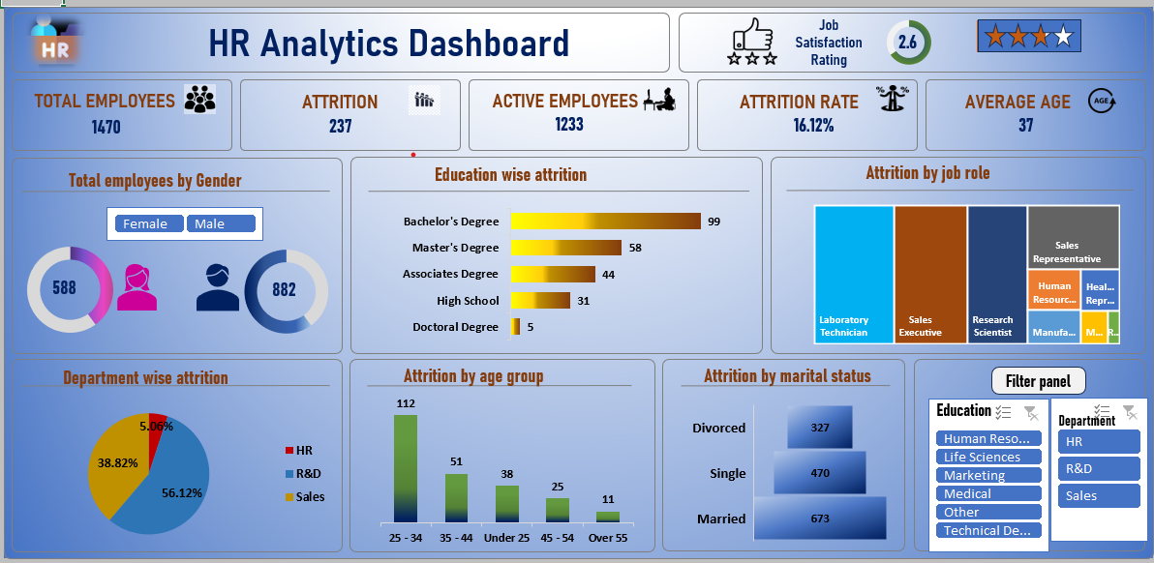
EXCEL DASHBOARD EMPLOYEE ATTRITION/HR ANALYTICS

Slide 9
Conclusion
After carefully analyzing all the factors, we can conclude that reasons for employee attrition can be lower job satisfaction, lower income, overtime, certain age group, job role, gender, or poor work life balance.
It is important to address these concerns with employee friendly work environment and policies along with providing them good opportunities of growth. There should be good training and appraisal/increment programs for employees to not just improve their performance but also keep them motivated and feel involved in their job roles.
There can be periodic employee surveys to assess their needs and requirements to better plan and make effective policies for their job role management and work life balance.

