Slide 1
Advanced Topics in Software Engineering CSE 6324 – Section 004 Team 10 INCEPTION
Vanjari, Vaishali Sunil - 1001956614 Solanki, Siddhrajsinh Pradumansinh - 1001957988 ⁠Parimi, Taraka Naga Nikhil - 1001985955 ⁠Komireddy, Sannihith Reddy – 1001982437

Slide 2
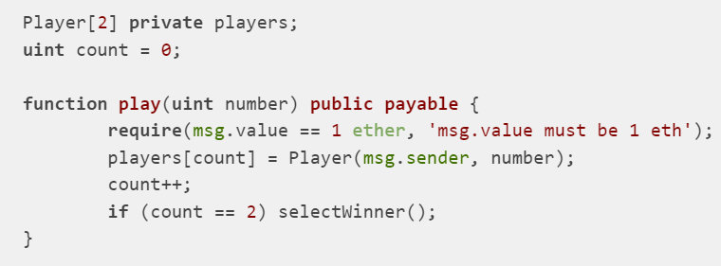
THE IDEA
New detector – Compliance Checker
New detector – Detecting Unencrypted Private data on-chain
Remediation – Add private data off chain
Remediation – Encrypt the private data

Slide 3
PLANNING
Set up compliance standard
Define the compliance rule
Load the solidity contract
Analyze the solidity contract
Generate the compliance report
Analysis using several iterations

Slide 4
NEED OF COMPLIANCE CHECKERS
Verifying that a smart contract meets specific requirements or various standards
Requirements or standards can be related to security, functionality, performance, or other aspects of smart contract development
Ensuring that smart contracts are secure, reliable, and fit for their intended purpose
Validating the compliance of smart contracts using custom checkers
Gaining a deeper understanding of smart contracts and potential risks associated with them
Making informed decisions about how to improve smart contracts and avoid common security and reliability issues

Slide 5
FEATURES
Standards-based checking
Customizable checks
Automated reporting
Integration with development tools
Regular updates
Third-party validation

Slide 6
CUSTOMERS & USERS
Developers of solidity community
Developers of Slither Community
Ethereum Researchers

Slide 7
RISKS
Evolving Solidity language
Precise compliance rule definition
Technical Complexity
False positives
Resource constraints
Lack of compatibility with other tools

Slide 8
COMPETITORS
Mythril: a security analysis platform that performs smart contract auditing.
Oyente: an automatic and analytical security evaluator for Ethereum smart contracts.
Securify: a tool for automatically detecting and mitigating security vulnerabilities in Ethereum smart contracts.
SmartCheck: a security auditing tool for Ethereum smart contracts that checks for potential vulnerabilities and security risks.

Slide 9
REFERNCES
https://github.com/crytic/slither
https://github.com/crytic/slither/wiki/Detector-Documentation
https://github.com/crytic/slither/wiki/Adding-a-new-detector
https://swcregistry.io/docs/SWC-136
https://github.com/crytic/slither/wiki/ERC-Conformance
https://www.getsecureworld.com/blog/top-10-solidity-smart-contract-audit-tools/

Slide 10
QUESTIONS??

