Slide 1

Advanced Topics in Software Engineering CSE 6324 - Section 004 Team 10 ITERATION 2
Vanjari, Vaishali Sunil - 1001956614 Solanki, Siddhrajsinh Pradumansinh - 1001957988 ⁠Parimi, Taraka Naga Nikhil - 1001985955 ⁠Komireddy, Sannihith Reddy - 1001982437

Slide 2

The Idea
Adding a detector in Slither [3]
Detecting unencrypted private data on-chain Blockchain network [1].
Detecting incorrect constructor name in Solidity Smart Contract [2].

Slide 3
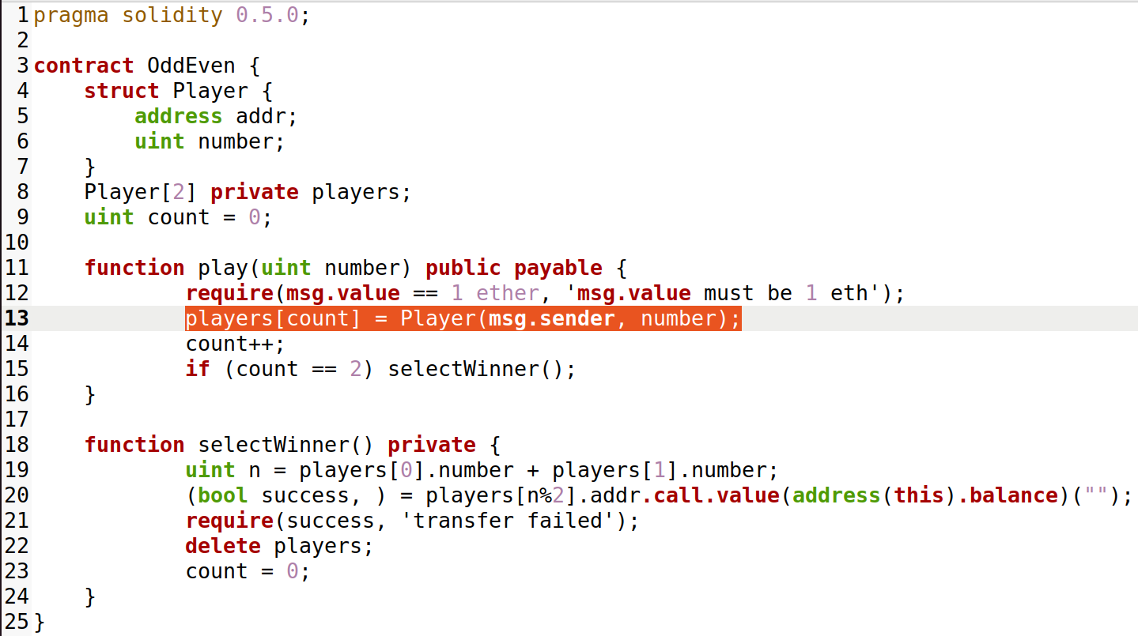
Detecting unencrypted private data on-chain_{[1]}

Slide 4
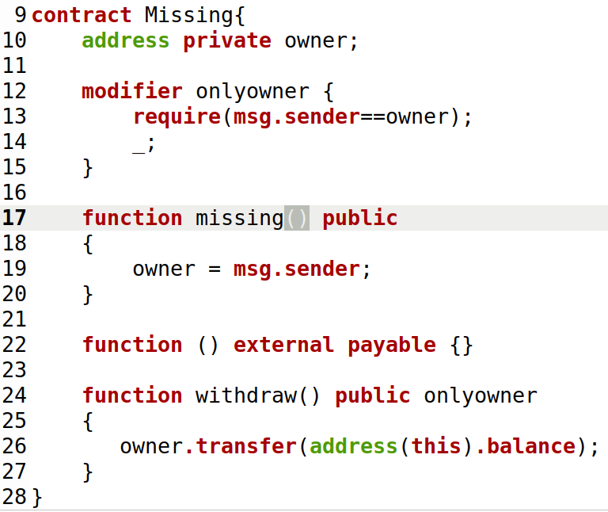
Detecting incorrect constructor name_{[2]}

Slide 5
Demo

Slide 6
Planning
Install Python v3.6+ & solc compiler
Install Slither
Analyze the solidity contract
Add the new detector in all_detectors.py file
Set up the solc compiler version
Load the solidity contract
Generate the report
Install solc-select to specify solc version

Slide 7
Risks and Mitigation Plan
# | Risk | Mitigation Plan
1. | Issue with CWE-767 detector | Need to get expert advice.
2. | False-positive analysis on the detector to detect CWE-767 | Need to modify the added detector on the vulnerability CWE-767
3. | Inexperience with Solidity language | Understand solidity language as you progress.

Slide 8
Users and Customers
# | User | Feedback/Suggestions
1. | Shubham Rathi ( Solidity beginner ) | More sample solidity contracts must be tested for the recently introduced detector.
2. | Ashwini Shenvi ( Solidity Enthusiast ) | Would like to know how such detector will identify an incorrect constructor name.
3. | Darshan Patil ( CSE 6324 – Team 2 ) | Need to work on false positive analysis if private function is modifying private data and calling it through public function.

Slide 9
References
Unencrypted-private-data-on-chain-network
Incorrect-constructor-name-smart-contract
Slither-Adding-a-new-detector
CWE-767:Access-to-private-data-in-public-method

Slide 10

Questions?

