Slide 1
Advanced Topics in Software Engineering CSE 6324 - Section 004 Team 10 ITERATION 1
Vanjari, Vaishali Sunil - 1001956614 Solanki, Siddhrajsinh Pradumansinh - 1001957988 ⁠Parimi, Taraka Naga Nikhil - 1001985955 ⁠Komireddy, Sannihith Reddy - 1001982437

Slide 2

The Idea
Adding a new detector to Slither
Detecting unencrypted private data on-chain
Compliance checker

Slide 3
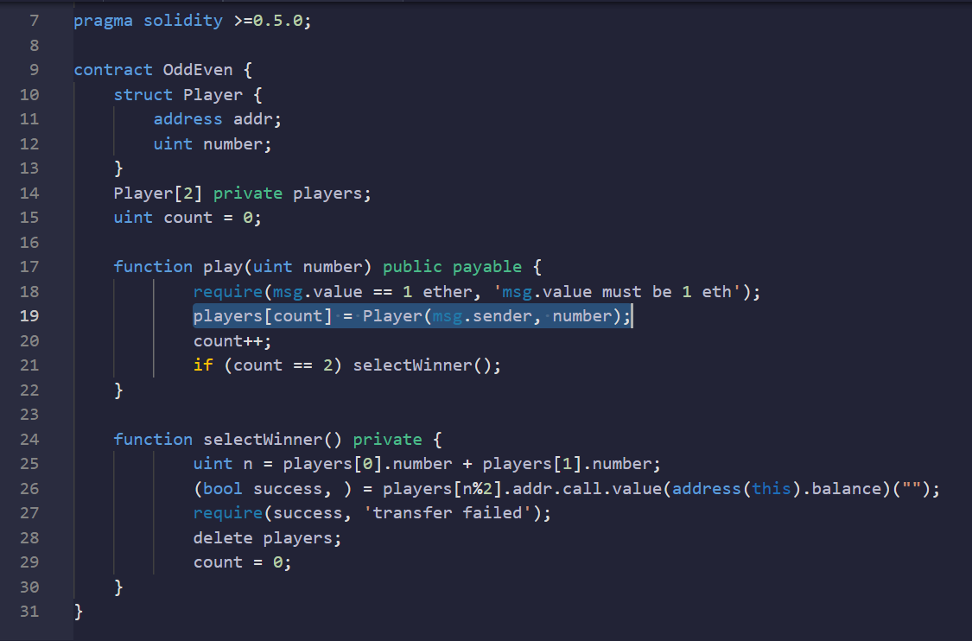
Detecting an unencrypted private data on-chain _{[1]}
CWE-767 _{[3]}
What is on-chain and off-chain transaction?
Remediation – Store private data off-chain _{[1]}
Remediation – Encrypt the private data on-chain _{[1]}

Slide 4
Planning
Install Python v3.6+ & solc compiler
Install Slither
Analyze the solidity contract
Add the new detector
Set up the solc compiler version
Load the solidity contract
Generate the report
Decrypt the private data on-chain

Slide 5
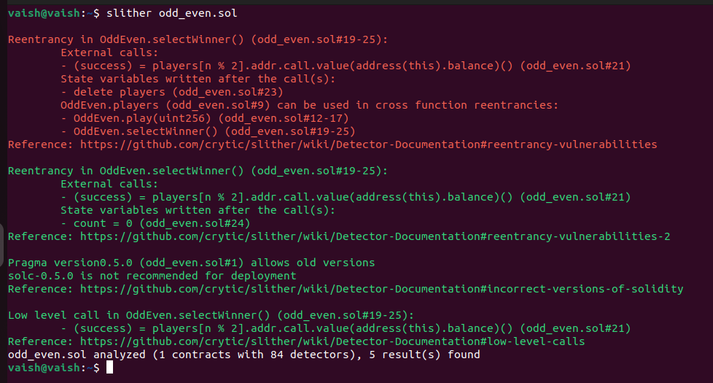
Slither Analysis on odd_even solidity contract

Slide 6
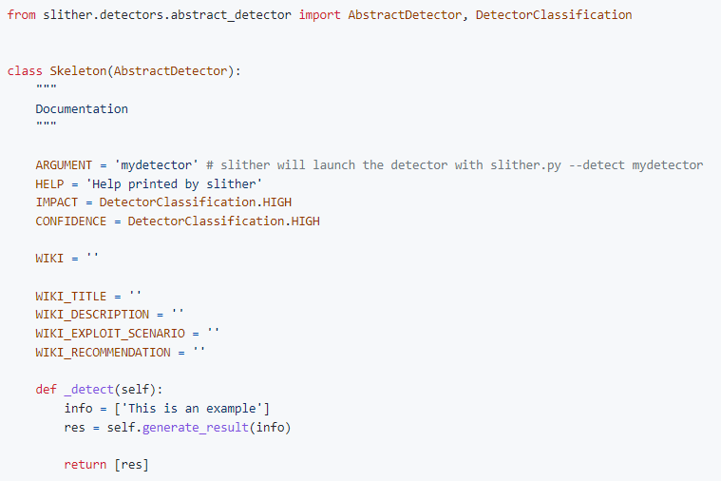
How to add a new detector? _{[2]}
Integrate a new detector with Slither by-
Adding it to all_detectors.py _{[4]}
Creating plugin package _{[5]}

Slide 7
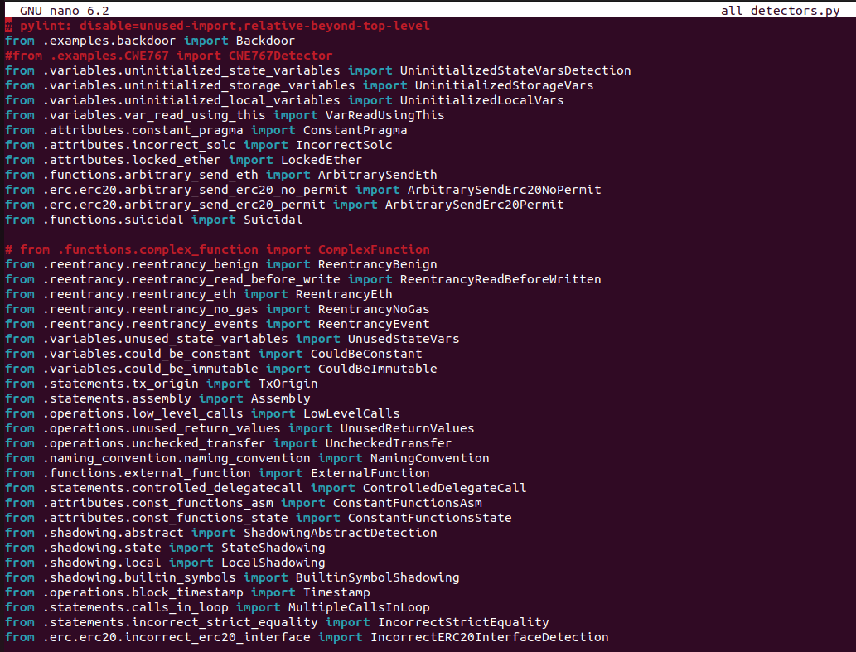
all_detectors.py file

Slide 8
Demo

Slide 9
Risks and Mitigation Plan
# | Risk | Mitigation Plan
1. | Evolving Solidity Language | Considering a fixed version of the solc compiler to avoid compatibility issues.
2. | Technical issue – inexperience with Python | Spend time learning Python
3. | Inexperience with Solidity language | Spend time learning solidity language to handle errors while developing the detector

Slide 10
Users and Customers
# | User/ Customer | Feedback / Suggestions
1. | Shubham Rathi ( Solidity beginner ) | Good concept Make it more user friendly
2. | Ashwini Shenvi ( Solidity Enthusiast ) | Easy to understand Interested in knowing how vulnerability will be detected by detector
3. | Darshan Patil ( CSE 6324 – Team 2 ) | Need to test a few more sample solidity contracts

Slide 11
References
SWC-136-Unencryped-private-data-on-chain
Adding-a-new-detector-to-Slither
CWE-767
slither/detectors/all-detectors.py
crytic/slither/plugin-example
GitHub link: https://github.com/vaishalivanjari/CSE6324ASE

Slide 12
Questions?

