Slide 1

Advanced Topics in Software Engineering CSE 6324 - Section 004 Team 10 FINAL ITERATION
Vanjari, Vaishali Sunil - 1001956614 Solanki, Siddhrajsinh Pradumansinh - 1001957988 ⁠Parimi, Taraka Naga Nikhil - 1001985955 ⁠Komireddy, Sannihith Reddy - 1001982437

Slide 2

The Idea
Adding a detector in Slither [3]
Detecting unencrypted private data on-chain Blockchain network [1].
a) CWE – 767 [4]
Detecting incorrect constructor name in Solidity Smart Contract [2].
CWE – 665 [5]

Slide 3
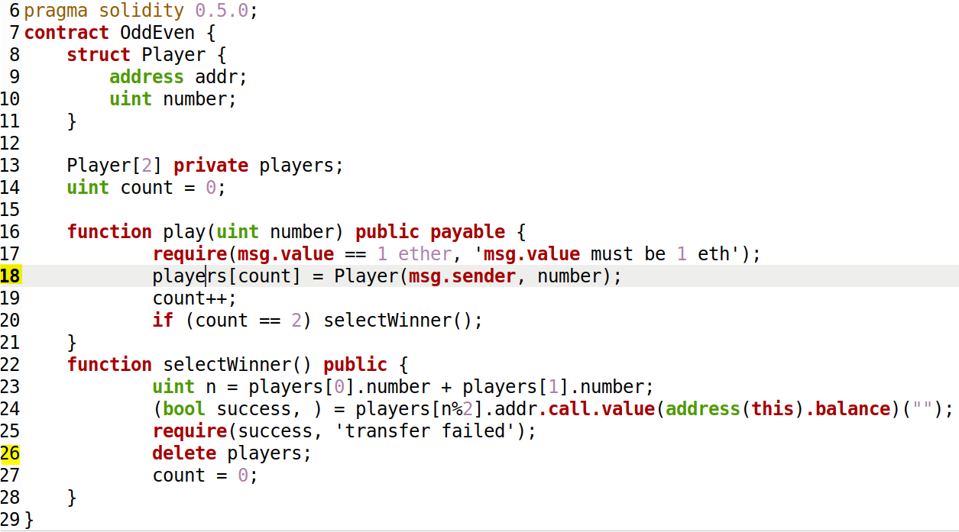
Detecting unencrypted private data on-chain_{[1]}

Slide 4
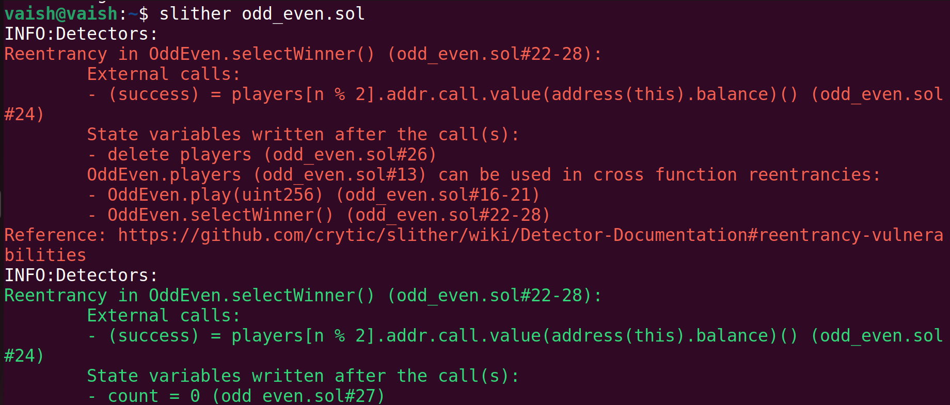
Analysis before adding the CWE-767 detector

Slide 5
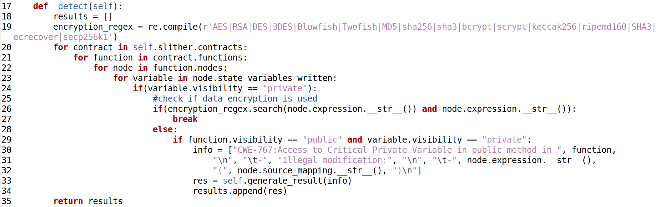
CWE-767 Detector _{[7]}

Slide 6
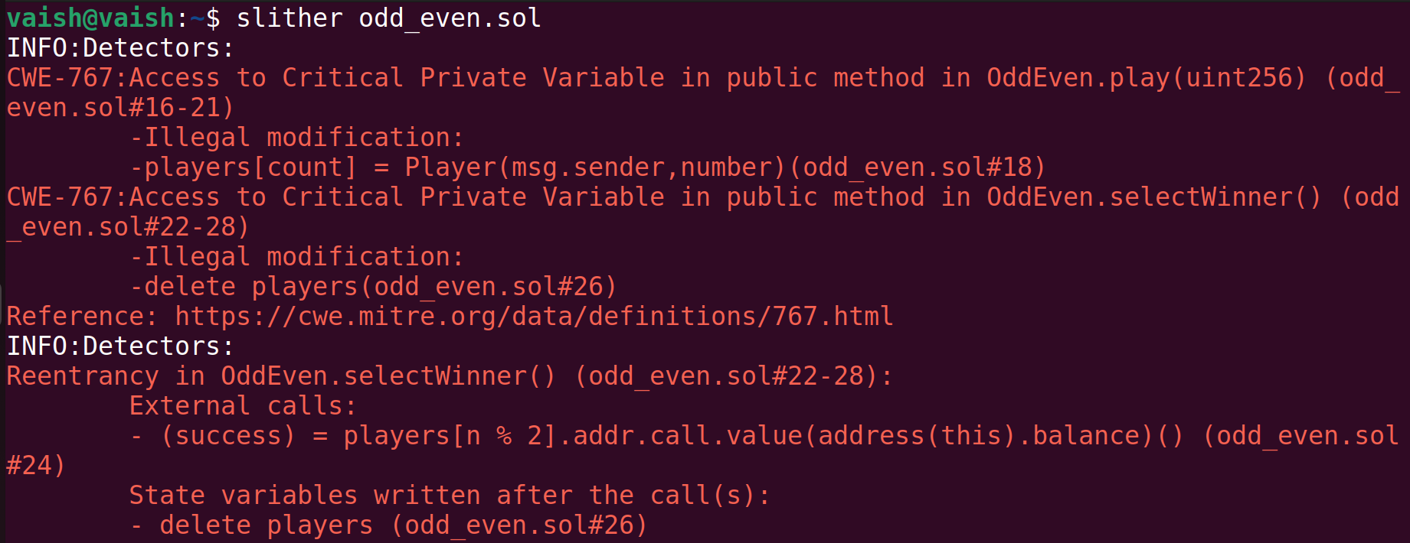
Analysis after adding the CWE-767 detector

Slide 7
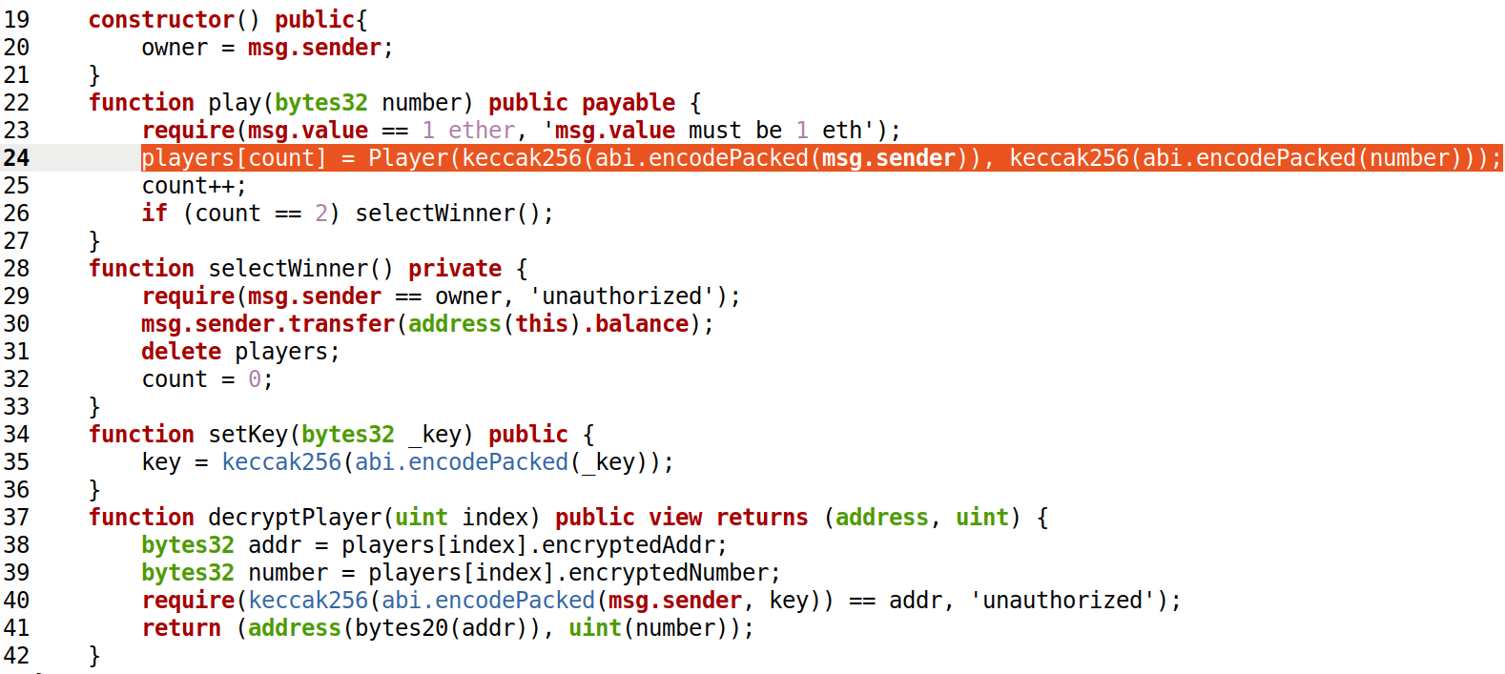
Mitigation on CWE-767

Slide 8
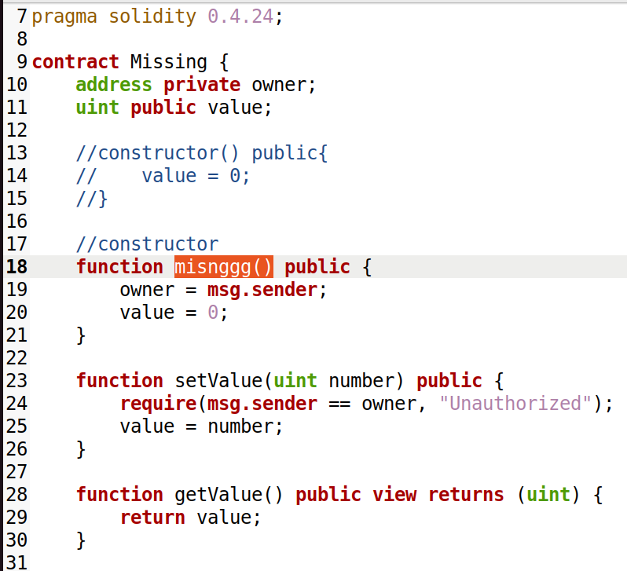
Detecting incorrect constructor name_{[2]}

Slide 9
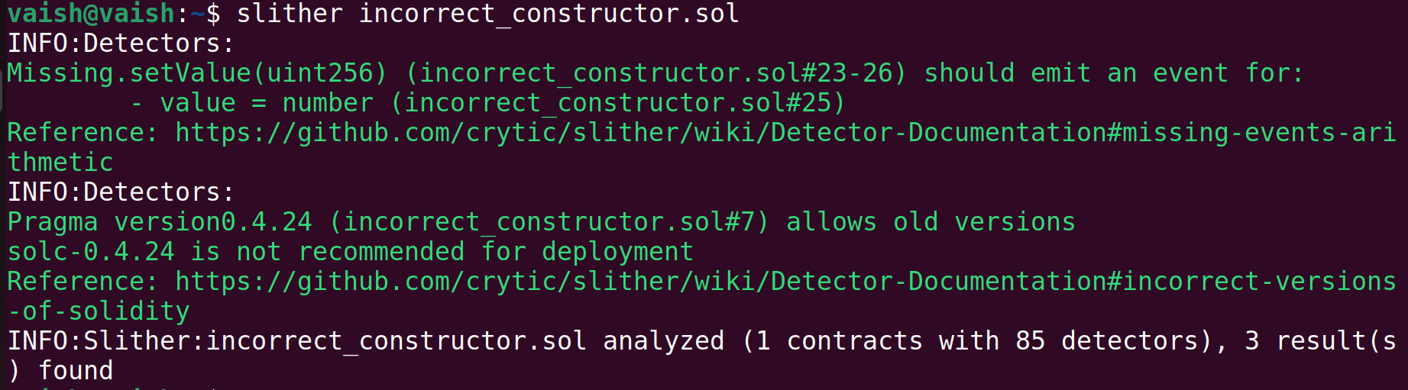
Analysis before adding the CWE-665 detector

Slide 10
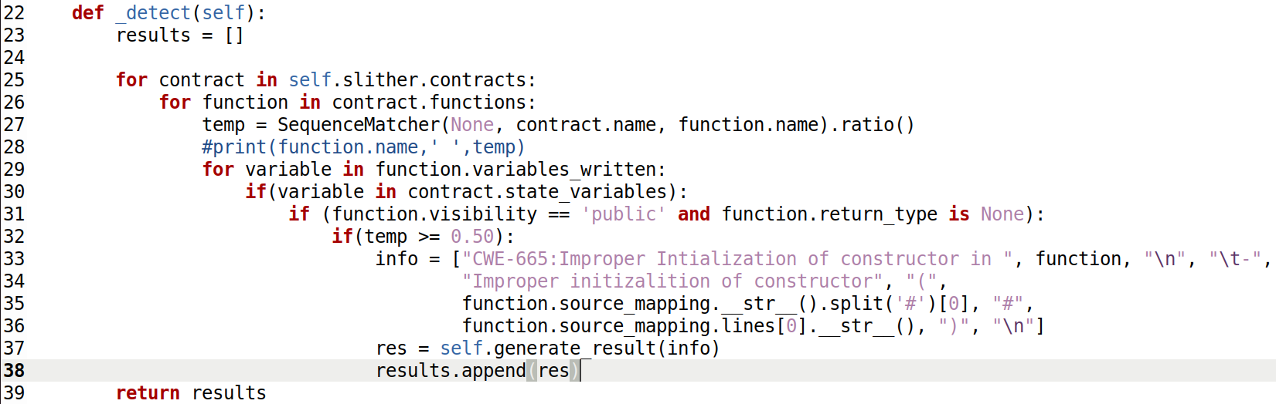
CWE-665 Detector _{[6]}

Slide 11
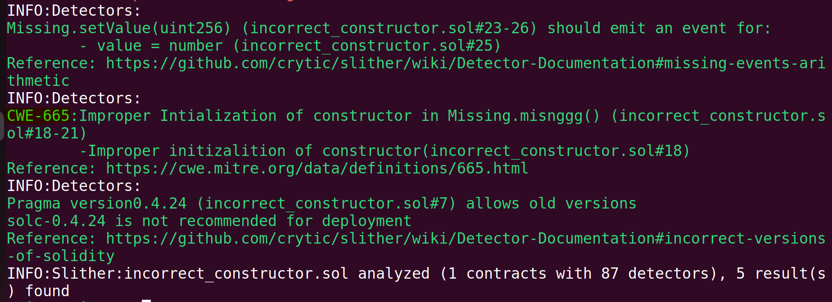
Analysis after adding the CWE-665 detector

Slide 12
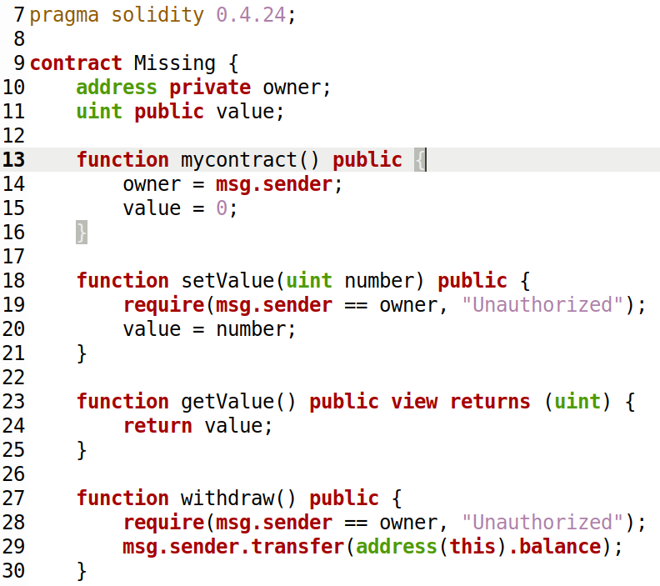
Limitation in CWE-665

Slide 13
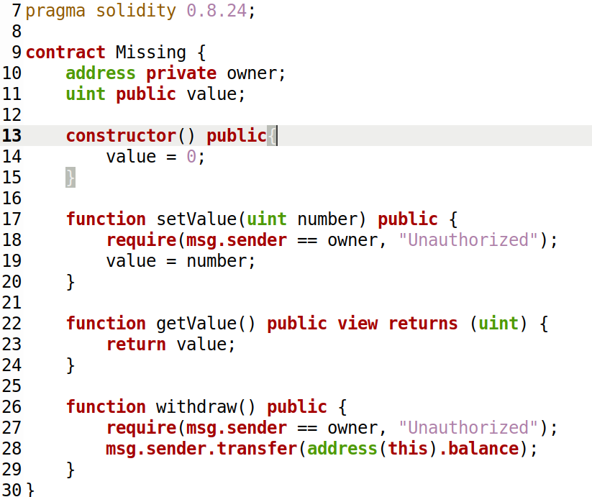
Mitigation on CWE-665

Slide 14
Planning
Install Python v3.6+ & solc compiler
Install Slither
Analyze the solidity contract
Add the new detector in all_detectors.py file
Set up the solc compiler version
Load the solidity contract
Generate the report
Install solc-select to specify solc version

Slide 15
Risks and Mitigation Plan
# | Risk | Mitigation Plan
1. | Very few inbuilt cryptographic functions in Solidity[7]. | Used the external cryptographic functions in CWE-767 detector.
2. | Facing issue with differentiation of function name and incorrect constructor name. | Import similarity metric library[6] to check similarity between two strings.
3. | Inexperience with Solidity language. | Progress as move forward.

Slide 16
Competitor Detectors in Slither
# | The proposed detector | Name of competitor detector in Slither
1. | CWE-767 Detector | Not available
2. | CWE-665 Detector | Not available
Note: naming-convention detector is used to check the rules such as the first letter of the function name should be lowercase. It cannot be used to detect incorrect constructor name

Slide 17
Users and Customers
# | User | Feedback/Suggestions
1. | Shubham Rathi ( Solidity beginner ) | Thank the team for being proactive in providing mitigation for the discovered issue.
2. | Ashwini Shenvi ( Solidity Enthusiast ) | The idea is easy for beginners to understand.
3. | Darshan Patil ( CSE 6324 – Team 2 ) | Looking forward to the professor's evaluation on the suggested CWE-767 solution.

Slide 18
Demo

Slide 19
References
Unencrypted-private-data-on-chain-network
Incorrect-constructor-name-smart-contract
Slither-Adding-a-new-detector
CWE-767:Access-to-private-data-in-public-method
CWE-665:incorrect-initialization-constructor
find-the-similarity-metric-between-two-strings
slither-mathematical-and-cryptographic-functions
GitHub link: https://github.com/vaishalivanjari/CSE6324ASE

Slide 20

Questions?

