Slide 1
Design for Testability
Understanding Self-Test Mechanisms
Vaishali T
R&D Senior Engineer

Slide 2
Design for Testability
Design for Testability (DFT) is a set of techniques used to improve the ease of testing integrated circuits (ICs).
As modern chips have millions to billions of transistors, traditional external testing methods (functional testing) are not enough.
DFT techniques help ensure high fault coverage, reduce test time, and improve manufacturability

Slide 3
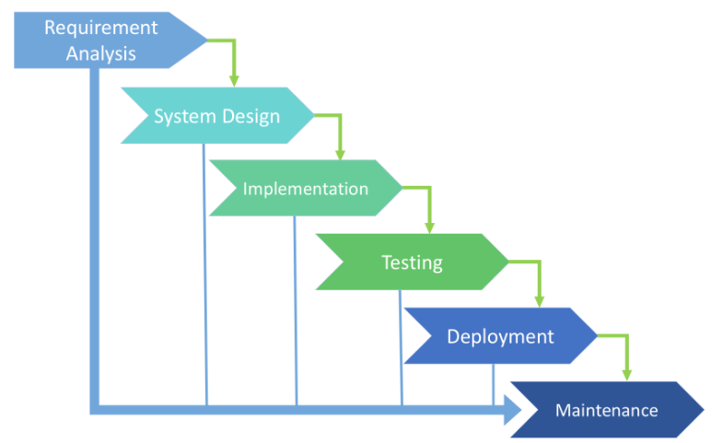
Product Life cycle
Testing model used in development, the most common ones are:
Waterfall Model – Sequential
V-Model (Validation & Verification) –Parallel
Agile Model –Spint
Spiral Model – Loop

Slide 4
DFT Need
Why is DFT Important?
Manufacturing Defects
Finds short circuits, open circuits, and process variations in IC fabrication and Post-production.
Reduces Test Cost and Time
Built-in test structures allow quick diagnosis and reduce dependency on expensive testers.
Increases Fault Coverage
Detects faults like stuck-at faults, transition faults, delay faults, bridging faults, etc.
Enables In-System Testing
DFT allows chips to be tested even after deployment (e.g., aerospace, automotive applications)
Saves cost resource reputation on commitments

Slide 5
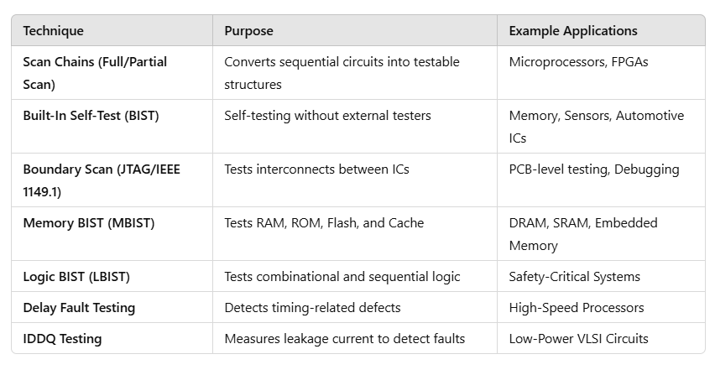
DFT TYPES
Notes:
Iddq-Quiescent current measurement in CMOS circuits

Slide 6
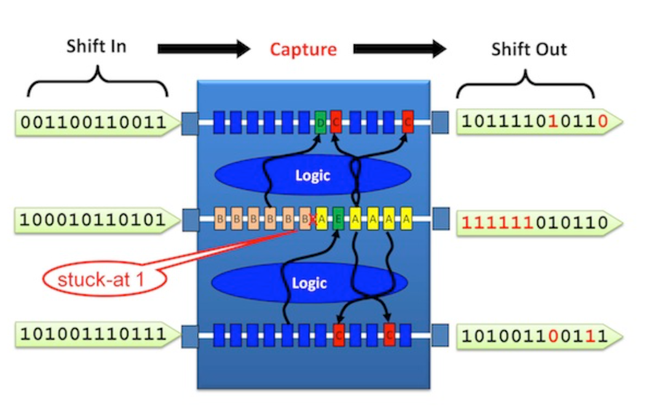
Fault Issue OUTCOME
Two Possible Outcomes:
✅ Case 1: Reprogrammable Fault (Firmware Fix)
If the fault is minor (e.g., a timing issue or a register that can be bypassed), the firmware updates the processing algorithm.
The touch controller adjusts the signal interpretation to ignore the faulty bit and use redundancy mechanisms.
Example: A touchscreen detects a dead zone in one corner, but a firmware update recalibrates the panel to redistribute sensor input.
❌ Case 2: Permanent Hardware Failure (Defective Chip)

Slide 7
Scan Chain Testing (Scan-Based DFT)
Converts sequential circuits into testable structures.
Adds multiplexers (MUXes) to flip-flops, allowing test patterns to be shifted in/out.
Example: Scan Chain Insertion
Normal flip-flops are replaced with scan flip-flops.
A Test Mode (Scan Mode) is added.
Enables shifting test vectors through serial scan chains.

Slide 8
Scan Chain Testing (Scan-Based DFT)
Problem:
During manufacturing, faults may occur in the flip-flops or registers that hold the touch sensor signals. If a flip-flop is faulty: ❌ It may always store ‘1’ (stuck-at-1) → A false touch detected. ❌ It may always store ‘0’ (stuck-at-0) → A real touch goes undetected. ❌ It may have timing issues (delay faults) → Touch detection lags.

Slide 9
Scan Chain Testing
1️⃣ Scan Mode Activation:
2️⃣ Test Pattern Insertion:
3️⃣ Response Capture:
4️⃣ Fault Diagnosis:

Slide 10
Flow scan chain Testing
Step | Process | Example in Touch Sensor
Step 1 | Enter Scan Mode | MCU enters test mode via a JTAG command.
Step 2 | Load Test Pattern | A pattern 101010... is shifted through the flip-flops storing touch signals.
Step 3 | Capture Response | The system reads back the pattern.
Step 4 | Compare Expected vs. Actual | If a flip-flop stuck at ‘1’ returns 111110..., a fault is detected.
Step 5 | Diagnose & Repair | The faulty register is identified and fixed.

Slide 11
Built-In Self-Test (BIST)
BIST is an automated self-testing mechanism integrated into ICs and PCBs.
Allows the circuit to test itself without external testers.
Uses Pattern Generator, Response Analyzer, and Test Controller.
(Example: LFSR or a ROM-based pattern generator)
Reduces dependency on expensive Automatic Test Equipment (ATE).

Slide 12
Types of BIST
Logic BIST (LBIST): Tests combinational and sequential logic circuits.
Memory BIST (MBIST): Tests embedded RAM, ROM, Flash, and Cache.
Analog BIST: Tests analog components like ADCs, DACs, and power circuits.

Slide 13
Components of a BIST System
Test Pattern Generator (TPG)
Circuit Under Test (CUT)
Response Analyzer (RA)
BIST Controller
Output Interface

Slide 14
MBIST
MBIST (Memory Built-In Self-Test) – Testing Embedded Memory (SRAM, DRAM, Flash)
Memory BIST (MBIST) is a special test mechanism inside ICs that checks the functionality of embedded memory (SRAM, DRAM, Flash) without external testing equipment.
MBIST generates test patterns to read/write different memory locations.
0x55AA (Binary: 0101 0101 1010 1010) 0x33CC (Binary: 0011 0011 1100 1100)
Detects stuck-at faults, bit flipping, and access failures in memory cells.
Helps in self-repairing defective memory blocks if redundancy is available.

Slide 15
Testing Flash Memory
-The touch controller also uses Flash memory to store calibration data, which ensures accurate touch detection.
MBIST tests the Flash memory by reading and verifying stored values.
If Flash memory is corrupted:
The screen might register incorrect touch positions.
Multi-touch gestures (zoom, swipe) might not work correctly.

Slide 16
Calibration Data is Stored and Updated in Flash
Factory Calibration:
Preloaded during manufacturing based on default tuning parameters.
Field Calibration:
Updated via software updates or dynamic learning (e.g., adaptive transmission shifting).
Fault Recovery:
Store last known good calibration to restore settings after a power failure.
Redundant Storage:
Uses multiple flash memory sectors to prevent corruption.(Alternative)

Slide 17
Boundary Scan (JTAG)
Boundary Scan (JTAG) Checks the interconnects between components on a PCB without requiring physical test probes.
How It Works?
Uses JTAG (Joint Test Action Group) pins to send test signals between ICs.
Verifies if all the connections (e.g., between touch controller IC and main processor) are correctly soldered and functional.
Detects open circuits, short circuits, or missing connections.

Slide 18
Boundary Scan (JTAG)
How Boundary Scan (JTAG) Helps Detect the Issue
Instead of manually probing each pin with a multimeter or oscilloscope, engineers use JTAG-based boundary scan to perform automated testing.
✔ Step 1: Scan the I²C or SPI Bus
Boundary scan sends test signals through the I²C or SPI lines.
If the signal does not reach the touch controller, there is a broken connection.
✔ Step 2: Check for Shorts Between Power and Ground
✔ Step 3: Verify CPU ↔ Touch Controller Communication
Issue might be in the PCB routing or faulty soldering.

Slide 19
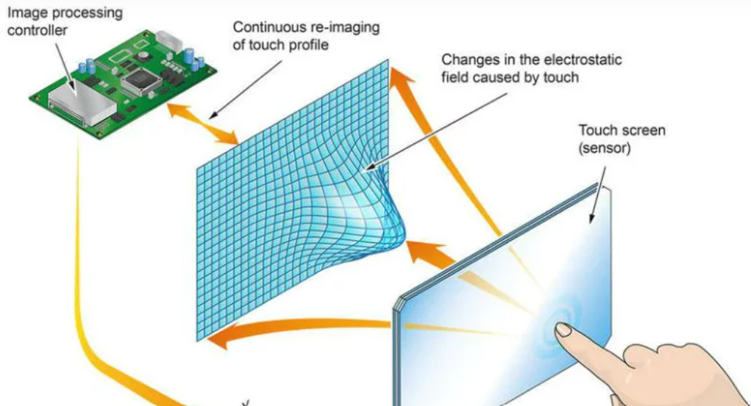
Use case: Capacitive Touch screen
When a user touches a capacitive screen, it changes the capacitance of the touch sensor.
The difference between the baseline (no touch) and the new signal (with touch) is called the delta value.
T10 ensures this delta remains within expected limits to avoid errors.(thresholds )

Slide 20
Delta Monitoring
If the delta is too low → The touch might be weak or the sensor is faulty.
If the delta is too high → The system might be detecting noise, unintended touches, or a faulty sensor. 4️⃣ Fault Reporting: If the delta is outside limits, T10 triggers a fault event, indicating a sensor issue.

Slide 21
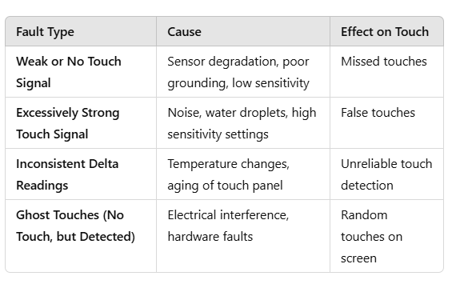
Touch possibility

Slide 22
Power Test
Power Test
🔹 Validates that power rails provide stable voltage to different components. 🔹 Checks:
Voltage levels (3.3V, 5V, 1.8V, etc.).
Brownout detection (voltage drop below the threshold then trigger events).
Power consumption during different operating modes. 🔹 Example: If power is unstable, the touchscreen controller may reset frequently or fail.

Slide 23
Pin Fault Test
Pin Fault Test
🔹 Detects electrical faults in sensor pins, power pins, and ground connections. 🔹 Checks:
Shorts between adjacent pins.
Opens (disconnected lines).
Leakage currents between power and ground. 🔹 Example: A shorted sensor pin in a touchscreen can cause dead zones or incorrect touch points.

Slide 24
Signal Test
Signal Test
🔹 Ensures signal transmission is strong and within expected limits. 🔹 Checks:
Signal strength degradation in long sensor traces.
Crosstalk detection (unwanted signal interference).
High/Low voltage levels for digital signals. 🔹 Example: In a touchscreen, weak signals could result in ghost touches or unresponsive areas.

Slide 25
CTE
CTE (Capacitive Touch Engine) Test
🔹 Specific to touchscreen controllers, ensuring the capacitive sensing engine works properly. 🔹 Checks:
Mutual & Self-Capacitance measurement integrity.
Touch detection thresholds (to prevent false touches).
Noise immunity from power lines. 🔹 Example: If the CTE is not working correctly, a touchscreen may register false or no touches.

Slide 26
RAM Test
RAM (Random Access Memory) Test
🔹 Ensures RAM is functioning correctly for temporary data storage and execution. 🔹 Checks:
Memory cell integrity (Reads/Writes at different locations).
Stuck-at faults (0s or 1s permanently set).
Address line faults (Checking correct bit storage). 🔹 Example: In a touchscreen system, faulty RAM could cause erratic touch response or crashes.

Slide 27
Flash Memory Test
Flash Memory Test
🔹 Verifies the integrity of flash memory, which stores firmware and critical data. 🔹 Checks:
Read/Write errors (Bit-flipping due to aging).
ECC (Error Correction Code) validation for flash data.
Sector Erase & Reprogramming tests. 🔹 Example: If firmware storage in a touchscreen controller is corrupted, the device may fail to boot or process touches incorrectly.

Slide 28
Clock Test
Clock Test
🔹 Ensures that the system clock (oscillator/crystal) is running at the expected frequency. 🔹 Checks:
Main system clock accuracy (e.g., 16MHz crystal in MCUs).
Internal vs. External clock consistency.
Jitter and stability in clock signals. 🔹 Example: In a touchscreen controller, a clock failure can cause missed inputs or incorrect touch coordinates.

Slide 29
Interrupt Test
Interrupt Test
🔹 Verifies that interrupts (IRQs) are properly handled by the processor. 🔹 Checks:
Whether hardware interrupt requests (IRQs) trigger the correct handler.
Ensures interrupt vectors are correctly mapped.
Validates priority levels in a nested interrupt controller (NVIC). 🔹 Example: If a touch controller sends an interrupt when touched, the system ensures it triggers the correct function.

Slide 30
Peripherals Testing
✅ GPIO – Toggle pin states, check pull-up/down. ✅ UART – Loopback test, baud rate verification. ✅ I2C – Detect devices, read/write registers. ✅ SPI – Check clock phase, data integrity. ✅ ADC – Verify voltage readings, noise analysis. ✅ PWM – Validate duty cycle, motor/LED control. ✅ USB/CAN – Check data transfer, error handling.

Slide 31
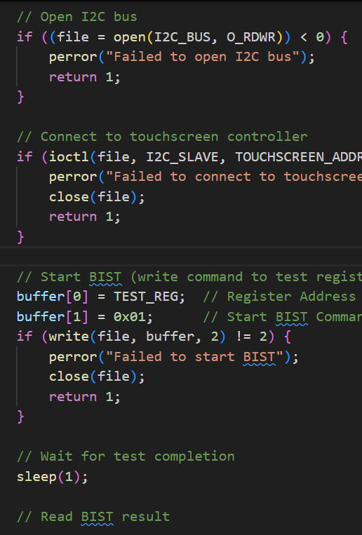
Sample script Testing
BIST Flow for Touchscreen
Initialize I2C/SPI Communication.
Trigger BIST mode via a specific register write.
Wait for test completion (polling or delay).
Read test results from a register.
Pass/Fail Decision:
✅ Pass: Normal operation.
❌ Fail: Display error message/log.

Slide 32
How CI is Used in Embedded Testing
1. Firmware Continuous Integration
Embedded C/C++ firmware is automatically compiled and tested.
Unit Testing frameworks (Ceedling, Unity, Google Test) run inside CI.
Example CI Tools: Jenkins, GitHub Actions, GitLab CI
2. Hardware Integration Testing
CI automates flashing firmware onto microcontrollers (MCUs).
Tests run on real or simulated hardware.
3. Automated Regression Testing
Regression tests run for peripherals (I2C, SPI, UART, ADC, etc.).
Boundary scan (JTAG), power analysis, and reliability testing are included.
4. Continuous Deployment & OTA Updates
Embedded firmware updates are tested and deployed automatically via Over-the-Air (OTA) updates.

Slide 33
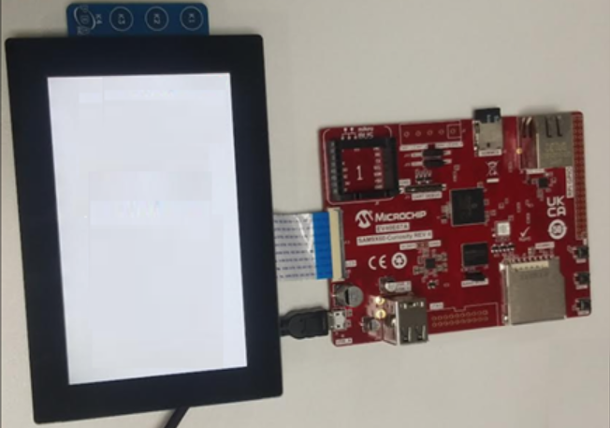
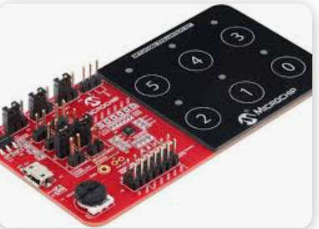
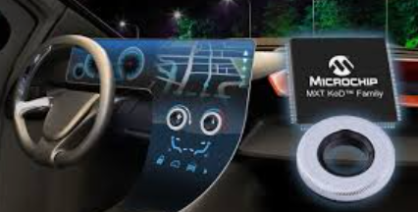

Slide 34


