Slide 1

KOBIE LAUNCHPAD 2026
One-Click-Ops
[Track : Cloud Engineering]
Team Members
Vaishnavi J P
Vivek G
PES UNIVERSITY
Notes:
TITLE SLIDE — ~30 seconds • Introduce your team name, members, and institution. • State which track you've chosen and why it excited your team. • Keep it brief — the substance is in the next 3 slides.

Slide 2

Problem Understanding & Approach
WHAT WE UNDERSTAND
We are building a system that transforms a single command into a fully operational cloud environment with networking, database, Kubernetes infrastructure, platform tooling, and a deployed three-tier application without manual intervention. Our One-Click Environment Provisioner uses modular Terraform to provision a production grade AWS stack with VPC, RDS, and EKS, alongside secure remote state management and least-privilege IAM. FluxCD manages platform and application deployments declaratively through Git, preventing configuration drift. A Jenkins CI/CD pipeline handles testing, vulnerability scanning, and deployment with strict failure gates. The platform is idempotent, secure, observable through Prometheus and Grafana, and designed with realistic MVP scope and risk mitigation strategies.
KOBIE LAUNCHPAD 2026
1 /1 3
Notes:
SLIDE 1 — PROBLEM UNDERSTANDING & APPROACH (~2 minutes) Left column — Problem Understanding: • Demonstrate you've identified the CORE challenge, not just restated the brief. • Show awareness of what makes this hard (anti-patterns, failure modes). • Mention key constraints: data scale, latency, accuracy vs. coverage, etc. Right column — Your Approach: • Describe your high-level strategy. Don't just list tools — explain your THINKING. • Briefly mention alternatives you considered and why you chose this path. • This should feel like a conversation about problem-solving, not a feature list. Bottom bar — Key Insight: • One sentence. What is the single idea that makes your approach compelling? EVALUATION CRITERIA THIS COVERS: → Problem Understanding (25 pts) → Proposed Approach & Solution Design (partial — 30 pts) → Creativity & Originality (partial — 20 pts)

Slide 3
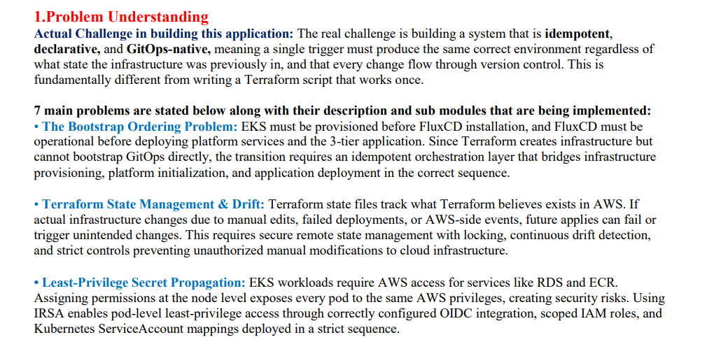

WHAT WE UNDERSTAND
OUR APPROACH
Replace this with a high-level summary of your solution approach.
• What is your core strategy / insight?
• How does your approach address what makes this hard?
• What alternatives did you consider and why did you reject them?
Key Insight: [Summarise your single most important idea in one sentence — what makes your approach different?]
KOBIE LAUNCHPAD 2026
2 / 13
Notes:
SLIDE 1 — PROBLEM UNDERSTANDING & APPROACH (~2 minutes) Left column — Problem Understanding: • Demonstrate you've identified the CORE challenge, not just restated the brief. • Show awareness of what makes this hard (anti-patterns, failure modes). • Mention key constraints: data scale, latency, accuracy vs. coverage, etc. Right column — Your Approach: • Describe your high-level strategy. Don't just list tools — explain your THINKING. • Briefly mention alternatives you considered and why you chose this path. • This should feel like a conversation about problem-solving, not a feature list. Bottom bar — Key Insight: • One sentence. What is the single idea that makes your approach compelling? EVALUATION CRITERIA THIS COVERS: → Problem Understanding (25 pts) → Proposed Approach & Solution Design (partial — 30 pts) → Creativity & Originality (partial — 20 pts)

Slide 4
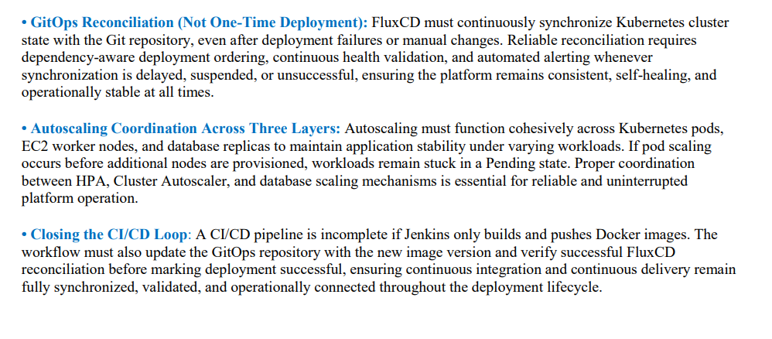
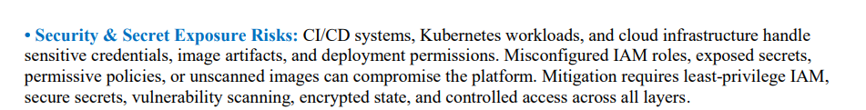
Problem Understanding & Approach
WHAT WE UNDERSTAND
OUR APPROACH
Replace this with a high-level summary of your solution approach.
• What is your core strategy / insight?
• How does your approach address what makes this hard?
• What alternatives did you consider and why did you reject them?
Key Insight: [Summarise your single most important idea in one sentence — what makes your approach different?]
KOBIE LAUNCHPAD 2026
3 /1 3
Notes:
SLIDE 1 — PROBLEM UNDERSTANDING & APPROACH (~2 minutes) Left column — Problem Understanding: • Demonstrate you've identified the CORE challenge, not just restated the brief. • Show awareness of what makes this hard (anti-patterns, failure modes). • Mention key constraints: data scale, latency, accuracy vs. coverage, etc. Right column — Your Approach: • Describe your high-level strategy. Don't just list tools — explain your THINKING. • Briefly mention alternatives you considered and why you chose this path. • This should feel like a conversation about problem-solving, not a feature list. Bottom bar — Key Insight: • One sentence. What is the single idea that makes your approach compelling? EVALUATION CRITERIA THIS COVERS: → Problem Understanding (25 pts) → Proposed Approach & Solution Design (partial — 30 pts) → Creativity & Originality (partial — 20 pts)

Slide 5
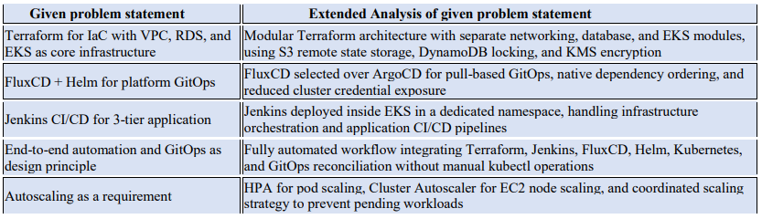
Problem Understanding & Approach
WHAT WE UNDERSTAND
OUR APPROACH
Replace this with a high-level summary of your solution approach.
• What is your core strategy / insight?
• How does your approach address what makes this hard?
• What alternatives did you consider and why did you reject them?
Key Insight: [Summarise your single most important idea in one sentence — what makes your approach different?]
KOBIE LAUNCHPAD 2026
4 / 13
Notes:
SLIDE 1 — PROBLEM UNDERSTANDING & APPROACH (~2 minutes) Left column — Problem Understanding: • Demonstrate you've identified the CORE challenge, not just restated the brief. • Show awareness of what makes this hard (anti-patterns, failure modes). • Mention key constraints: data scale, latency, accuracy vs. coverage, etc. Right column — Your Approach: • Describe your high-level strategy. Don't just list tools — explain your THINKING. • Briefly mention alternatives you considered and why you chose this path. • This should feel like a conversation about problem-solving, not a feature list. Bottom bar — Key Insight: • One sentence. What is the single idea that makes your approach compelling? EVALUATION CRITERIA THIS COVERS: → Problem Understanding (25 pts) → Proposed Approach & Solution Design (partial — 30 pts) → Creativity & Originality (partial — 20 pts)

Slide 6
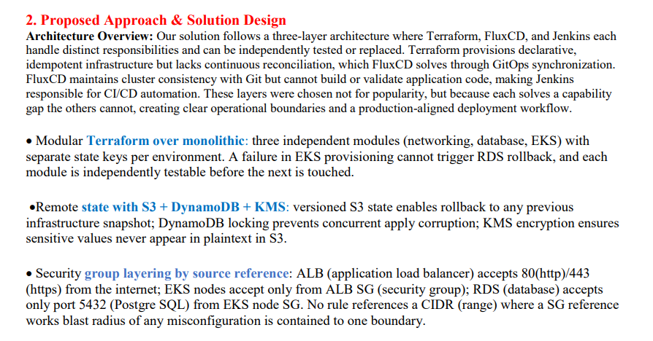
Replace this entire area with your architecture diagram or component layout.
Show the key components of your system, how they interact, and the data flow between them.
Use boxes, arrows, and labels. This is the most important visual in your presentation.
Tip: Draw it on paper first, then recreate it here. Keep it clean — 4–6 components max.
TOOLS & TECH CHOICES
EDGE CASES & ERROR HANDLING
[List key tools/libraries/models and WHY you chose them — not just names]
[How does your system handle failures, bad inputs, or unexpected scenarios?]
KOBIE LAUNCHPAD 2026
5 /1 3
Notes:
SLIDE 2 — ARCHITECTURE & SOLUTION DESIGN (~2.5 minutes) Architecture diagram (main area): • This is the centrepiece. Show 4–6 clearly labelled components. • Draw arrows showing data flow between components. • Label what each component DOES, not just what it IS. • If your system has a 'brain' (orchestrator, pipeline manager), make it obvious. Tools & Tech Choices (bottom-left): • Don't just list names — justify choices. 'XGBoost for transition prediction because class imbalance handling and interpretable feature importances' > 'XGBoost'. • If using an LLM, specify which model and where in the pipeline. Edge Cases (bottom-right): • Show you've thought about what can go wrong. • Examples: missing data, API failures, ambiguous inputs, adversarial cases. EVALUATION CRITERIA THIS COVERS: → Proposed Approach & Solution Design (30 pts) → Creativity & Originality (partial — 20 pts)

Slide 7
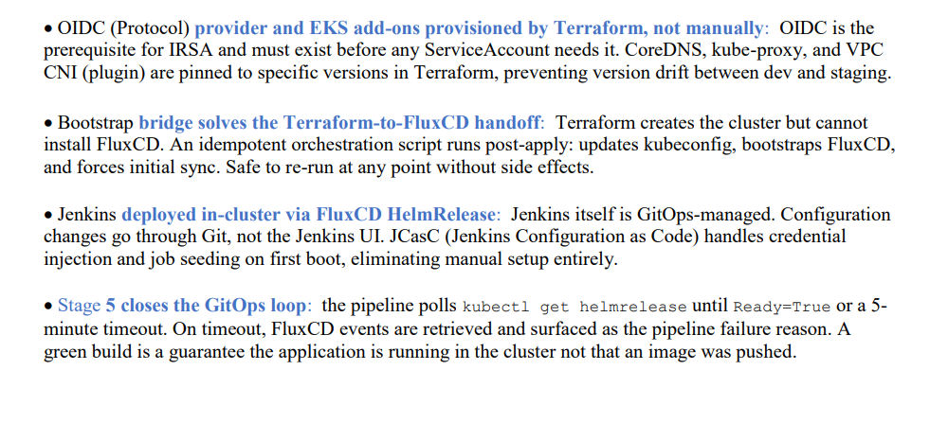
Replace this entire area with your architecture diagram or component layout.
Show the key components of your system, how they interact, and the data flow between them.
Use boxes, arrows, and labels. This is the most important visual in your presentation.
Tip: Draw it on paper first, then recreate it here. Keep it clean — 4–6 components max.
TOOLS & TECH CHOICES
EDGE CASES & ERROR HANDLING
[List key tools/libraries/models and WHY you chose them — not just names]
[How does your system handle failures, bad inputs, or unexpected scenarios?]
KOBIE LAUNCHPAD 2026
6 / 13
Notes:
SLIDE 2 — ARCHITECTURE & SOLUTION DESIGN (~2.5 minutes) Architecture diagram (main area): • This is the centrepiece. Show 4–6 clearly labelled components. • Draw arrows showing data flow between components. • Label what each component DOES, not just what it IS. • If your system has a 'brain' (orchestrator, pipeline manager), make it obvious. Tools & Tech Choices (bottom-left): • Don't just list names — justify choices. 'XGBoost for transition prediction because class imbalance handling and interpretable feature importances' > 'XGBoost'. • If using an LLM, specify which model and where in the pipeline. Edge Cases (bottom-right): • Show you've thought about what can go wrong. • Examples: missing data, API failures, ambiguous inputs, adversarial cases. EVALUATION CRITERIA THIS COVERS: → Proposed Approach & Solution Design (30 pts) → Creativity & Originality (partial — 20 pts)

Slide 8
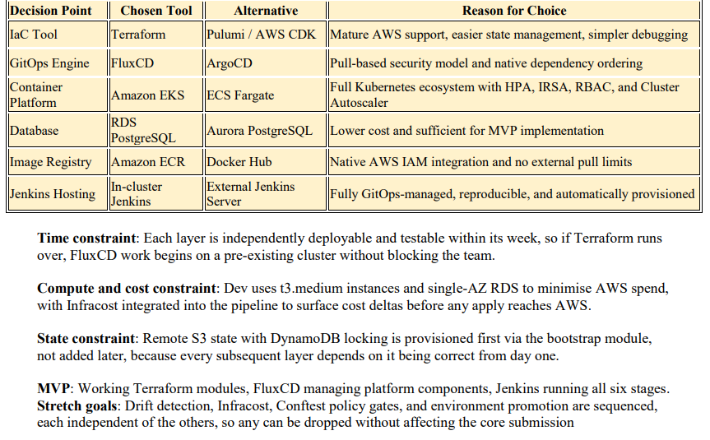
Replace this entire area with your architecture diagram or component layout.
Show the key components of your system, how they interact, and the data flow between them.
Use boxes, arrows, and labels. This is the most important visual in your presentation.
Tip: Draw it on paper first, then recreate it here. Keep it clean — 4–6 components max.
TOOLS & TECH CHOICES
EDGE CASES & ERROR HANDLING
[List key tools/libraries/models and WHY you chose them — not just names]
[How does your system handle failures, bad inputs, or unexpected scenarios?]
KOBIE LAUNCHPAD 2026
7 / 13
Notes:
SLIDE 2 — ARCHITECTURE & SOLUTION DESIGN (~2.5 minutes) Architecture diagram (main area): • This is the centrepiece. Show 4–6 clearly labelled components. • Draw arrows showing data flow between components. • Label what each component DOES, not just what it IS. • If your system has a 'brain' (orchestrator, pipeline manager), make it obvious. Tools & Tech Choices (bottom-left): • Don't just list names — justify choices. 'XGBoost for transition prediction because class imbalance handling and interpretable feature importances' > 'XGBoost'. • If using an LLM, specify which model and where in the pipeline. Edge Cases (bottom-right): • Show you've thought about what can go wrong. • Examples: missing data, API failures, ambiguous inputs, adversarial cases. EVALUATION CRITERIA THIS COVERS: → Proposed Approach & Solution Design (30 pts) → Creativity & Originality (partial — 20 pts)

Slide 9
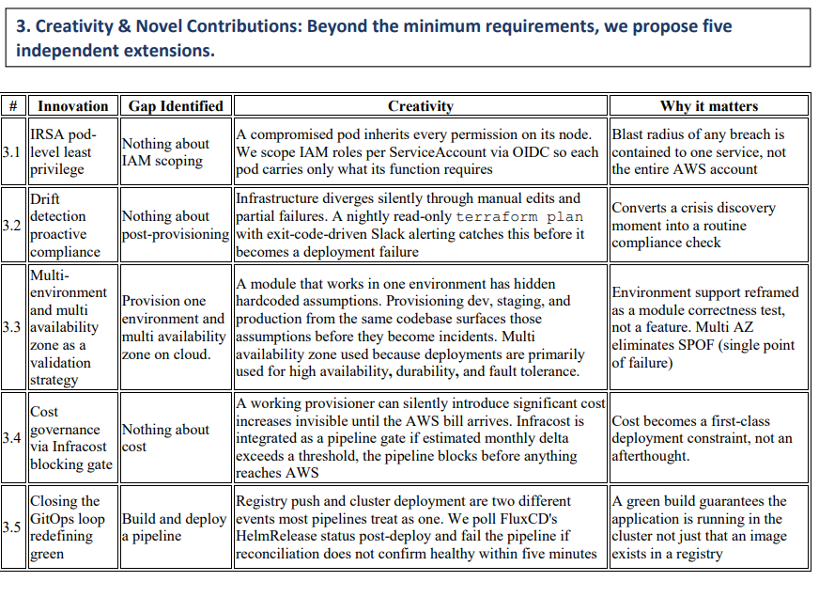
Replace this entire area with your architecture diagram or component layout.
Show the key components of your system, how they interact, and the data flow between them.
Use boxes, arrows, and labels. This is the most important visual in your presentation.
Tip: Draw it on paper first, then recreate it here. Keep it clean — 4–6 components max.
TOOLS & TECH CHOICES
EDGE CASES & ERROR HANDLING
[List key tools/libraries/models and WHY you chose them — not just names]
[How does your system handle failures, bad inputs, or unexpected scenarios?]
KOBIE LAUNCHPAD 2026
8 / 13
Notes:
SLIDE 2 — ARCHITECTURE & SOLUTION DESIGN (~2.5 minutes) Architecture diagram (main area): • This is the centrepiece. Show 4–6 clearly labelled components. • Draw arrows showing data flow between components. • Label what each component DOES, not just what it IS. • If your system has a 'brain' (orchestrator, pipeline manager), make it obvious. Tools & Tech Choices (bottom-left): • Don't just list names — justify choices. 'XGBoost for transition prediction because class imbalance handling and interpretable feature importances' > 'XGBoost'. • If using an LLM, specify which model and where in the pipeline. Edge Cases (bottom-right): • Show you've thought about what can go wrong. • Examples: missing data, API failures, ambiguous inputs, adversarial cases. EVALUATION CRITERIA THIS COVERS: → Proposed Approach & Solution Design (30 pts) → Creativity & Originality (partial — 20 pts)

Slide 10
AI Powered Kubernetes Troubleshooting (K8sGPT)
When a deployment, pod, service, ingress, or workload enters a failed state, K8sGPT automatically collects live Kubernetes context including pod logs, events, deployment status, service configurations, and cluster resource conditions, no training dataset or custom model development is required.
K8sGPT analyzes this real-time operational data using an LLM-backed reasoning engine to correlate failures across multiple Kubernetes components instead of examining logs or events in isolation.
The system identifies probable root causes for issues such as CrashLoopBackOff, ImagePullBackOff, Pending Pods, failed ingress routing, missing secrets, resource exhaustion, and connectivity failures.
It generates human-readable diagnostics, supporting evidence, and recommended remediation steps, significantly reducing the time engineers spend manually debugging distributed cloud-native environments.
By integrating K8sGPT into the GitOps and deployment workflow, troubleshooting becomes proactive, automated, and context-aware, improving platform reliability and reducing Mean Time To Resolution (MTTR).
What data is used? → Logs, events, deployments, services, cluster state.
What exactly happens? → Automated root-cause analysis.
Business impact? → Faster troubleshooting, lower MTTR, improved reliability.
KOBIE LAUNCHPAD 2026
9/1 3
Notes:
SLIDE 1 — PROBLEM UNDERSTANDING & APPROACH (~2 minutes) Left column — Problem Understanding: • Demonstrate you've identified the CORE challenge, not just restated the brief. • Show awareness of what makes this hard (anti-patterns, failure modes). • Mention key constraints: data scale, latency, accuracy vs. coverage, etc. Right column — Your Approach: • Describe your high-level strategy. Don't just list tools — explain your THINKING. • Briefly mention alternatives you considered and why you chose this path. • This should feel like a conversation about problem-solving, not a feature list. Bottom bar — Key Insight: • One sentence. What is the single idea that makes your approach compelling? EVALUATION CRITERIA THIS COVERS: → Problem Understanding (25 pts) → Proposed Approach & Solution Design (partial — 30 pts) → Creativity & Originality (partial — 20 pts)

Slide 11
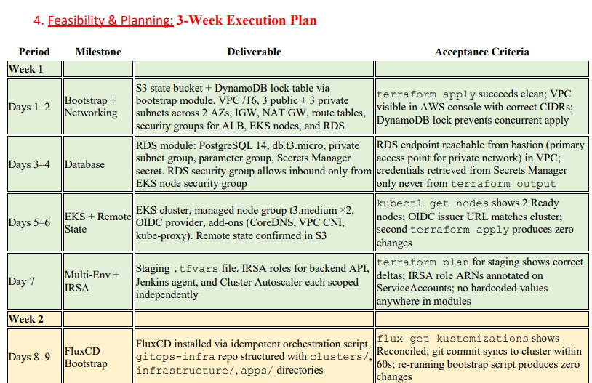
Replace this entire area with your architecture diagram or component layout.
Show the key components of your system, how they interact, and the data flow between them.
Use boxes, arrows, and labels. This is the most important visual in your presentation.
Tip: Draw it on paper first, then recreate it here. Keep it clean — 4–6 components max.
TOOLS & TECH CHOICES
EDGE CASES & ERROR HANDLING
[List key tools/libraries/models and WHY you chose them — not just names]
[How does your system handle failures, bad inputs, or unexpected scenarios?]
KOBIE LAUNCHPAD 2026
7 / 3
Notes:
SLIDE 2 — ARCHITECTURE & SOLUTION DESIGN (~2.5 minutes) Architecture diagram (main area): • This is the centrepiece. Show 4–6 clearly labelled components. • Draw arrows showing data flow between components. • Label what each component DOES, not just what it IS. • If your system has a 'brain' (orchestrator, pipeline manager), make it obvious. Tools & Tech Choices (bottom-left): • Don't just list names — justify choices. 'XGBoost for transition prediction because class imbalance handling and interpretable feature importances' > 'XGBoost'. • If using an LLM, specify which model and where in the pipeline. Edge Cases (bottom-right): • Show you've thought about what can go wrong. • Examples: missing data, API failures, ambiguous inputs, adversarial cases. EVALUATION CRITERIA THIS COVERS: → Proposed Approach & Solution Design (30 pts) → Creativity & Originality (partial — 20 pts)

Slide 12
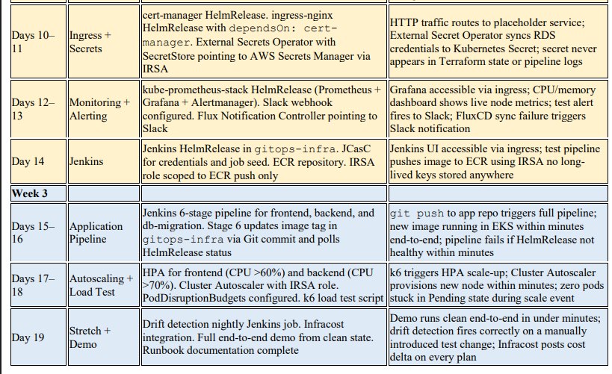
Replace this entire area with your architecture diagram or component layout.
Show the key components of your system, how they interact, and the data flow between them.
Use boxes, arrows, and labels. This is the most important visual in your presentation.
Tip: Draw it on paper first, then recreate it here. Keep it clean — 4–6 components max.
TOOLS & TECH CHOICES
EDGE CASES & ERROR HANDLING
[List key tools/libraries/models and WHY you chose them — not just names]
[How does your system handle failures, bad inputs, or unexpected scenarios?]
KOBIE LAUNCHPAD 2026
7 / 3
Notes:
SLIDE 2 — ARCHITECTURE & SOLUTION DESIGN (~2.5 minutes) Architecture diagram (main area): • This is the centrepiece. Show 4–6 clearly labelled components. • Draw arrows showing data flow between components. • Label what each component DOES, not just what it IS. • If your system has a 'brain' (orchestrator, pipeline manager), make it obvious. Tools & Tech Choices (bottom-left): • Don't just list names — justify choices. 'XGBoost for transition prediction because class imbalance handling and interpretable feature importances' > 'XGBoost'. • If using an LLM, specify which model and where in the pipeline. Edge Cases (bottom-right): • Show you've thought about what can go wrong. • Examples: missing data, API failures, ambiguous inputs, adversarial cases. EVALUATION CRITERIA THIS COVERS: → Proposed Approach & Solution Design (30 pts) → Creativity & Originality (partial — 20 pts)

Slide 13
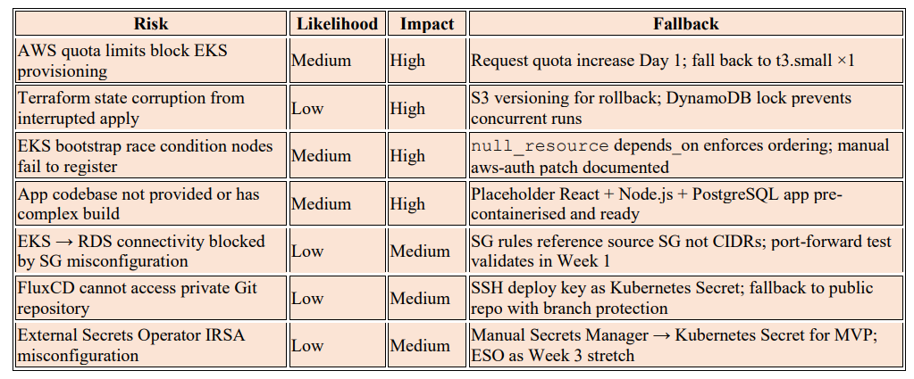

Feasibility, Timeline & Team
2-WEEK BUILD PLAN
TEAM & READINESS
Week 1
How is work divided across the team?
[Member 1] → [Component / responsibility]
[Member 2] → [Component / responsibility]
[Member 3] → [Component / responsibility]
[What will you build in Week 1? What's your MVP?]
Week 2
[What do you harden, test, and polish in Week 2?]
MVP vs. STRETCH GOALS
Key Risks
[What's your minimum viable submission vs. what you'll add if time permits?]
[Biggest risks and how you'll mitigate them]
Preliminary Work Done: [Any prototyping, EDA, or experiments you've already completed — shows readiness and initiative]
KOBIE LAUNCHPAD 2026
11/ 13
Notes:
SLIDE 3 — FEASIBILITY, TIMELINE & TEAM (~1.5 minutes) 2-Week Build Plan (left): • Week 1 should focus on the foundation / MVP — what must work. • Week 2 should focus on hardening, testing, edge cases, documentation. • Key Risks: show self-awareness. What could go wrong? What's your backup plan? Team & Readiness (right-top): • Show clear division of work. Each member owns a component. • Faculty want to see that all members contribute meaningfully. MVP vs. Stretch (right-bottom): • Define your minimum viable submission clearly. • Stretch goals show ambition but shouldn't make the core plan feel unrealistic. Preliminary Work (bottom bar): • Even small things count: 'explored the dataset', 'prototyped the constraint checker', 'tested 3 clustering algorithms on a subsample'. Shows initiative. EVALUATION CRITERIA THIS COVERS: → Feasibility & Planning (15 pts) → Team Composition & Readiness (10 pts) → Creativity & Originality (partial — 20 pts)

Slide 14
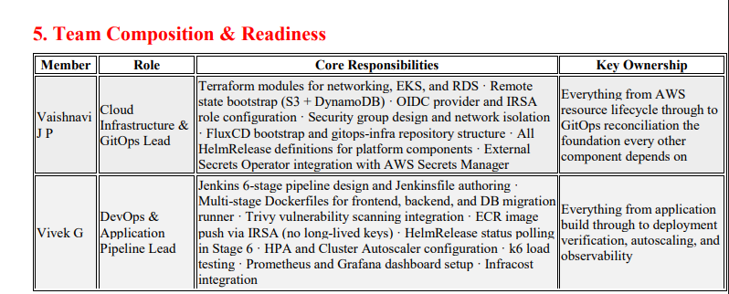
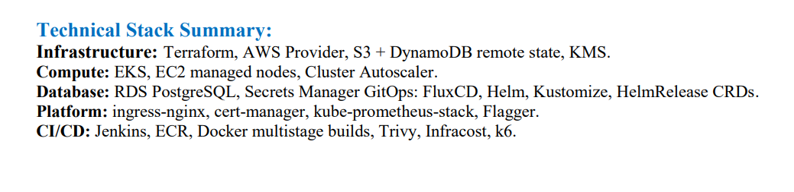
Feasibility, Timeline & Team
2-WEEK BUILD PLAN
TEAM & READINESS
Week 1
How is work divided across the team?
[Member 1] → [Component / responsibility]
[Member 2] → [Component / responsibility]
[Member 3] → [Component / responsibility]
[What will you build in Week 1? What's your MVP?]
Week 2
[What do you harden, test, and polish in Week 2?]
MVP vs. STRETCH GOALS
Key Risks
[What's your minimum viable submission vs. what you'll add if time permits?]
[Biggest risks and how you'll mitigate them]
Preliminary Work Done: [Any prototyping, EDA, or experiments you've already completed — shows readiness and initiative]
KOBIE LAUNCHPAD 2026
12/ 13
Notes:
SLIDE 3 — FEASIBILITY, TIMELINE & TEAM (~1.5 minutes) 2-Week Build Plan (left): • Week 1 should focus on the foundation / MVP — what must work. • Week 2 should focus on hardening, testing, edge cases, documentation. • Key Risks: show self-awareness. What could go wrong? What's your backup plan? Team & Readiness (right-top): • Show clear division of work. Each member owns a component. • Faculty want to see that all members contribute meaningfully. MVP vs. Stretch (right-bottom): • Define your minimum viable submission clearly. • Stretch goals show ambition but shouldn't make the core plan feel unrealistic. Preliminary Work (bottom bar): • Even small things count: 'explored the dataset', 'prototyped the constraint checker', 'tested 3 clustering algorithms on a subsample'. Shows initiative. EVALUATION CRITERIA THIS COVERS: → Feasibility & Planning (15 pts) → Team Composition & Readiness (10 pts) → Creativity & Originality (partial — 20 pts)

Slide 15
KOBIE LAUNCHPAD 2026
One-Click-Ops
THANK YOU !!!!
Notes:
TITLE SLIDE — ~30 seconds • Introduce your team name, members, and institution. • State which track you've chosen and why it excited your team. • Keep it brief — the substance is in the next 3 slides.

