Slide 1
KOBIE LAUNCHPAD AI HACKATHON
Solution Presentation
One-Click-Ops
Track: Cloud Engineering
Team Members:
Vaishnavi J P
Vivek G
PES University
Notes:
TITLE SLIDE — ~30 seconds • Introduce team name, track, and members with their roles. • Each member should state which component they owned. • Keep it crisp — the substance is in the next 6 slides. TIP: Don't read the slide. Introduce yourselves naturally.

Slide 2

Problem?
Innovation shouldn't wait for infrastructure. Yet every new cloud project begins with weeks of provisioning, configuring, integrating, and validating countless components before a single feature is delivered. The result is slower releases, inconsistent deployments, configuration drift, rising operational costs, and reduced engineering productivity.
What we solve?
One-Click-Ops changes that, one command provisions a complete, production - grade AWS
environment with security, cost governance, Infra drift detection and AI diagnostics built in.
Reproducible every time. Zero manual steps
KOBIE LAUNCHPAD 2026
Notes:
SLIDE 1 — PROBLEM UNDERSTANDING & APPROACH (~2 minutes) Left column — Problem Understanding: • Demonstrate you've identified the CORE challenge, not just restated the brief. • Show awareness of what makes this hard (anti-patterns, failure modes). • Mention key constraints: data scale, latency, accuracy vs. coverage, etc. Right column — Your Approach: • Describe your high-level strategy. Don't just list tools — explain your THINKING. • Briefly mention alternatives you considered and why you chose this path. • This should feel like a conversation about problem-solving, not a feature list. Bottom bar — Key Insight: • One sentence. What is the single idea that makes your approach compelling? EVALUATION CRITERIA THIS COVERS: → Problem Understanding (25 pts) → Proposed Approach & Solution Design (partial — 30 pts) → Creativity & Originality (partial — 20 pts)

Slide 3
THE CORE CHALLENGE : Make it idempotent, declarative, and Git Ops-native, one trigger
must yield the same correct environment every time.
1) Bootstrap ordering 4) State & drift
2) FluxCD reconciles cluster 5) Jenkins Health Check
3) Least-privilege secrets 6) Auto-scaling at two layers
KEY INSIGHT: One command, one source of truth that is Git.
Every layer of infrastructure, platform, and application is declarative and self-reconciling, so the environment converges to the same correct state no matter where it started.
KOBIE LAUNCHPAD AI HACKATHON
Notes:
SLIDE 1 — PROBLEM & APPROACH (~2 minutes) What to cover: • Lead with your understanding of the CORE challenge, not a restatement of the brief. • Your key insight — the one idea that makes your approach compelling. • Briefly: alternatives you considered and why you rejected them. • Data quality: what you found, how it shaped your pipeline. This proves you did EDA. What NOT to do: • Don't re-read the problem statement back to the judges. • Don't list tools. Explain your THINKING. EVALUATION CRITERIA: → Business Value & Domain Understanding (20 pts) → Technical Depth & Correctness (partial — 20 pts)

Slide 4



Results & Key Outputs
WHAT WE SHIPPED
AUTOMATION HIGHLIGHTS
Every layer is automated end to end:
• Single Terraform Apply command (along with S3 state + DynamoDB locking)
• FluxCD reconciles platform + app from Git (matches the cluster every 60 seconds without manual command)
• Jenkins: build → Trivy scan → Infracost gate → push
• Daily drift detection + K8sGPT auto-diagnosis
A complete environment, provisioned and running on AWS:
• EKS cluster (oneclick-cluster, ap-south-1) + RDS PostgreSQL
• Alert Portal: React/Vite, Node/Express, Postgres
• Monitoring stack: Prometheus, Grafana, Alertmanager.
WHAT IT ENABLES
WHY IT MATTERS
One command turns an empty AWS account into a running, observable platform.
• Repeatable environments for every demo.
• No drift, Git is the source of truth, every change is auditable. Continuous flux reconciliation.
• Cost + security gates run before anything is provisioned + autoscaling of nodes and pods during traffic.
It removes the slow, error-prone manual setup that blocks teams.
• Faster onboarding, infra in minutes, not days
• Safer by default: least-privilege IRSA, scanned images + autoscaling of pods and nodes.
• Self-healing + AI triage lower mean-time-to-resolution. Faster troubleshooting.
KOBIE LAUNCHPAD AI HACKATHON
Notes:
SLIDE 3 — RESULTS & KEY OUTPUTS (~2 minutes) What to cover: • Your segments: names, sizes, what makes each distinct. • Why you chose this number — show your elbow plot / silhouette analysis. • Model performance: cluster metrics + transition prediction accuracy. • ONE strong visualization that tells the story. What NOT to do: • Don't just show metric tables. Interpret them — what do they mean? • Don't show every visualization you made. Pick the ONE best one. EVALUATION CRITERIA: → Working Demo & Functional Completeness (20 pts) → Technical Depth & Correctness (20 pts)

Slide 5


Learnings, Limitations & Next Steps
WHAT WE LEARNED
HONEST LIMITATIONS
• Terraform and various cloud AWS Services.
• GitOps reconciliation makes the stack self-healing, not just deployed
• K8sgpt AI powered Kubernetes trouble shooting
Infracost Budget maintenance.
• Trivy scanning for vulnerabilities, Infracost budget gate.
• Multi availability zone and Nat-Gateway set to false due to heavy cost.
• Infracost at pod level implementation, Infracost not calculated before Infra created because it is within Jenkins pipeline and Jenkins is inside EKS, creating chicken and egg problem
IF WE HAD MORE TIME…
Refactor Terraform into reusable modules (VPC, EKS, RDS), Implement Infracost at Pod level to get the exact cost while scaled up or down, K8sgpt for application and observability logs.
INDIVIDUAL CONTRIBUTIONS:
• Vaishnavi J P → Terraform infra + Bootstrap Bridge, Jenkins CI/CD, Infracost + K8sgpt + Drift Detection,Trivy Gating , Prometheus, Grafana.
• Vivek G → AlertPortal app, FluxCD GitOps, Alert manager, Autoscaling.
KOBIE LAUNCHPAD AI HACKATHON
Notes:
SLIDE 6 — LEARNINGS, LIMITATIONS & NEXT STEPS (~1.5 minutes) This is your chance to show intellectual honesty and self-awareness. What to cover: • Surprises: something the data or problem taught you. • Honest limitations: judges already know where your model is weak. Naming it yourself shows maturity. Hiding it looks naive. • Concrete next steps: not 'more data' — specific improvements you'd make. • Individual contributions: each member names their component. TIP: 'A well-documented pipeline with honest limitations scores higher than a complex model with no explanation.' EVALUATION CRITERIA: → Presentation & Communication (15 pts) → Technical Depth & Correctness (20 pts)

Slide 6
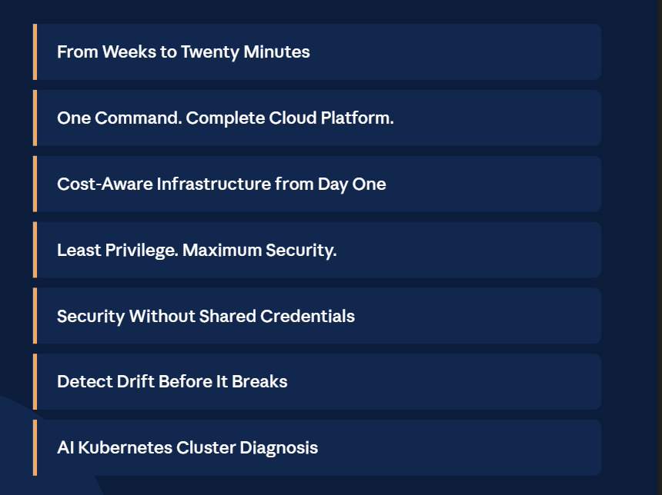
IMPACT AND VALUE
KOBIE LAUNCHPAD AI HACKATHON
Notes:
SLIDE 4 — BUSINESS IMPACT & ACTIVATION (~1.5 minutes) This is where you prove you understand WHY segmentation matters, not just HOW to do it. What to cover: • Concrete activation examples: segment × state → specific marketing action. • Business value: what does this enable that static RFM can't? • PLCC insight: did cardholders cluster differently? How would you treat them? TIP: Judges are loyalty domain experts. Speak their language — campaigns, journeys, treatments, retention, reactivation. Not just ML jargon. EVALUATION CRITERIA: → Business Value & Domain Understanding (20 pts) → Presentation & Communication (15 pts)

