Slide 1
15-464: Mini-Project 1
Alice Lai, Vaishnavi Mantha

Slide 2
Goals
Our objective was to create expressive animation via two methods: key frame animation and mocap animation. Our secondary objective was to then compare the techniques and results of the two.

Slide 3
Keyframe Animation

Slide 4
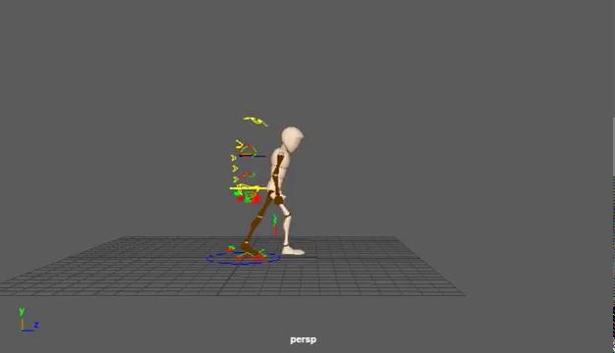
Angry Walk
Key Ideas:
Fists are clenched to signal tension
The legs have a “stompy” motion, accentuating the contact with the ground and downward motion to convey aggression
Movements are fast
Torso leaning forward
Foot is flexed to brace for impact

Slide 5
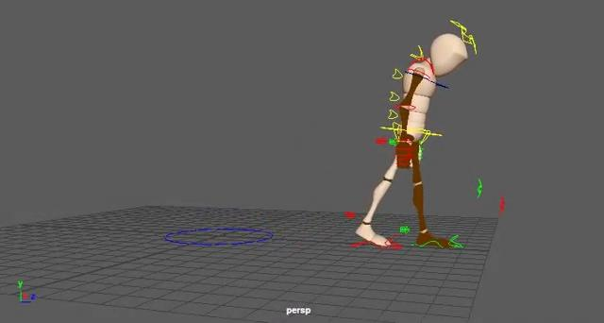
Sad Walk
Key Ideas:
Hands are relaxed and closer to the sides
The legs are raised much lower to convey low energy
Movements are slow
Torso hunched over
Foot is floppy

Slide 6
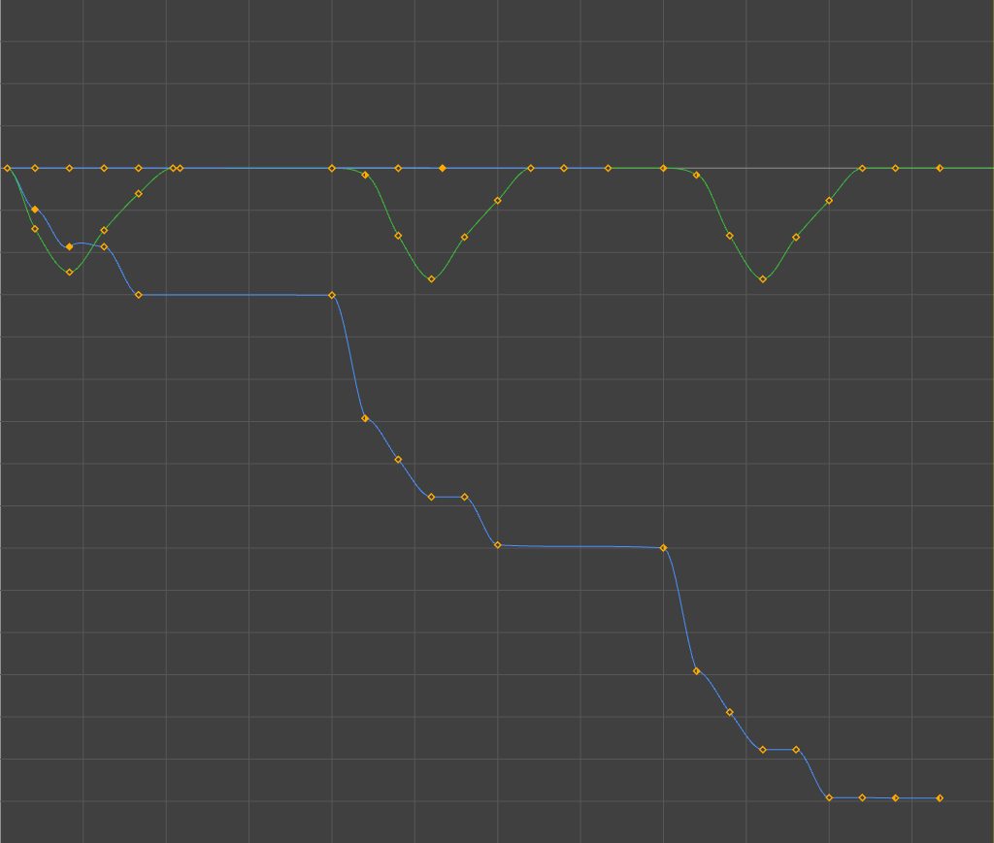
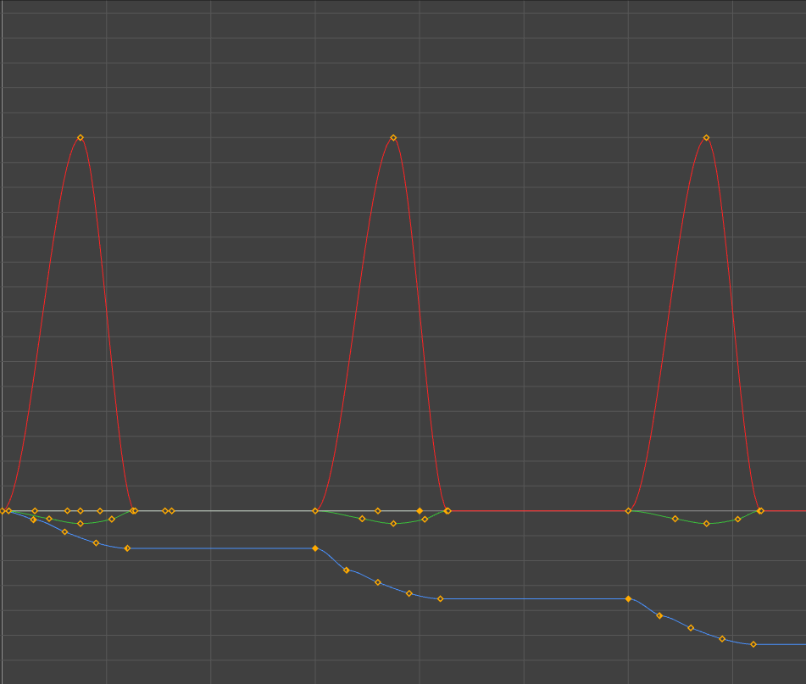
Motion Graphs
Angry Walk
Sad Walk
Foot Dragging
Large Leg Raise
Small Leg Raise
Fast Forward Motion
Slow Forward Motion

Slide 7
Mocap Animation

Slide 8
Sad Walk
Key Ideas
Position-based modifications
Head and neck tilted down
Spine and hips hunched forward
Arms “drooping” and reduced arm swing

Slide 9
Waving Goodbye
Key Ideas
Rotation-based modifications
Raise left arm for waving position
Rotate wrist and forearm to proper orientation
Tilt body back to face the friend

Slide 10
Observations: Mocap
Motion editing without animation software
Rotations (via quaternions), Translation
Easier to add new motion
Difficulty changing timing and offset
Harder to convey emotion
Ex: Dragging feet requires increased time on contact pose and down pose

Slide 11
Results
The Keyframe-based animation produced better-looking results, though it took significantly more time due to difficulties of using Maya for an amateur artist.
Next steps would be to look at creating animation with more action in Maya and figuring out alternatives to pose timing and offsetting with Mocap data. This would help confirm the ideal technique for certain animation goals.

