Slide 1
Mini Project 2: Cloth Simulation
Vaishnavi Mantha

Slide 2
Goals
Use a mass-spring system and simulate realistic-looking cloth
Try out a few different integrators

Slide 3
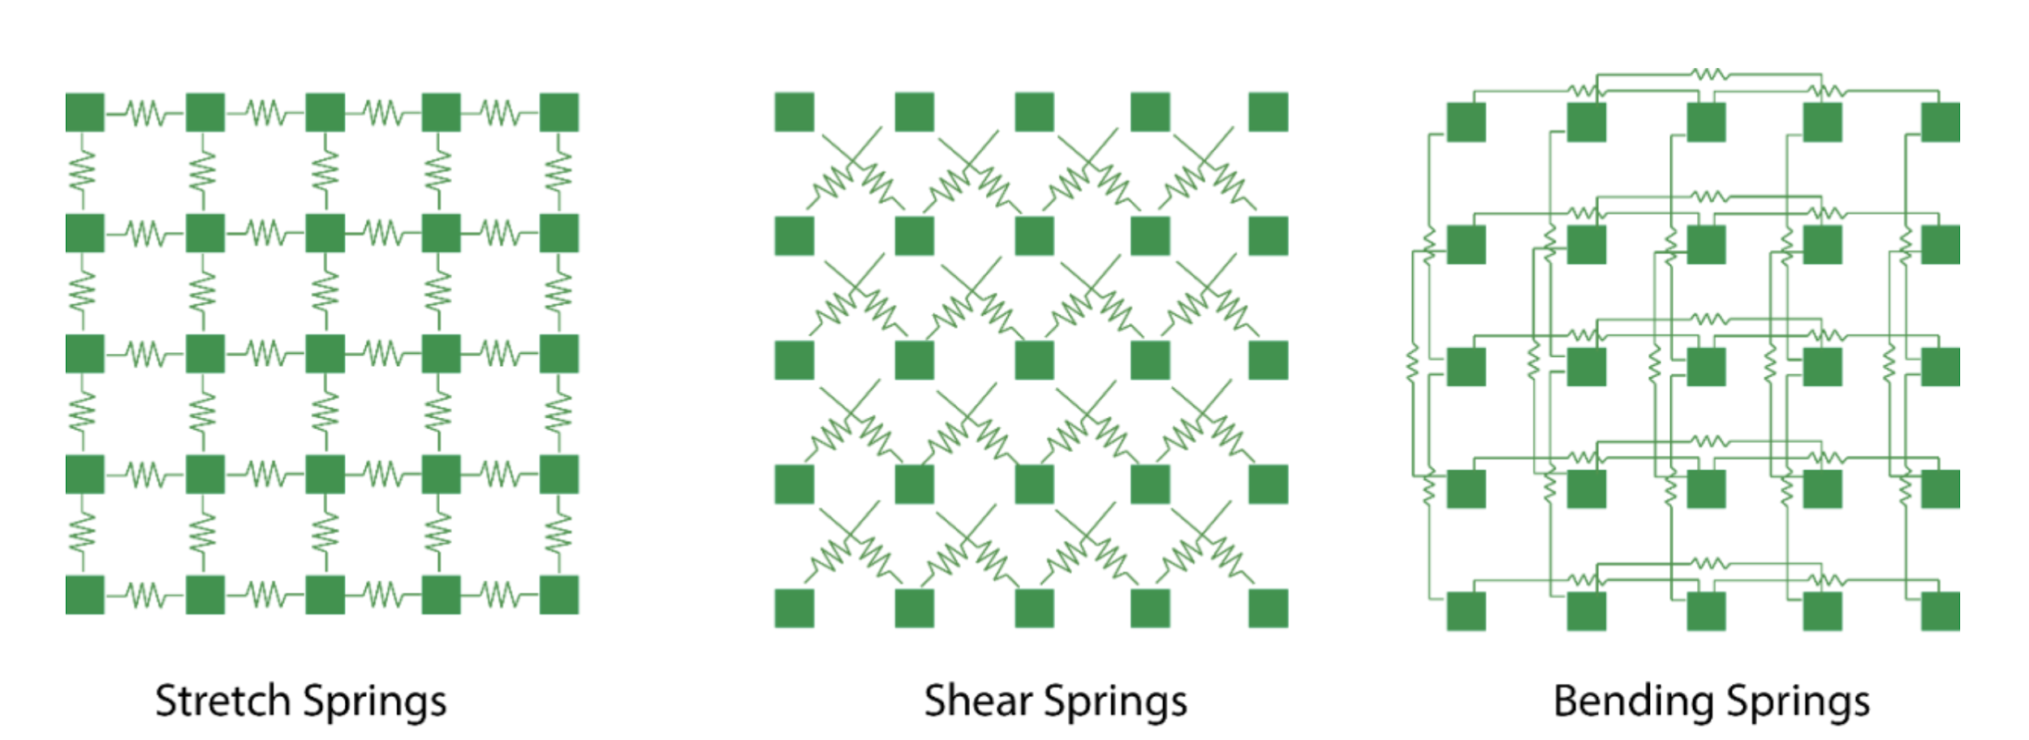
Techniques
Spring forces:
Stretch
Shear
Bending
Gravity
Spring-dampers
Wind force

Slide 4
Techniques
Integrators:
Euler
Semi-implicit Euler
Verlet

Slide 5
Demo
Particle mass
Wind force
Spring force
Integrator
Timestep
[proj3.html]

Slide 6

Stiffness
Speed
Faster movement
Explodes at smaller timestep for increased structural stiffness
T = 0.005, 0.004, 0.003
Stability
Jittering effects
Explodes at high timestep

Slide 7
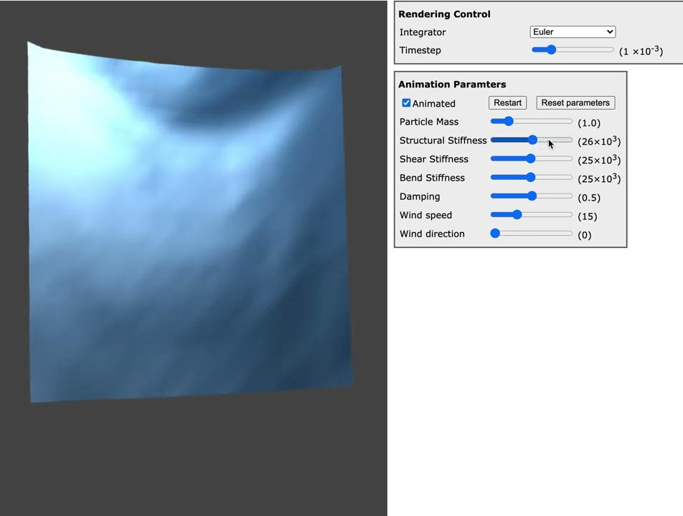
Stiffness
Appearance

Slide 8
Damping
Speed
Faster movement
Explodes around T = 0.004 for all damping levels
Stability
Jittering effects
Explodes at high timestep
Appearance
Higher damping reduces jittering

Slide 9
Wind Force

Slide 10
Euler Integration
Speed: Increased with timestep
Stability: Jittering effects and explodes at T = 0.005

Slide 11
Semi-implicit Euler Integration
Speed: Increased with timestep
Stability: Jittering effects and explodes at T = 0.004
Appearance: Does better with curling edges of cloth

Slide 12
Verlet Integration
Speed: Extremely slow?
Stability: Not stable at all explodes at increased timestep (T > 0.003)
Appearance: Hard to assess, not much simulated movement

Slide 13
Collisions NOT handled

Slide 14
Observations
Successfully simulated cloth!
Hard to find good range of values for proper simulation
Euler and semi-implicit euler very similar
More work: reduce jittering, try more integrators (investigate Verlet), collisions (objects and self)

Slide 15
References
Code base for JavaScript WebGL setup used from https://www.ics.uci.edu/~shz/courses/cs114/docs/proj3/index.html

