Slide 1


Wellness and Habit Tracker
FastAPI + MongoDB based Wellness and Habit Tracker system

Slide 2
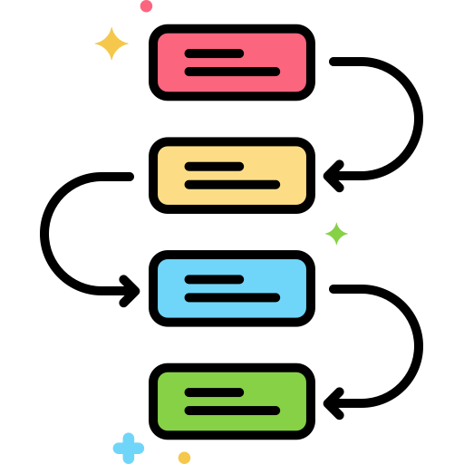

Project Overview
Many individuals struggle with consistency in maintaining healthy habits and monitoring wellness. There is a need for a system to help track, remind, and analyze daily habits and wellness metrics.
Wellness and Habit Tracker

Slide 3


Objectives
- Help users build and track healthy habits
- Log wellness metrics (sleep, water intake, steps, mood)
- Provide reminders and motivational nudges
- Offer insights and analytics for self-improvement
Wellness and Habit Tracker

Slide 4
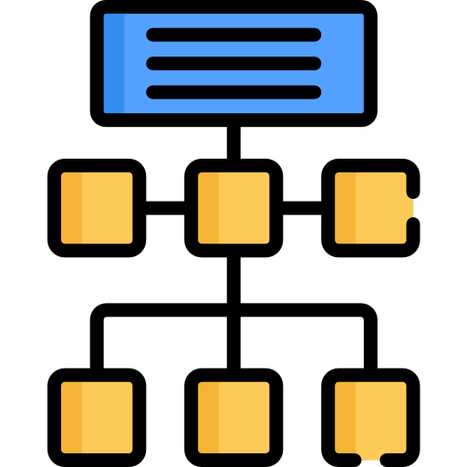
Architecture
wellness_habit_tracker/
│── app/
│ │── main.py # FastAPI entry point
│ │── database.py # MongoDB connection (Motor client)
│ │
│ |── models/ # Pydantic models (schemas)
│ │ │── user.py # User schemas
│ │ │── habit.py # Habit schemas
│ │ │── wellness.py # Wellness log schemas
│ │ │── reminder.py # Reminder schemas
│ │
│ |── routes/ # API endpoints
│ │ │── auth.py # Register, login, logout
│ │ │── users.py # User profile, update profile, change password
│ │ │── habits.py # Habit CRUD + logging
│ │ │── wellness.py # Wellness logging CRUD
│ │ │── reminders.py # Reminder CRUD
│ │ │── analytics.py # Analytics/insights endpoints
│ │
│ |── utils/ # Helper utilities
│ │ │── security.py # JWT utils, password hashing utils
│ │ │── mongo_helper.py # Logging config
│ │
│── requirements.txt # All dependencies
│── .env # Environment variables (DB URI, JWT secret, etc.)
│── README.md # Project documentation
Wellness and Habit Tracker

Slide 5

Technology Stack
Backend: Python (FastAPI)
Database: MongoDB
Authentication: JWT
Scheduling: Used(BackgroundTask)/Future Scope (Celery + Redis)
Wellness and Habit Tracker

Slide 6

Core Features
- User & Role Management
- Habit Tracking Module
- Wellness Tracking Module
- Reminders & Notifications
- Analytics & Insights
Wellness and Habit Tracker

Slide 7
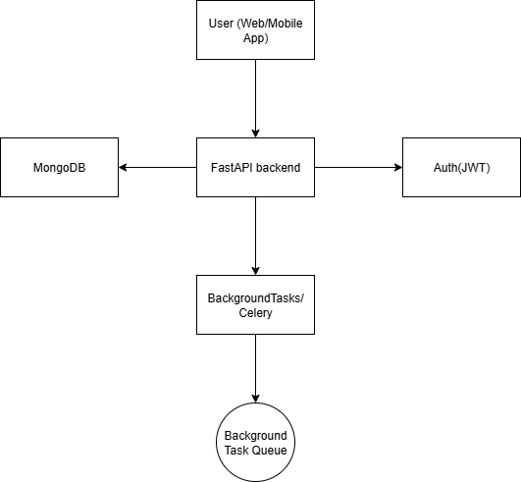
System Architecture
Wellness and Habit Tracker

Slide 8
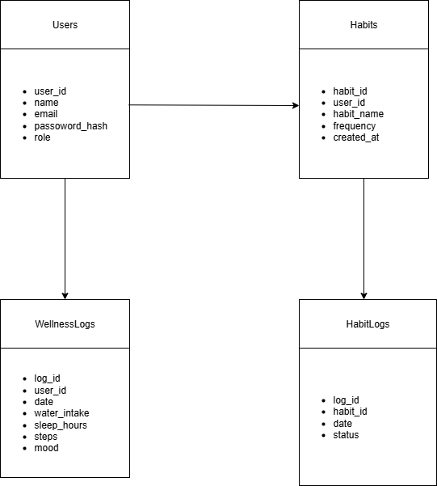
Database Design
Wellness and Habit Tracker

Slide 9
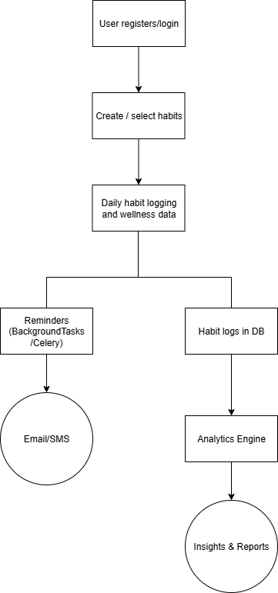
Workflow
Wellness and Habit Tracker

Slide 10
API Modules
Module | Key Endpoints | Purpose
Auth | Register, Login, Logout | User Authentication
Users | Profile, Update, Change password | Manage User Info
Habits | CRUD + Logging | Track Habits
Wellness | CRUD | Log Wellness Metrics
Reminders | CRUD | Schedule Reminders
Analytics | Insights/ Report | Show Progress and Trends

Slide 11
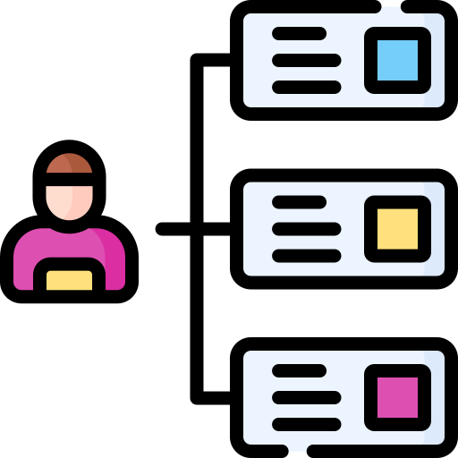
Example Use Case
User sets habits: Drink 2L water, Walk 5,000 steps, Read 20 minutes.
- Logs completion daily
- Receives reminders if missed
- Analytics shows 85% walking consistency, 70% reading consistency, and correlation between exercise and sleep quality.
Wellness and Habit Tracker

Slide 12

Future Scope
Integration with fitness APIs (Fitbit, Google Fit)
AI-powered personalized insights
Advanced gamification (leaderboards, group challenges)
Wellness and Habit Tracker

Slide 13

Conclusion
Developed a FastAPI + MongoDB Wellness and Habit Tracker
Helps users build healthy habits, log wellness metrics and stay consistent
Provides reminders, analytics and personalized insights for self-improvement
Ensures scalability and flexibility with containerized development (Docker + Cloud)
Sets Foundation for future enhancements-> AI-powered recommendations, fitness API integration and gamification

Slide 14
Thank You

