Slide 1
Module - 1
Business Functions and Business Processes

Slide 2
Objectives
After completing this chapter, you will be able to:
Name the main functional areas of operation used in business
Differentiate between a business process and a business function
Identify the kinds of data each main functional area produces
Identify the kinds of data each main functional area needs
Define integrated information systems, and explain why they are essential in today’s globally competitive business environment

Slide 3
Introduction
Enterprise Resource Planning (ERP) programs: Core software used by companies to coordinate information in every area of business
  Help manage companywide business processes
  Use common database and shared management reporting tools
Business process: Collection of activities that takes some input and creates an output that is of value to the customer

Slide 4
Functional Areas and Business Processes
To understand ERP, you must understand how a business works
  Functional areas of operation
  Business processes

Slide 5
Functional Areas of Operation
Marketing and Sales (M/S)
Supply Chain Management (SCM)
Accounting and Finance (A/F)
Human Resources (HR)
Business functions: Activities specific to a functional area of operation

Slide 6
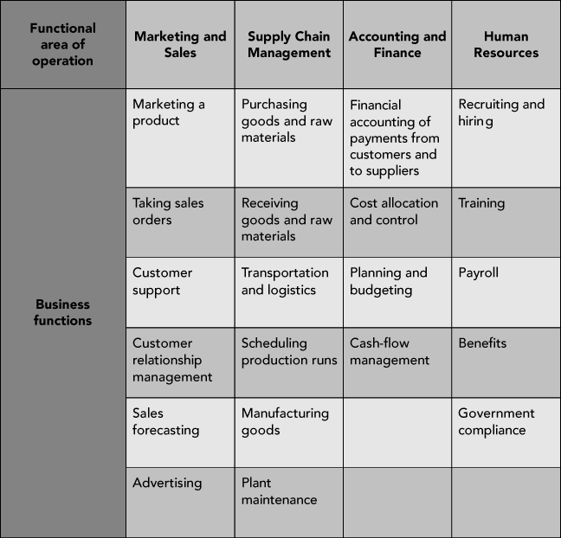
Functional Areas of Operation (cont’d.)
Figure 1-1 Examples of functional areas of operation and their business functions

Slide 7
Functional Areas of Operation (cont’d.)
Functional areas are interdependent
  Each requires data from the others
Better integration of functional areas leads to improvements in communication, workflow, and success of company
Information system (IS): Computers, people, procedures, and software that store, organize, and deliver information

Slide 8
Business Processes
Collection of activities that takes one or more kinds of input and creates an output that is of value to customer
  Customer can be traditional external customer or internal customer
Thinking in terms of business processes helps managers to look at their organization from the customer’s perspective

Slide 9
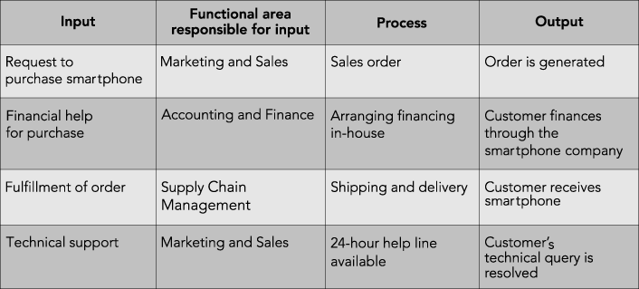
Business Processes (cont’d.)
Figure 1-2 Sample business processes related to the sale of a personal smartphone

Slide 10
Business Processes (cont’d.)
Businesses must always consider customer’s viewpoint in any transaction
Successful customer interaction
  Customer (either internal or external) is not required to interact with each business function involved in the process
Successful business managers view business operations from the perspective of a satisfied customer

Slide 11
Business Processes (cont’d.)
Sharing data effectively and efficiently between and within functional areas leads to more efficient business processes
Integrated information systems: Systems in which functional areas share data

Slide 12
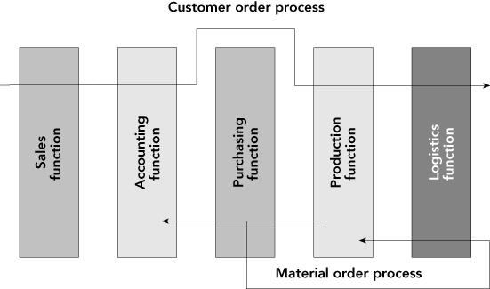
Business Processes (cont’d.)
Figure 1-3 A process view of business

Slide 13
Business Processes (cont’d.)
Businesses take inputs (resources) and transform these inputs into goods and services for customers
  Inputs: Material, people, equipment
Managing inputs and business processes effectively requires accurate and up-to-date information

Slide 14
Functional Areas and Business Processes of a Very Small Business
Example: A fictitious coffee shop
  Examine business processes of the coffee shop
  See why coordination of functional areas helps achieve efficient and effective business processes
  Look at how integration of the information system improves the business

Slide 15
Marketing and Sales
Functions of Marketing and Sales
  Developing products
  Determining pricing
  Promoting products to customers
  Taking customers’ orders
  Helping create a sales forecast

Slide 16
Marketing and Sales (cont’d.)
Marketing and Sales tasks for the coffee shop
  Formal recordkeeping not required
  Need to keep track of customers
  Product development can be done informally
  Good repeat customers allowed to charge purchases—up to a point
    Records must show how much each customer owes and his or her available credit

Slide 17
Supply Chain Management
Functions within Supply Chain Management
  Making the coffee (manufacturing/production)
  Buying raw materials (purchasing)
Production planning requires sales forecasts from M/S functional area
  Sales forecasts: Analyses that attempt to predict the future sales of a product

Slide 18
Supply Chain Management (cont’d.)
Production plans used to develop requirements for raw materials and packaging
  Raw materials: Bottled spring water, fresh lemons, artificial sweetener, raw sugar
  Packaging: Cups, straws, napkins
SCM and M/S must choose a recipe for each coffee product sold

Slide 19
Accounting and Finance
Functions within Accounting and Finance
  Recording raw data about transactions (including sales), raw material purchases, payroll, and receipt of cash from customers
Raw data: Numbers collected from sales, manufacturing and other operations, without any manipulation, calculation, or arrangement for presentation

Slide 20
Accounting and Finance (cont’d.)
Data from Accounting and Finance used by Marketing and Sales and Supply Chain Management
  Sales records are important component of sales forecast
  Sales forecast is used in making staffing decisions and in production planning
  Records from accounts receivable used to monitor the overall credit-granting policy of the coffee shop

Slide 21
Human Resources
Functions of Human Resources
  Recruit, train, evaluate, and compensate employees
HR uses sales forecasts developed by the individual departments to plan personnel needs
Systems integrated using ERP software provide the data sharing necessary between functional areas

Slide 22
Functional Area Information Systems
Potential inputs and outputs for each functional area described next
Note the kinds of data needed by each area and how people use the data
Information systems maintain relationships between all functional areas and processes

Slide 23
Marketing and Sales
Needs information from all other functional areas
Customers communicate orders to M/S in person or by telephone, e-mail, fax, the Web, etc.
M/S has a role in determining product prices
  Pricing might be determined based on a product’s unit cost, plus some percentage markup
  Requires information from Accounting and Finance, and Supply Chain Management data

Slide 24
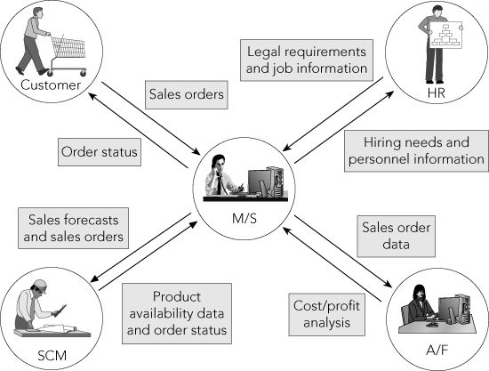
Marketing and Sales (cont’d.)
Figure 1-4 The Marketing and Sales functional area exchanges data with customers and with the Human Resources, Accounting and Finance, and Supply Chain Management functional areas

Slide 25
Marketing and Sales (cont’d.)
M/S needs to interact with Human Resources to exchange information on hiring needs, legal requirements, etc.
Inputs for M/S
  Customer data
  Order data
  Sales trend data
  Per-unit cost
  Company travel expense policy

Slide 26
Marketing and Sales (cont’d.)
Outputs for M/S
  Sales strategies
  Product pricing
  Employment needs

Slide 27
Supply Chain Management
Needs information from various functional areas
Production plans based on information about product sales (actual and projected) that comes from Marketing and Sales
With accurate data about required production levels:
  Raw material and packaging can be ordered as needed
  Inventory levels can be kept low, saving money

Slide 28
Supply Chain Management (cont’d.)
Supply Chain Management data and records can:
  Provide data needed by Accounting and Finance to determine how much of each resource was used
  Support the M/S function by providing information about what has been produced and shipped
Supply Chain Management interacts in some ways with Human Resources

Slide 29
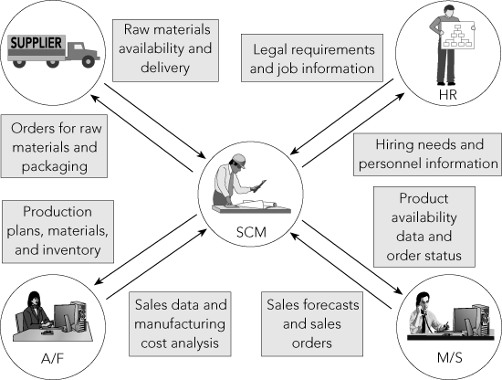
Supply Chain Management (cont’d.)
Figure 1-5 The Supply Chain Management functional area exchanges data with suppliers and with the Human Resources, Marketing and Sales, and Accounting and Finance functional areas

Slide 30
Supply Chain Management (cont’d.)
Inputs for SCM
  Product sales data
  Production plans
  Inventory levels
  Layoff and recall company policy

Slide 31
Supply Chain Management (cont’d.)
Outputs for SCM
  Raw material orders
  Packaging orders
  Resource expenditure data
  Production and inventory reports
  Hiring information

Slide 32
Accounting and Finance
Needs information from all other functional areas
A/F personnel:
  Record company’s transactions in the books of account
  Record accounts payable when raw materials are purchased and cash outflows when they pay for materials
  Summarize transaction data to prepare reports about company’s financial position and profitability

Slide 33
Accounting and Finance (cont’d.)
People in other functional areas provide data to A/F
  M/S provides sales data
  SCM provides production and inventory data
  HR provides payroll and benefit expense data
M/S personnel require data from A/F to evaluate customer credit

Slide 34
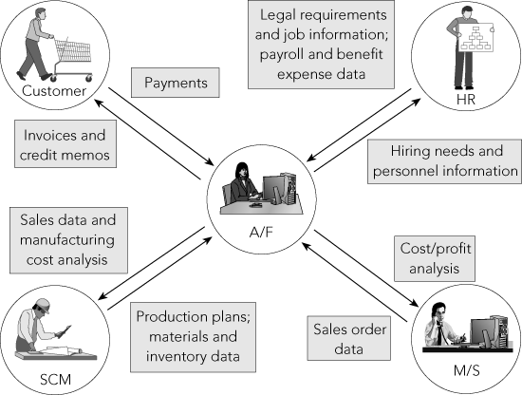
Accounting and Finance (cont’d.)
Figure 1-6 The Accounting and Finance functional area exchanges data with customers and with the Human Resources, Marketing and Sales, and Supply Chain Management functional areas

Slide 35
Accounting and Finance (cont’d.)
Inputs for A/F
  Payments from customers
  Accounts receivable data
  Accounts payable data
  Sales data
  Production and inventory data
  Payroll and expense data

Slide 36
Accounting and Finance (cont’d.)
Outputs for A/F
  Payments to suppliers
  Financial reports
  Customer credit data

Slide 37
Human Resources
HR needs information from the other departments
Tasks related to employee hiring, benefits, training, and government compliance are all responsibilities of HR
HR needs accurate forecasts of personnel needs from all functional units
HR needs to know what skills are needed to perform a particular job and how much the company can afford to pay employees

Slide 38
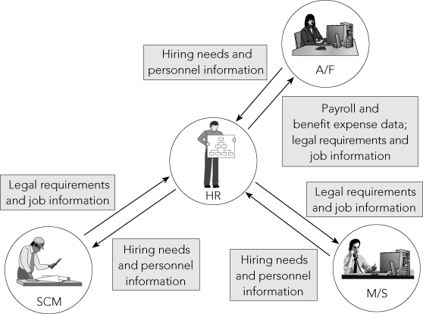
Human Resources (cont’d.)
Figure 1-7 The Human Resources functional area exchanges data with the Accounting and Finance, Marketing and Sales, and Supply Chain Management functional areas

Slide 39
Human Resources (cont’d.)
Observing governmental regulations in recruiting, training, compensating, promoting, and terminating employees
Inputs for HR
  Personnel forecasts
  Skills data

Slide 40
Human Resources (cont’d.)
Outputs for HR
  Regulation compliance
  Employee training and certification
  Skills database
  Employee evaluation and compensation

Slide 41
Human Resources (cont’d.)
Significant amount of data is maintained by and shared among the functional areas
Timeliness and accuracy of these data critical to each area’s success and to company’s ability to make a profit and generate future growth
ERP software allows all functional areas to share a common database
  Allows accurate, real-time information to be available

Slide 42
Summary
Basic functional areas: Marketing and Sales, Supply Chain Management, Accounting and Finance, and Human Resources
Marketing and Sales: Sets product prices, promotes products through advertising and marketing, takes customer orders, supports customers, and creates sales forecasts
Supply Chain Management: Develops production plans, orders raw materials from suppliers, receives raw material, manufactures products, maintains facilities, and ships products to customers

Slide 43
Summary (cont’d.)
Accounting and Finance: Financial accounting to provide summaries of operational data in managerial reports, controlling accounts, planning and budgeting, and cash-flow management
Human Resources: Recruits, hires, trains, and compensates employees, ensures compliance with government regulations, and oversees the evaluation of employees
Information systems capture, process, and store data to provide information needed for decision making

Slide 44
Summary (cont’d.)
Employees working in one functional area need data from employees in other functional areas
  Functional area information systems should be integrated, so shared data are accurate and timely
Managers think in terms of business processes that integrate the functional areas
  Need to share information between functions and functional areas
  ERP software provides this capability by means of a single common database

