Slide 1
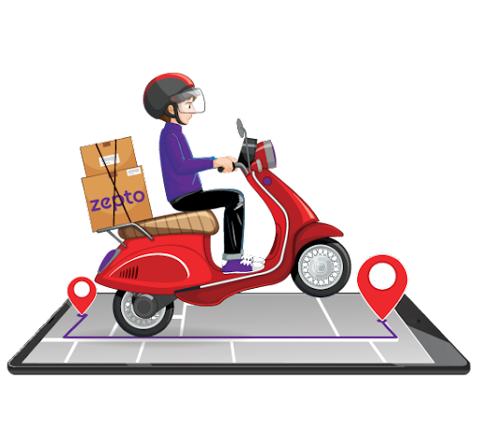
FMCG Analytics
Group No: 1
Date – 08/03/2025

Slide 2

Team Member
Ruchika Landge
Vaishnavi Ambre
Veena Dhilip
Harshvardhan Mishra
Mishal Ashraf
Mentors :
Abirami R
Mahendra Singh

Slide 3
Project overview
Objective:
To understand, evaluate, and provide actionable insights on sales data, trends, and growth opportunities in the FMCG sector.
Scope :
The Project involves Data collection,analysis,reporting for various sales Metrics
Methodology :
Data Collection : Gather data from sales reports, store records, and POS systems.
Analysis : Use statistical tools and software to analyze the data and identify trends, growth patterns, and areas needing improvement.
Reporting : Create detailed reports and dashboards to visualize the sales data and make informed decisions.

Slide 4
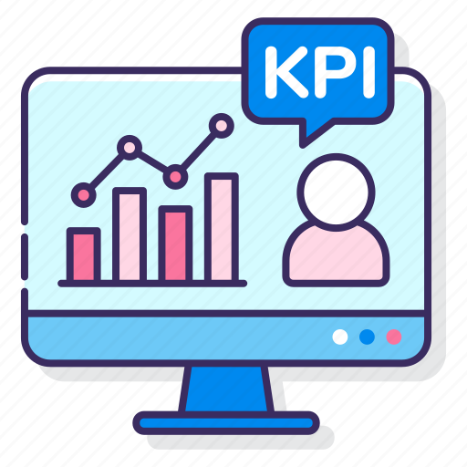
Kpis :
Total Sale
Store Wise Sales
Sales Growth
Daily Sales Trend
Brand Wise Sales
AM Wise Sales
Sales vs Budget
Sales Comparison
Product Wise Sales
Sales by Store Category
Sales by Meal Type

Slide 5
Key Insights & Analysis
Total Sales: Reflects overall revenue performance. A decline may indicate operational inefficiencies, low demand, or market competition.
2. Store Wise Sales: Identifies high- and low-performing store locations.
3. Sales Growth: Measures business expansion or contraction. A declining growth rate suggests the need for new strategies.
4. Daily Sales Trend : Shows fluctuations in sales, peak hours, and seasonal trends.
5. Brand Wise Sales: Evaluates brand popularity and customer preferences.
6. AM Wise Sales: Measures sales contributions of individual account managers.
7. Sales vs Budget: Compares actual sales to budgeted projections, identifying performance gaps.
8. Model Wise Sales: Identifies best-selling and underperforming product models.
9. Sales Comparison: Provides a comparative view of sales across different periods, regions, and product categories.
10. Product Wise Sales: Highlights top and low-selling products.
11. Sales by Store Category: Analyzes sales across store types (e.g., flagship, franchise, online).
12. Sales by Meal Type: Identifies meal preferences (e.g., breakfast, lunch, dinner) and peak demand times.

Slide 6
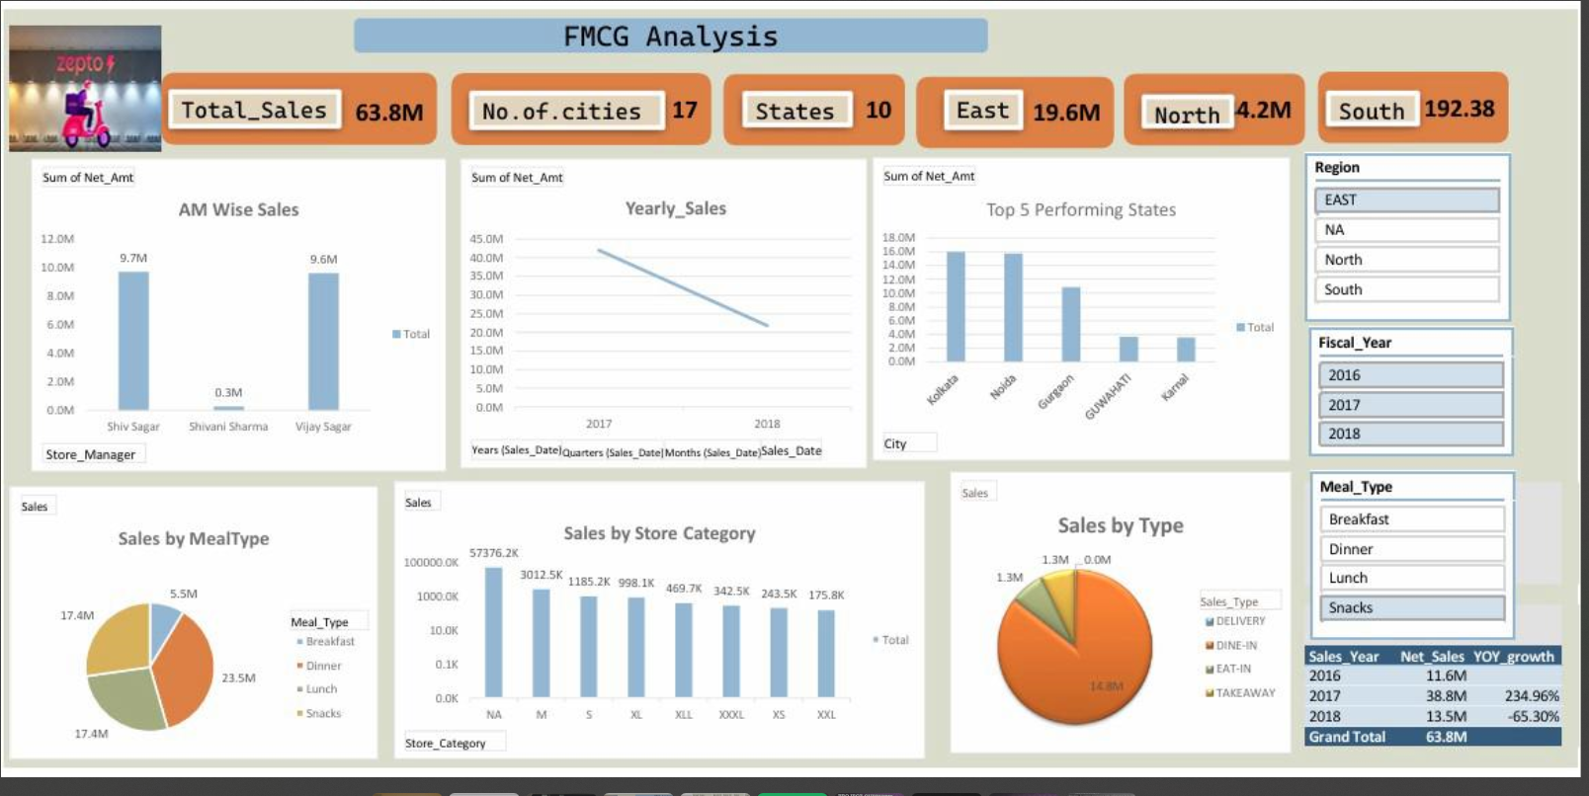
Excel Dashboard

Slide 7
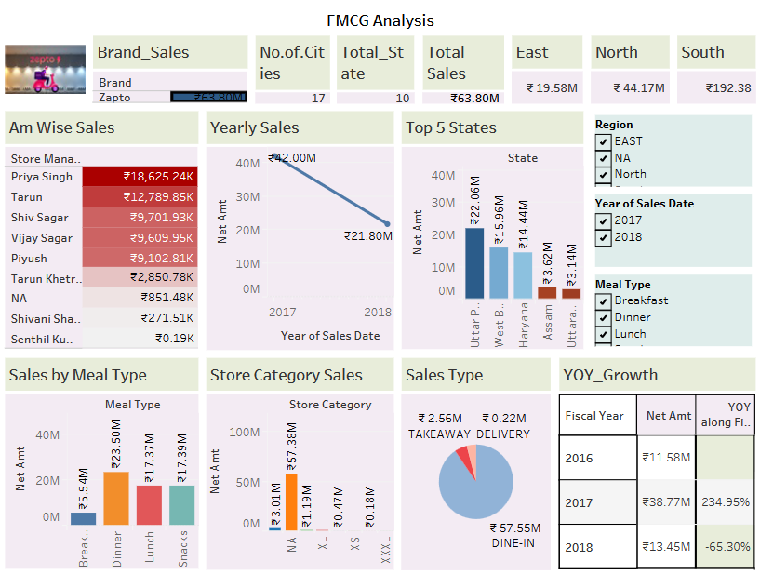
Tableau Dashboard

Slide 8
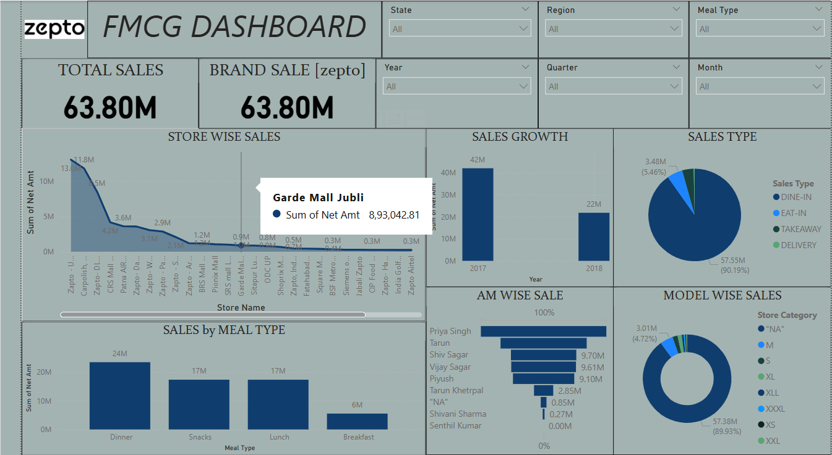
PowerBI Dashboard

Slide 9
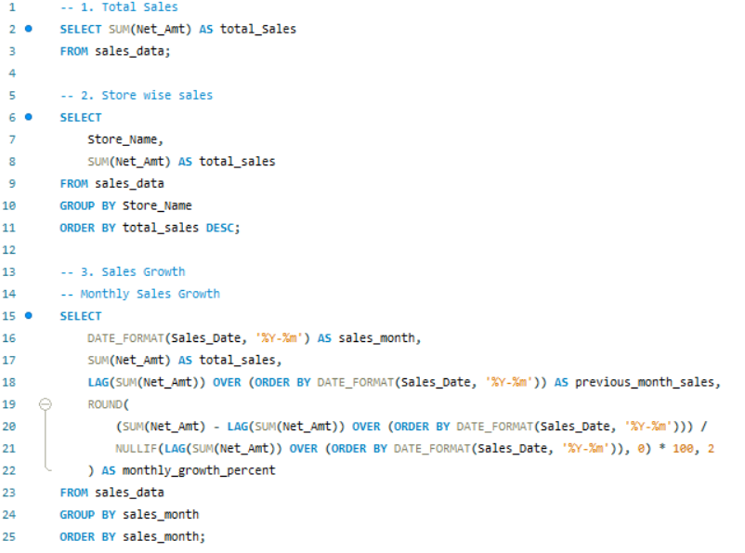
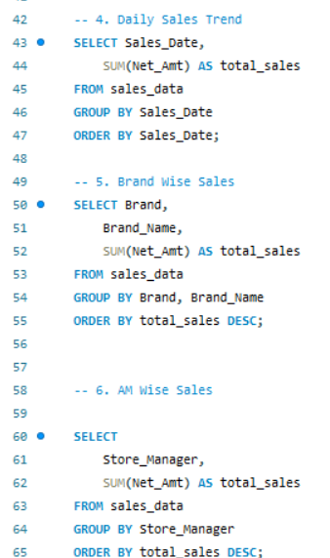
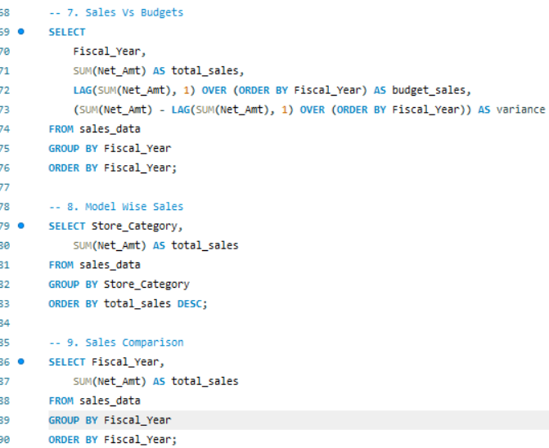
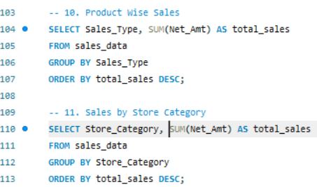
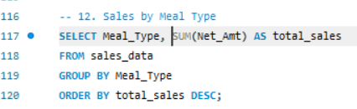
QA Validation

Slide 10

Recommendation
Regularly analyze trends, adjust pricing strategies, and enhance customer engagement to boost revenue.
Improve marketing and operational strategies for underperforming stores while scaling successful strategies across all locations.
Identify growth drivers (seasonal demand, product performance), optimize promotions, and explore new market segments.
Align marketing and promotional activities with peak sales periods to maximize revenue.
Invest in marketing for high-performing brands and reassess the viability of underperforming brand.
Provide sales training, set performance incentives, and replicate best practices among managers.
Adjust budget allocations based on past performance and set more accurate forecasts.
Optimize inventory for high-demand models and phase out or improve underperforming ones.

Slide 11

conclusion
Optimizing sales in the FMCG sector requires continuous trend analysis, pricing adjustments, and customer engagement. Strengthening underperforming stores while scaling successful strategies ensures consistent growth.
Identifying key growth drivers like seasonal demand and product performance helps optimize promotions and expand market reach. Aligning marketing with peak sales periods and investing in high-performing brands boosts revenue.
Enhancing sales through training, incentives, and best practices improves team efficiency. Dynamic budget allocation and accurate forecasting support financial stability. Inventory optimization ensures high-demand products are prioritized, improving supply chain efficiency.

Slide 12
Thank you …
Group 1

