Slide 1
TEAM 4
TEAM MEMBERS:
Vaishnavi Avinash Gawali
Temitope Adenuga
Madhur Chaudhari
Venkateshwarlusajja

Slide 2
Topic 2: Anomaly Detection

Slide 3
What is Anomaly Detection?
Observations that deviate from WELL DEFINED NOTION OF DATA SET.

Slide 4
About the Data Set
Secondhand data set from Kaggle of Credit Card Transaction
Detect whether banking transaction is counterfeit or not.

Slide 5
More About the Data Set
Data Set contains:
Step - represents a unit of time where 1 step equals 1 hour
type - type of online transaction
amount - the amount of the transaction
nameOrig - customer starting the transaction
oldbalanceOrg - balance before the transaction
newbalanceOrig - balance after the transaction
nameDest - recipient of the transaction

Slide 6
More About the Data Set
oldbalanceDest - initial balance of recipient before the transaction
newbalanceDest - the new balance of recipient after the transaction
isFraud - fraud transaction
Variables: 11
Records : 101613

Slide 7
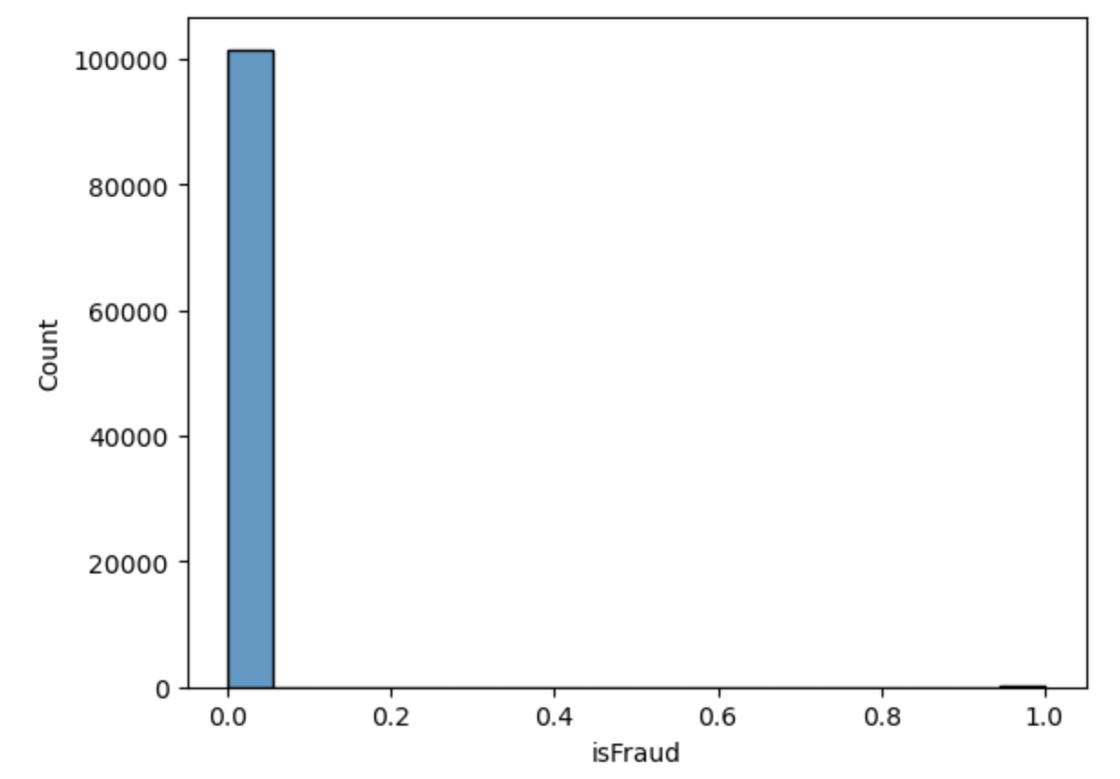
Plot Histogram to Understand the variable is fraud
fraudulent transactions

Slide 8
Approach…
Data Cleaning
Dropped the duplicate Columns
Checked for Null Values
Converting Categorical Variable to Numeric
Variable Type changed to Numeric

Slide 9
Classification Model - 1
KNN Classifier-
Split the Data Set
Training Data - 75%
Validation Data – 25%
Performance Matrix-
Accuracy for Training - 0.9990289860777598
Accuracy for Validation - 0.9990159030074004

Slide 10
Classification Model - 2
Logistic Regression-
Split the Data Set
Training Data - 75%
Validation Data – 25%
Performance Matrix
Precision score: 0.5
Recall score: 0.1724137931034483
Accuracy score: 0.9988584474885844
F1 score: 0.25641025641025644

Slide 11
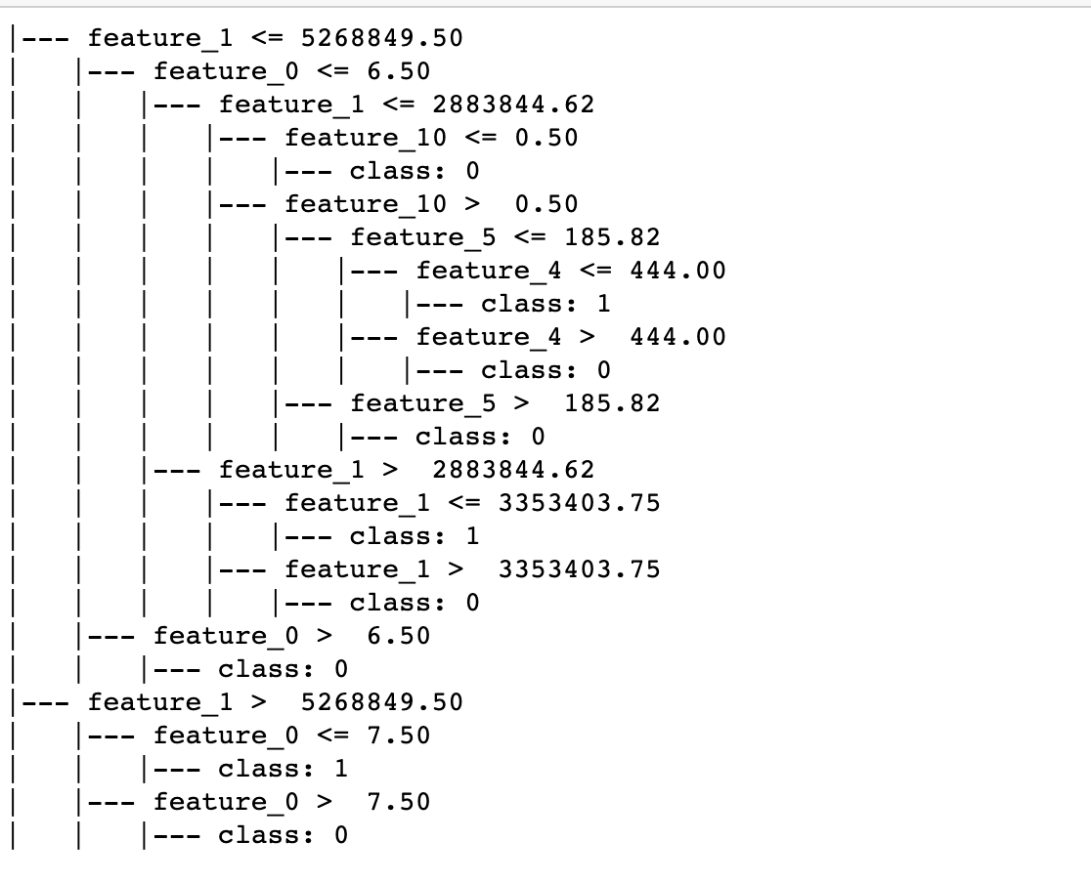
Classification Model - 3
Decision Tree
Accuracy- 0.9989764967717509

Slide 12
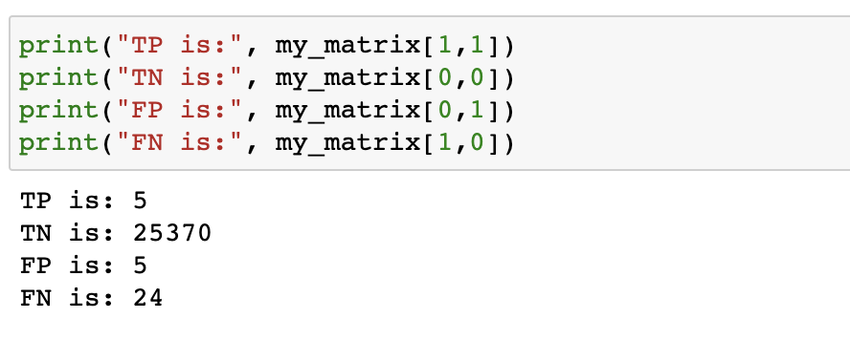
Confusion Matrix
 |  | Actual
 |  | Positive | Negative
Predict | True | 5 | 5
 | Negative | 24 | 25370

Slide 13
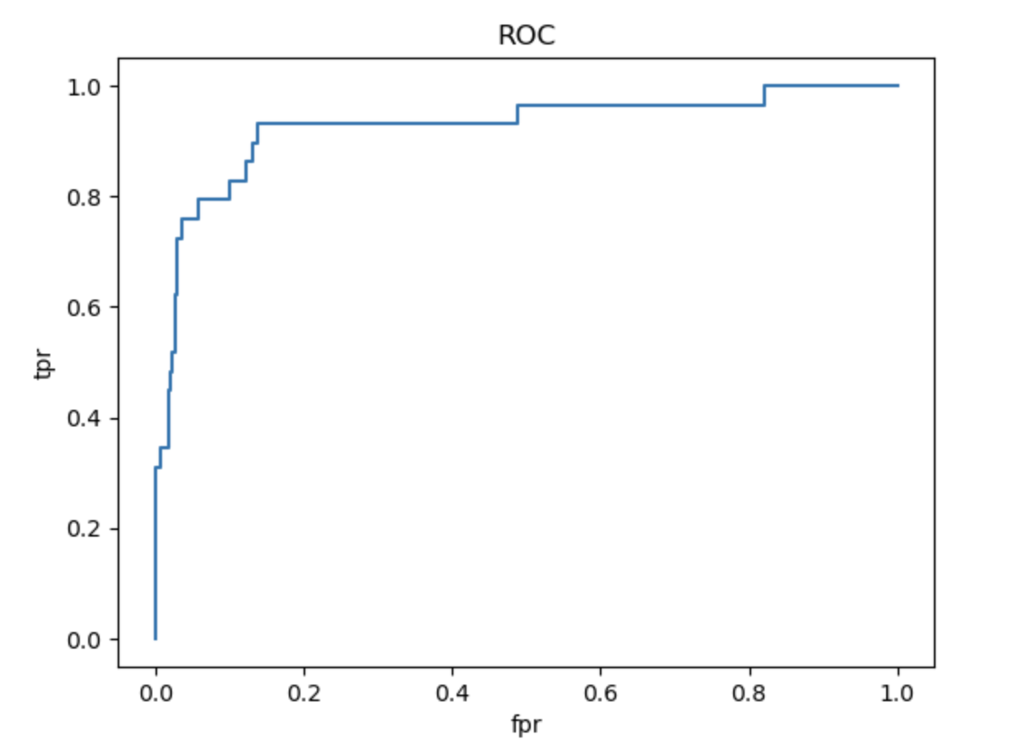
ROC Curve
Margin of Error
Area under the curve

Slide 14
Conclusion
Accuracy of KNN Classifier and Logistic Regression is around 99%
The model we built perform well with the data set in predicting Fraudulent Transactions.

