Slide 1




NILA SOCIAL MEDIA
A Web-Based Social Media Application with Local AI Studio
STUDENT
Vaishnavi Gireesh
MLM25MCA-2057
Department of Computer Applications
PROJECT GUIDE
Ms. Ashwini Vijayachandran
Assistant Professor
Department of Computer Applications
Local AI Studio
Notes:
Introduce the project Nila Social Media, yourself, your guide and the department. Fill in the college name and academic year placeholders before presenting.

Slide 2
Introduction
A web-based social media application where users share posts, stories and reels and interact with each other.
WHY IT WAS DEVELOPED
Provide core social features together with AI assistance for captions, hashtags and moderation.
A Local AI Studio built into the application, so intelligence is part of everyday posting.
Registered users, and a Super Admin who manages users, features and reports.
Notes:
Explain what Nila Social Media is, its purpose, target users and why it was developed.

Slide 3
Abstract
Web application built with Flask and SQLite for sharing posts, stories and reels.
Registration, login, profiles, private accounts, follow requests, block, mute and restrict.
Likes, comments, saves, search and explore, direct messaging and notifications.
Image captions, hashtag suggestions, bilingual support, places and toxicity moderation.
Super Admin manages users, feature flags, reports and analytics.
Notes:
Read the five points: social networking, accounts and privacy, interaction, Local AI Studio, administration.

Slide 4




Problem Definition
PROBLEM
NEED
No auto caption or hashtag tools
Users write captions and hashtags manually, with no AI assistance.
AI-based caption and hashtag generation for every post.
Weak spam and fake account detection
Bots and fake profiles are hard to catch without ML-based detection.
A classifier that detects spam and suspicious accounts.
Rigid story limitations
A fixed 24-hour window limits creators and audience engagement.
Extended stories with viewer tracking and easy search.
Poor image recognition
Uploaded media is not automatically identified, which limits smart tagging.
Computer vision to identify objects and scenes for smart tagging.
Source: problem statement of the project. Privacy controls (private accounts, block, mute, restrict) are covered under Scope.
Notes:
Walk through each problem and the need it creates.

Slide 5
Objectives
Develop a full-featured social media web application.
1
ALSO COVERED IN SCOPE
Private accounts, block, mute and restrict
Follow / unfollow with approval for private accounts
Direct messaging
Comment moderation and hashtag recommendation
Integrate NLP-based automatic caption and hashtag generation.
2
Apply computer vision for image recognition and smart tagging.
3
Build an ML-based personalized content recommendation engine.
4
Detect spam and fake accounts using classification models.
5
Notes:
Five main objectives. The panel on the right lists what else is in scope.

Slide 6



Existing System
Basic social media apps
Fixed story duration
Manual captioning
WHAT EXISTS
Photo and video sharing, likes, comments and follow features.
LIMITATION
No intelligence layer on top of the basic features.
WHAT EXISTS
Stories last for a strict 24-hour window.
LIMITATION
No flexibility or extended viewing for creators.
WHAT EXISTS
Users write their own captions and hashtags.
LIMITATION
No AI-assisted suggestions or auto-generation.
Notes:
Existing platforms already offer sharing, likes, comments and follow. The gap is the missing intelligence layer.

Slide 7



Proposed System
AI Caption & Hashtag Generator
Image Recognition
NLP-based suggestions of relevant captions and hashtags for uploaded posts.
Computer vision identifies objects and scenes for smart auto-tagging.
Spam & Fake Account Detection
Extended Stories
An ML classifier detects bots and suspicious accounts.
Stories beyond 24 hours with viewer tracking and easy search.
Notes:
Nila Social Media combines the four AI-driven additions with the core social features.

Slide 8






Scope of the Project
User Features
Social Features
AI Features
Register, login, logout
Profiles and posts
Stories and reels
Search and explore
Follow / unfollow
Approval for private accounts
Likes, comments, saves
Direct messaging
Caption and hashtag suggestions
Image recognition
Bilingual, places, mood feed
Comment moderation
Privacy & Safety
Administration
Deployment
Private accounts
Block, mute, restrict
Report, not interested
Toxicity filter
User management
Feature flags
Reports and analytics
System settings
Flask web application
SQLite database
Open-source tools
Minimal hosting cost
Notes:
Scope is grouped into six areas. Target roles: User and Super Admin.

Slide 9
Literature Review
Title & Year | Author & Publication | Algorithm Used | Method / Feature | Performance Metric | Result / Findings
[1] Automated Image Captioning (2020) | A. Puscasiu et al. | CNN + RNN | Transfer learning | BLEU, METEOR | Accurate image captions
[2] Image Captioning: A Survey (2020) | H. Sharma et al. | Deep learning | Survey | Analysis | Reviews recent methods
[3] BLIP (2022) | J. Li et al. | BLIP | Vision + language | CIDEr, BLEU | Better caption quality
[4] Deep Learning Approaches on Image Captioning: A Review (2022) | T. Ghandi et al. | Deep learning | Review | BLEU, CIDEr | Summarizes modern models
[5] Review of Transformer-Based Image Captioning Models (2023) | O. Ondeng et al. | Transformer | Review | BLEU, CIDEr | Strong performance
[6] Image Captioning by Diffusion Models: A Survey (2024) | F. Daneshfar et al. | Diffusion | Survey | BLEU, CIDEr | Latest captioning approaches
[7] Attention-Based Transformer Models for Multilingual Image Captioning (2025) | I. Albadarneh et al. | Attention transformer | Multilingual | BLEU, ROUGE | Better context
[8] Next-Generation Image Captioning: A Systematic Review (2026) | M. Al-Malla et al. | Vision-language models | Systematic review | BLEU, CIDEr, SPICE | Future of image captioning
Notes:
Eight papers on image captioning, the basis for the AI caption feature. BLIP is the model named for image captioning in the architecture.

Slide 10




Technologies Used
Frontend
Backend
Database
HTML
CSS
Python
Flask
SQLite
JavaScript
Bootstrap
Flask-Login
AI / ML
Tools
PyTorch
OpenCV
BLIP
VS Code
GitHub
Notes:
Frontend: HTML, CSS, JavaScript, Bootstrap. Backend: Python and Flask. Database: SQLite. AI: PyTorch, OpenCV and BLIP.

Slide 11








Software & Hardware Requirements
Software Requirements
Hardware Requirements
Operating System
Any OS that runs Python (not specified)
Processor
Not specified
Language
Python (version not specified)
RAM
Not specified
Browser
Modern web browser
Storage
Not specified
Frameworks
Flask, Flask-Login, Bootstrap
Peripherals
Not specified
AI libraries
PyTorch, OpenCV
Network
Local / web access via browser
Database / Tools
SQLite; VS Code, GitHub
Overall
Standard system capable of running Python / Flask applications
Notes:
Hardware values were not documented, so the slide states a standard Python/Flask-capable system.

Slide 12
System Architecture
USER
Guest · Registered User · Super Admin
Presentation Layer
HTML · CSS · Bootstrap · JavaScript
Flask Application Layer
Business logic · Request routing · Views
Functional Modules
Auth
Profile
Content
Stories & Reels
Messaging
Social
Explore
AI Studio
Admin
AI Processing / Scoring Engine
ML models · Recommendation engine · Moderation engine · Evaluation logic · Result computation
Database (SQLite)
Users, profiles, posts, reels, stories, messages, likes, comments, follows, reports, feature flags, logs
Results / Output
Personalized feed · Recommendations · AI suggestions · Notifications · Reports · Insights
Notes:
Flow: User -> presentation layer -> Flask application layer -> functional modules -> AI processing engine -> SQLite database -> results and output.

Slide 13
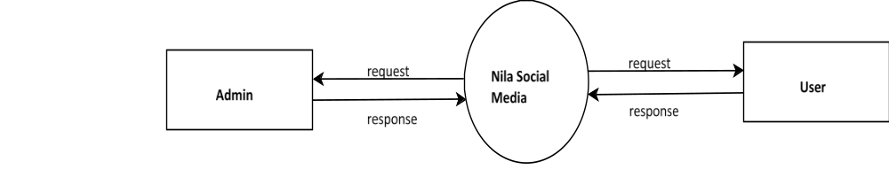
Design Diagrams
DFD Level 0
Notes:
Overview of the design diagrams: DFD level 0, level 1 for Admin and User, ER, use case, class, state and sequence diagrams. The use case diagram has been relabelled with the Nila Social Media title and Create Post.

Slide 14
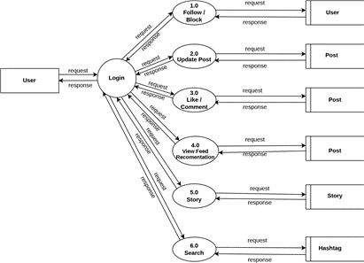
DFD Level 1 – User

Slide 15
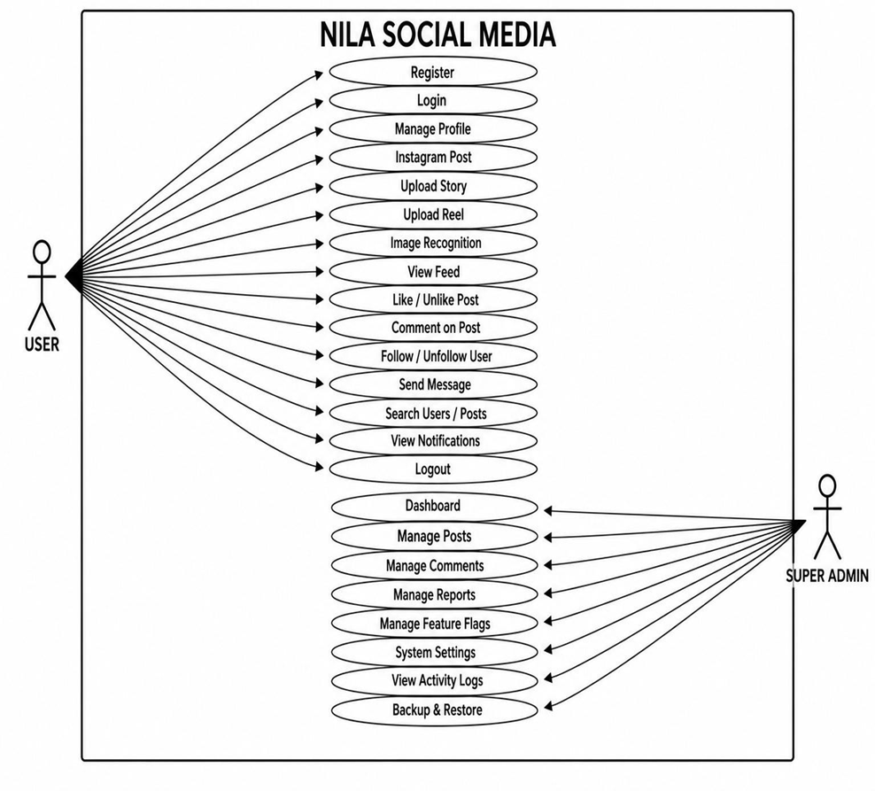
Use Case Diagram

Slide 16
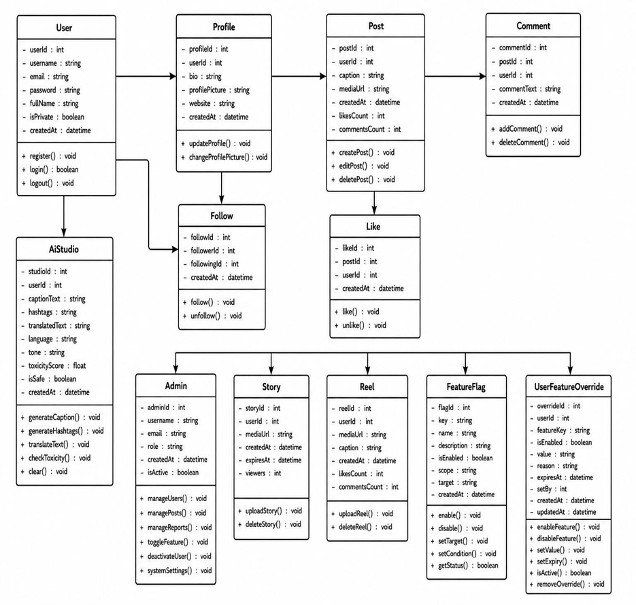
Class Diagram

Slide 17
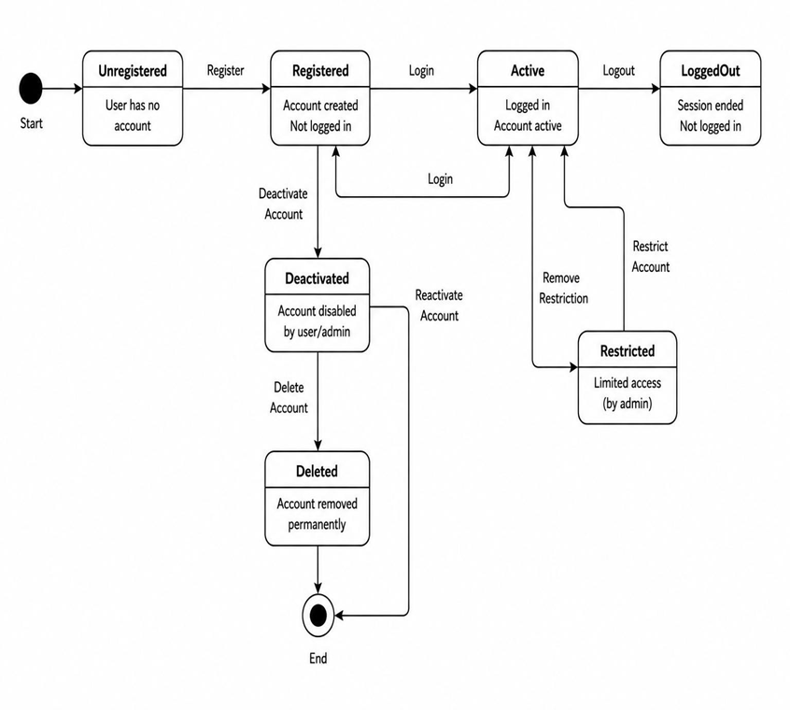
State Diagram

Slide 18
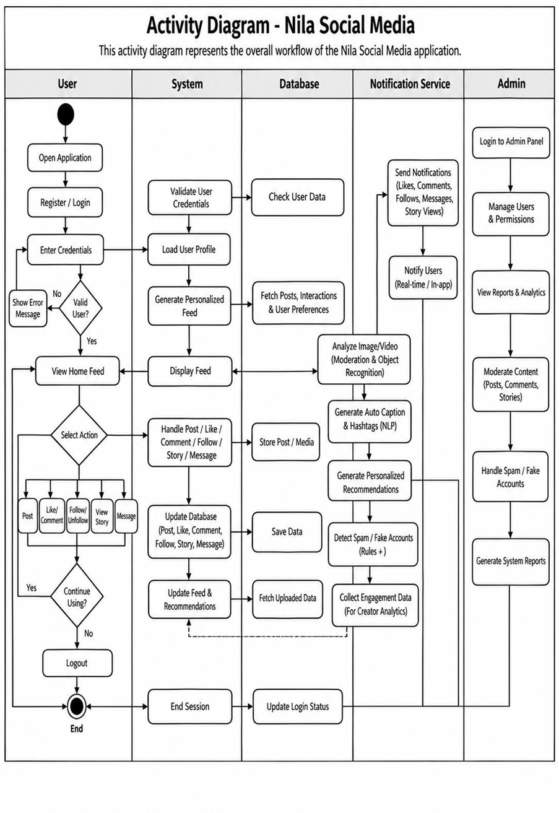
Activity Diagram

Slide 19
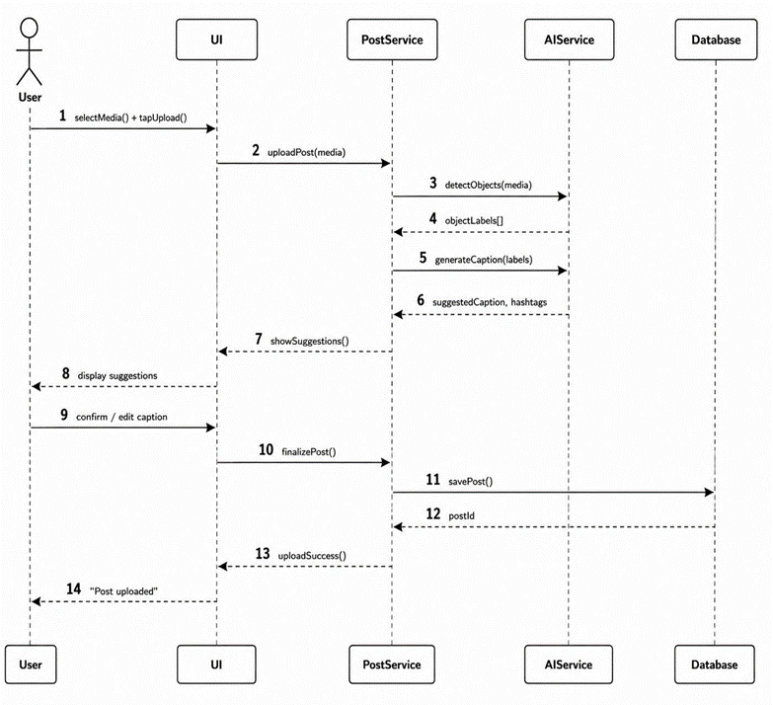
Sequence Diagram

Slide 20





Module Description
Authentication
1
Profile
2
Content
3
Register, login, logout, password reset and session management.
User profile, edit profile, privacy settings and account management.
Create posts, upload media, likes, comments, save and share.
Stories & Reels
4
Messaging
5
Social
6
Stories, highlights, reels and AI best-frame thumbnail.
Direct messages, conversations, message status and inbox.
Follow / unfollow, follow requests, block, mute, restrict and report.
Explore
7
AI Studio
8
Search users, explore posts, hashtags and trends.
BLIP captions, hashtags, toxicity filter, bilingual, mood feed, festival mode.
Notes:
Nine functional modules from the architecture diagram.

Slide 21


Algorithm / Methodology
AI-ASSISTED POST CREATION WORKFLOW (FROM SEQUENCE DIAGRAM)
1
2
3
4
5
6
Select media
User uploads an image through the UI
Detect objects
AIService returns object labels
Generate caption
Caption and hashtags suggested
Show suggestions
UI displays them to the user
Confirm / edit
User finalizes the caption
Save post
PostService stores it in the database
DEVELOPMENT METHODOLOGY (FROM PROJECT PLAN)
1
Requirement Analysis
2
System Design
3
Module Setup
4
Backend & Database
5
AI / ML Integration
6
Testing & Deployment
Notes:
Top: the post creation flow from the sequence diagram. Bottom: the six-phase development methodology.

Slide 22
Implementation
Presentation layer
Flask application layer
SQLite database
HTML, CSS and JavaScript
Bootstrap for the interface
Feed, profile, post, messages, search and AI Studio screens
Python and Flask
Request routing and views
Business logic for the eight modules
Users, profiles, posts, reels, stories
Messages, likes, comments, follows
Reports, feature flags and logs
AI processing
Security & sessions
Admin & safety
PyTorch and OpenCV
BLIP image captioning
Recommendation and moderation engines
Flask-Login sessions
Password reset
Private accounts and follow approval
Feature flags
User management, reports and analytics
Block, mute, restrict and report
Notes:
Implementation follows the layered architecture: presentation, Flask application, modules, AI processing and SQLite.

Slide 23


Results / Analysis
Login & registration
Account screens implemented.
Home feed
Feed with suggested users and an AI panel.
Profile
Profile page showing posts and counts.
Post creation
New post screen with Local AI Studio options.
Messaging
Inbox with a list of conversations.
Search
User search with follow actions.
Mood feed
Mood selection page for the feed.
Notes:
These are qualitative observations. No numerical performance results were documented.

Slide 24
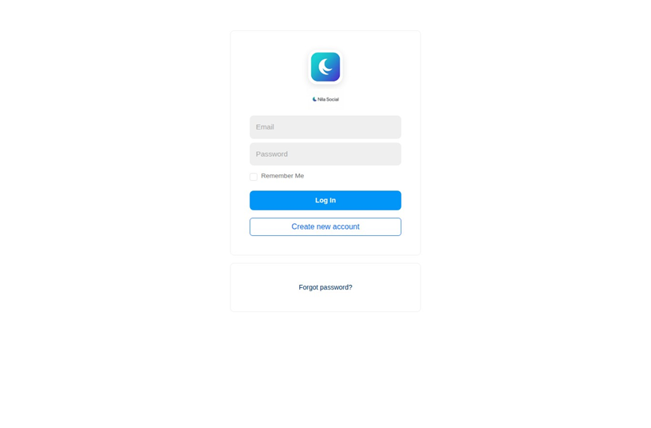
Screenshots / Output
Login
Notes:
Screenshots are taken from the project. Retake them after the application name is changed to Nila Social Media, since the interface in these images still shows the earlier name.

Slide 25
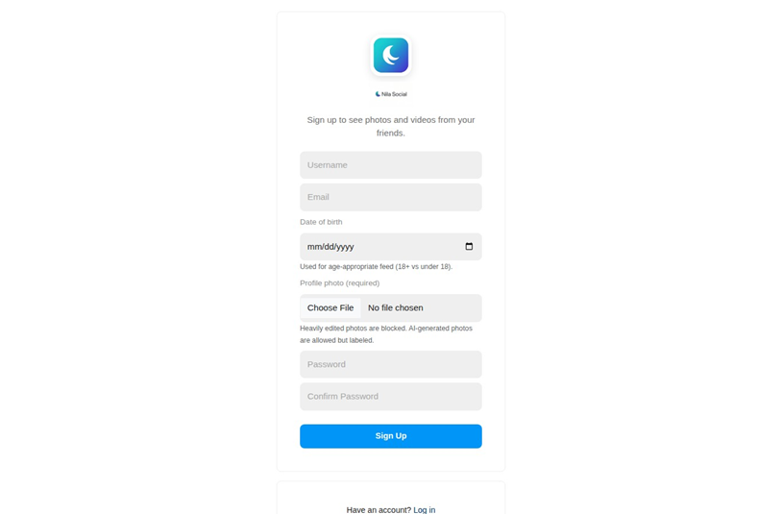
Registration Page

Slide 26
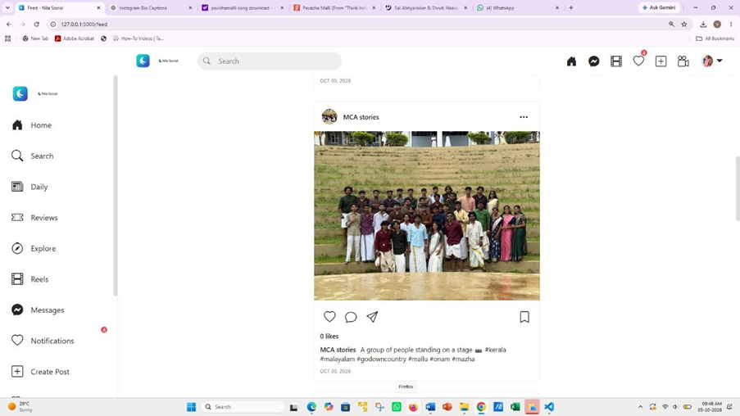
Home Feed

Slide 27
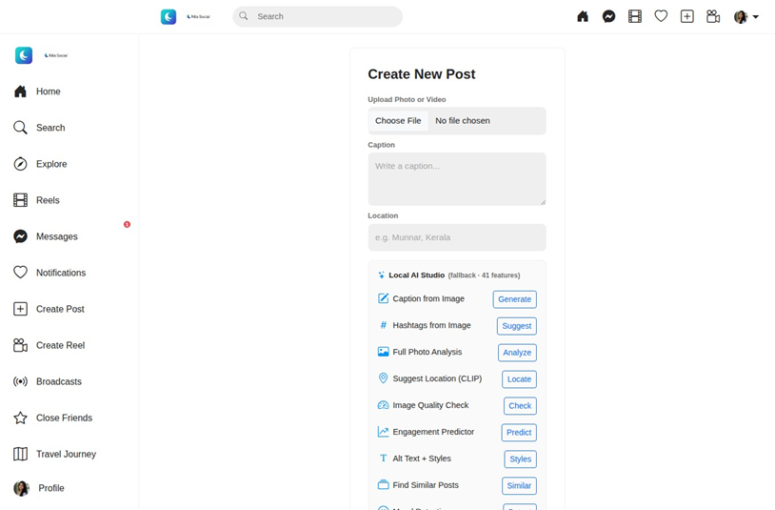
Create Post with Local AI Studio

Slide 28
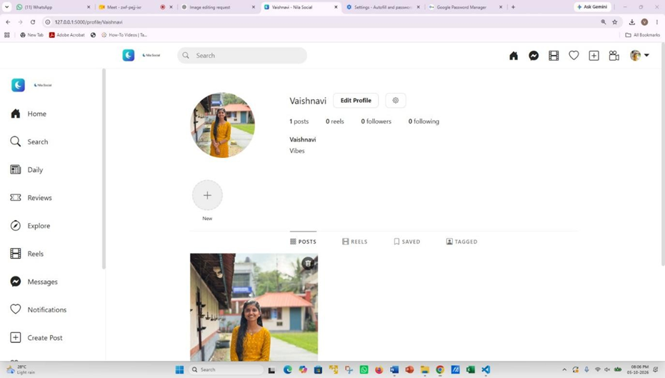
User Profile Page

Slide 29
Comparison with Existing System
Feature | Existing System | Nila Social Media
Posts, likes, comments, follow | Provided as standard features | Provided, with private accounts and follow approval
Captions & hashtags | Written manually by the user | AI-assisted caption and hashtag suggestions
Image recognition | No automated object or scene identification | Computer vision for smart tagging
Story duration | Fixed 24-hour window | Extended stories with viewer tracking
Spam & fake accounts | Weak detection without ML | ML classifier for spam and fake accounts
Comment moderation | Not covered in the source | Toxicity filter in Local AI Studio
Privacy controls | Not covered in the source | Private accounts, block, mute, restrict, report
Administration | Not covered in the source | Feature flags, user management, reports and analytics
"Existing System" means basic social media apps as described in the project problem statement.
Notes:
Keep the comparison factual. Rows marked Not covered in the source were not described for existing systems in the project material.

Slide 30



Testing
Unit Testing
Individual functions and modules
Test Case | Expected Result | Actual Result | Status
User registration | Account created | Account created | Pass
Login / logout | Session started and ended | Session started and ended | Pass
Create post | Post saved and shown in feed | Post saved and shown in feed | Pass
AI caption & hashtags | Suggestions displayed for the upload | Suggestions displayed for the upload | Pass
Follow a private account | Request sent, then approved by owner | Request sent and approved by owner | Pass
Send direct message | Message appears in the conversation | Message appeared in the conversation | Pass
Toxic comment check | Comment flagged by the filter | Comment flagged by the filter | Pass
Admin user management | User can be activated or deactivated | User activated and deactivated | Pass
Integration Testing
Modules, AI services and SQLite together
System Testing
Complete user and admin workflows
User Acceptance
Feedback from users, if applicable
Results recorded from manual functional testing of the project; no test statistics are claimed.
Notes:
All eight test cases were observed working during manual testing.

Slide 31

Demo Video
Suggested demo flow
1
Login
2
Profile
3
Create post
4
Feed
5
Stories / Reels
6
Social interaction
7
Messaging
8
AI assistance
PROJECT DEMONSTRATION
Nila Social Media · video to be embedded here
9
Privacy / safety
10
Admin
Notes:
Insert the demo video, or add the link or QR code in the placeholder. Follow the suggested demo flow.

Slide 32








Advantages
Integrated platform
Social features and AI assistance in one application.
Less manual effort
AI suggests captions and hashtags for posts.
Smart tagging
Image recognition identifies objects and scenes.
Privacy controls
Private accounts, block, mute and restrict options.
Safer interaction
Toxicity moderation, with admin review of flagged items.
Flexible stories
Stories can last beyond the fixed 24-hour window.
Modular design
Nine functional modules that are easy to extend.
Low cost
Free, open-source tools with no licensing cost.
Notes:
Advantages drawn from the project scope, architecture and feasibility study.

Slide 33






Limitations
Draft – verify against project documentation
Local SQLite database
Suited to a local academic setup rather than large-scale use.
AI model resources
PyTorch-based models need adequate computing resources.
Suggestions need review
AI captions and moderation results should be checked by users and admins.
Real-time-style messaging
Direct messaging is described as real-time-style, not full real-time delivery.
No quantitative AI evaluation
AI accuracy and response time are not specifically measured.
Hosting not yet set up
Real-world deployment would need hosting, with minimal cost expected.
Notes:
Present these as boundaries of the current version. Confirm against your documentation.

Slide 34



Conclusion
Nila Social Media adds an AI layer to a complete social media web application.
What was developed
A Flask and SQLite web application with nine functional modules.
Main functionality
Posts, stories, reels, follow system, messaging, search and administration.
Technical approach
Local AI Studio using PyTorch, OpenCV and BLIP captioning.
Outcome
Addresses the missing intelligence layer in basic social media apps.
Notes:
Summarize what was built, the main functionality, the technical approach and the outcome, without overclaiming.

Slide 35


Future Scope
Draft – future possibilities, not current features
Real-world deployment
Host the application online for wider use.
Server database
Move from SQLite to a database such as MySQL.
Stronger AI models
Improve caption, tagging and moderation quality.
AI evaluation
Measure accuracy using standard metrics.
Better recommendations
Refine the personalized feed engine.
Detection upgrades
Strengthen spam and fake account detection.
The project material has no future-scope section. These points follow from the feasibility study and architecture; confirm before presenting.
Notes:
Stress that these are possible improvements, not current features.

Slide 36
References
[1] A. Puscasiu et al., “Automated image captioning,” 2020.
[2] H. Sharma et al., “Image captioning: A survey,” 2020.
[3] J. Li et al., “BLIP: Bootstrapping language-image pre-training for unified vision-language understanding and generation,” 2022.
[4] T. Ghandi et al., “Deep learning approaches on image captioning: A review,” 2022.
[5] O. Ondeng et al., “Review of transformer-based image captioning models,” 2023.
[6] F. Daneshfar et al., “Image captioning by diffusion models: A survey,” 2024.
[7] I. Albadarneh et al., “Attention-based transformer models for multilingual image captioning,” 2025.
[8] M. Al-Malla et al., “Next-generation image captioning: A systematic review,” 2026.
Journal / conference names, volumes and pages were not available in the project material and should be added before submission.
Notes:
References follow IEEE style as far as the available details allow.

Slide 37
THANK YOU
Nila Social Media
A Web-Based Social Media Application with Local AI Studio
Vaishnavi Gireesh · MCA (S3) · Guide: Ms. Ashwini Vijayachandran
Notes:
Thank the panel and invite questions.

