Slide 1
JAVA PROGRAMMING PROJECT | CO1–CO6
TRAVEL MADE SIMPLE
INTERCITY BUS
RESERVATION SYSTEM
CITY A
CITY B
Book tickets. Manage passenger details.
Make bus reservations easier.
PASSENGER → BUS → TICKET
B. Vaishnavi — 2620030613
S. Lasya — 2620030612
CSPG • PROJECT PRESENTATION

Slide 2
PROJECT OVERVIEW
Abstract & Problem Statement
A Java application concept for organizing intercity bus bookings.
PROJECT ABSTRACT
PROBLEM TO SOLVE
• Records passenger and journey details
• Selects source, destination and travel date
• Checks requested seat availability
• Calculates fares and confirms bookings
• Displays reservation details
Manual booking can lead to confusion about passenger information, available seats and ticket details.
The system structures these steps into a clear booking workflow.
PROJECT GOAL • Make booking information easier to record, validate and retrieve.
INTERCITY BUS RESERVATION SYSTEM • JAVA PROJECT
02

Slide 3
CO1 — JAVA FOUNDATIONS
Input, Data & Output
The program follows the basic computational pattern: input → process → output.
INPUT
PROCESS
OUTPUT
• Passenger name
• Source and destination
• Journey date
• Number of seats
• Validate entries
• Check seat count
• Calculate fare
• Prepare reservation
• Booking status
• Passenger details
• Bus and route details
• Fare and ticket summary
Java concepts: Scanner for input, String for text, int for seat counts, and formatted output for ticket details.
INTERCITY BUS RESERVATION SYSTEM • JAVA PROJECT
03

Slide 4
CO2 — CONDITIONS & LOOPS
Reservation Control Flow
Conditions decide whether a booking can proceed.
if (seatsRequested <= 0) {
System.out.println("Invalid seat count");
} else if (seatsRequested > availableSeats) {
System.out.println("Seats not available");
} else {
System.out.println("Booking can proceed");
}
KEY POINTS
• if-else checks booking conditions
• Loops can repeat passenger or booking entry
• Validation prevents invalid requests
• Status messages explain the result
Example only: connect these checks to the actual bus and reservation data in the implementation.
INTERCITY BUS RESERVATION SYSTEM • JAVA PROJECT
04

Slide 5
CO3 — METHODS & ARRAYS
Reusable Calculations
Methods keep repeated calculations organized and easier to test.
static double calculateFare(
double farePerSeat, int seats) {
return farePerSeat * seats;
}
// Example call
double total = calculateFare(450.0, 2);
KEY POINTS
• A method groups one task
• Parameters carry input values
• A return value provides the result
• Arrays can store multiple fares or seat numbers
• Reuse avoids duplicating logic
Illustration: ₹450 per seat × 2 seats = ₹900 total fare.
INTERCITY BUS RESERVATION SYSTEM • JAVA PROJECT
05

Slide 6
CO 4— CLASSES, OBJECTS & EXCEPTIONS
Object-Oriented Programming
Classes model the real-world entities used in the reservation system.
class Bus {
private String busNumber;
private String source;
private String destination;
private int availableSeats;
Bus(String number, String from,
String to, int seats) {
busNumber = number;
source = from;
destination = to;
availableSeats = seats;
}
}
ONLY THE KEY POINTS
• Bus is a blueprint for bus objects
• Fields store route and seat information
• The constructor initializes an object
• private fields support encapsulation
• Objects represent individual buses
INTERCITY BUS RESERVATION SYSTEM • JAVA PROJECT
06

Slide 7
CO5 — MODELLING RELATIONSHIPS
Passenger, Bus & Reservation
A reservation connects the passenger with the bus journey.
PASSENGER
BUS
RESERVATION
Stores passenger name and contact details.
Stores bus number, route and available seats.
Stores the passenger, selected bus and seats booked.
Nouns → classes: Passenger, Bus, Reservation
Verbs → methods: bookTicket(), checkAvailability(), cancelReservation()
INTERCITY BUS RESERVATION SYSTEM • JAVA PROJECT
07

Slide 8
CO6— REUSABLE DESIGN
Interfaces & Booking Operations
An interface defines an operation that a class agrees to provide.
interface Bookable {
void bookTicket();
}
class BusReservation implements Bookable {
public void bookTicket() {
System.out.println(
"Ticket booked successfully");
}
}
KEY POINTS
• An interface defines a contract
• implements provides the required method
• Classes can use a common booking operation
• Inheritance can model an “is-a” relationship
• Overriding provides class-specific behaviour
Use inheritance only when the relationship is genuinely an “is-a” relationship.
INTERCITY BUS RESERVATION SYSTEM • JAVA PROJECT
08

Slide 9
CO6 — EXCEPTION HANDLING
Errors, Exceptions & Safe Validation
Exception handling helps the application respond to invalid booking requests.
try {
if (seatsBooked <= 0) {
throw new IllegalArgumentException(
"Seat count must be positive");
}
System.out.println("Request accepted");
} catch (IllegalArgumentException e) {
System.out.println("Booking error: "
+ e.getMessage());
} finally {
System.out.println("Process completed");
}
KEY POINTS
• try contains code that may fail
• throw raises an exception
• catch handles a matching exception
• finally is used for cleanup or final steps
• Checked and unchecked exceptions differ in how they must be handled or declared
INTERCITY BUS RESERVATION SYSTEM • JAVA PROJECT
09

Slide 10
Validation & Error Reporting
Give the user a clear message instead of allowing an invalid reservation.
VALIDATE INPUTS
HANDLE FAILURES
• Passenger name is present
• Source and destination are valid
• Journey date is acceptable
• Seat count is positive
• Requested seats do not exceed availability
• Display useful error messages
• Use try-catch for expected failures
• Use throws when a method declares a possible exception
• Consider a custom SeatNotAvailableException
Design principle: validate early, fail safely and report the reason clearly.
INTERCITY BUS RESERVATION SYSTEM • JAVA PROJECT
10

Slide 11
WORKFLOW & TESTING
How the System Works
A simple booking workflow from passenger input to confirmation.
Enter passenger details
Choose route and journey date
Select number of seats
01
02
03
Validate and check availability
Calculate fare and confirm
Display ticket or error message
04
05
06
TEST CASES • Valid booking accepted • Negative/zero seats rejected • Unavailable seats rejected • Successful booking displays ticket details
INTERCITY BUS RESERVATION SYSTEM • JAVA PROJECT
11

Slide 12
PROJECT OUTCOME
Conclusion
WHAT THE PROJECT DEMONSTRATES
FUTURE IMPROVEMENTS
• Classes and objects model buses, passengers and reservations
• Encapsulation protects important data
• Interfaces support reusable operations
• Exceptions help manage invalid requests
• Methods organize booking and fare calculations
• Database storage
• Online payment integration
• Seat selection and cancellation
• Booking history and ticket printing
KEY BENEFIT • A structured way to manage intercity bus bookings and seat availability.
THANK YOU! | B. Vaishnavi — 2620030613 • S. Lasya — 2620030612

Slide 13
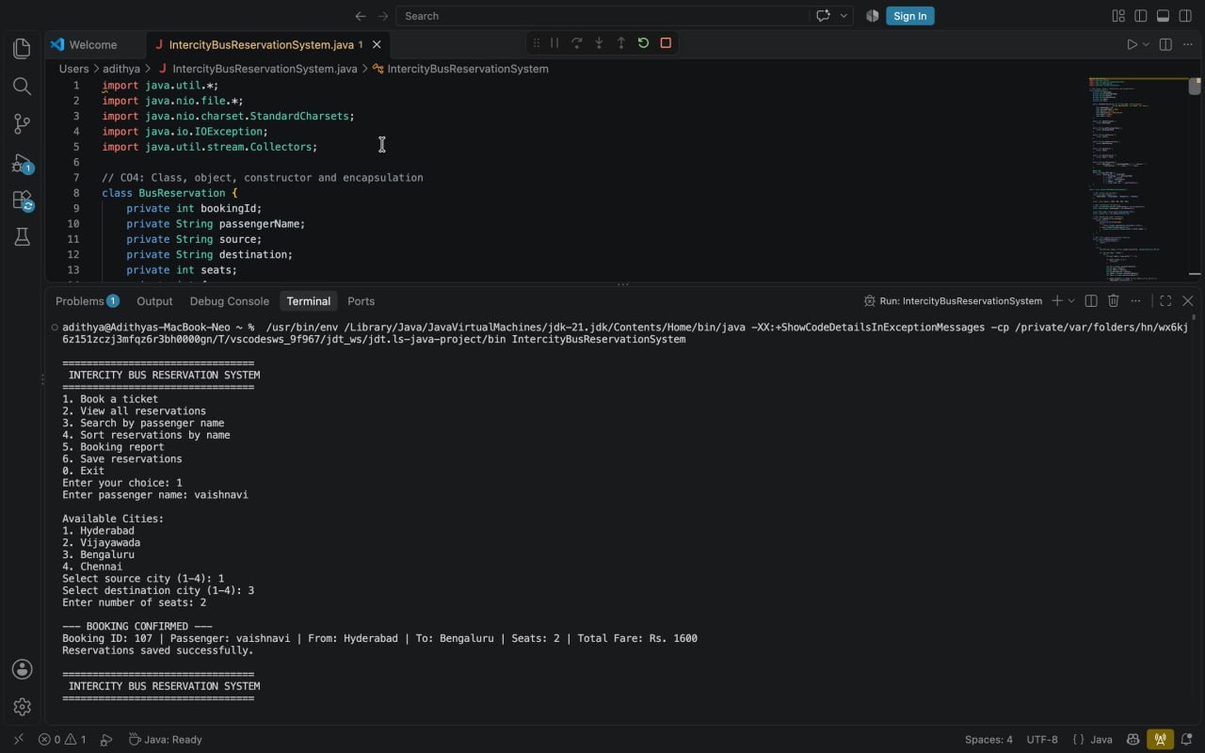

Slide 14
PROJECT REPOSITORY
GITHUB URL
INTERCITY BUS RESERVATION SYSTEM • JAVA PROJECT
13

Slide 15
THANK YOU!
Questions & feedback are welcome.
B. Vaishnavi — 2620030613
S. Lasya — 2620030612
INTERCITY BUS RESERVATION SYSTEM • JAVA PROJECT

