Slide 1
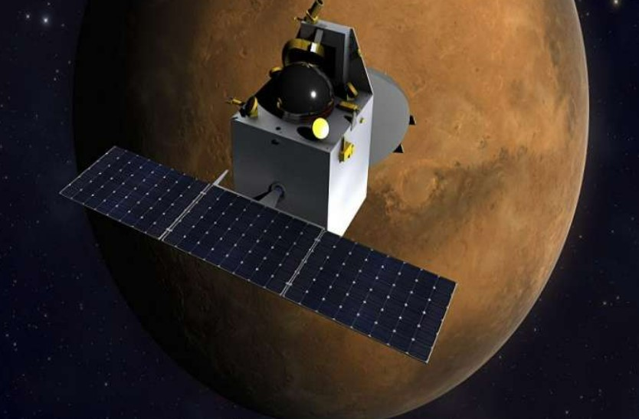
Physics seminar
Topic: mom satellite

Slide 2

TEAM MEMBERS:
Tanisha Jadhav
Ullas K
V . Manisha
Vaishnavi A K
Varsha B K

Slide 3
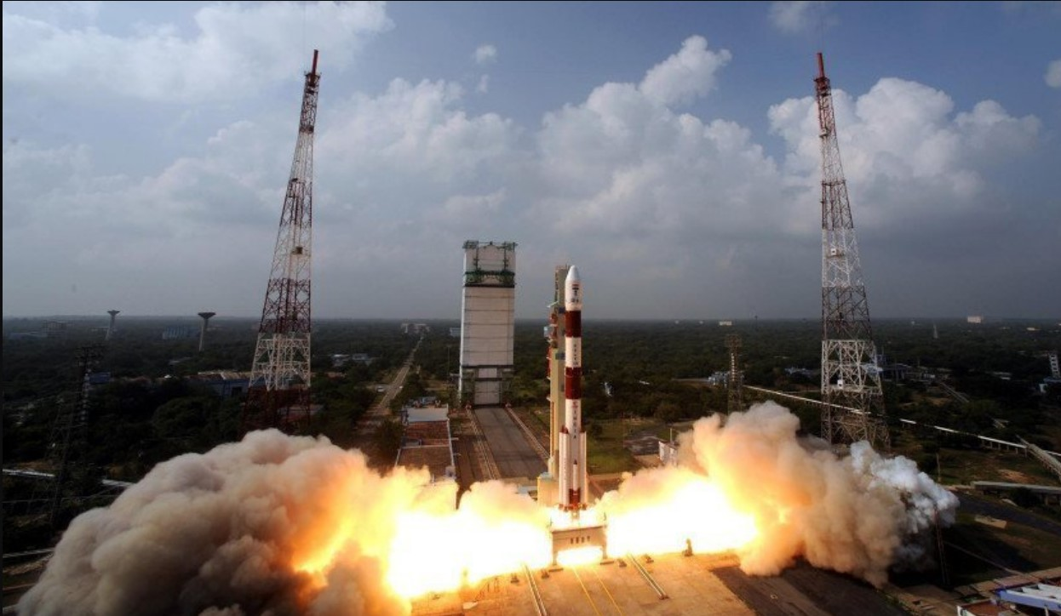
INTRODUCTION
MOM, also called Mangalyaan ("Mars-craft", from mangala, "Mars" and yāna, "craft, vehicle"), is a space probe orbiting Mars since 24 September 2014.
It was launched on 5 November 2013 by the Indian Space Research Organisation (ISRO).
It is India's first interplanetary mission and it made it the fourth space agency to achieve Mars orbit

Slide 4
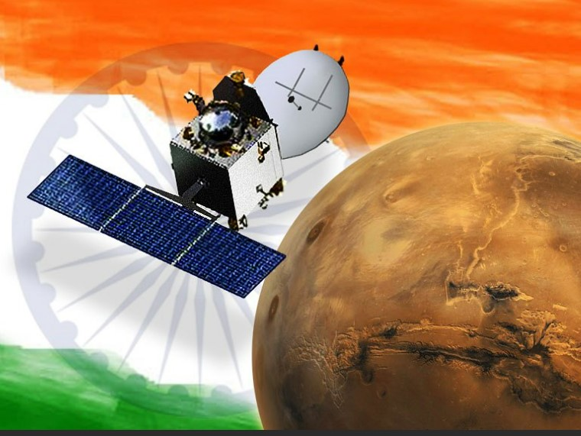
It made India the first Asian nation to reach Martian orbit and the first nation in the world to do so on its maiden attempt.
The mission is a "technology demonstrator" project to develop the technologies for designing, planning, management, and operations of an interplanetary mission.
The spacecraft is currently being monitored from the Spacecraft Control Centre at ISRO Telemetry, Tracking and Command Network (ISTRAC) in Bengaluru with support from the Indian Deep Space Network (IDSN) antennae at Bengaluru, Karnataka

Slide 5
LIST OF SCIENTISTS WHO MADE THE MISSION POSSIBLE
K Radhakrishnan
M Annadurai
S Ramakrishnan
SK Shivakumar
V Adimurthy
P Kunhikrishnan
Chandradathan
AS Kiran Kumar
MYS Prasad
S Arunan
B Jayakumar
MS Pannirselvam
V Kesava Raju
V Koteswara Rao

Slide 6

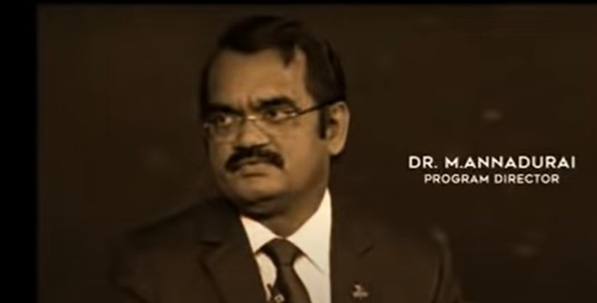

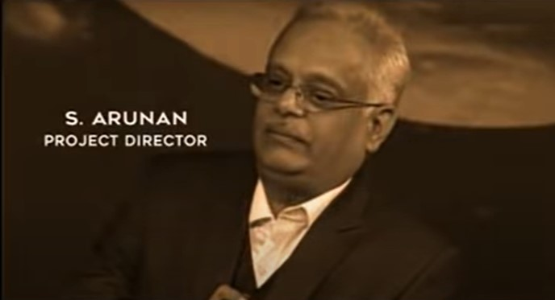
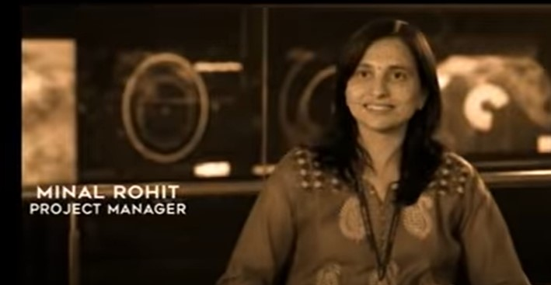
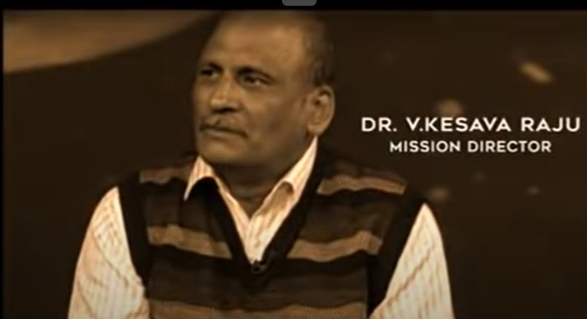

Slide 7



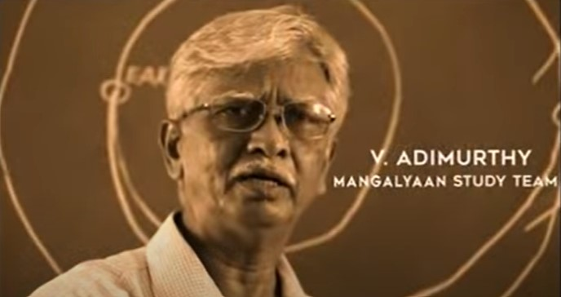
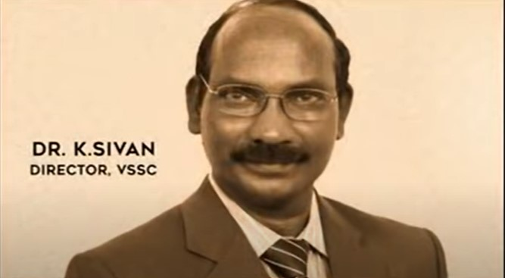
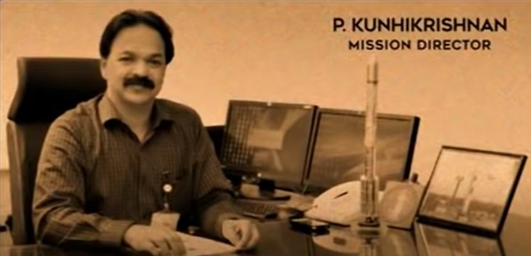

Slide 8
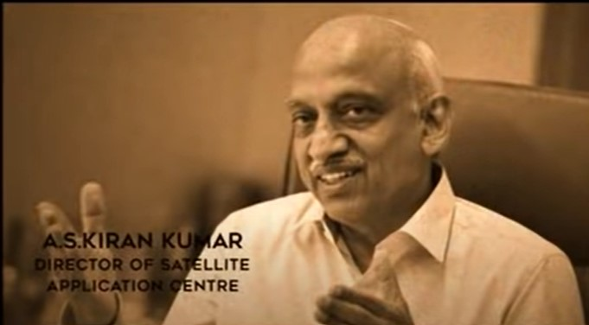
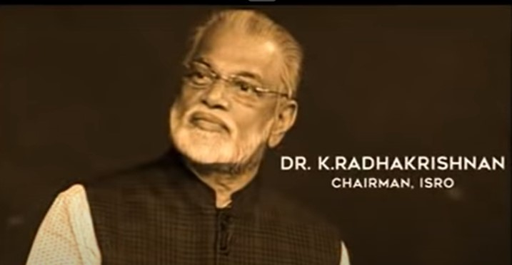
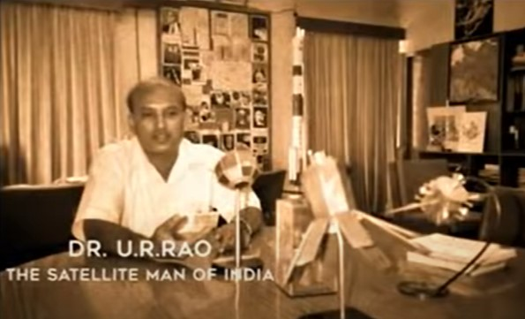

Slide 9

COST OF THE MISSION
The total cost of the mission was approximately ₹450 Crore (US$73 million, making it the least-expensive Mars mission to date.
The low cost of the mission was ascribed by K. Radhakrishnan, the chairman of ISRO, to various factors, including a "modular approach", few ground tests and long (18–20 hour) working days for scientists.
BBC's Jonathan Amos specified lower worker costs, home-grown technologies, simpler design, and a significantly less complicated payload than NASA's MAVEN.
Rs. 7 per kilometer journey from earth to mars

Slide 10

MAIN OBJECTIVE OF THE MISSION:
The primary objective of the mission is to develop the technologies required for designing, planning, management and operations of an interplanetary mission.
The secondary objective is to explore Mars' surface features, morphology, mineralogy and Martian atmosphere using indigenous scientific instruments.
The main objectives are to develop the technologies required for designing, planning, management and operations of an interplanetary mission comprising the following major tasks
Orbit manoeuvres to transfer the spacecraft from Earth-centred orbit to heliocentric trajectory and finally, capture into Martian orbit

Slide 11
Development of force models and algorithms for orbit and attitude (orientation) computations and analysis
Navigation in all phases
Maintain the spacecraft in all phases of the mission
Meeting power, communications, thermal and payload operation requirements
Incorporate autonomous features to handle contingency situations

Slide 12
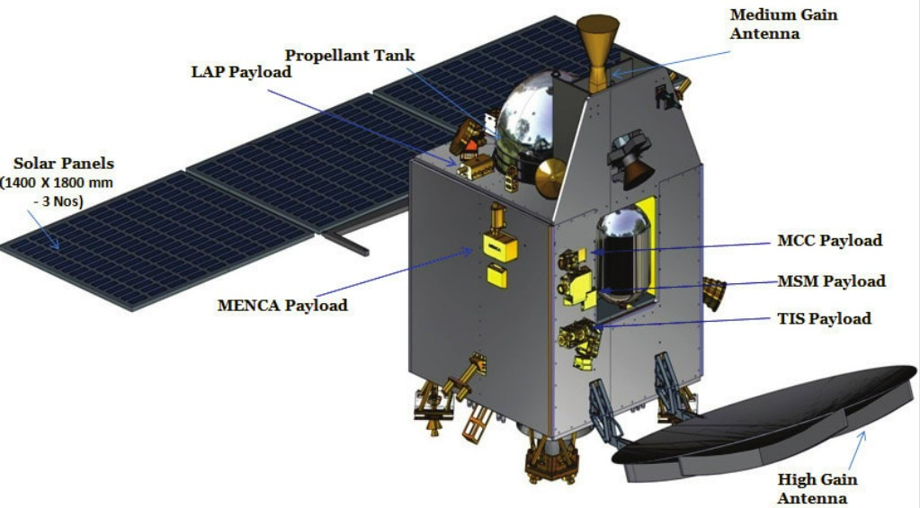
Satellite design:

Slide 13
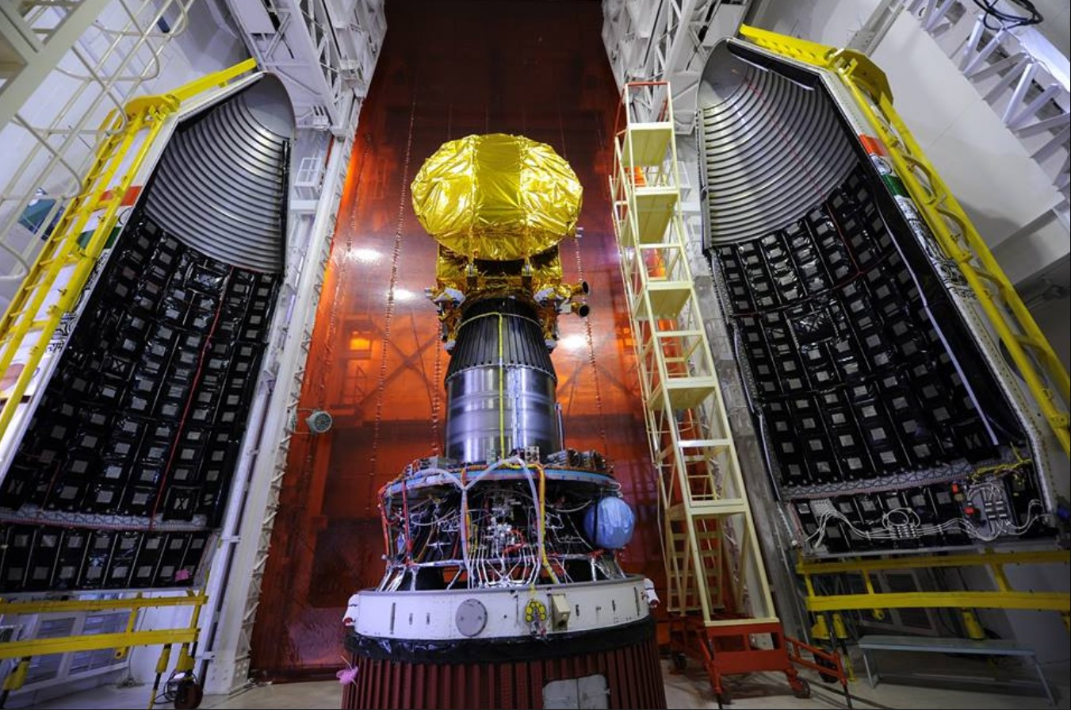
SPACE CRAFT DESIGN
Mass:
The lift-off mass was 1,337.2 kg (2,948 lb), including 852 kg (1,878 lb) of propellant.
Power:
Electric power is generated by three solar array panels of 1.8 m × 1.4 m (5 ft 11 in × 4 ft 7 in) each (7.56 m2 (81.4 sq ft) total), for a maximum of 840 watts of power generation in Mars orbit. Electricity is stored in a 36 Ah Lithium-ion battery.

Slide 14
Propulsion: A liquid fuel engine with a thrust of 440 newtons (99 lbf) is used for orbit raising and insertion into Mars orbit. The orbiter also has eight 22-newton (4.9 lbf) thrusters for attitude control (orientation). Its propellant mass at launch was 852 kg (1,878 lb). Attitude and Orbit Control System: Maneuvering system that includes electronics with a MAR31750 processor, two star sensors, a solar panel Sun sensor, a coarse analog Sun sensor, four reaction wheels, and the primary propulsion system. Antennae: Low gain antenna, mid gain antenna, and high gain antenna

Slide 15
THREE PHASES OF THE SPACECRAFT
Geo Centric Phase
The spacecraft is injected into an Elliptic Parking Orbit by the launcher. With six main engine burns, the spacecraft is gradually maneuvered into a departure hyperbolic trajectory with which it escapes from the Earth's Sphere of Influence (SOI) with Earth's orbital velocity + V boost
Helio Centric Phase
The spacecraft leaves Earth in a direction tangential to Earth's orbit and encounters Mars tangentially to its orbit. The flight path is roughly one half of an ellipse around sun. Eventually it will intersect the orbit of Mars at the exact moment when Mars is there too.
3.Aereocentric phase
On 24 September 2019, MOM completed 5 years in orbit around Mars, sending 2 terabytes of imaging data, and had enough propellant to complete another year in orbit

Slide 16
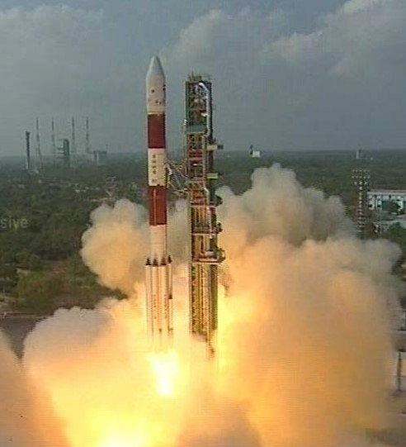
THE LAUNCH
On 19 October 2013, ISRO chairman K. Radhakrishnan announced that the launch had to be postponed by a week for 5 November 2013 due to a delay of a crucial telemetry ship reaching Fiji.
The launch was rescheduled ISRO's PSLV-XL placed the satellite into Earth orbit at 09:50 UTC on 5 November 2013, with a perigee of 264.1 km (164.1 mi), an apogee of 23,903.6 km (14,853.0 mi), and inclination of 19.20 degrees, with both the antenna and all three sections of the solar panel arrays deployed.
During the first three orbit raising operations, ISRO progressively tested the spacecraft systems.

Slide 17
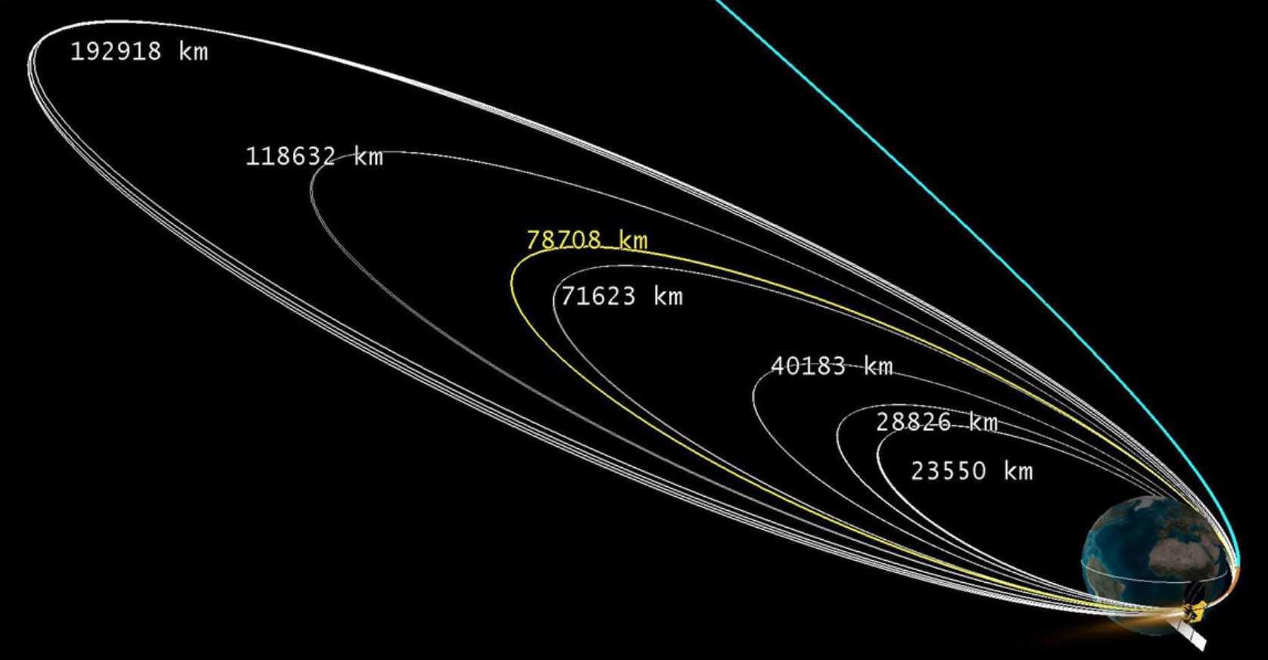
Trajectory:

Slide 18
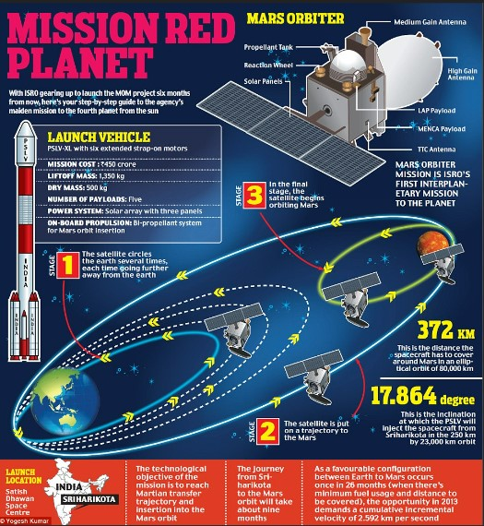
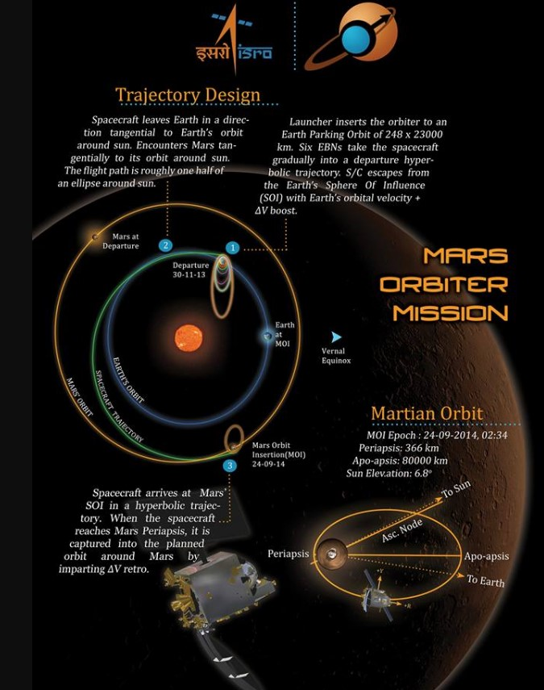
M
O
M

Slide 19
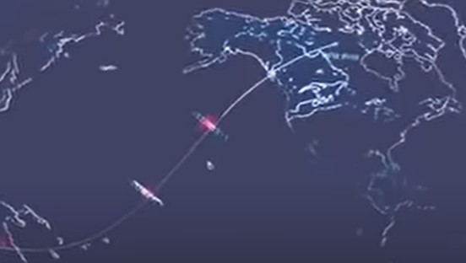
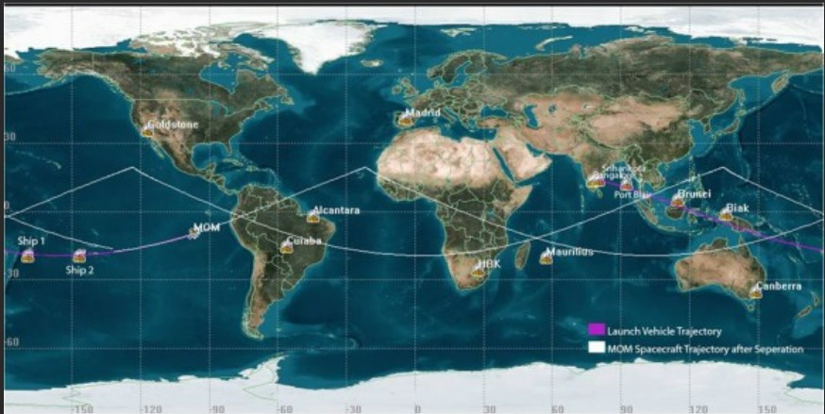
Navigations established to track the satellite:

Slide 20
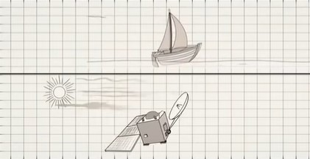
Fuel saving method:
In order to reduce the fuel consumption antennas were installed
This technique is similar to the method of ships travelling by the flow of wind
Similarly the antennas will absorb the solar radiation and provide an alternate for fuel
This reduced the weight of the satellite
It also reduced the cost spent on fuel

Slide 21

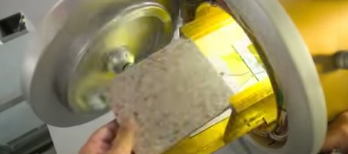
Material of the satellite:
A composite fibre created from plastic dumped in the oceans along with Aluminium metal
Light weight and capability to bare high weather conditions

Slide 22
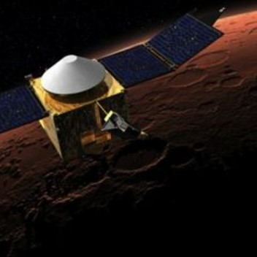
TRANS MARS INJECTION
On 30 November 2013 at 19:19 UTC, a 23-minute engine firing initiated the transfer of MOM away from Earth orbit and on heliocentric orbit toward Mars. The probe travelled a distance of 780,000,000 kilometres (480,000,000 mi) to reach Mars

Slide 23
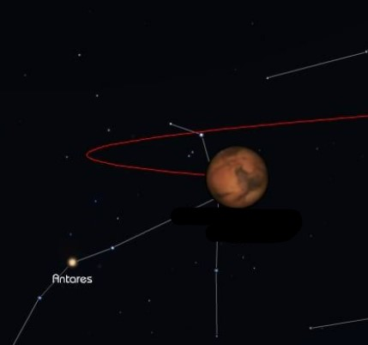
MARS ORBIT INSERTION
The plan was for an insertion into Mars orbit on 24 September 2014, approximately 2 days after the arrival of NASA's MAVEN orbiter.
The 440-newton liquid apogee motor was test fired on 22 September at 09:00 UTC for 3.968 seconds, about 41 hours before actual orbit insertion
After these events, the spacecraft performed a reverse manoeuvre to reorient from its deceleration burn and entered Martian orbit

Slide 24
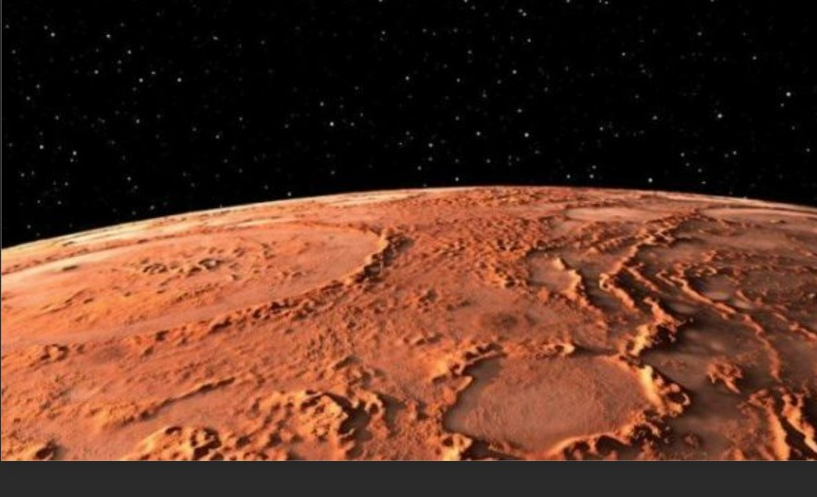
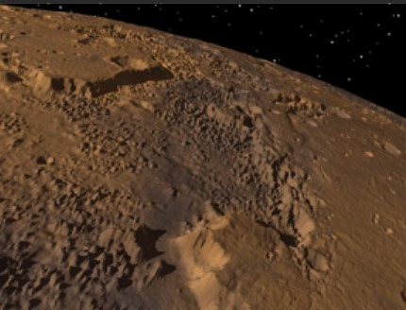
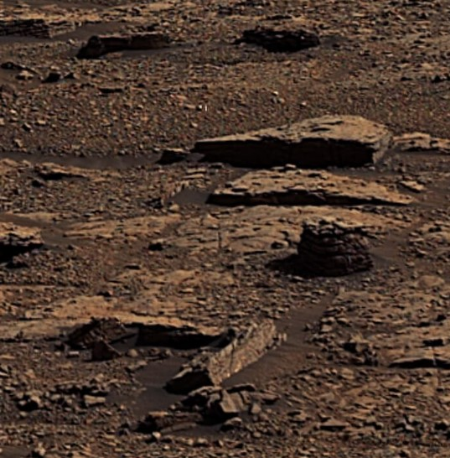
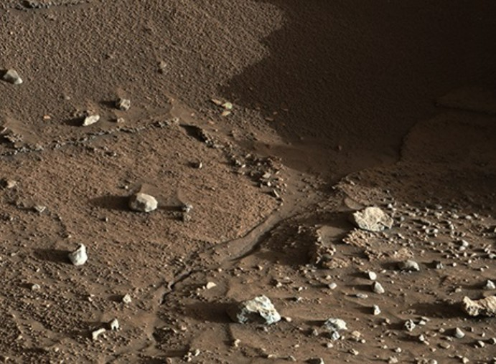
Pics sent by the satellite:

Slide 25

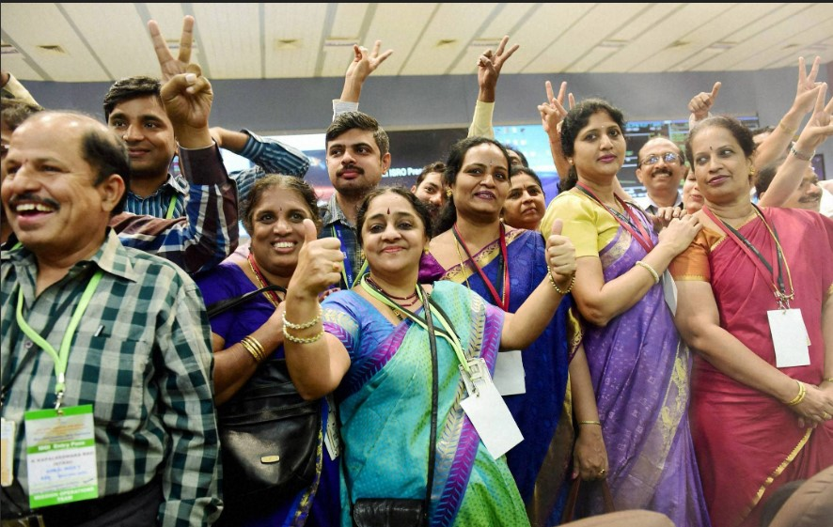
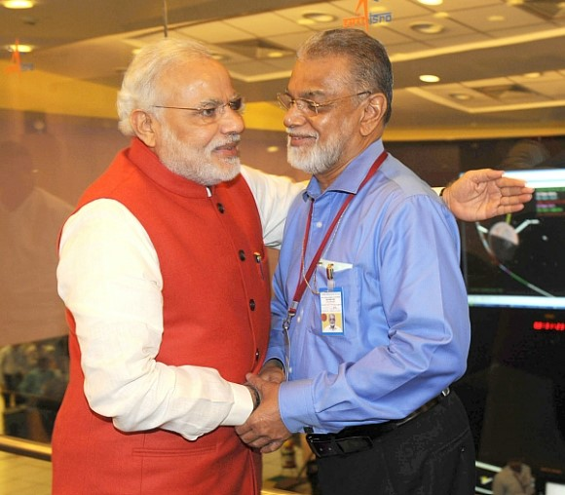
Mangalyan insertion in mars orbit successful!!!

Slide 26
RECOGNITION
In 2014, China referred to India's successful Mars Orbiter Mission as the "Pride of Asia".
The Mars Orbiter Mission team won US-based National Space Society's 2015 Space Pioneer Award in the science and engineering category.
NSS said the award was given as the Indian agency successfully executed a Mars mission in its first attempt; and the spacecraft is in an elliptical orbit with a high apoapsis where, with its high resolution camera, it is taking full-disk colour imagery of Mars.
Very few full disk images have ever been taken in the past, mostly on approach to the planet, as most imaging is done looking straight down in mapping mode.
These images will aid planetary scientists.
An illustration of the Mars Orbiter Mission spacecraft is featured on the reverse of the ₹2,000 currency note of India.
An image taken by the Mars Orbiter Mission spacecraft was the cover photo of the November 2016 issue of National Geographic magazine, for their story "Mars: Race to the Red Planet"

Slide 27
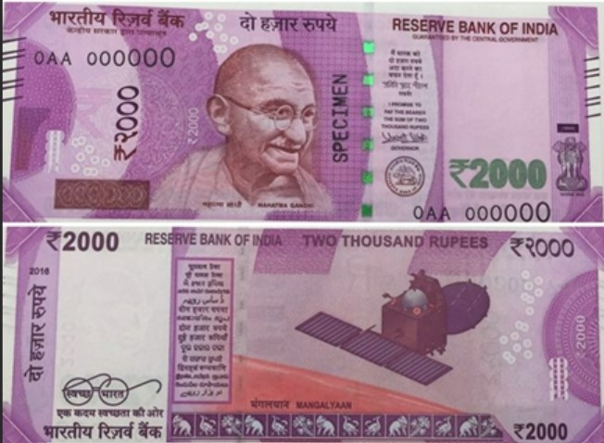

thank you

