Slide 1


AD POSTING WEBSITE
FOR BUYER-SELLER INTERACTION OVER PURCHASE OF USED PRODUCTS
18071A0509 – CH YASASWINI
18071A0524 – K VAISHNAVI
18071A0565 – CH LIKHITA

Slide 2
ABSTRACT
Our main focus is on the student community, because it is limited to college or of any organization and by which there is very less chance of frauds to take place.
On connect platform ,buyer can search for the product based on categories, seller will take the pictures of his product and then choose a category for posting his product price and description to sell

Slide 3
FEATURES
Any user can add his/her favourite products to ‘My Favourites’.
Any event details of the organization can be posted in the website by the club heads.
Buyer can interact with product-seller and can bargain with seller through the WhatsApp chat option available.

Slide 4
EXISTING SYSTEM
Sometimes sellers ask for some money in advance as shipping charge and the rest amount as Cash on Delivery. So buyers may suffer from trust issues .
You are prone to a fraud if you are wiring money or you don't take precaution while transacting with a seller / Buyer.
It's more of a hyperlocal platform and you need to continuously search for products in order to get a bargain or a great deal.

Slide 5
PROPOSED SYSTEM
Since the proposed website (CONNECT) is limited to a particular organization, there is less chance of frauds to take place.
In case of any fraud, the problem can be resolved since all the details of every seller and buyer are stored in that particular organization’s database.
Giving them your home address is not absolutely required .

Slide 6
Python
Command Prompt
Virtual environment
Django
Visual Studio Code
Pillow
Passlib.hash
PostgreSQL
PgAdmin4
Psycopg2
SOFTWARE
REQUIREMENTS

Slide 7
Ethernet connection (LAN) OR a wireless adapter (Wi-Fi)
Hard Drive: Minimum 32 GB; Recommended 64 GB or more.
Memory (RAM): Minimum 1 GB; Recommended 4 GB or above.
Processor: Intel i3 and above
Hard Disk: 10GB: Minimum
HARDWARE
REQUIREMENTS

Slide 8
SOFTWARE DESIGN
UML DIAGRAMS
Unified Modelling Language is a tool that helps a designer to present his ideas about the project to his client and his developer.
Modelling plays a crucial role in designing a software.
A poorly designed model can lead to a poorly developed software.
A UML system has using five different views that help in describing systems from different perspectives.

Slide 9


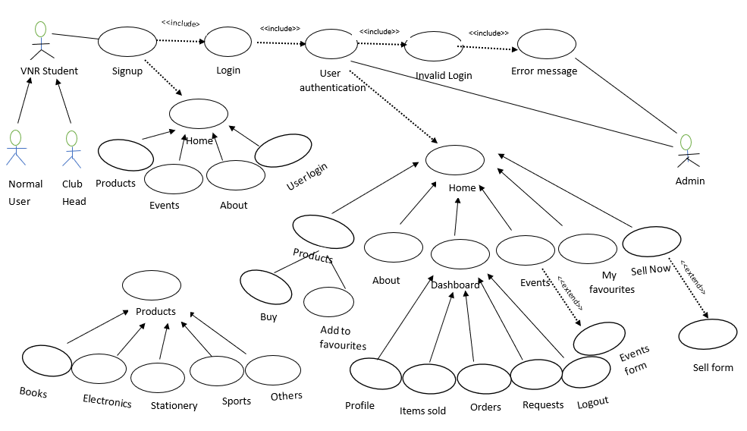
USE CASE DIAGRAM

Slide 10
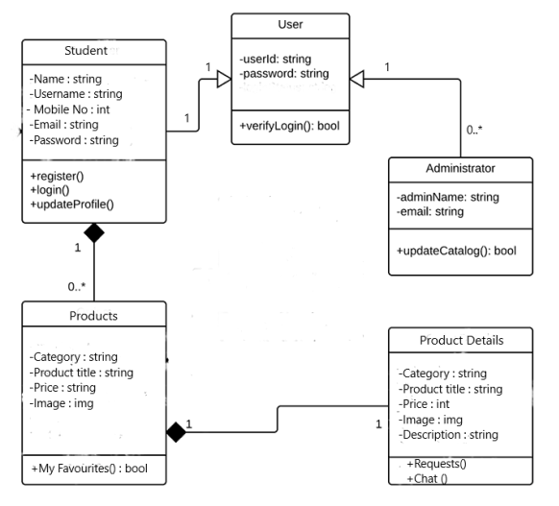
CLASS DIAGRAM

Slide 11
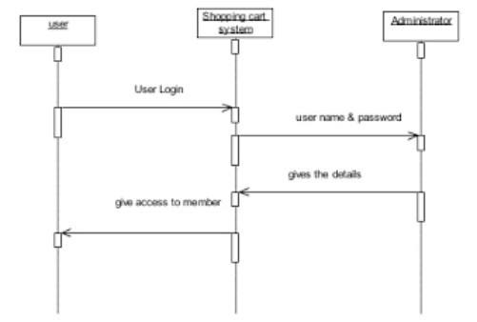
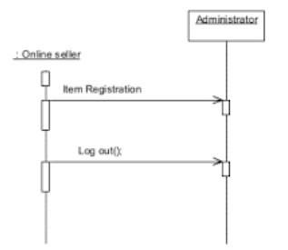
SEQUENCE DIAGRAM
User Registration
Seller Registration

Slide 12
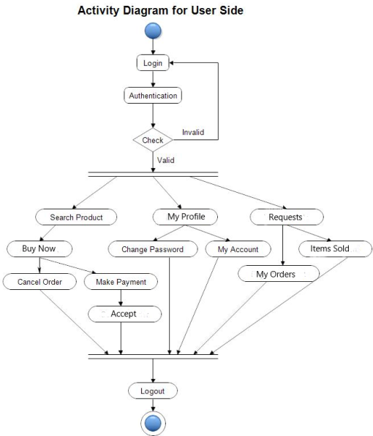
ACTIVITY DIAGRAM

Slide 13
Sign Up Page
Login Page
Home Page
About Page
Product Pages
Events Page
My Favourites Page
User Dashboard
Sell Form
Event Registration Form
WEB PAGE
DETAILS

Slide 14
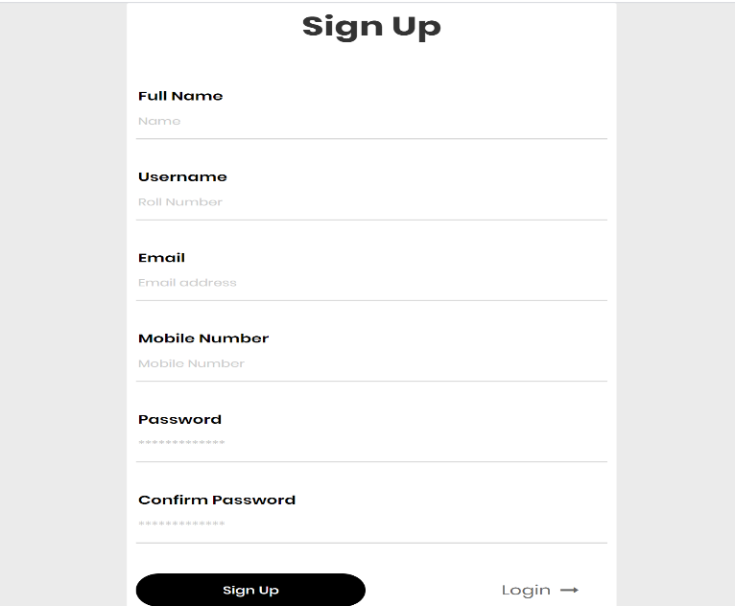
SIGN UP PAGE
The student who wants to register in the website needs to provide his/her valid organization roll number as username, full name, email, mobile number, password.

Slide 15
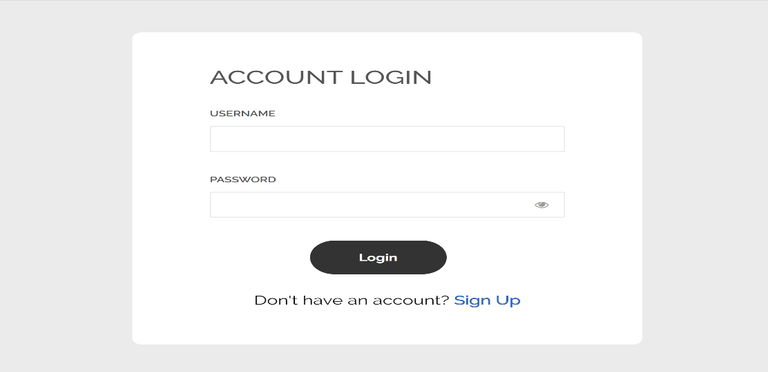
LOGIN PAGE
The user has to provide valid credentials and get authenticated in order to get logged in.

Slide 16
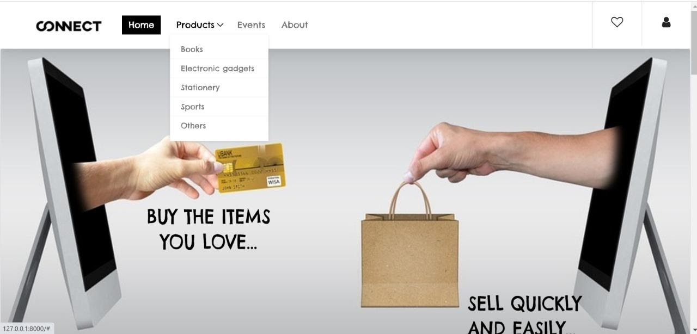
HOME PAGE
Home page consists of Product Categories, Events, Sell Now Button, Latest Products, User Dashboard, About, Favourites.

Slide 17
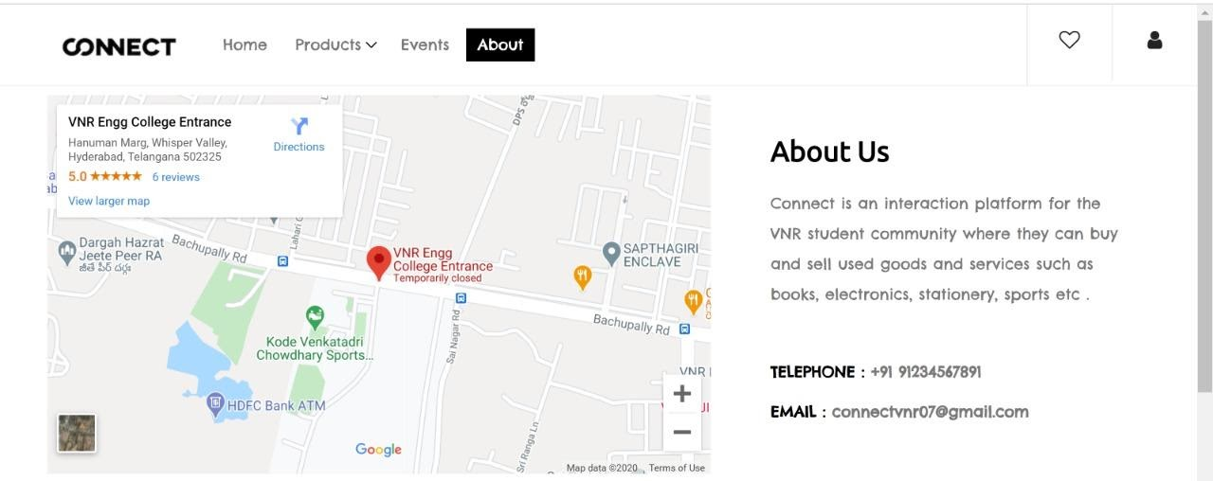
ABOUT PAGE
Location of the organization can be seen here.
In case of any queries, users can contact the details provided.

Slide 18
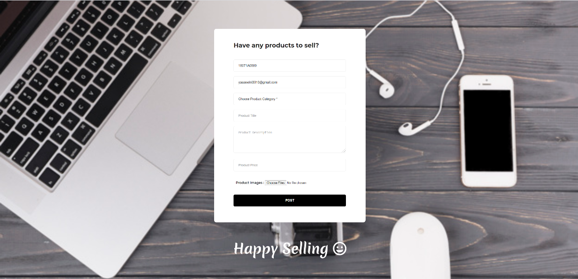
SELL FORM
The seller needs to fill in this form by providing details such as product category, product title, product description, product image, product price.

Slide 19
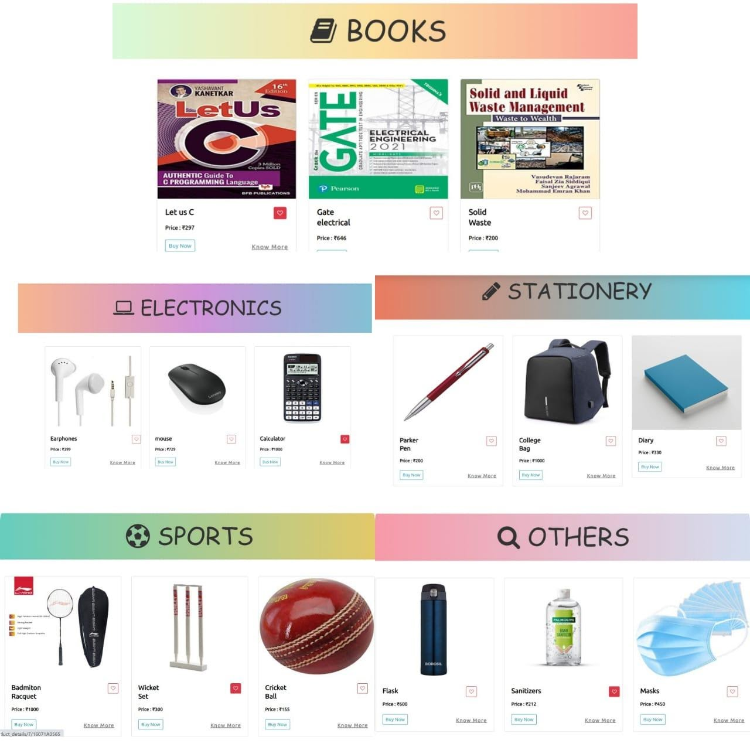
PRODUCTS PAGE
We have five product categories – Books, Electronics, Stationery, Sports, Others.
Every card has its own product image, product title, product price, Know More, buy now and favourite buttons.

Slide 20
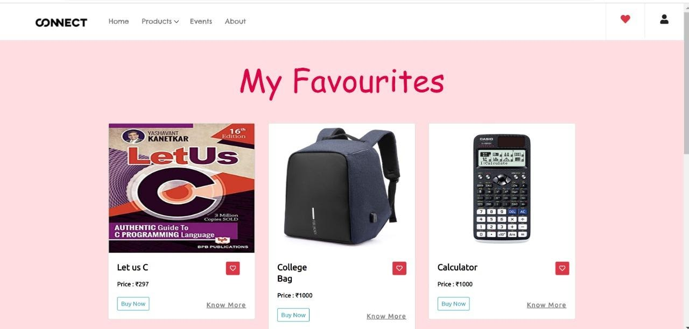
MY FAVOURITES PAGE
The user’s favourite products are displayed here.

Slide 21
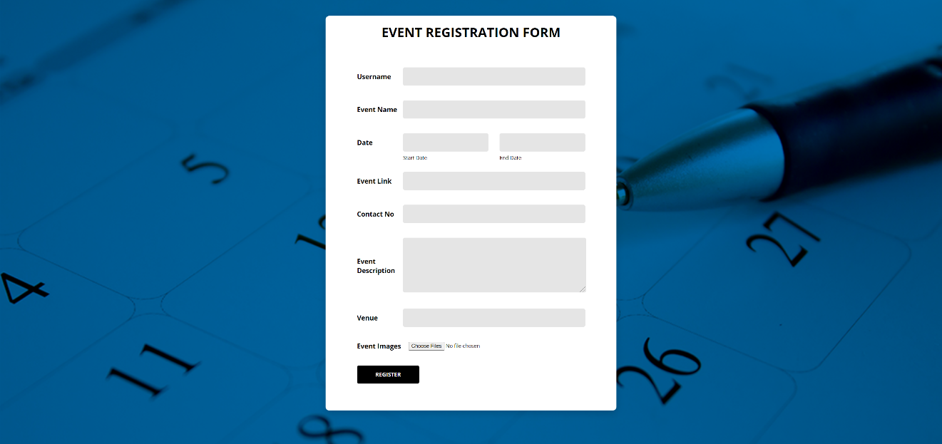
EVENT REGISTRATION FORM
The club heads need to fill in this form by providing details such as username, event name, event description, contact number, start date, end date, venue, event link, event images.

Slide 22
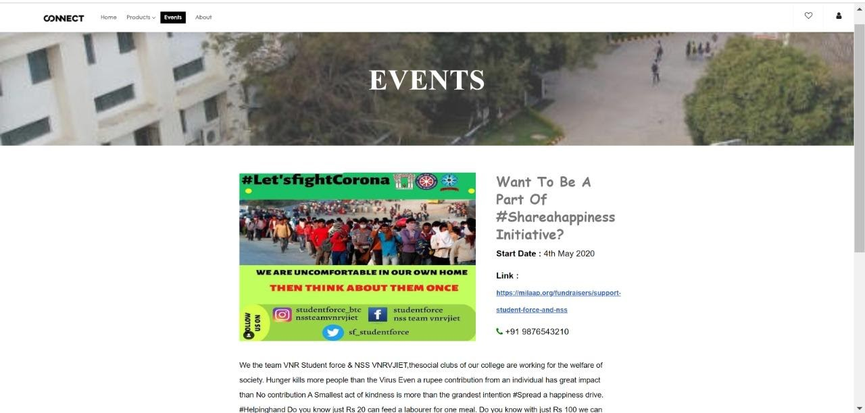
EVENTS PAGE
Event details such as event image, event title, start-date, end-date, event link, venue, event description is displayed which have been posted by the clubs.

Slide 23
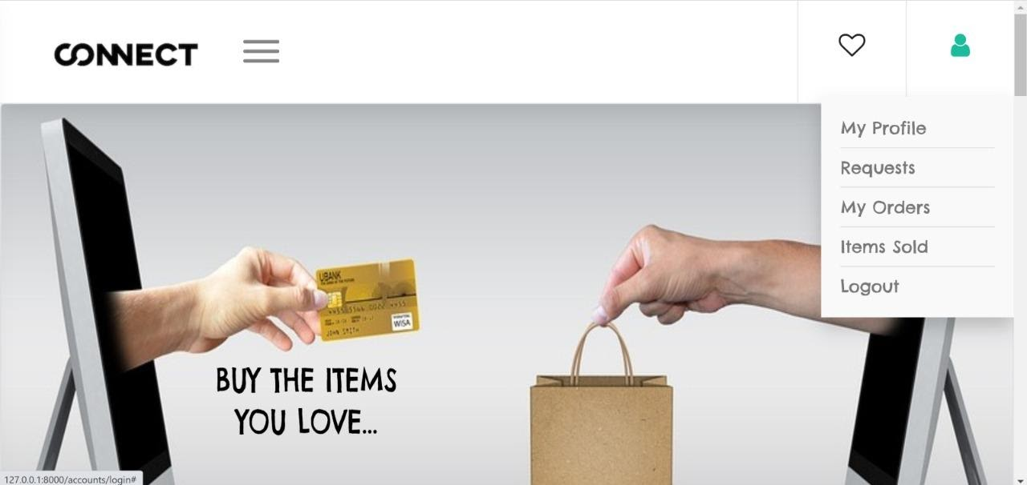
USER DASHBOARD
After user gets logged in, a dashboard will appear that contains My profile, My Orders, Items sold, Requests ,Chat, Logout.

Slide 24
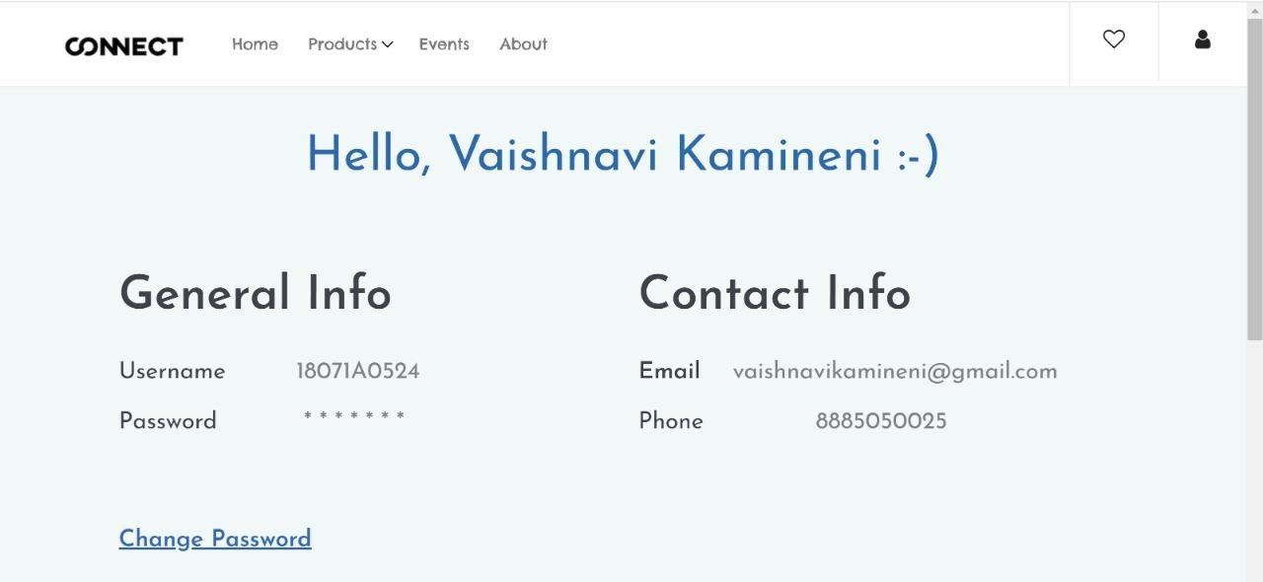
PROFILE
The user details such as name, email, phone number, password (in encrypted format) are displayed.

Slide 25
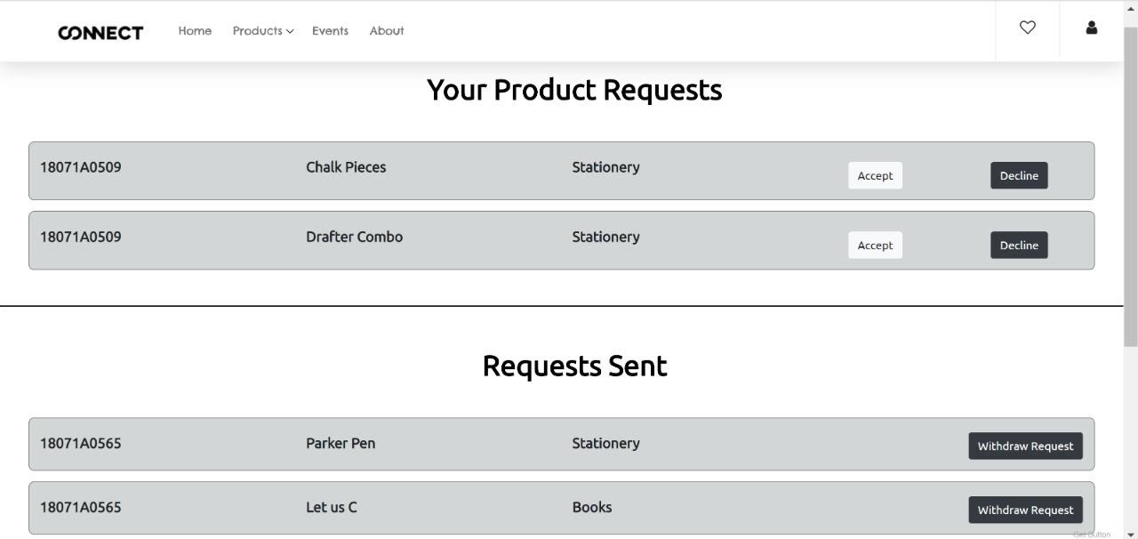
REQUESTS PAGE
When the buyer clicks on “Buy Now” button, then a request is sent to that particular seller and is visible in the seller’s product request. page.

Slide 26
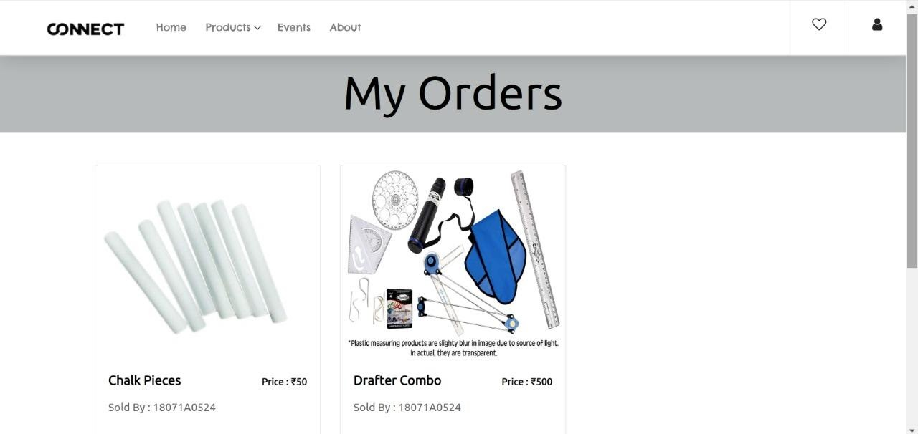
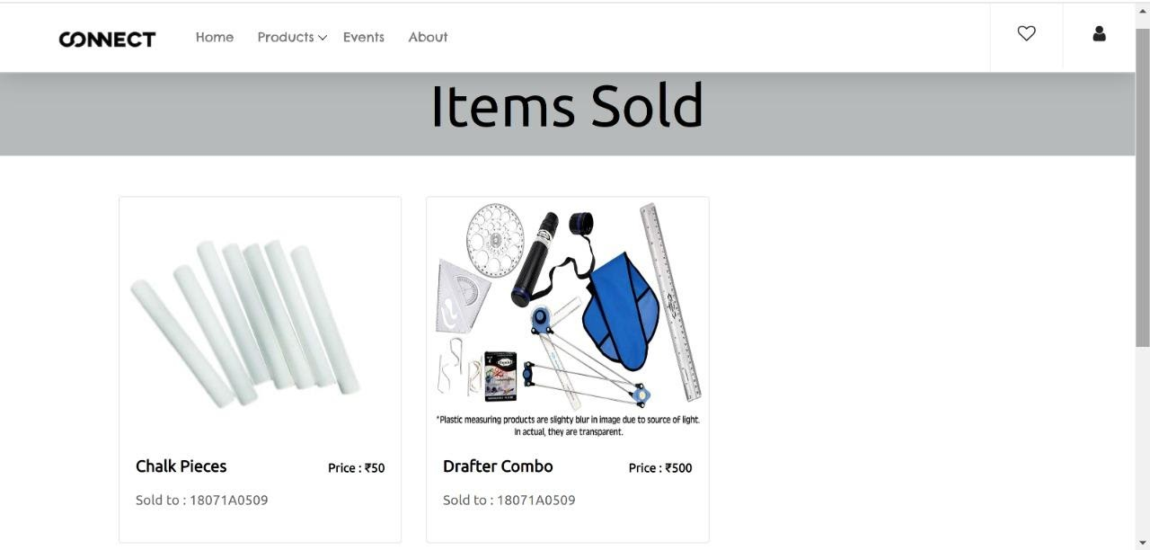
MY ORDERS & ITEMS SOLD
My Orders Page of the buyer
Items Sold Page of the Seller

Slide 27
Website is user friendly (can be opened in any device of any width-responsive).Our website serves a platform where the students can sell their used products when not required to other students who are in need. Students will get to know about the upcoming event details through our platform .As we limited the access of our website to an organization, there will be less chance of frauds and can be resolved easily if any.
CONCLUSION

Slide 28
Implementing inbuilt chat.
Notifications about the events.
Generating personalized information using ML and AI.
Offering discounts using analytics.
Developing the 'Connect' app.
Extending 'Connect to various organizations.
FUTURE SCOPE

Slide 29
https://docs.djangoproject.com/en/3.1/
https://getbootstrap.com/docs/4.0/getting-started/introduction/
https://developer.mozilla.org/en-US/
https://fontawesome.com/
https://fonts.google.com/
https://stackoverflow.com/
http://uigradients.com/
https://colorlib.com/wp/templates/
REFERENCES

Slide 30
THANK YOU

