Slide 1

Introduction to Artificial Intelligence
Sai Deekshith Miyapuram
Vaishnavi Malapati Sai

Slide 2
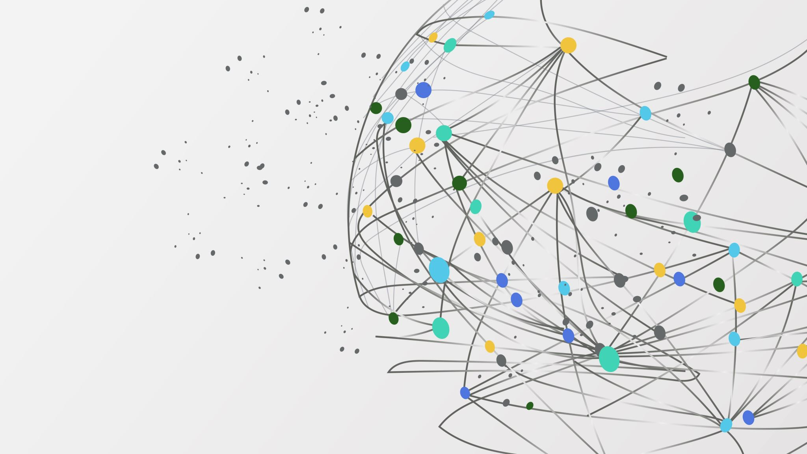
Facial Emotion Recognition

Slide 3
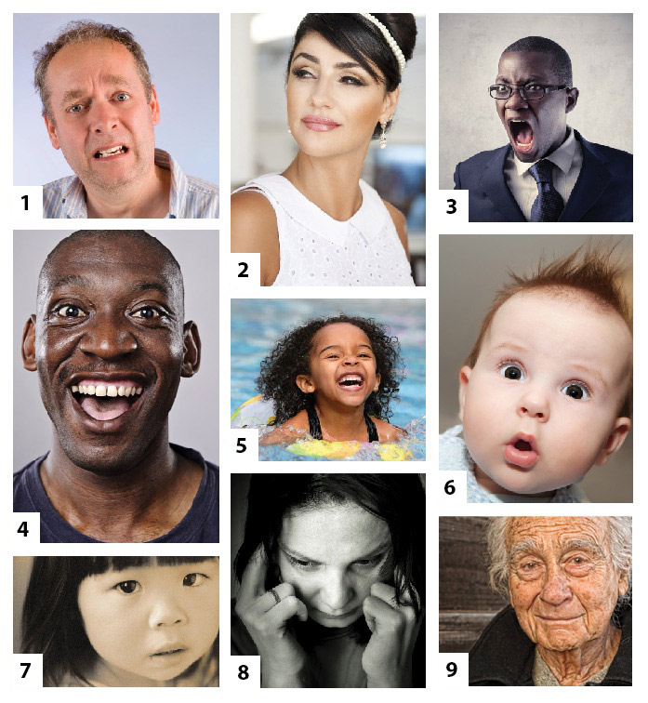
Approach
Facial recognition is a technology which works by comparing selected facial features from given images.
Various expressions are captured based on facial features for identification of emotion.
A model where each face is classified based on the emotion shown on the individual’s face
One of seven categories such as Angry, Disgust, Fear, Happy, Sad, Surprise, Neutral is predicted by the model.

Slide 4
Methodology
In this project we are targeting the emotions of an individual using neural networks. The pipeline for the project is given below:
Input Data : A dataset from dropbox is downloaded and unzipped in the colab.
2. Pre-processing : The training set consists of images for various expressions and is divided into train and test. The data is pre-processed to standard size so the image is easily recognizable.
3. Building CNN layers :A sequential CNN model is used in this project. The CNN model is designed and trained using Keras. We use OpenCV for face detection by using its face detection classifier.

Slide 5
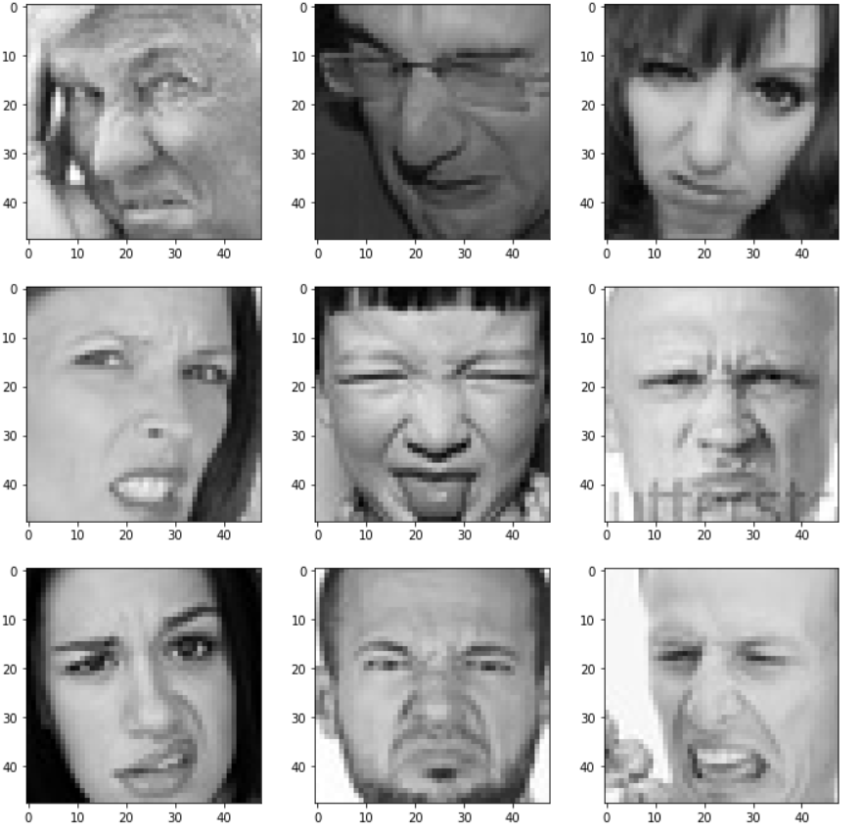
Image processing
1:importing the image via image acquisition tools
2:analysing and manipulating the image
3:output based on image analysis

Slide 6
Steps to execute the Project
Insert the Dataset in Python Notebook.
Install the required Packages & run the code in Python integrated environment.
Insert an image and check if it’s correctly detecting the emotion.
Then run the .py file to identify the emotions

Slide 7
Deliverables
Face Emotion Recognition Model
Source Code with README file
YouTube Demo Video

Slide 8
Evaluation methodology
AI model to identify various expressions
How accurately the model is predicting the expressions.
Graph showing the loss/epoch and accuracy/epoch

Slide 9
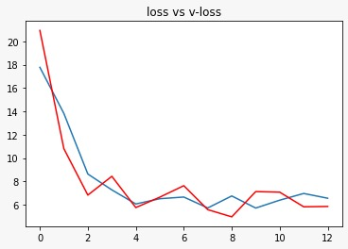
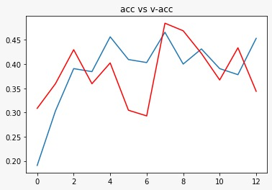
Plotting Accuracy and Loss
The lesser the difference between validation accuracy and the accuracy more stable will be the model and similarly lesser the difference between Loss and validation loss it’s better for the model.

Slide 10

Thank you…!

