Slide 1

LENDING CLUB CASE STUDY
Group member:
VAISHNAVI NAYAK S

Slide 2

PROBLEM STATEMENT
Lending club is largest online loan marketplace, facilitating personal loans, business loans.
Lending club wants to identify “risky” loan applicants who are unlikely to pay loan back. These applicants are called as “Defaulters”.
Identify variables which are strong indicators of loan default so that club can prevent giving loan to them avoiding credit loss.

Slide 3
PROBLEM SOLVING METHODOLOGY
Data understanding
Data cleaning
Datatype conversion
Derived metrics
Univariate analysis
Segmented univariate analysis
Bivariate analysis

Slide 4
DATA CLEANING & DERIVED METRICS
FIXING ROWS:
Remove summary rows, header and footer rows
Delete duplicate rows
FIXING CLOUMNS
Add column names if missing.
Delete unnecessary columns.
Align misaligned columns.
Remove columns that have all missing values.
Remove columns that have high percentage of missing values.
Drop unnecessary columns with string names.
Drop columns having only 1 unique values.
Drop customer behavior variables as these are not available at time of loan application.
DERIVED METRICS
Derive the new column of loan issue month and year
Create buckets of loan amount and annual income as these are continuous variables.

Slide 5
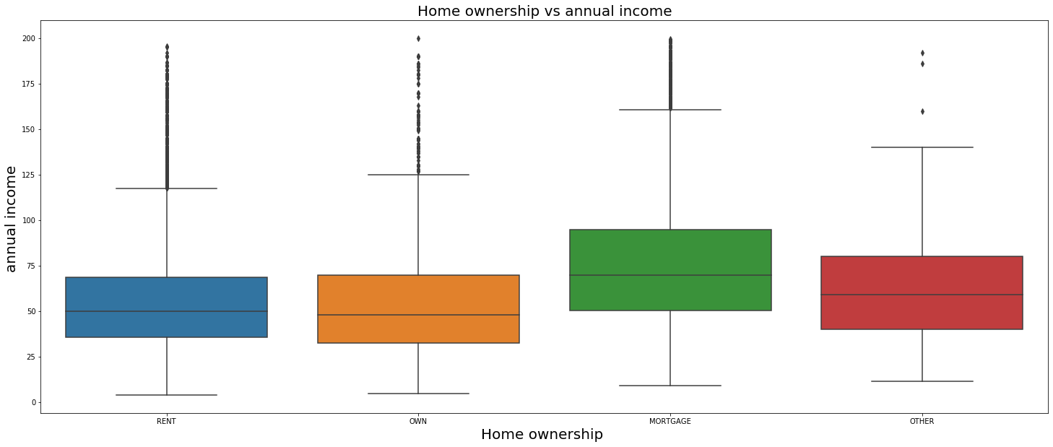
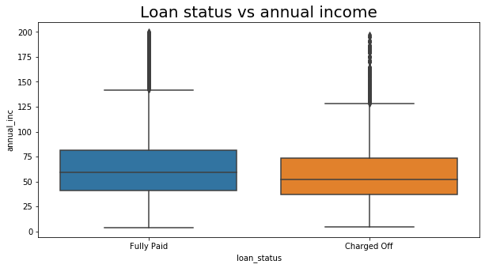
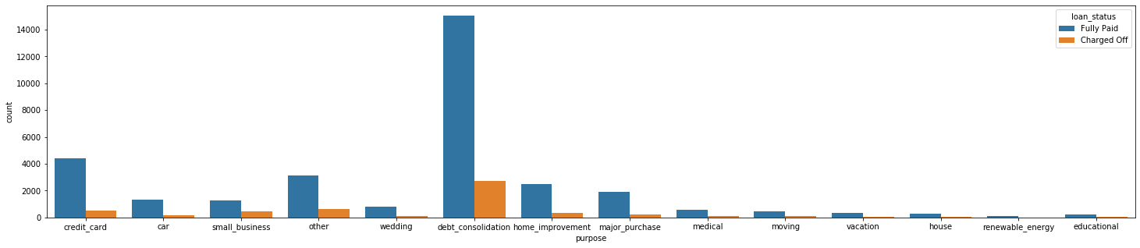
ANNUAL INCOME ANALYSIS

Slide 6
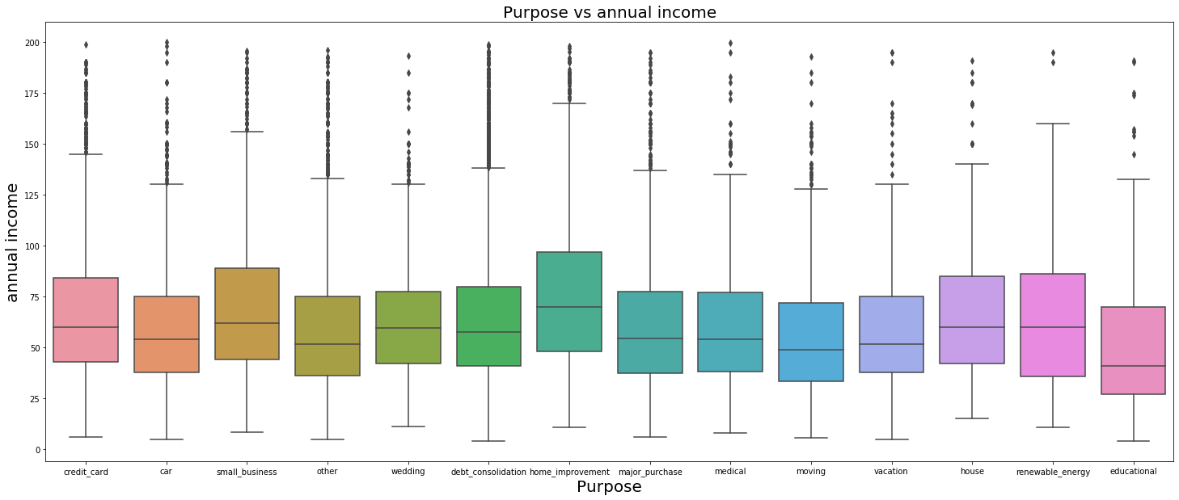
Observations:
Lesser the annual income , more chances of getting defaulted
Those kept home on mortgage have higher annual income, so less chance of getting defaulted.
Debt reconsolidation purpose loan borrowers have less annual and chances of getting charged off is also more .
Ones who have taken loan for home improvement loan amount is lesser and annual income is higher so less chance of getting defaulted

Slide 7
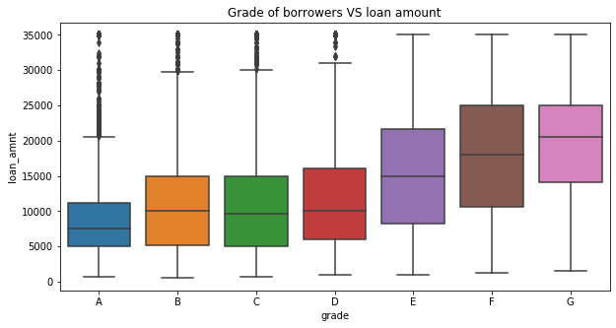
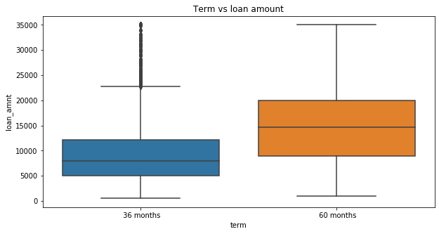
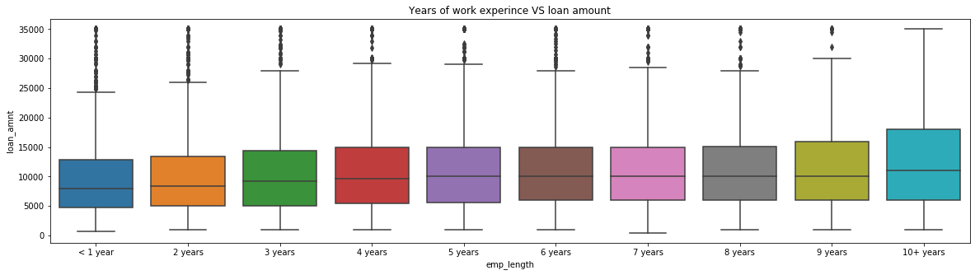
LOAN AMOUNT ANALYSIS

Slide 8
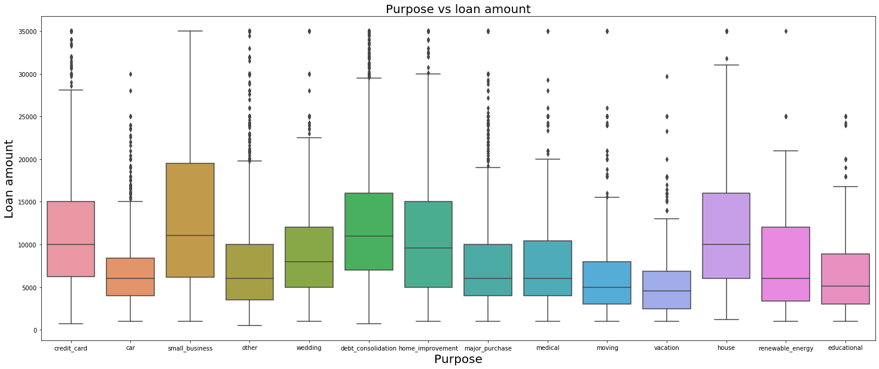
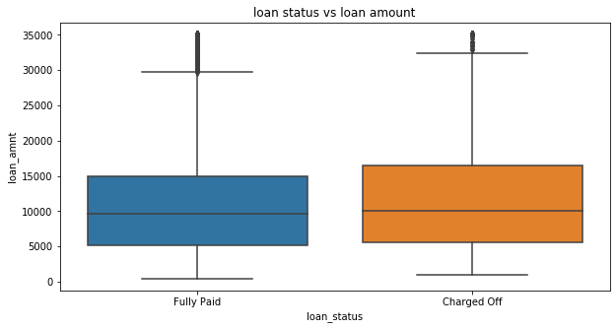
Observations:
Loan amount is more for higher term(60 months)
Lesser the grades ,higher the loan amount, grade A has lower loan amount median, Grade G has higher loan amount
As years of experience increases, loan amount increases
Charged Off loans have higher loan amounts compared to fully Paid ones.
Loan amount for small business is high, followed by house and debt consolidation

Slide 9
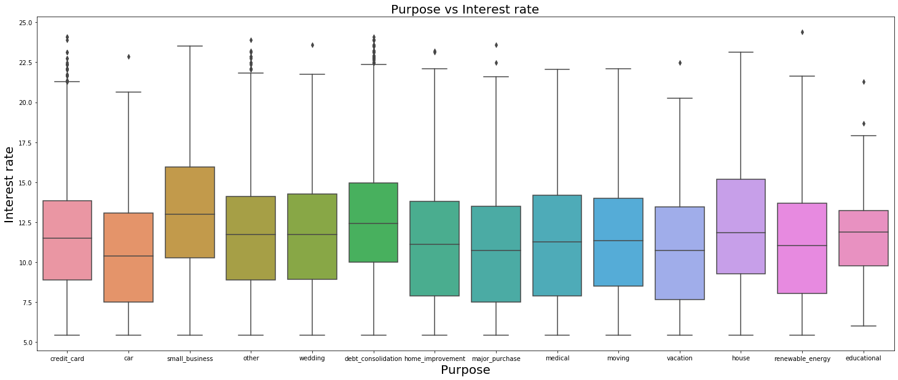
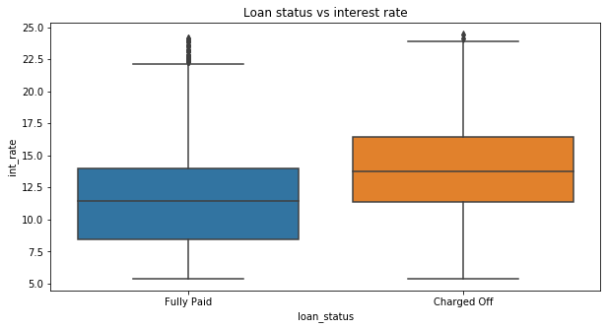
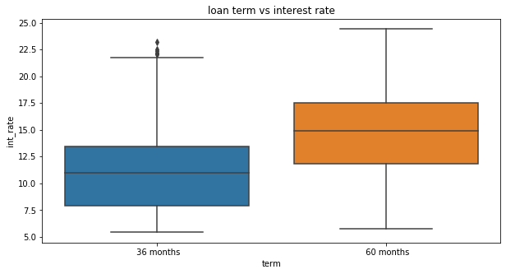
INTEREST RATE ANALYSIS
Observations:
Higher the interest rate , more the term
Higher the interest rate more the chances of getting defaulted as term and loan amount is more
Interest rate for small business followed by house and debt consolidation is more

Slide 10
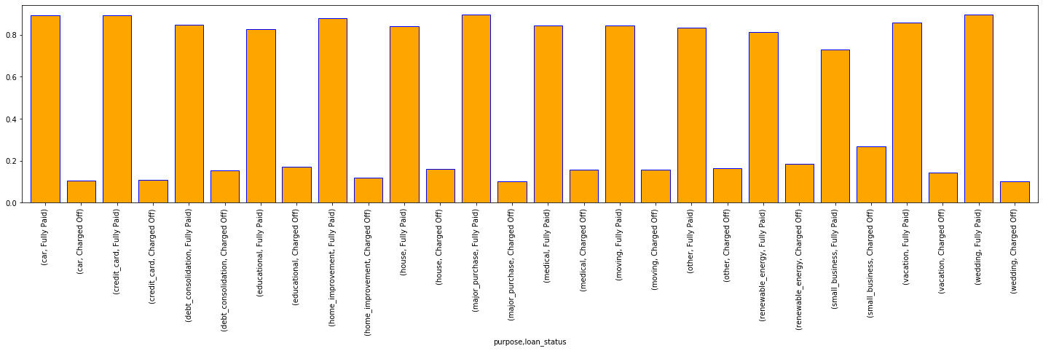
Loan status Vs Purpose
Observation:
Small business and renewable energy, debt reconsolidation have high charge off % , hence risky

Slide 11
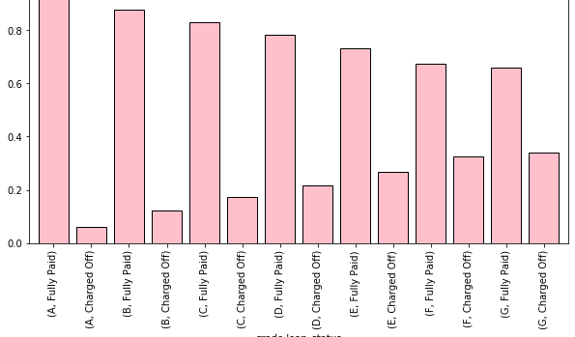
Loan status vs Grade
Observation:
Lesser the grades , more chances of getting defaulted

Slide 12
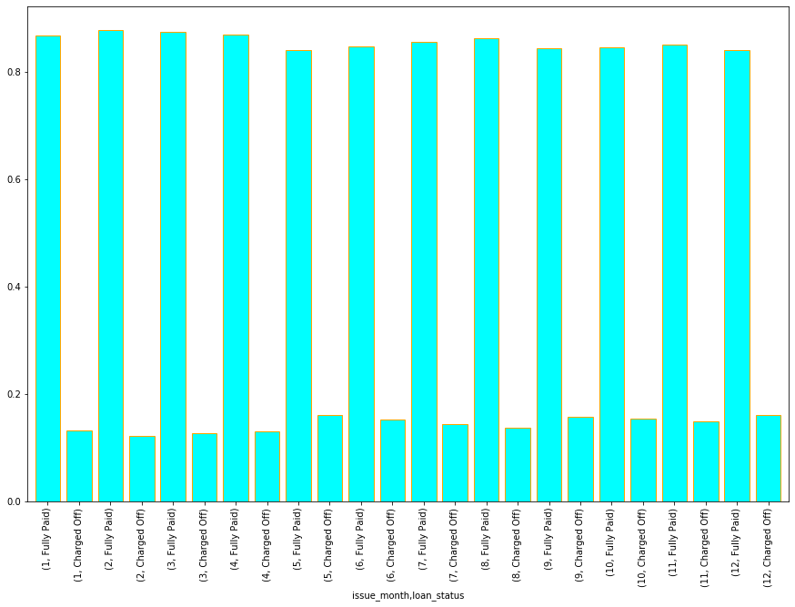
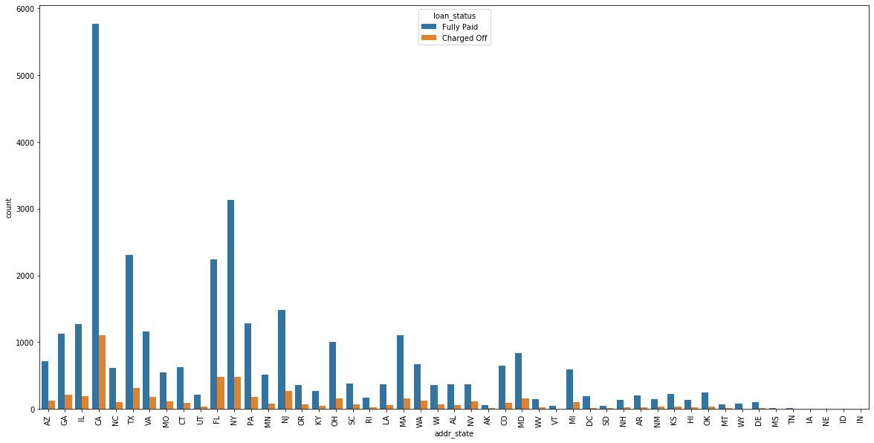
Loan status vs state
Loan status vs Issue month
Observation:
State CA ,NY, FL have high chances of getting defaulted
Loan taken in month of May and December have high chances of defaulted

Slide 13

CONCLUSION
DTI of applicant must be checked as chances of getting defaulted is more if DTI is more
Loan amount greater than 16000 $ and annual income less than 30000 $ have high risk of getting defaulted.
Debt reconsolidation, renewable energy , house loan and small business purpose loans are risky.
Lower the grades more the risk i.e. grades E,F,G.
Loans having high interest rate above 15% is risky, this is taken for small business and house loan.
If the term is 60 months then risk is more.
State CA ,NY, FL have high chances of getting defaulted.
Loan taken in month of May and December have high chances of defaulted, due to mid and year end vacation.
House and major purchase loan, with high annual income , less DTI hence safe investment

