Slide 1
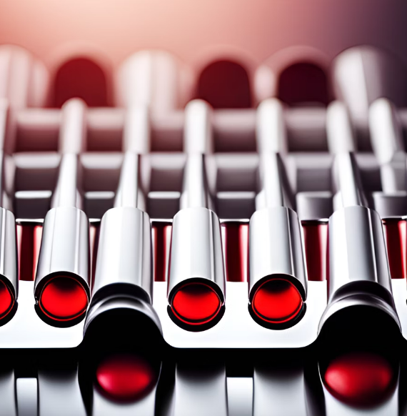
Optimizing Your Health: A Comprehensive Blood Test Panel

Slide 2
Problem statement:
Blood Test Panel to check blood sugar level, electrolytes balance and kidney health.

Slide 3
Solution:
Blood Test Panel is a project designed to obtain the results of various blood tests, including blood sugar levels, electrolyte balance, and kidney health. The blood test panel prompts the user to select the desired blood test, makes the necessary inputs accordingly, and outputs the test results accordingly

Slide 4

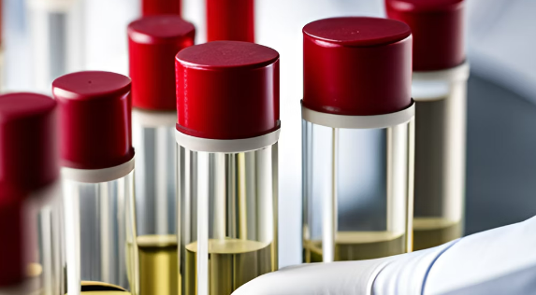
Introduction to Blood Test Panels Blood test panels are a common way for healthcare professionals to evaluate a patient's overall health. These panels typically include tests for blood sugar levels, electrolyte balance, and kidney health. In this section, we will provide an overview of what to expect from a blood test panel and why it is important to get one.

Slide 5
Electrolyte Balance | Blood Sugar Levels | Kidney Health
Electrolytes are minerals in the body that carry an electric charge. They are essential for many bodily functions, including nerve and muscle function, maintaining fluid balance, and regulating blood pressure | Blood sugar levels are an important indicator of overall health and can help identify potential issues with blood glucose regulation. Fasting blood sugar levels should be between 70-99 mg/dL. | The blood test panel also includes tests to check the health of your kidneys. The kidneys play a vital role in filtering waste and excess fluids from your body. Abnormal levels of certain substances in the blood can indicate kidney problems

Slide 6
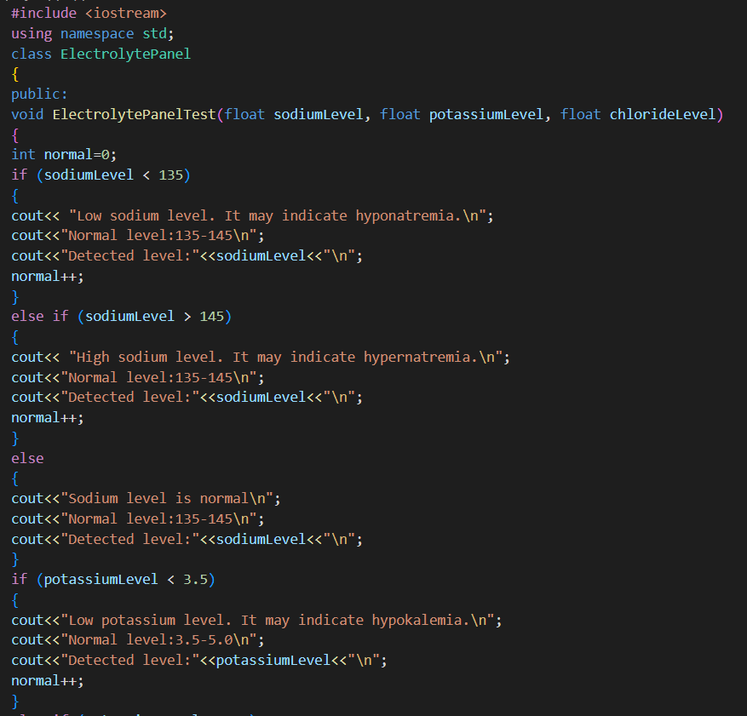
Code

Slide 7
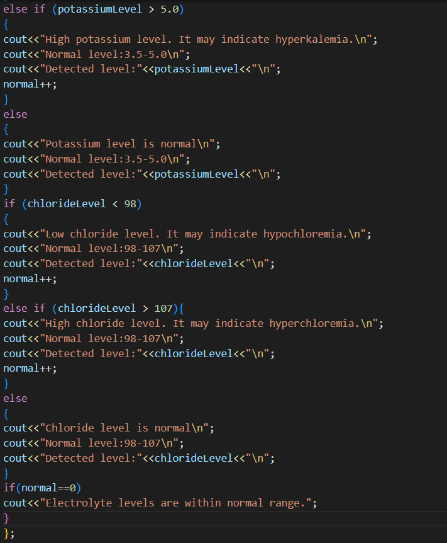

Slide 8
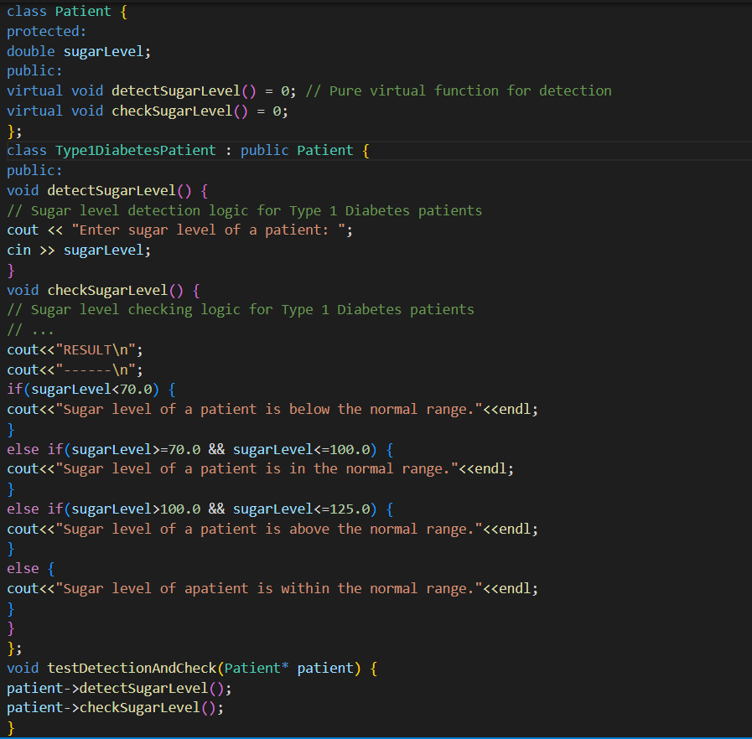

Slide 9
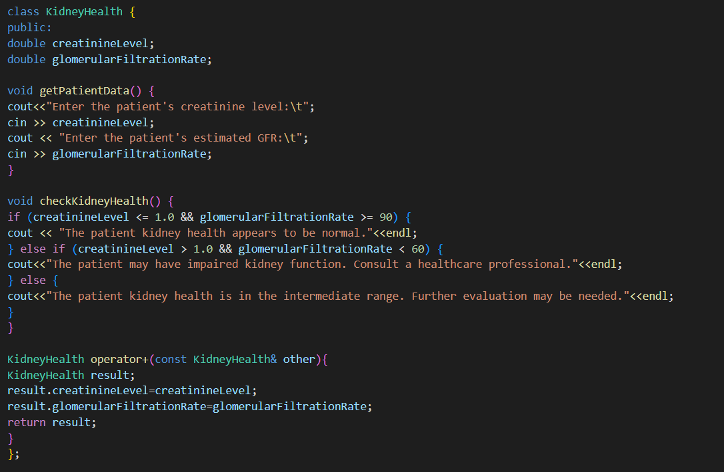

Slide 10
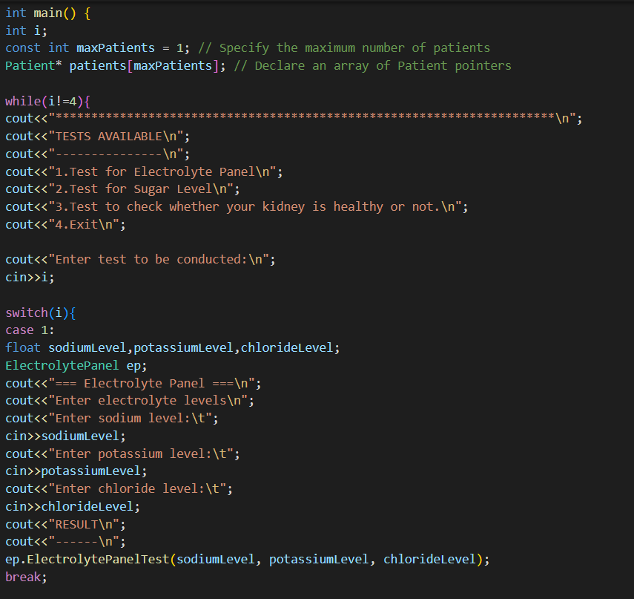

Slide 11
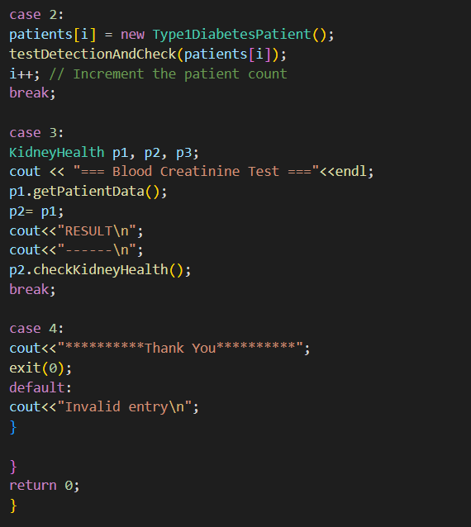

Slide 12
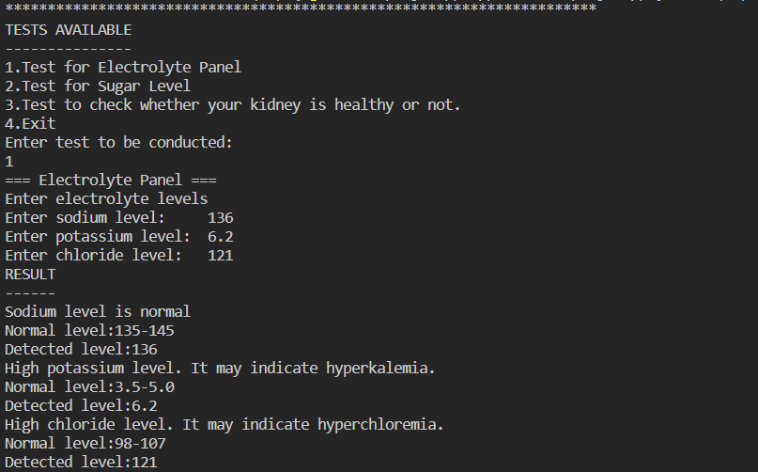
OUTPUT

Slide 13
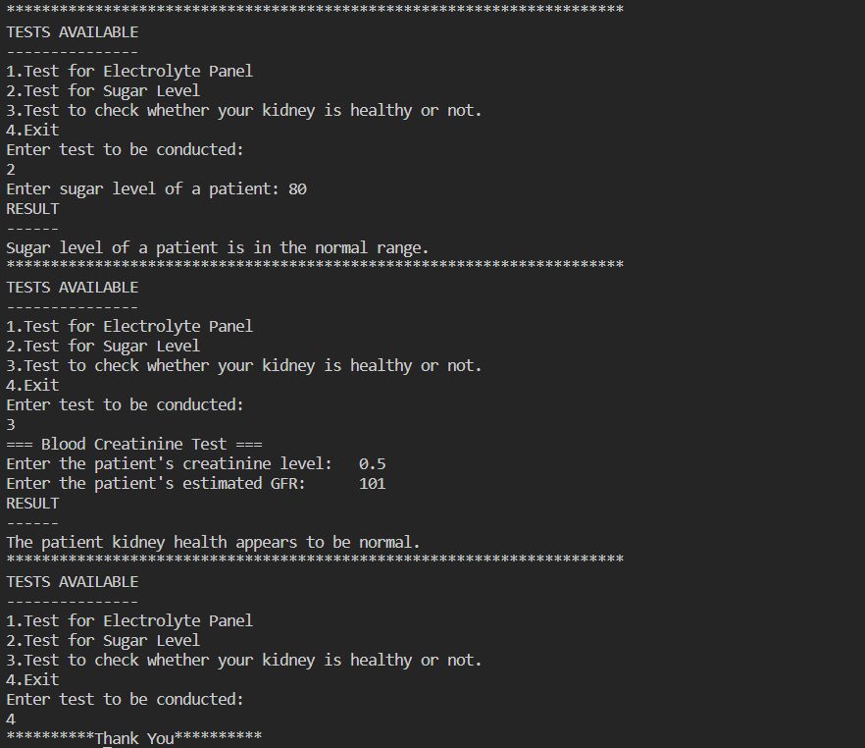

Slide 14


FUTURE SCOPE
The blood test panel project holds significant potential for further development and enhancement like Additional Test Panels, User Interface Improvement,
Machine Learning and Predictive Analytics.
.

Slide 15


CONCLUSION:
The blood test panel project has great potential for improving healthcare outcomes and patient experiences. With continued development and innovation, it can become an indispensable tool for healthcare professionals and individuals seeking to maintain their health.

Slide 16
THANK YOU
NAME- Swapnaja paikrao 22070122230
Sreevaishnavi PS 22070122220
Sneha Kumari 22070122212

