Slide 1
Mining Environment Inspection Module
ECEN 5613 – Embedded System Design
Project Design Review (PDR)
Mrunal Yadav (mrunal.yadav@colorado.edu)
Vaishnavi Patekar (vaishnavi.patekar@colorado.edu)
Mining Environment Inspection Module
(Mrunal Yadav & Vaishnavi Patekar)
03-12-2023

Slide 2
Project Overview
Developing a portable device to inspect the mining-environment in order to decide whether the mine-environment is safe for the mine-workers or not.
Determining the environment conditions like the harmful gases present, temperature, pressure and the humidity based on the sensor data
Log the environment data and use this information for the decision making.
Mining Environment Inspection Module
(Mrunal Yadav & Vaishnavi Patekar)
03-12-2023

Slide 3
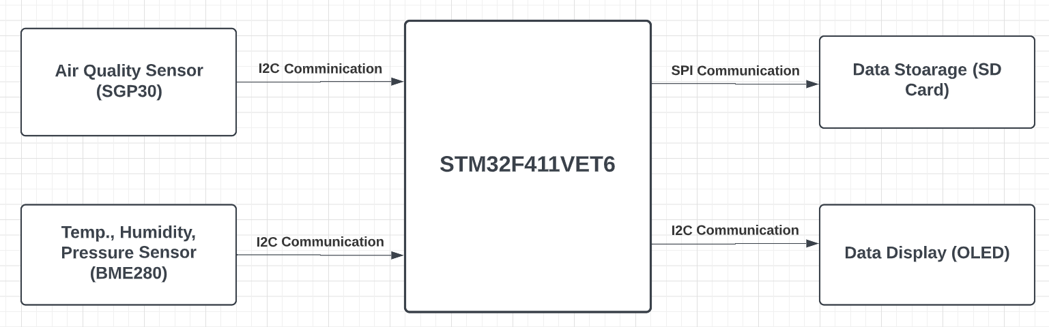
Block Diagram
Mining Environment Inspection Module
(Mrunal Yadav & Vaishnavi Patekar)
03-12-2023

Slide 4
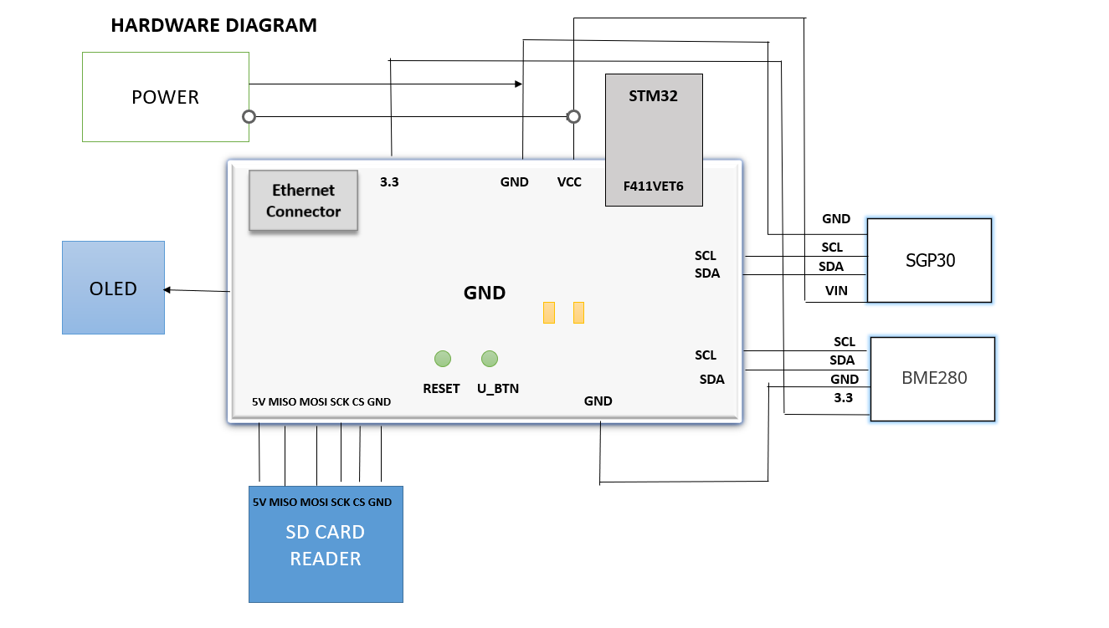
Mining Environment Inspection Module
(Mrunal Yadav & Vaishnavi Patekar)
03-12-2023

Slide 5
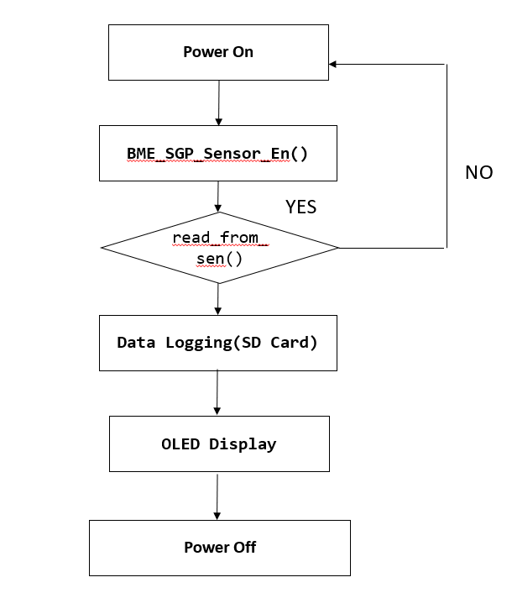
Software Flow Diagram
Mining Environment Inspection Module
(Mrunal Yadav & Vaishnavi Patekar)
03-12-2023

Slide 6
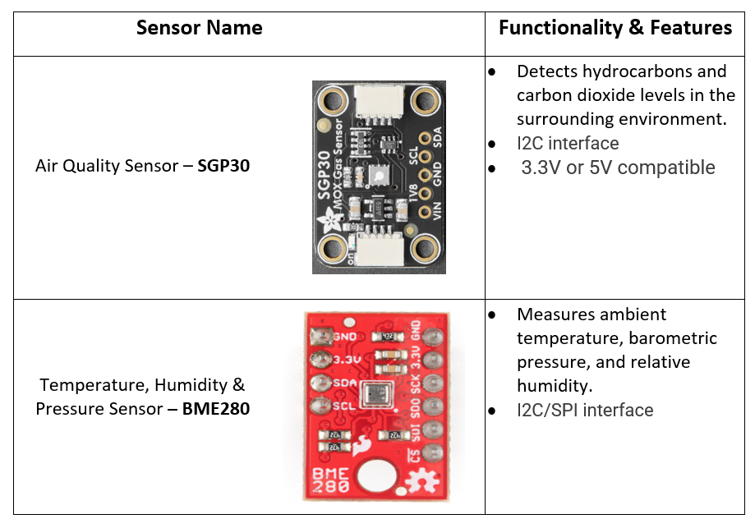
Sensor Details
Mining Environment Inspection Module
(Mrunal Yadav & Vaishnavi Patekar)
03-12-2023

Slide 7
Project milestones
Task | Student(s) Responsible | Target Completion Date | Expected Completion Date
Ordering Components | Both | 19 March | 19 March
Interfacing Air Quality Sensor SGP30 | Vaishnavi | 26 March | 26 March
Interfacing BME280 Sensor | Mrunal | 26 March | 26 March
SD card over SPI data logger to record data points | Both | 9 April | 9 April
OLED interfacing | Vaishnavi | 16 April | 16 April
PCB designing | Mrunal | 23 April | 23 April
Testing and Stretch goals | Both | Last week | Last week
Mining Environment Inspection Module
(Mrunal Yadav & Vaishnavi Patekar)
03-12-2023

Slide 8
New Software/Hardware Implementation
Data Logging using SD card (SPI Communication, FatFs File System)
PCB Design (using Altium) and manufacture of prototype
OLED Display
Temperature Sensor hardware bring-up (Extended)
Data communication via Bluetooth (Extended)
Mining Environment Inspection Module
(Mrunal Yadav & Vaishnavi Patekar)
03-12-2023

Slide 9
Project Deliverables
Project Basic Goals
Interfacing Air Quality Sensor SGP30 with STM32 Microcontroller.
Interfacing BME280 Sensor with STM32 with STM32 Microcontroller.
SD card over SPI data logger to record the data.
PCB designing
Fall-back plan
Wireless data display using Bluetooth in case data logging through SD card does not work
Solderless breadboard implementation if PCB board isn’t functional
Stretch requirements
Motor driving Bot
Temperature Sensor Bring-Up
Mining Environment Inspection Module
(Mrunal Yadav & Vaishnavi Patekar)
03-12-2023

