Slide 1

SDM COLLEGE OF ENGINEERING AND TECHNOLOGY,DHARWAD-580002
(An autonomous Institution affiliated to Visvesvaraya Technological University, Belgaum – 590018)
Department of Electronics and Communication Engineering
MAJOR PROJECT ON STUDY AND ANALYSIS OF CMOS PERFORMANCE FACTORS
PROPOSED BY:
Khushi S.A - 2SD21EC035
Santrupti F - 2SD21EC077
Vaishnavi P - 2SD21EC111
Veena Goudru - 2SD21EC113
STUDENTS OF 7th SEMESTER
UNDER THE GUIDANCE OF:
Prof. Vyas Murnal
Department of ECE, SDMCET, Dharwad-02

Slide 2
Contents
Introduction
Motivation
Literature Survey
Objectives
Problem Statement
Technologies Used
Preliminary Study Done
Introduction To Leakage Power
Leakage Power Reduction
Preliminary Results
Future work
References

Slide 3
Introduction
Study and Analysis of CMOS (Complementary Metal-Oxide-Semiconductor) performance factors are crucial in understanding and enhancing the efficiency of modern electronic devices.
Widely used in integrated circuits (ICs) due to its low power consumption, high noise immunity, and scaling potential.
Essential for optimizing performance as device dimensions shrink and the demand for higher speed and lower power increases.

Slide 4
Motivation
The motivation behind studying and analyzing CMOS performance factors stems from the rapid advancements and evolving demands in modern electronics.
As technology progresses, the need for highly efficient, low-power, and high-speed devices has grown exponentially, particularly in fields such as telecommunications, computing, and portable electronics.

Slide 5
Literature survey
SI No. | Authors | Year Of Publication | Title | Techniques Employed
1. | Yuan Taur and Tak H. Ning | 2022 | Fundamentals of modern VLSI Devices | Scaling techniques
2. | Sarthak Talwara , B. Mohapatrab and Mohammad Rashid Ansari | 2020 | Performance Analysis of CMOS Technology | Reduction of Parasitic
3. | Zitong Han | 2020 | The power-delay product and its implication to CMOS Inverter | Gate sizing and transistor sizing
4. | Vikas Singhai, Saima Ayyub, Paresh Rawat | 2016 | Comparison of Leakage Power Reduction Techniques in 65nm Technologies | Leakage Power Reduction Techniques

Slide 6
Objectives
To perform detailed literature survey on various CMOS performance factors.
To investigate sensitivity of CMOS delay to device parameters.

Slide 7
Problem statement
To perform detailed study, analysis on various CMOS performance factors in VLSI technology.
To perform performance related simulations using CADENCE virtuoso ( 90nm).

Slide 8

Technologies Used
Cadence Virtuoso (Electronic Design Automation (EDA) tool suite)
Technology node : 90 nm

Slide 9
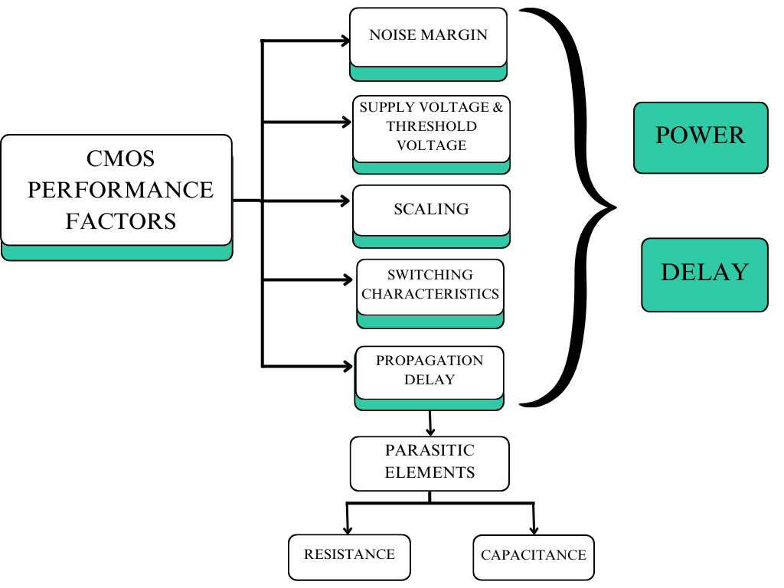


Slide 10
Preliminary Study Done
Noise Margin
Noise margin is the tolerance level for unwanted voltage (noise) that can be present on an input signal without causing errors in the output.
Impact on Power
- Reduced noise margin: Decreased power consumption.
- Increased noise margin: Increased power consumption.
Impact on Delay
- Reduced noise margin: Decreased delay.
- Increased noise margin: Increased delay.

Slide 11
Preliminary Study Done
Switching Characteristics
Switching characteristics in CMOS refers to behaviour of the signal when they change their states from 0 to 1 and 1 to 0 .
Impact on Power
- Increased switching activity – increases power consumption
Impact on Delay
- Longer transition times ( increased switching activity) increases the delay

Slide 12
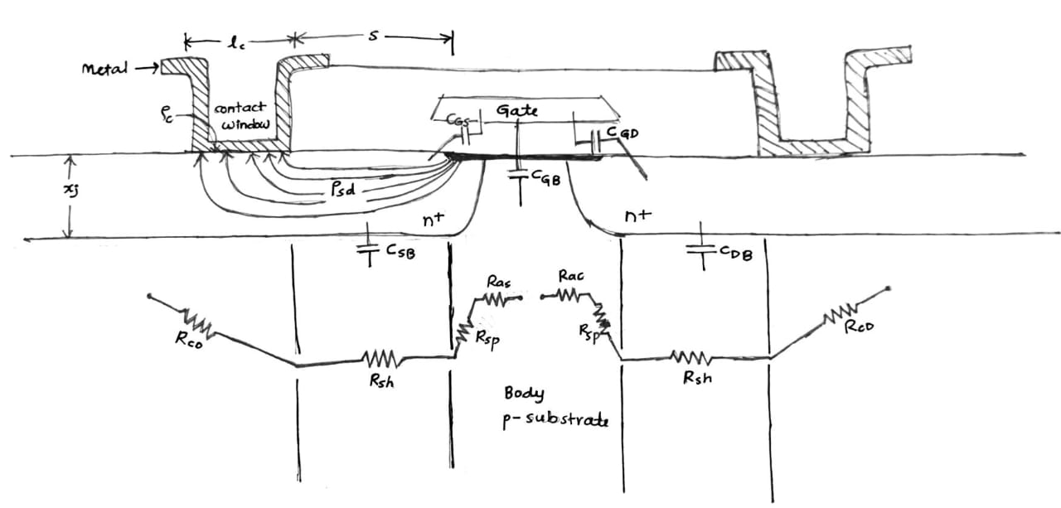
Preliminary Study Done
Parasitic Elements (resistance, capacitance)

Slide 13
Preliminary Study Done
Propagation delay of CMOS inverter
Propagation delay refers to the time taken by the signal to reach from input to output.
Impact on Power
- Increased propagation delay leads to lower power consumption.
Impact on Delay
- Increased propagation delay leads to longer signal path delays and takes more time to reach output.

Slide 14
Preliminary Results
CMOS LOGIC CIRCUITS | POWER | DELAY
INVERTER | 46nW | 16.33ps
NAND | 40.35nW | 26.71ps
NOR | 52.7nW | 31.718ps

Slide 15
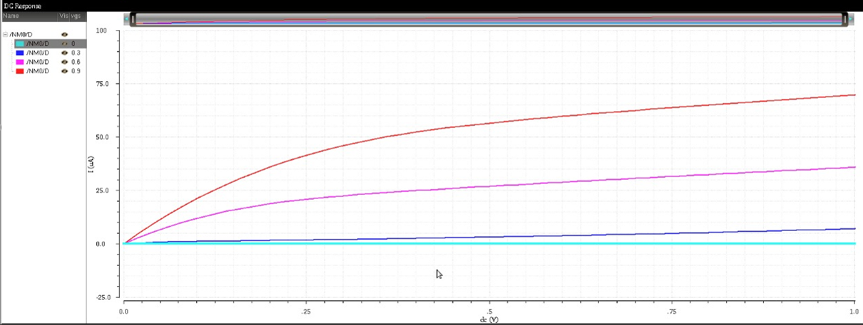
Preliminary Results
NMOS – Vds vs Ids
Vgs=0.9v
Vgs=0.6v
Ids
Vgs=0.3v
Vgs=0v
Vds

Slide 16
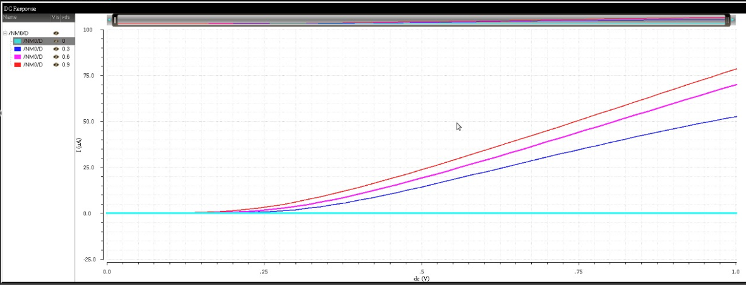
Preliminary Results
NMOS – Vgs vs Ids
Vds=0.9v
Vds=0.6v
Vds=0.3v
Ids
Vds=0v
Vgs

Slide 17
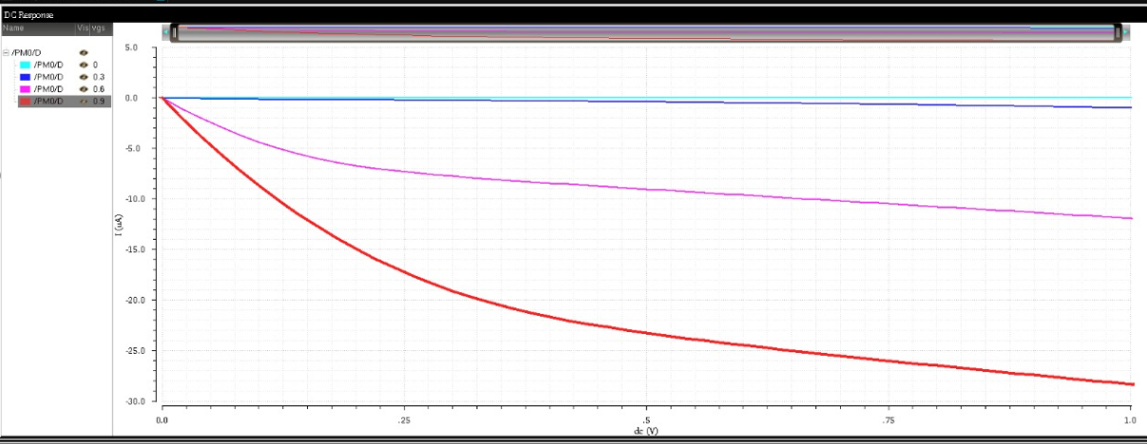
Preliminary Results
PMOS – Vds vs Ids
Vds
Vgs=0v
Vgs=0.3v
Vgs=0.6v
Ids
Vgs=0.9v

Slide 18
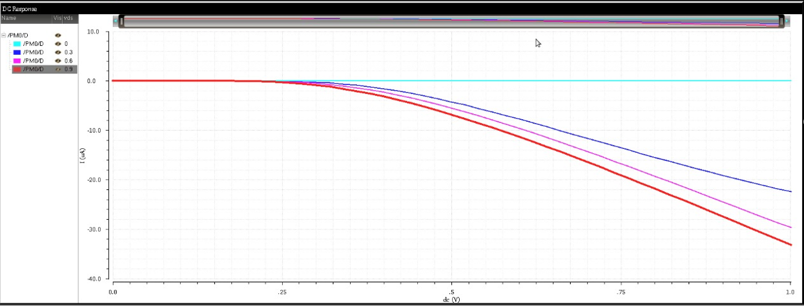
Preliminary Results
PMOS – Vgs vs Ids
Vgs
Vds=0v
Ids
Vds=0.3v
Vds=0.6v
Vds=0.9v

Slide 19
Leakage Power Reduction
Leakage power consumption is the power consumed by the sub threshold currents and by reverse biased diodes in a CMOS transistor.
Short circuit power consumption occurs during switching of both NMOS and PMOS transistors in the circuit and they conduct simultaneously for a short amount of time.

Slide 20
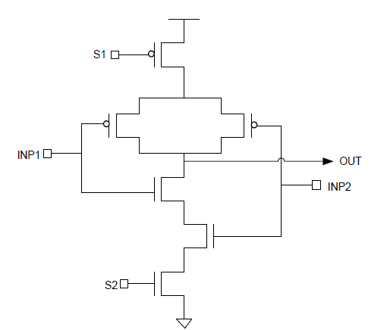
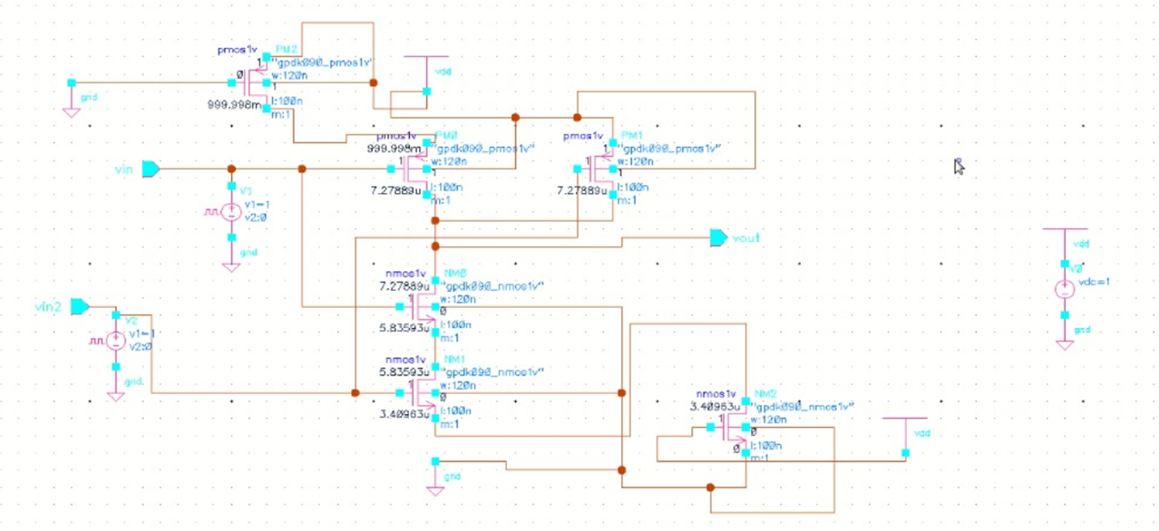
Leakage Power Reduction
Sleep Approach NAND gate – 26.55 nw

Slide 21
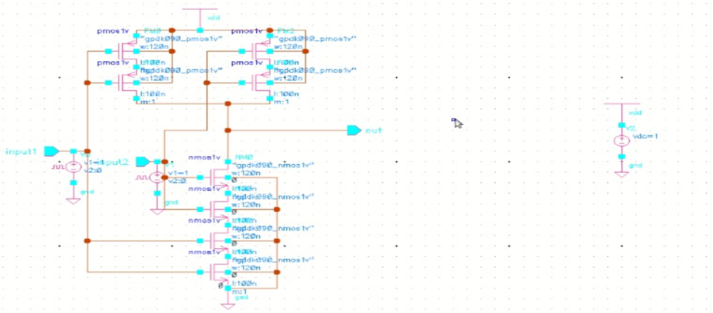
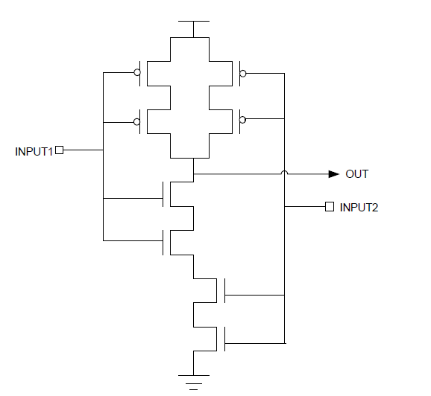
Leakage Power Reduction
Stack Approach based 2 input NAND gate – 19.47 nw

Slide 22
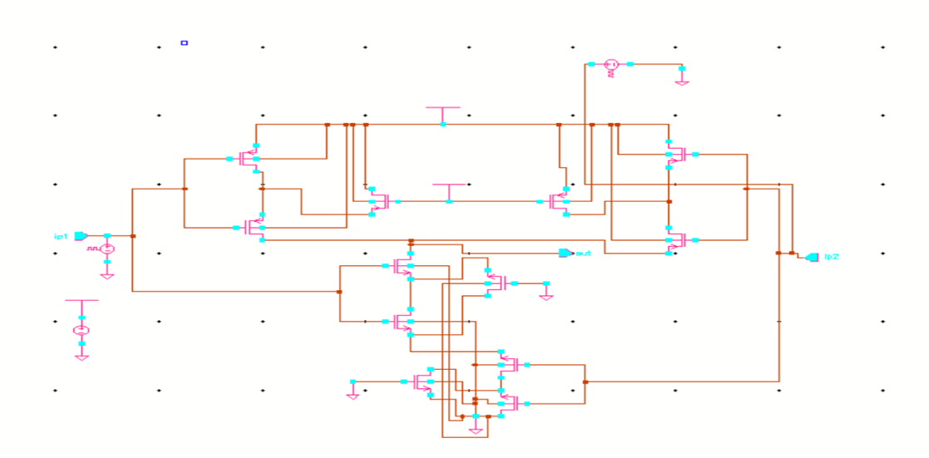
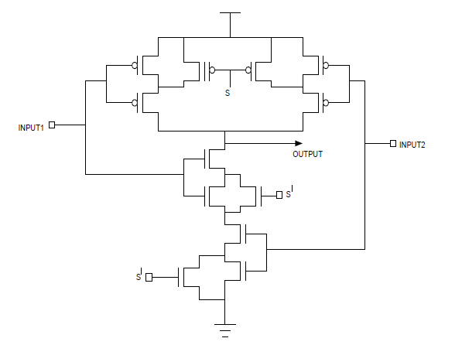
Leakage Power Reduction
Sleepy Stack Approach based 2 input NAND gate – 24.62 nw

Slide 23
Leakage Power Reduction
90 nm | Power (nW)
Sleep Approach NAND gate | 26.55 nW
Stack Approach based 2 input NAND gate | 19.47 nW
Sleepy Stack Approach based 2 input NAND gate | 24.62 nW

Slide 24
Sensitivity of CMOS delay to device parameters
Key Factors affecting device parameters :
1) Capacitance
The total delay of a circuit is influenced by the time it takes to charge or discharge the load capacitance (CL​) through the driving transistor. The delay can be separated into rise time (charging) and fall time (discharging).
Capacitance | 0.1pF | 0.3pF | 0.5pF | 0.8pF | 1pF | 2pF
Delay | 1.182ns | 3.378ns | 5.568ns | 8.77ns | 10.838ns | 18.75ns

Slide 25
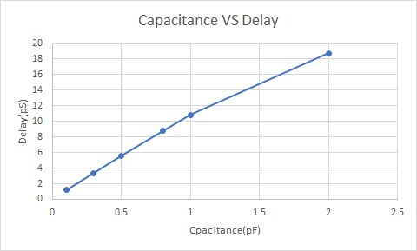
Sensitivity of CMOS delay to device parameters
CONCLUSION : An increase in load capacitance increases the delay in a CMOS inverter, as it takes more time to charge and discharge the capacitance. Larger load capacitance results in slower switching and higher propagation delay.

Slide 26
Sensitivity of CMOS delay to device parameters
2) Power Supply Voltage
The power supply voltage is the external voltage provided to a circuit or device to power its operation.
Power Supply Voltage | 0.45V | 0.7V | 0.9V | 1.2V | 1.5V | 1.8V
Delay | 25.17ns | 0.0953ns | 0.0488ns | 0.0356ns | 0.0292ns | 0.025ns

Slide 27
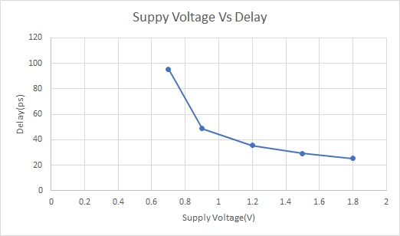
Sensitivity of CMOS delay to device parameters
CONCLUSION: An increase in delay occurs when the supply voltage (VDD) is reduced, as the transistors switch slower, resulting in longer rise and fall times. This increases the overall propagation delay of the CMOS inverter.

Slide 28
Sensitivity of CMOS delay to device parameters
3) Threshold Voltage
The threshold voltage (VT​) is the minimum voltage required at the gate of a transistor (e.g., MOSFET) to create a conducting path between the source and drain terminals. Beyond this voltage, the transistor switches from the OFF state to the ON state.
Threshold Voltage | 0.45V | 0.40V | 0.25V | 0.125V | 0.09V
Delay | 82.46ps | 79.52ps | 50.67ps | 27.33ps | 14.99ps
t_{pd} = (C_{L}V_{dd})/ I_{ds}

Slide 29
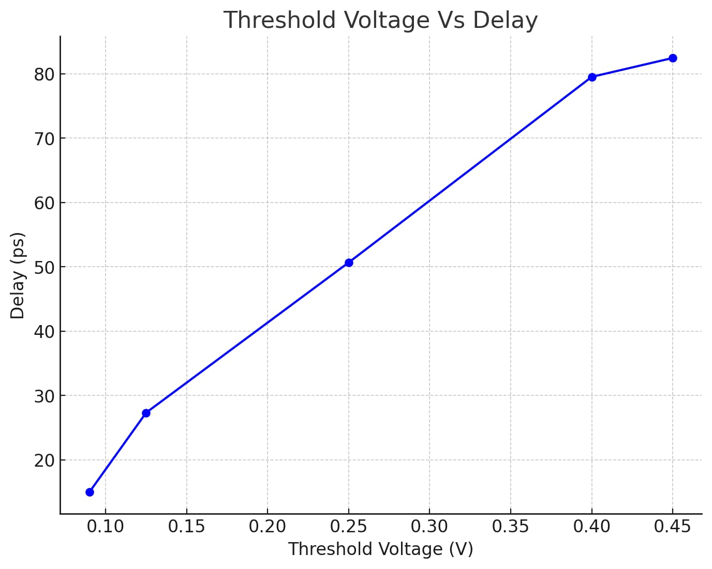
Sensitivity of CMOS delay to device parameters
CONCLUSION : A decrease in threshold voltage lowers the required voltage for the transistor to turn on, increases the current that can flow through it, and reduces the time needed to charge discharge the capacitances associated with switching. As a result, delay decreases.

Slide 30
Sensitivity of CMOS delay to device parameters
4) Channel Width
The channel width refers to the width of the conductive channel in a MOSFET (Metal-Oxide-Semiconductor Field-Effect Transistor) that connects the source and drain terminals. This channel allows the flow of charge carriers (electrons or holes) when the transistor is turned on.
a) Width of pmos =120nm (fixed)
Width of nmos | 120nm | 180nm | 240nm | 300nm | 450nm | 600nm
Delay | 54.01ps | 56.24ps | 57.73ps | 59.74ps | 63.98ps | 67.045ps

Slide 31
Sensitivity of CMOS delay to device parameters
b) Width of nmos =120nm (fixed)
Width of pmos | 120nm | 180nm | 240nm | 300nm | 450nm | 600nm
Delay | 54.01ps | 49.8ps | 46.84ps | 44.905ps | 41.345ps | 38.955ps

Slide 32
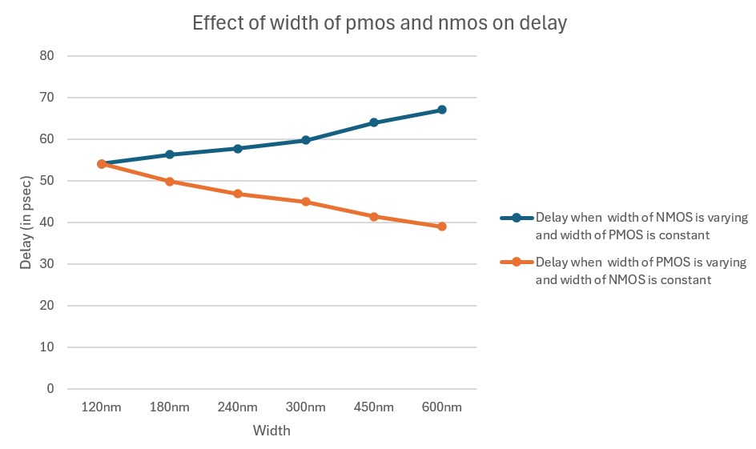
Sensitivity of CMOS delay to device parameters
CONCLUSION : Increasing NMOS width increases delay due to secondary effects like leakage current, short-channel effects, or insufficient improvement in current drive . Increasing PMOS width decreases delay as it compensates for the PMOS's lower mobility, improving current drive and speeding up switching.
CONCLUSION :

Slide 33
Sensitivity of CMOS delay to device parameters
5) Channel length
The channel length (L) in a MOSFET (Metal-Oxide-Semiconductor Field-Effect Transistor) refers to the distance between the source and drain terminals, where the current flows through the channel created in the semiconductor material between these two terminals.
a) Length of pmos =100nm (fixed)
Length of nmos | 100nm | 150nm | 200nm | 250nm | 300nm | 500nm
Delay | 54.01ps | 50.62ps | 48.62ps | 47.4ps | 46.53ps | 44.92ps

Slide 34
Sensitivity of CMOS delay to device parameters
b) Length of nmos =100nm (fixed)
Length of pmos | 100nm | 150nm | 200nm | 250nm | 300nm | 500nm
Delay | 54.015ps | 59.925ps | 62.345ps | 66.69ps | 70.47ps | 90.195ps

Slide 35
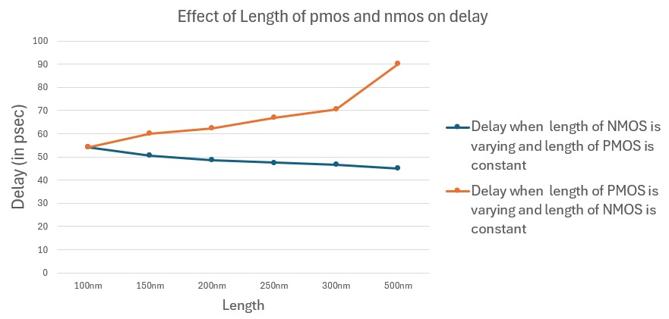
Sensitivity of CMOS delay to device parameters
CONCLUSION: the lower mobility of holes in PMOS transistors explains why delay increases significantly as the PMOS length increases, while NMOS devices exhibit a relatively stable delay.

Slide 36
Sensitivity of CMOS delay to device parameters
6) Gate oxide Thickness
Gate oxide thickness refers to the thickness of the insulating layer of oxide that separates the gate electrode from the semiconductor channel in a Metal-Oxide-Semiconductor Field-Effect Transistor (MOSFET). This layer plays a critical role in the performance of the transistor, as it controls the flow of current between the source and drain terminals by influencing the gate's ability to control the channel.
Gate oxide | 2.0nm | 2.5nm | 3.0nm | 3.5nm | 4.0nm | 4.5nm
Delay | 20.34ps | 22.89ps | 25.54ps | 28.23ps | 31.83ps | 34.61ps

Slide 37
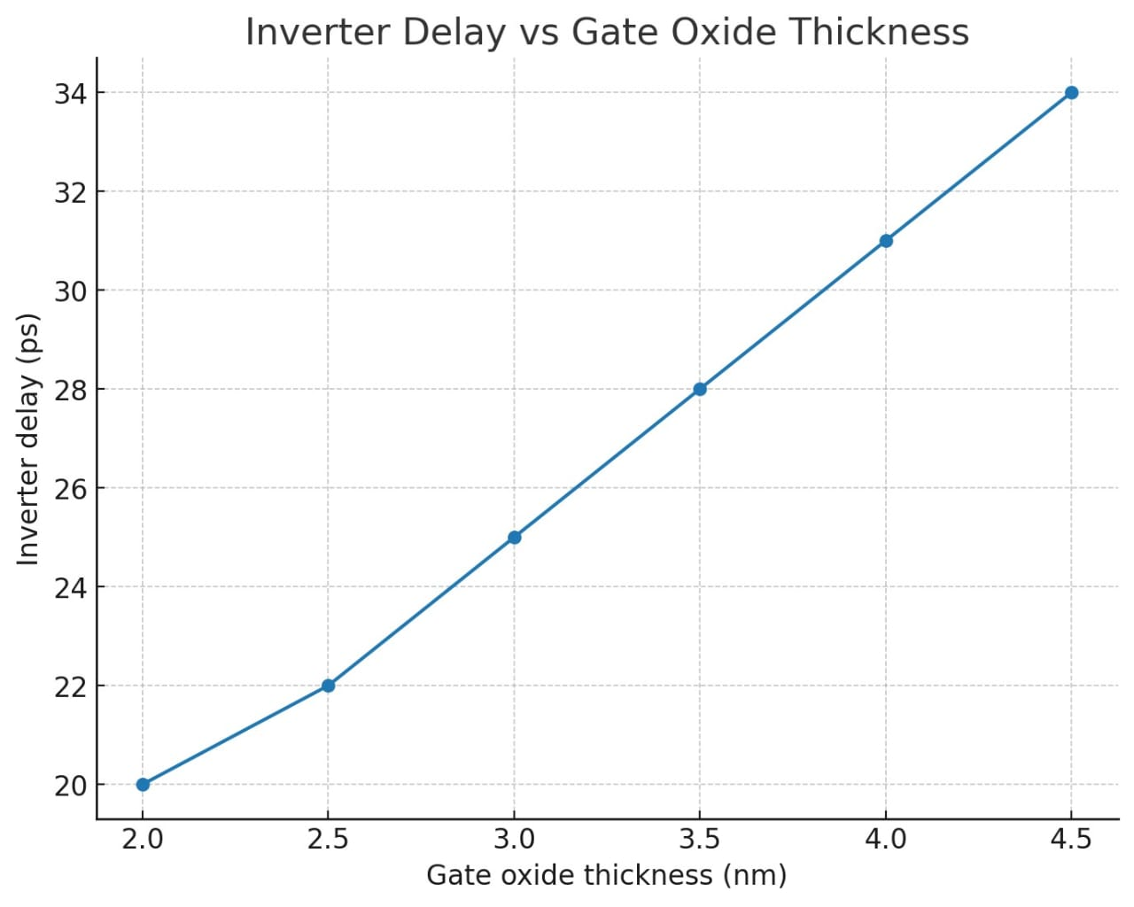
Sensitivity of CMOS delay to device parameters
CONCLUSION : Thinner oxide leads to a higher gate capacitance. Higher gate capacitance increases the charging/discharging time, resulting in greater propagation delay, reducing overall circuit speed and performance.

Slide 38
Conclusion
The objectives of performing a detailed analysis of CMOS performance factors and investigating delay sensitivity using simulations in Cadence Virtuoso have been successfully met.

Slide 39
Future Work
Sensitivity of delay parameter with respect to NAND and NOR gates.
In similar manner as delay, analyzing the sensitivity of CMOS performance factors to power.

Slide 40
References
[1]Taur, Y., & Ning, T. H. (2023). Fundamentals of modern VLSI devices (3rd ed.). Cambridge University Press.
[2] Talwar, S., Mohapatra, B., & Ansari, M. R. (2020, May 23). Performance Analysis of CMOS Technology. 2nd International Conference on Communication & Information Processing (ICCIP) 2020. SSRN. https://papers.ssrn.com/sol3/papers.cfm?abstract_id=3647984
[3] Zitong Han 2021. The power-delay product and its implication to CMOS Inverter. J. Phys.: Conf. Ser. 1754 012131 https://iopscience.iop.org/article/10.1088/1742-6596/1754/1/012131/pdf
[4]International Journal of Computer Applications (0975 – 8887) Volume 134 – No.8, January 2016 28 Comparison of Leakage Power Reduction Techniques in 65nm Technologies

Slide 41
THANK YOU

Slide 42
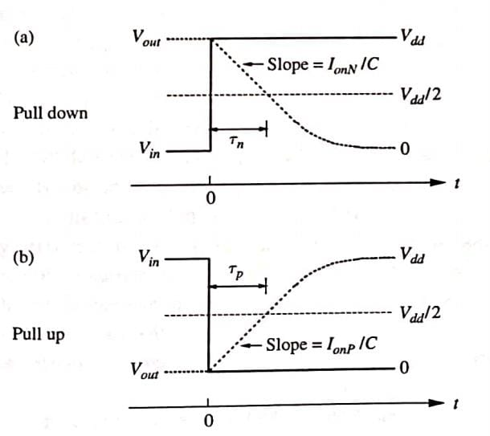
Additional Study Done
Switching Characteristics
Overview of CMOS Inverter Switching: Describes the basic switching characteristics of a CMOS inverter, especially when the gate voltage undergoes an abrupt or infinitely sharp transition.
2. Switching Transition
Example: In an inverter, when Vin​ transitions from 0 to Vdd
Before the transition, the nMOSFET is off, and the pMOSFET is on. After the transition, the nMOSFET is on, and the pMOSFET is off.
3. Pull-Down Switching Characteristics: The switching behaviour is defined by the differential equation:
(C_​+C+​)dVout/dt​​=−IN​(Vin​=Vdd​)
4. Definition of nMOSFET Pull-Down Delay (τn):Defined as the time it takes for the output node voltage to reach Vdd/2.
5. Definition of pMOSFET Pull-Up Delay (τp​):Defined as the time for the output voltage to rise.
Waveforms of the output node voltage (dotted) of a CMOS inverter. (a) Pull-down transition after an abrupt rise of input voltage (solid). (b) Pull-up transition after an abrupt fall of input voltage (solid).

Slide 43
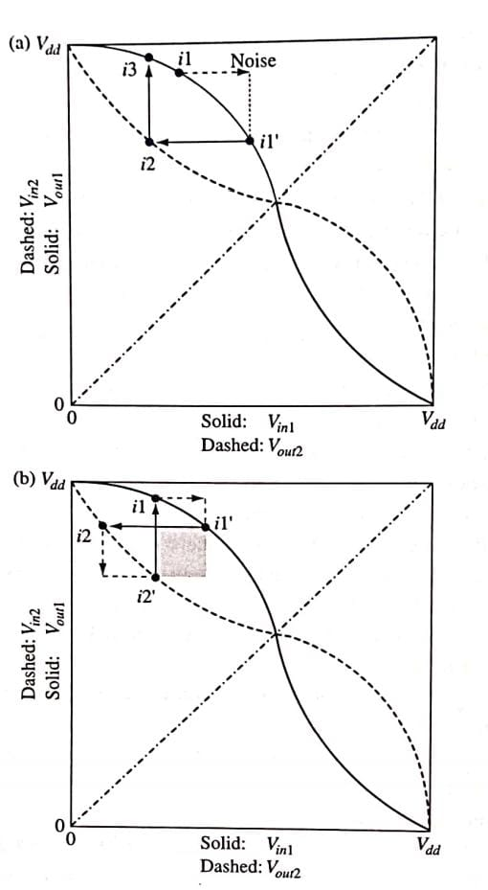
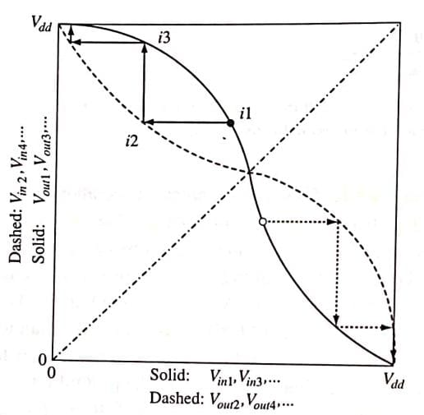
Additional Study Done
Noise Margin
Noise margin is the tolerance level for unwanted voltage
(noise) that can be present on an input signal without causing
errors in the output.
Noise margin for a given transfer curve is measured by the size of the maximum square that can fit between itself and its complementary curve.

Slide 44
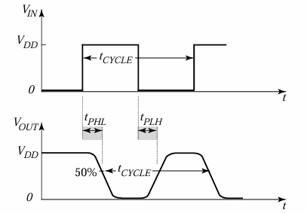
Additional Study Done
Propagation delay of CMOS inverter
Inverter propagation delay: time delay between input and output signals; figure of merit of logic speed. Typical propagation delays: < 100 ps.
Average propagation delay: tp = (T_{PHL}+T_{LHP})/2.
Where, T_{PHL}= propagation delay high to low
and T_{PLH}= propagation delay low to high
Propagation delay and Power tradeoff:
V_{DD} increases⇒ tp decreases
– Reason: V_{DD} increases as a result, the overdrive voltage V_{GS}-V_{TH} is also increased which increases the current I_{D}
– Trade-off: VDD ↑⇒more power consumed.

Slide 45
Additional Study Done
Parasitic Elements
Parasitic elements in CMOS (Complementary Metal-Oxide-Semiconductor) circuits refer to unintended components, such as capacitances, resistances, and sometimes inductances, that arise from the physical layout and materials used in semiconductor devices. These elements can affect the performance, power consumption, and reliability of CMOS circuits, especially as devices are scaled down in size. Common parasitic elements in CMOS :
1) Source-Drain Resistance
2) Gate Resistance
3) Junction Capacitance
4) Overlap Capacitance
5) Interconnect R and C

