Slide 1

Testing Mavens
Software Testing Redefined
Notes:
Welcome KPMG team

Slide 2


Playwright
An automation tool that enables reliable end-to-end testing for modern web apps.
Open source, developed and maintained by Microsoft with wide community support and faster adoption.

Slide 3


Usage
Any browser • Any platform • One API
Cross-browser: Playwright supports all modern rendering engines including Chromium (Chrome, Edge etc.), WebKit (Safari), and Firefox.
Cross-platform: Test on Windows, Linux, and macOS, locally or on CI, headless or headed.
Cross-language: Use the Playwright API in TypeScript, JavaScript, Python, .NET, Java.
Test Mobile Web: Native mobile emulation of Google Chrome for Android and Mobile Safari. The same rendering engine works on your Desktop and in the Cloud. But doesn’t support native mobile apps out of the box.
Multiple everything: Can test scenarios that span multiple tabs, multiple origins and multiple users in one test.
API & Visual: Can be used for API automation and visual testing.

Slide 4
Advantages
Auto-wait: Playwright automatically waits for elements to be actionable prior to performing actions
Web-first assertions: Playwright assertions are created specifically for the dynamic web. Checks are automatically retried until the necessary conditions are met.
Tracing: Configure test retry strategy, capture execution trace, videos, screenshots to eliminate flakes.
Browser contexts. Playwright creates a browser context for each test. Browser context is equivalent to a brand-new browser profile. This delivers full test isolation with zero overhead.
Browser control & network interception. Offers control over browser settings and behaviours, such as permissions and geolocation and provides robust tools for intercepting and modifying network requests and responses
Log in once. Save the authentication state of the context and reuse it in all the tests. This bypasses repetitive log-in operations in each test yet delivers full isolation of independent tests.

Slide 5
Tooling
Codegen: Generate tests by recording your actions. Save them into any language.
Playwright Inspector. Inspect page, generate selectors, step through the test execution, see click points, explore execution logs.
Built-in Test Runner. Includes Playwright Test, a built-in test runner with features like parallel execution and retries.
Trace Viewer. Capture all the information to investigate the test failure. Playwright trace contains test execution screencast, live DOM snapshots, action explorer, test source, and many more.
Screenshots/Videos: Captures and attaches the evidences to your reports for all runs, on-failures, on-retry as you prefer.

Slide 6
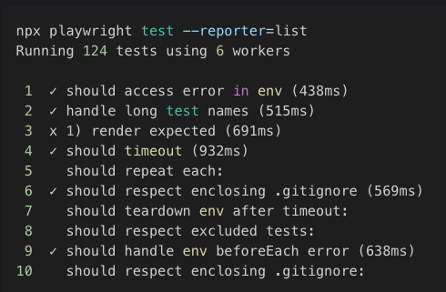
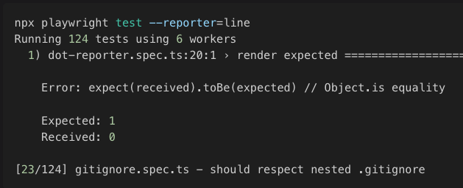

Reporting
Built-in reporters : Playwright provides these reporters out-of-box, by writing single line commands in config file
List
Line
Dot
Json
Html
Junit

Slide 7





Reporting Integrations
Allure
Jira
Testing Maven’s Framework Custom Reporters
Report Portal
Slack
Microsoft Teams

Slide 8





Key Aspects Our Framework
Custom Libraries
CICD
Framework built on TypeScript with structured files for web elements & functions belonging to the web pages
Isolated & parallel execution TCs to reduce time & dependencies
Get notified instantly after test execution & visualize the results
Helper functions for email/pdf validation, API requests, reporting, test data etc.
On demand or scheduled execution with Github Actions
Page Object Model
Efficient Execution
Custom Reporters

Slide 9
Installation
Pre-requisites: Should have installed npm/node.js and VSCode.
Extensions: Install ‘Playwright Test for VSCode’ to easily execute & debug tests
Git-repo: Download & install project from the git repo ’https://github.com/testingmavens/Playwright-template’
Dependencies: Packages needed for the project are placed in dependencies & dev-Dependencies sections in the package.json file of above repo.
Commands:
npm install -> install the project along with the dependencies.
npm init playwright@latest -- --quiet --browser=chromium --browser=firefox -> Installs playwright along with selected browsers
npm playwright tests -> executes all TCs which are in testDir or matches testMatch in config file
npx allure serve allure-results -> Generates and displays allure report

Slide 10
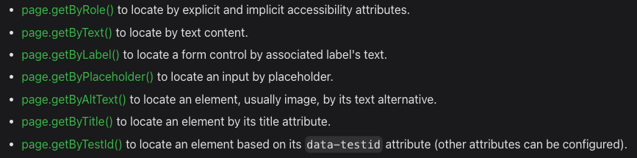
Page Object Model
Page files: All web element locator and required functions for the corresponding web pages
are saved here
Elements: These are declared at the class level as ‘Locator’ and instantiated in the constructor block. Recommended to prioritise the usage of Playwright built-in locators, followed by id, css, xpath etc.
Functions: ’async’ functions just covers what it is intended to do pertaining to the functionality of the page. All functions are enclosed in a test.step block to include a description to make it test reporter friendly.
Fixtures: Used for lazy initialization of page objects and and provided to test cases block as a parameter. Thus reduce the lines of code for page instantiation.

Slide 11
Test Structure
test files: Kept in ‘tests’ folder with an appropriate short name, suffixed with ‘.test.ts’.
test.describe: Groups a set of test belonging to same module or of similar nature.
beforeEach/afterEach: Common actions performed by each test cases of the describe block are kept here to follow DRY principle.
test: Corresponds to one test case. We maintain a 1 to 1 mapping of TC and automation script.
test.step: One or more lines of actions to be performed, can be enclosed in a test.step blocks. Providing a well-crafted description empowers the readability of your execution result reports.
Note:
All test cases are independent of each other and has dedicated browser instance generated at the beginning of the test which will be automatically destroyed at the end of that test case
Uses ‘set up’ project to ‘login once and use session as needed’ to avoid the duplicate effort of logging in with the same user

Slide 12
Config, Helpers & Utilities
playwright.config: Controls execution behaviours (parallel, headless), the projects/test files to include, browsers to run on, reports to publish, timeouts for test, navigation, actions & expect
Actions: Composting of various custom wait methods when Playwrights’ auto wait don’t work, click/type methods with auto-logging lines, custom compare functions, evaluate functions to deal with open/closed dom elements.
API Requests: Custom functions for various API methods with validations built-in and performance time monitored
Random & Generic: For random test data generation and to perform common repeated tasks independent of the test cases
Reporters: Jira integration for pass/fail/skip update as well as execution time for individual TCs, Slack & Teams integration for notification of execution completion of Github Actions pipeline

Slide 13

Playwright Implementation
330+
UI Test Cases automated
300+
API Test Cases automated
Daily
execution
ETE test cases with interaction on API layer for data geneartion and fetching
Test Cases from over 50 modules
Daily execution of API/UI regression test cases on Github Actions
2 hours
Execution time for UI
8 minutes
Execution time for API
With sharding and parallel execution reduced time taken from 7 hours to 2 hours
With sharding and parallel execution API automation suits gets completed in 8 minutes on CICD pipeline

Slide 14
Thank you!

