Slide 1
Modelling Passengers’ Airport and Airline Choice Behavior

Slide 2
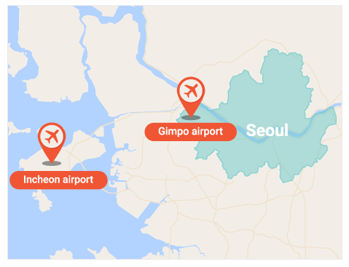
Airport & Airline Choice
Problem Description
Two international airports in Seoul Metropolitan Area
Gimpo airport: Smaller and old, but closer to the city
Incheon airport: Larger and new hub airport, but farther from the city
What drives passengers’ choice of airport and airline?

Slide 3
Airport & Airline Choice
Project Objective
Investigate passengers’ choice behavior
Airport choice
Airline choice
Apply several different approaches to modeling air travel behavior
Discrete Choice Models
Data Mining Models
Discuss substantive policy implications based on the quantitative analysis

Slide 4
Data
Survey data of 488 respondents
27 variables (originally 38 variables)
Airport choice
GMP, ICN
Airline
Korean Air (KE), Asiana Air (OZ), Korean LCC, Foreign Carriers
Socio-demographic: age, gender, occupation, income, etc
Alternative-Specific : flight information, travel time, mode of transport, etc

Slide 5
Data
Dependent Variable
Airport choice : Binary (ICN or GMP)
Airline choice : Multinomial
KE : Korean Air, full-service (legacy) carrier based in Korea, majority of market share
OZ: Asiana Airline, full-service carrier (legacy) based in Korea
Korean LCC : Low-cost carriers based in Korea
Foreign Carriers: Primarily based in China, Japan and Southeast Asia
Airline choice may be reduced to binary choice (recommended).
E.g. Korean Carriers vs Foreign
E.g. Korean full-service carriers (KE, OZ) vs. Others

Slide 6
Data
Independent Variables
Passenger specific: age, gender, occupation, income, etc
Alternative specific
Flight specific: Destination (China, Japan, Southeast Asia, other), travel time and etc
Mode specific : Mode of transport and etc
Passenger-alternative specific: Airfare, seat class, group travel, access time, access cost
We have many categorical variables with many (>3) categories.
You may need to further categorize. How?

Slide 7
Objective
Develop models to describe passengers’ airline and airport choice behavior.
Model implementation
Model evaluation
Describe passengers’ behavior based on the modeling results.
The Purpose of the project is description!
Descriptive models (logistic regression, decision tree) should be developed.
Other non-descriptive models (e.g. NN, SVM) can be developed for further model evaluation.
Discuss substantive policy implications based on the quantitative analysis.

Slide 8
Modeling
Description Methods
Find human-interpretable patterns that describe the data
Vs. prediction methods
Purpose of this study is description.
Classification Problem
Dependent (y) variable is categorical.
Airport choice
Airline choice
Vs. regression problem

Slide 9
If you are interested in..
Consumer behavior
Marketing
Public policy
Econometrics
Classification models

Slide 10
Instruction
One-on-one meeting after Exam 2.
Submit
A paper
Final paper should be no more than 20 pages including figures, graphs, and tables. No appendix, please.
All of your codes to show your work

Slide 11
Non Disclosure Agreement
Data, codes, papers, reports, and lecture materials, including assignments, lecture notes, and others, should not be shared by anybody or any other organization.
Students or anybody need to obtain an explicit permission from the faculty member for any use outside of class, including posting them on GitHub or anywhere else.

Slide 12
References
A Self Instructing Course in Mode Choice Modeling: Multinomial and Nested Logit Models by Frank S. Koppelman and Chandra Bhat
Airport Choice Modeling: Empirical Evidence from a Non‐Hub Airport. By S. Leon
Modelling air carrier choices with a Segment Specific Cross Nested Logit model by Tomasz Drabas and Cheng-Lung Wu
Exploring the potential for cross-nesting structures in airport-choice analysis: A case-study of the Greater London area by Stephane Hess, John W. Polak
Passengers’ airport choice within multi-airport regions (MARs): some insights from a stated preference survey at Hong Kong International Airport by Becky P.Y. Loo

