Slide 1
GAMING ARCADE
Created by:
Vaishnavi Rathod E016
Riya Tendulkar E047

Slide 2
INTRODUCTION
A big reason why we love games so much is because it is an escape from our boring and monotonous lives. They also give us sense of accomplishment. The feeling you get after playing a good game and winning it is unbeatable. Games are such recreational activities of our lives that make us forget everything else. They leave us wanting more.
With our knowledge of the python programming language we tried to make some of our favorite games for everyone to enjoy. We have attempted to give our little spin of these wonderful games, some of which have been a part of our childhoods.
These games are for everyone to enjoy, they guide those who are new to the game too.

Slide 3
SOFTWARE AND API USED
1. PYTHON IDLE
It is the graphical user interface used for python development. It is portable and can be run on all major platforms. The libraries we have used are:
Tkinter
Sqlite
Pygame
MessageBox
Random
PIL

Slide 4
SOFTWARE AND API USED
2. SQLITE3
It is a relational database management system contained in a C library. Rather than being a client-server database engine, its embedded into the end program. It is portable, reliable and ACID complaint. It also is lightweight and gives better performance.
3. DB BROWSER
Since it isnt possible to read the data directly from the SQL file, we require the help of this browser to navigate through the system and its data. It is compatible with sqlite and is visual, open source tool used for creating, designing and updating databases.

Slide 5
LAYOUTS (UI DESIGN)
We have implemented 5 games in our project. They are :
Guess the Logo Game( user must guess the name of popular logos by looking at the image)
Hangman Game (the user must name all the letters of the word before losing all the lives)
Snake Game( the user must navigate the snake to eat food to increase speed and avoid being killed by the corners or itself)
Tic Tac Toe (2 players play a game of X and O and the person who has the first his 3 symbols in a row wins)
Colour Game (the player must enter the colour of the word and not the name to score points before the timer runs out)

Slide 6
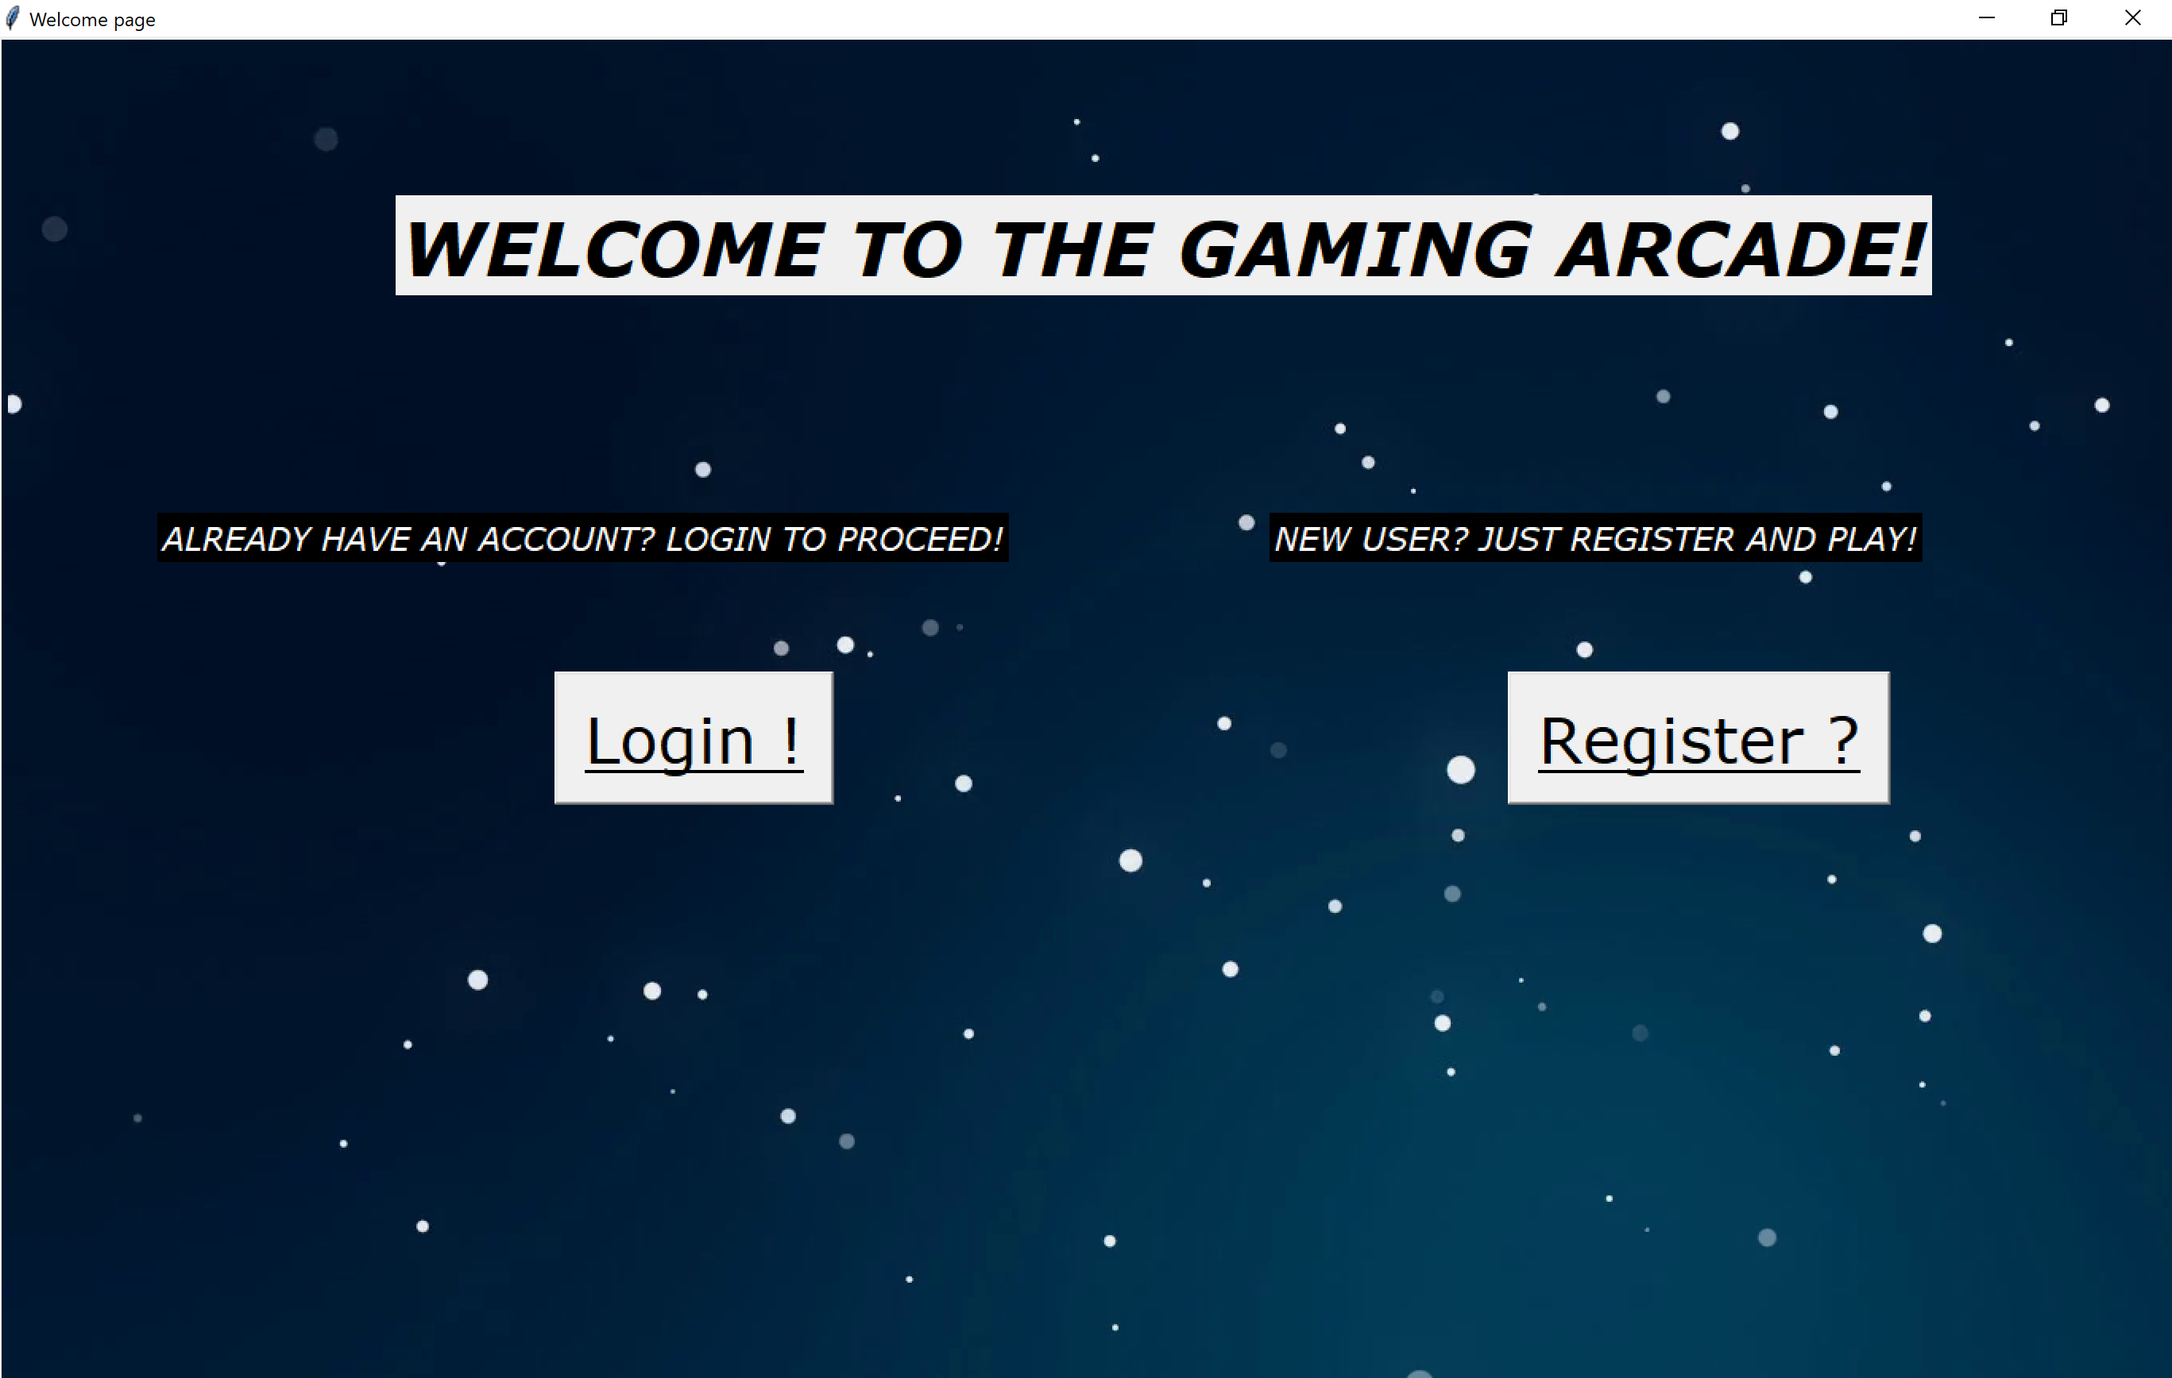
LAYouts (ui design)
Welcome page (to login or register)

Slide 7
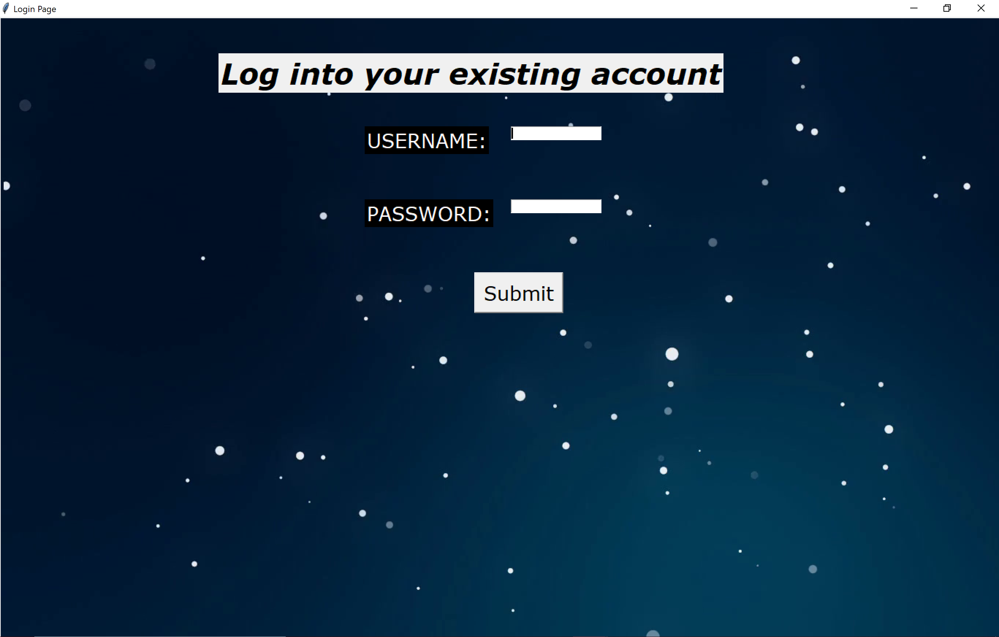
Layouts (ui design)
Login Page (enter the username and password)

Slide 8
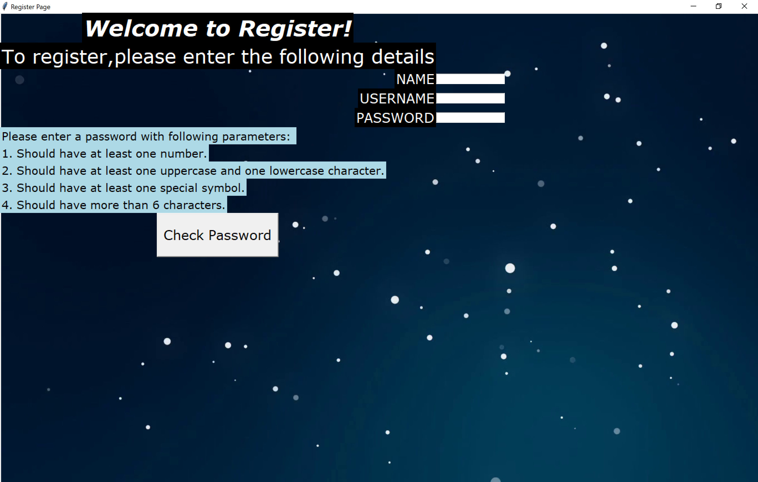
LAYOUTS (UI DESIGN)
Register Page (enter details to register for gaming arcade)

Slide 9
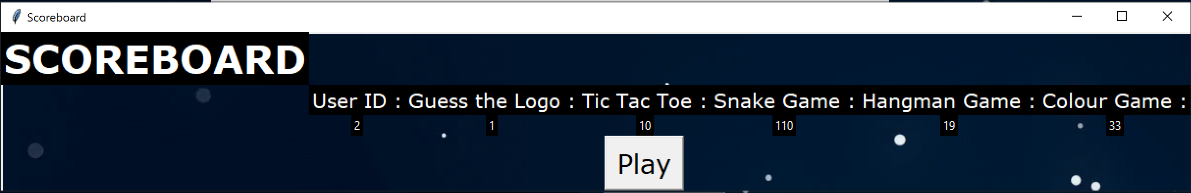
LAYOUTS (UI DESIGN)
Scoreboard (displays the scores of all the games stored of the user)

Slide 10
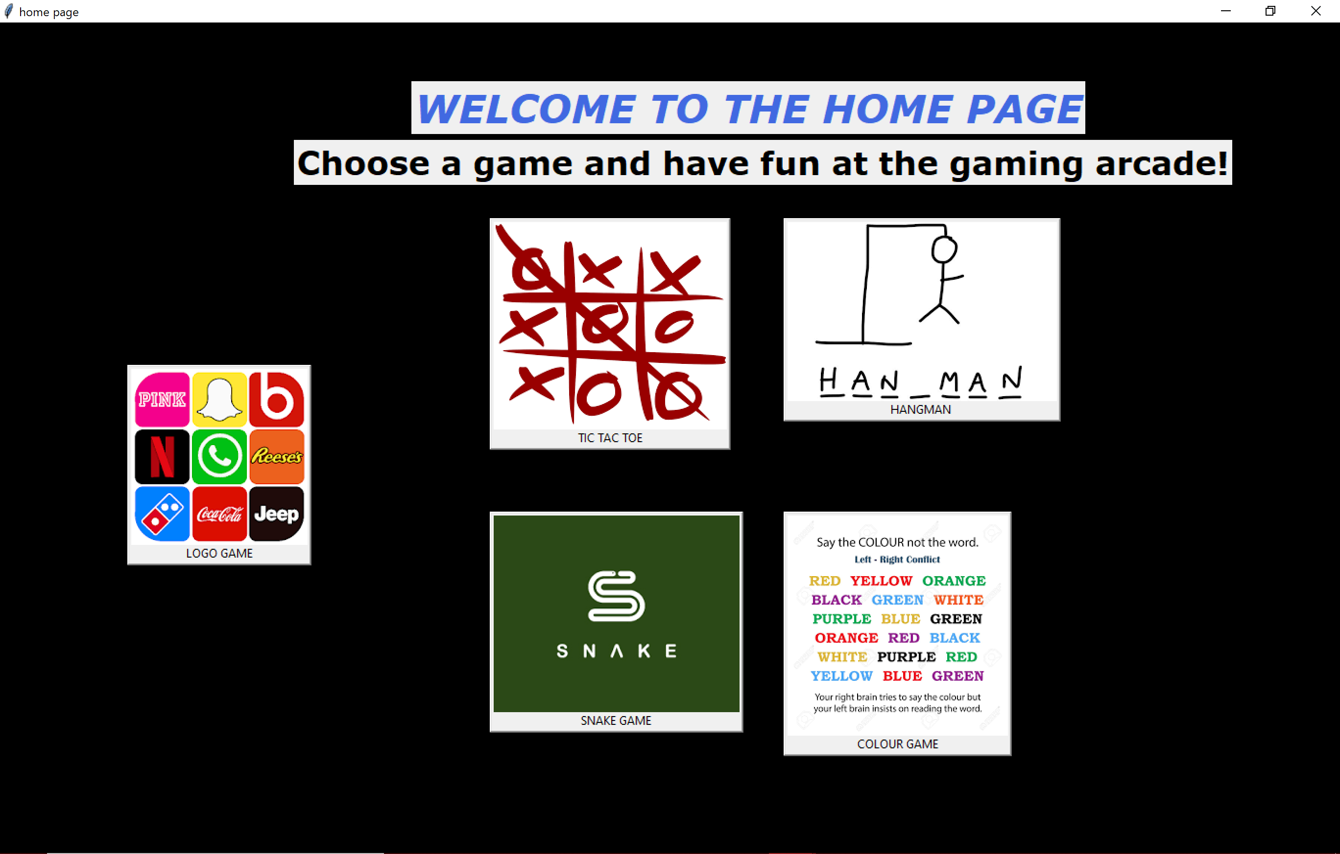
Layouts (ui design)
Home page (displays all games available to be played)

Slide 11
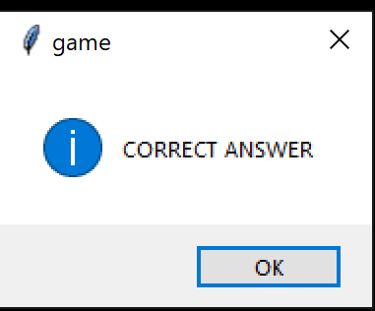
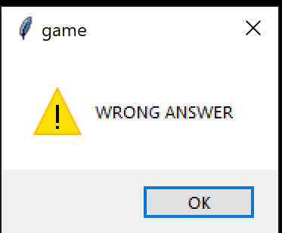
Layouts (ui design)
Message boxes for correct and wrong answers

Slide 12
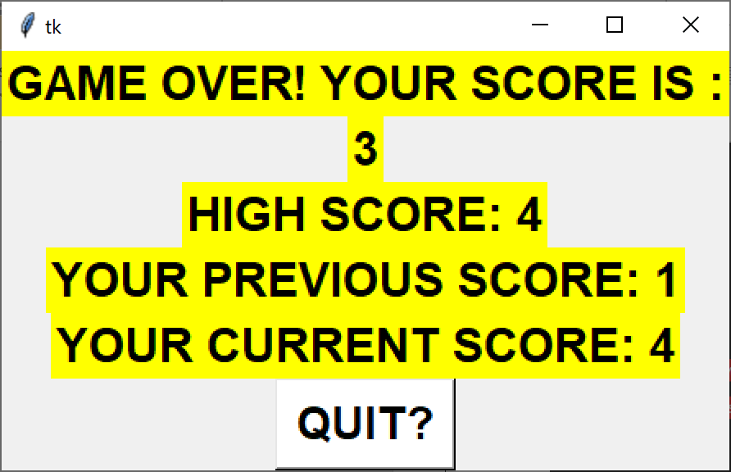
Layouts (ui design)
After the game ends or user quits

Slide 13
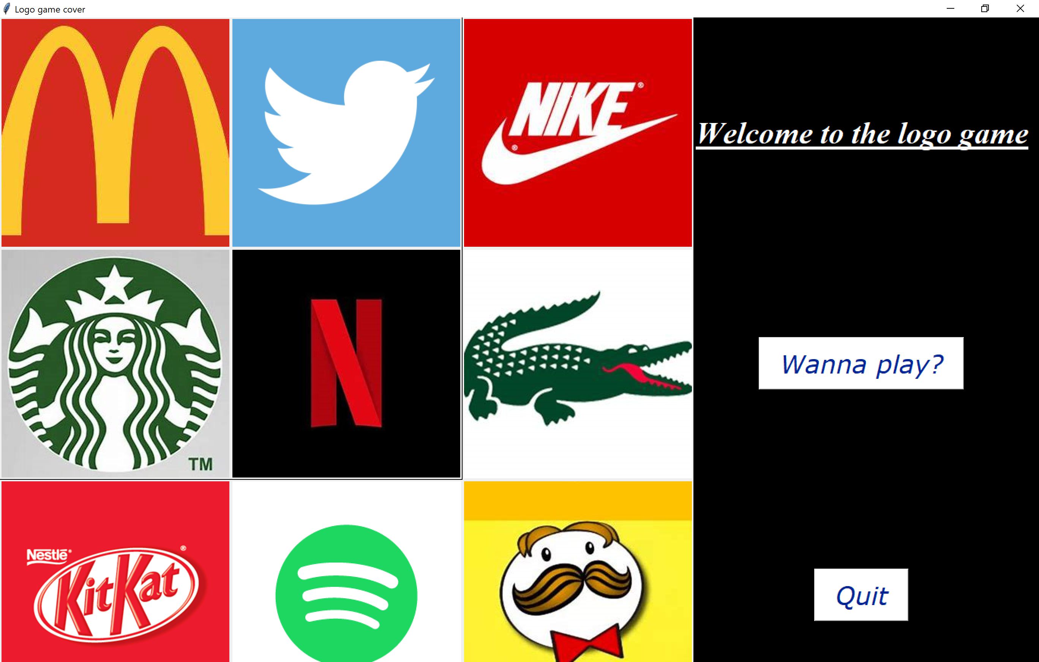
SCREENSHOTS game: guess the logo
Game 1: Guess the Logo
Cover image:

Slide 14
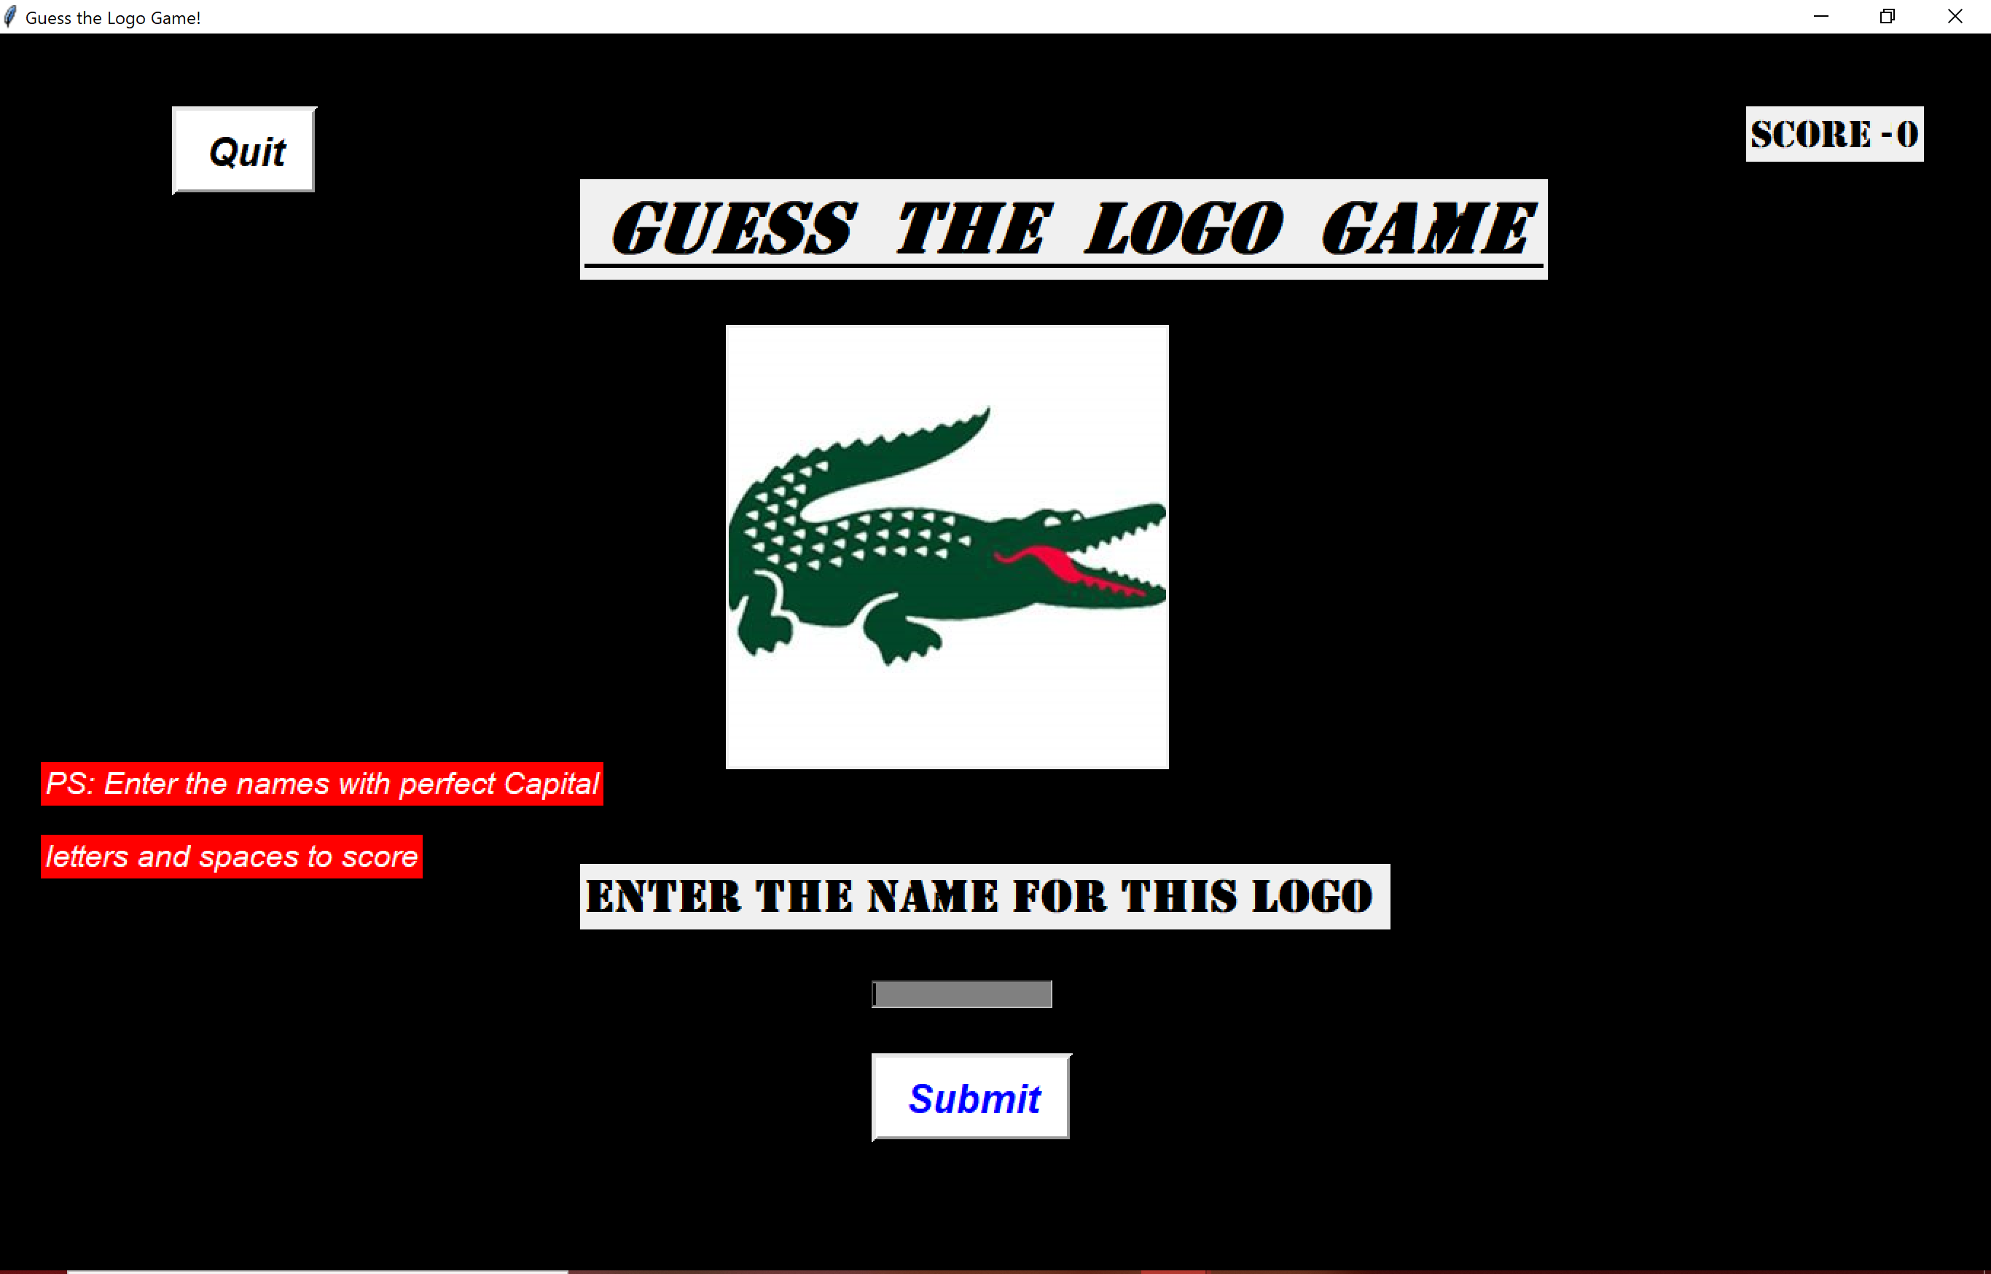
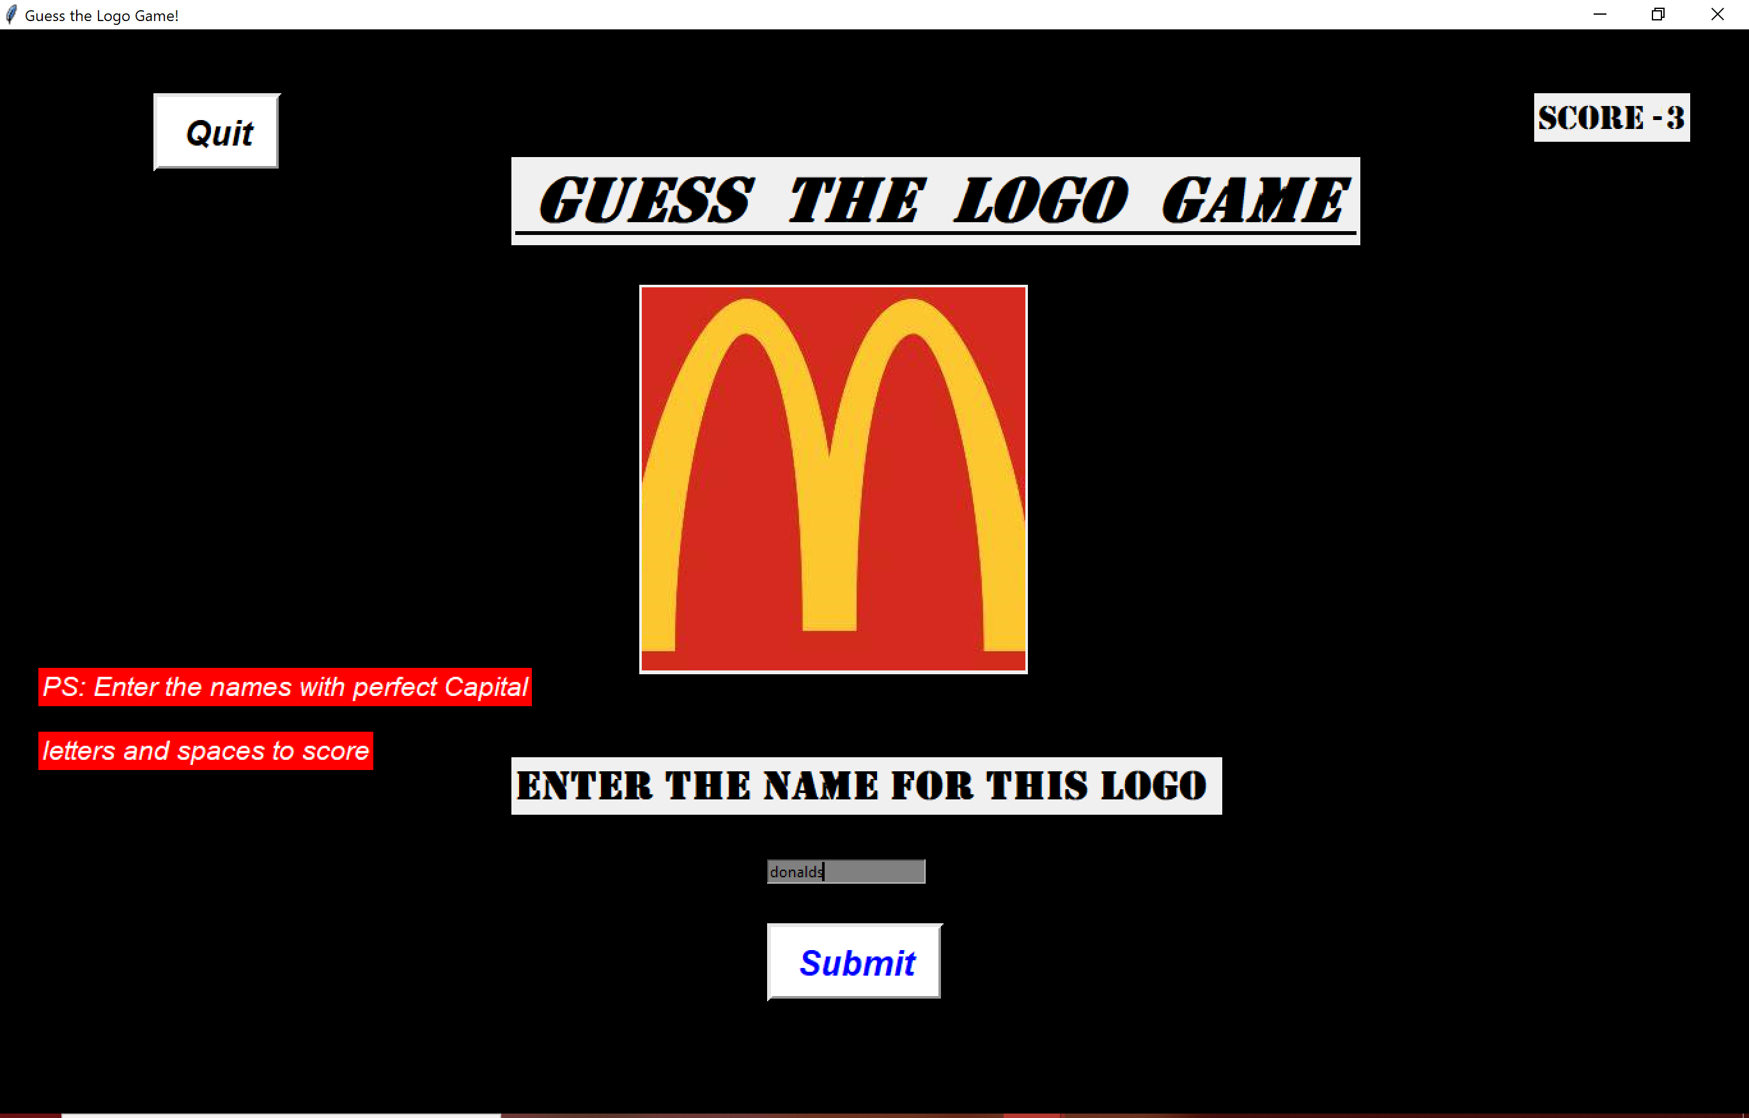
SCREENSHOTS game: guess the logo
Main game:

Slide 15
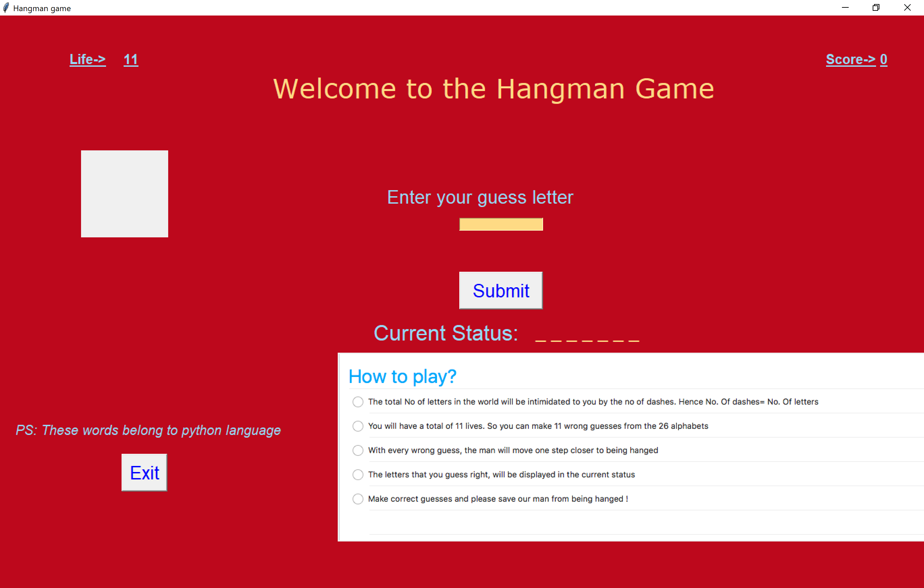
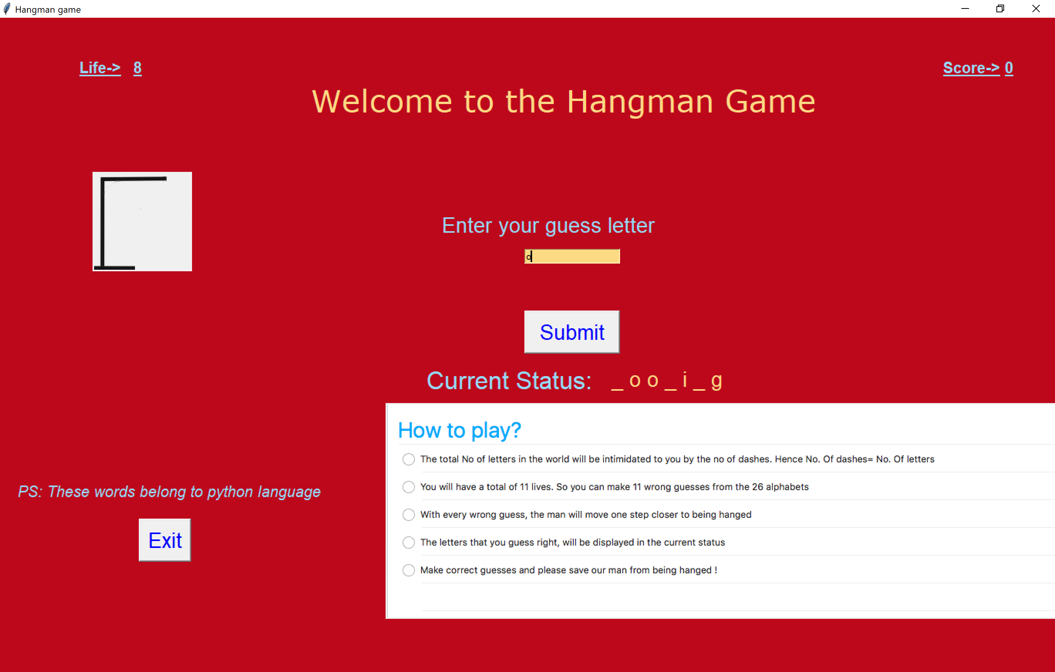
SCREENSHOTS game: hangman
Game 2: Hangman

Slide 16
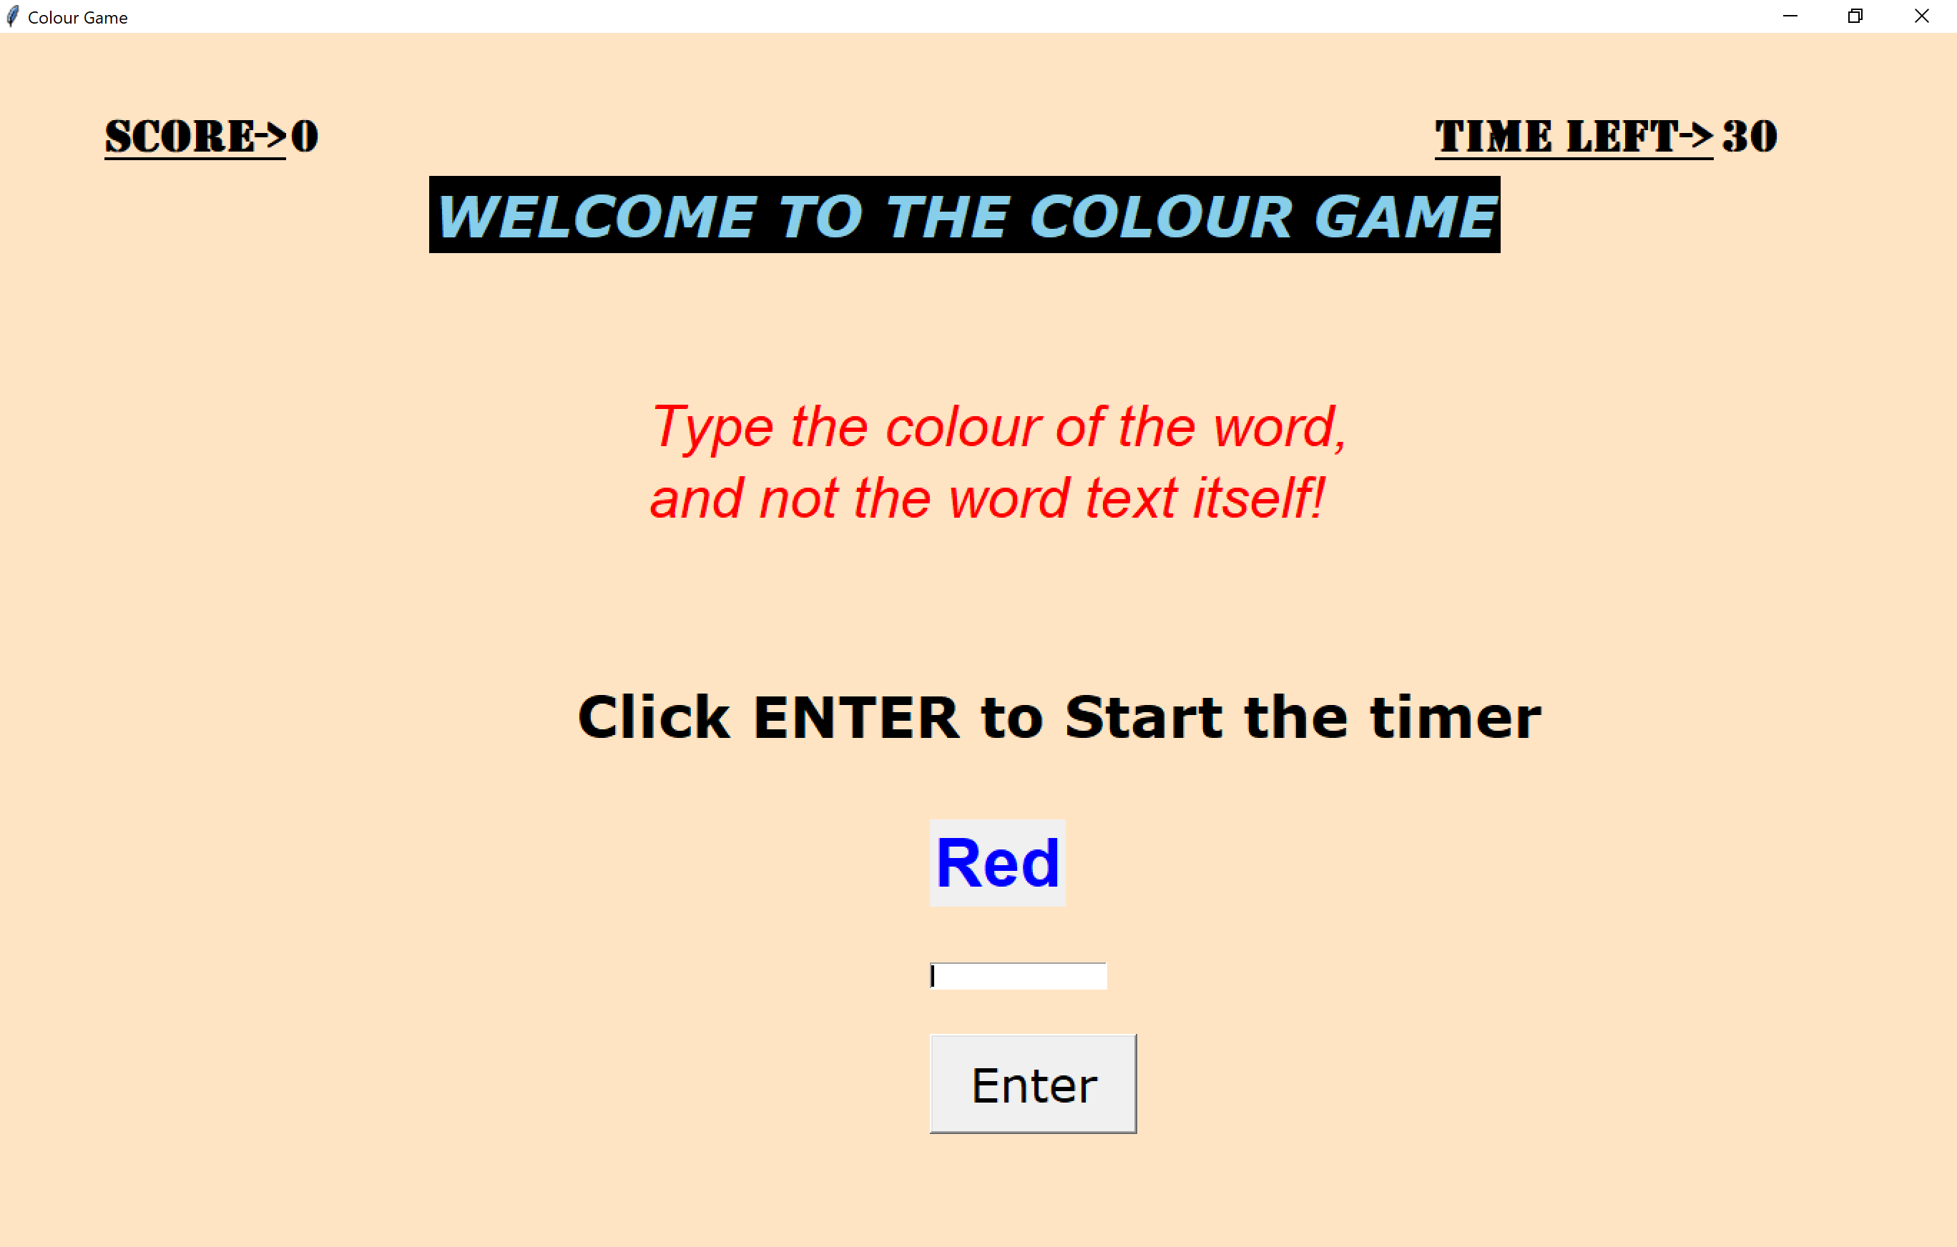
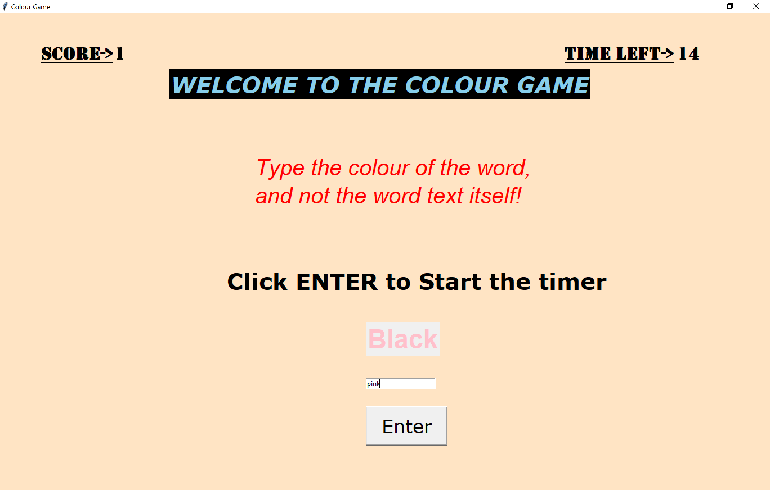
SCREENSHOTS game: colour game
Game 3: Colour Game

Slide 17
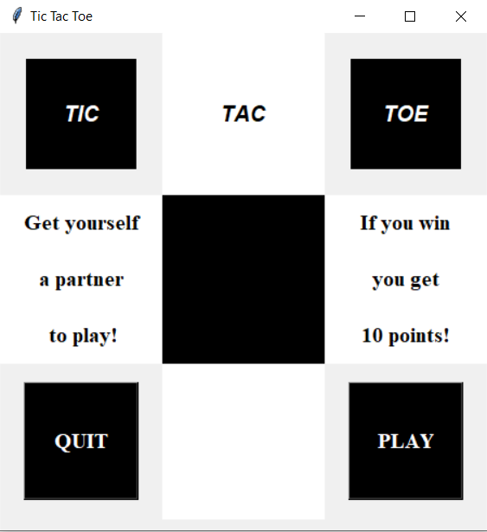
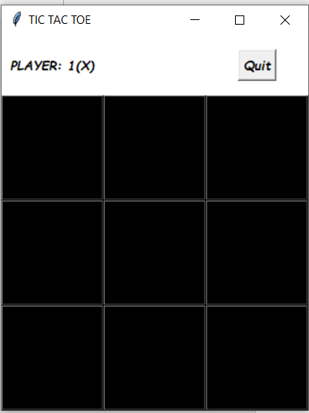
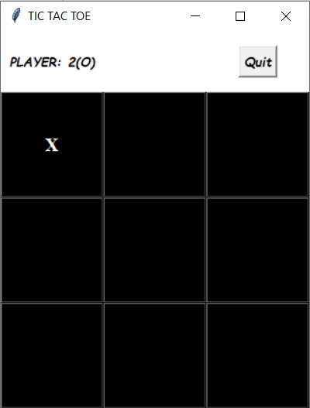
ScreenShots game: TIC TAC TOE

Slide 18
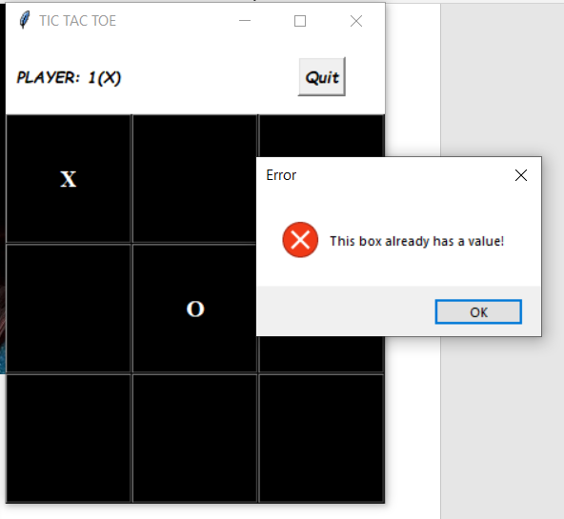
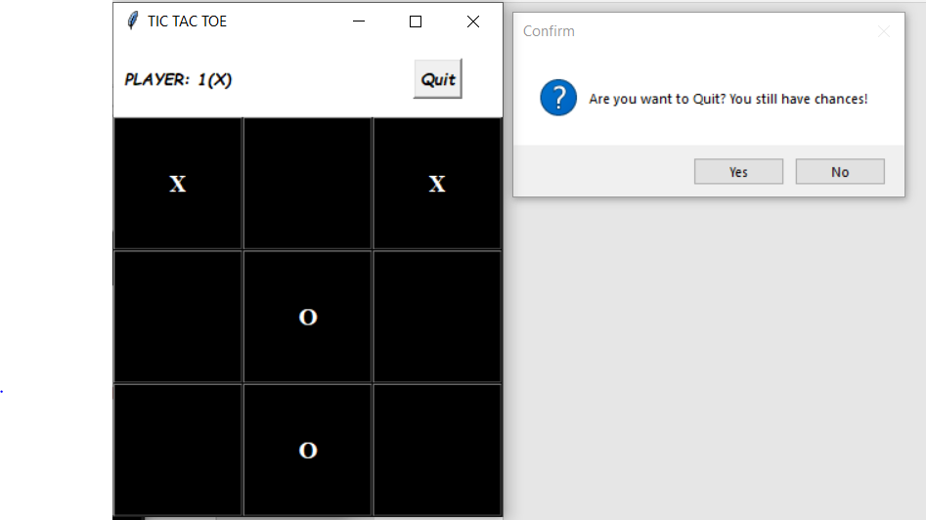
ScreenShots game: TIC TAC TOE

Slide 19
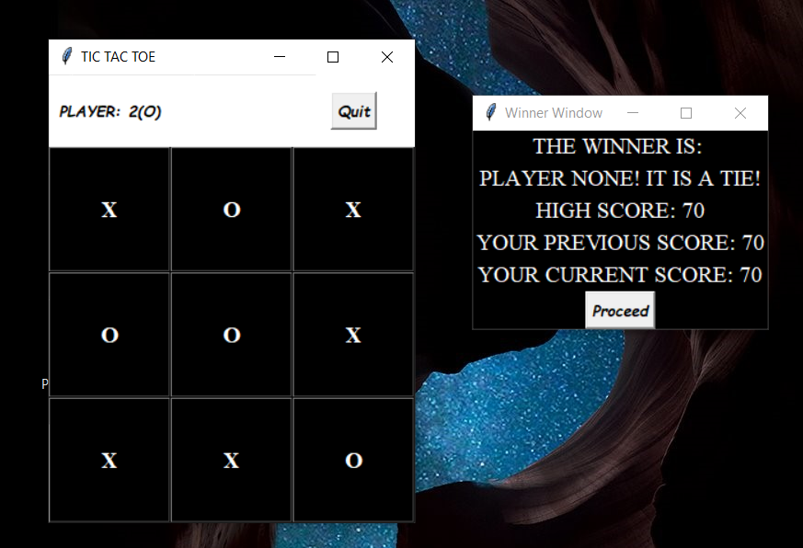
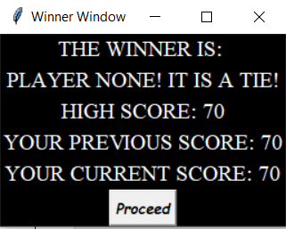
ScreenShots game: TIC TAC TOE

Slide 20
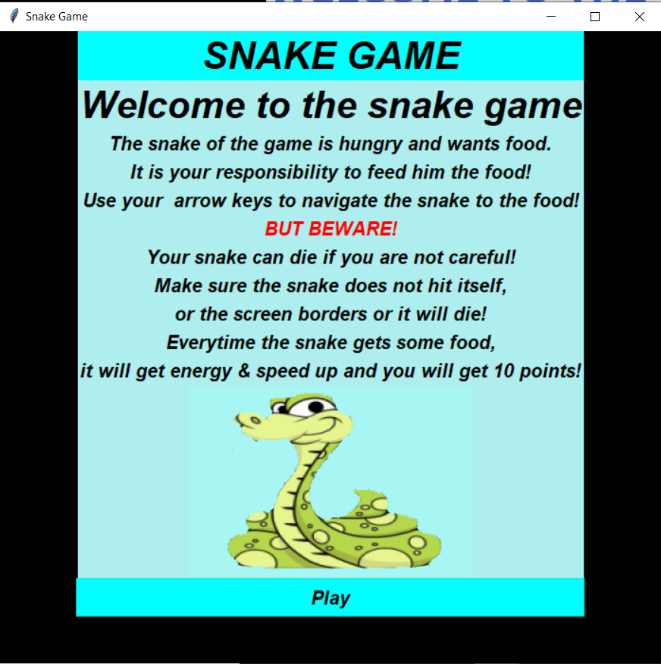
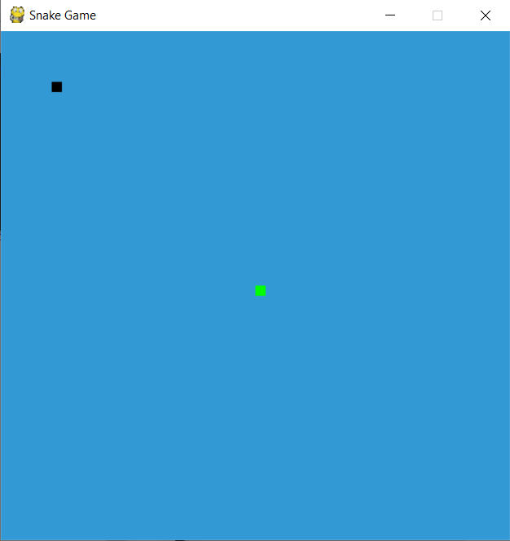
ScreenShots game: SNAKE GAME

Slide 21
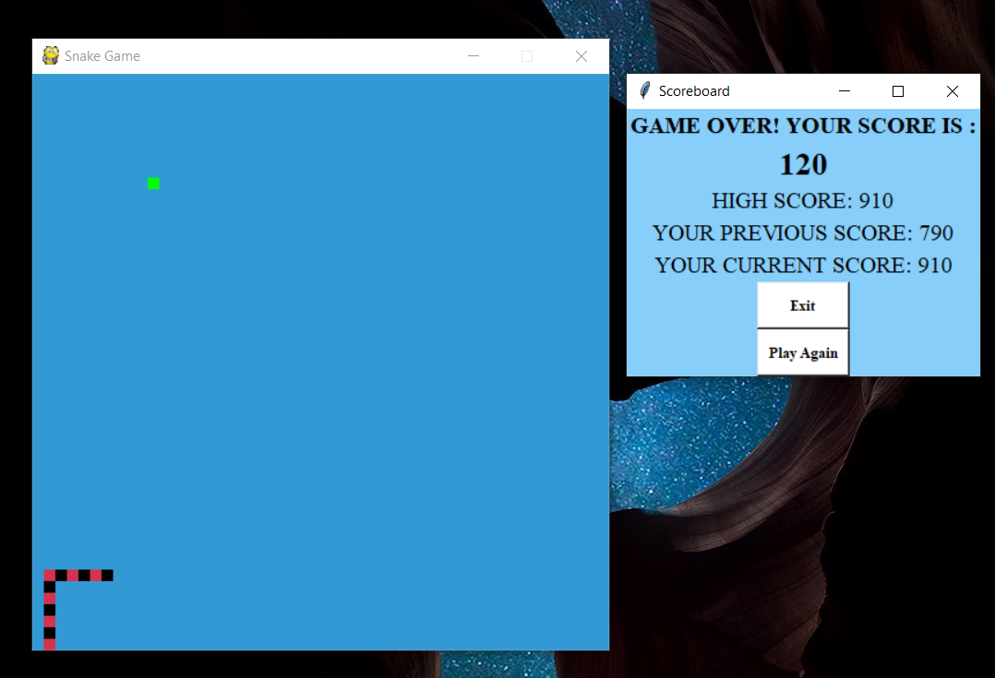
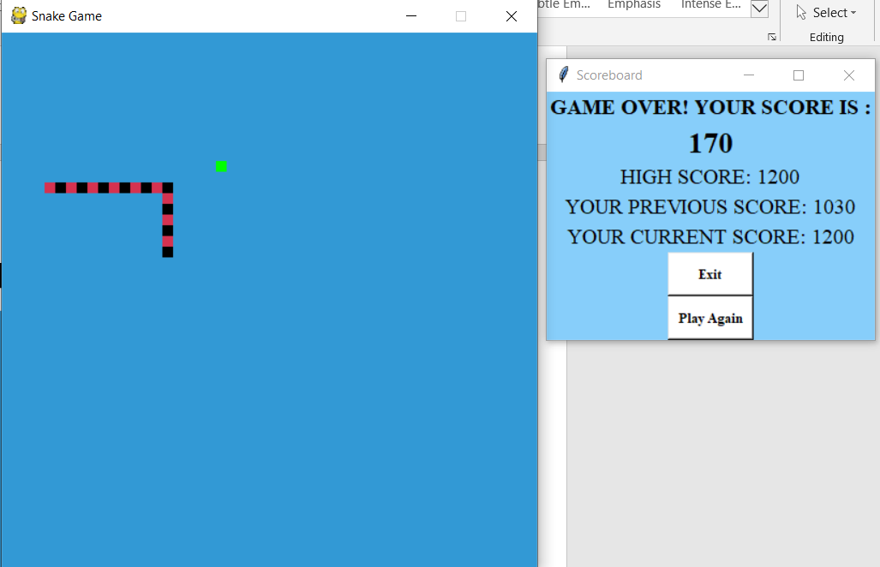
ScreenShots game: SNAKE GAME

Slide 22
conclusion
This Gaming Arcade constituents numerous concepts we learnt in our python programming language classes. Our understanding drove us to make this amazing project that we are proud to present to the world.
We absolutely enjoyed this experience that gave us an opportunity to create these games and taught us something as well.
This is the just the beginning of something great. We wish to add more games once we learn more concepts. We also wish to implement more levels and complexities in the games in the future.

