Slide 1
CareConnect
System Design Diagrams
Connecting volunteers, NGOs and beneficiaries
Notes:
Title slide for the CareConnect system design presentation.

Slide 2
What's in this deck
Requirements & flow
System design
Use Case, Flowchart and Data Flow Diagram show what the system does and how data moves.
Class, Sequence and ER diagrams show how the system is built and how its data is organised.
1
Use Case Diagram
4
Class Diagram
2
System Flowchart
5
Sequence Diagram
3
Data Flow Diagram – Level 1
6
ER Diagram
Notes:
Six diagrams in two groups: requirements and flow, then system design.

Slide 3
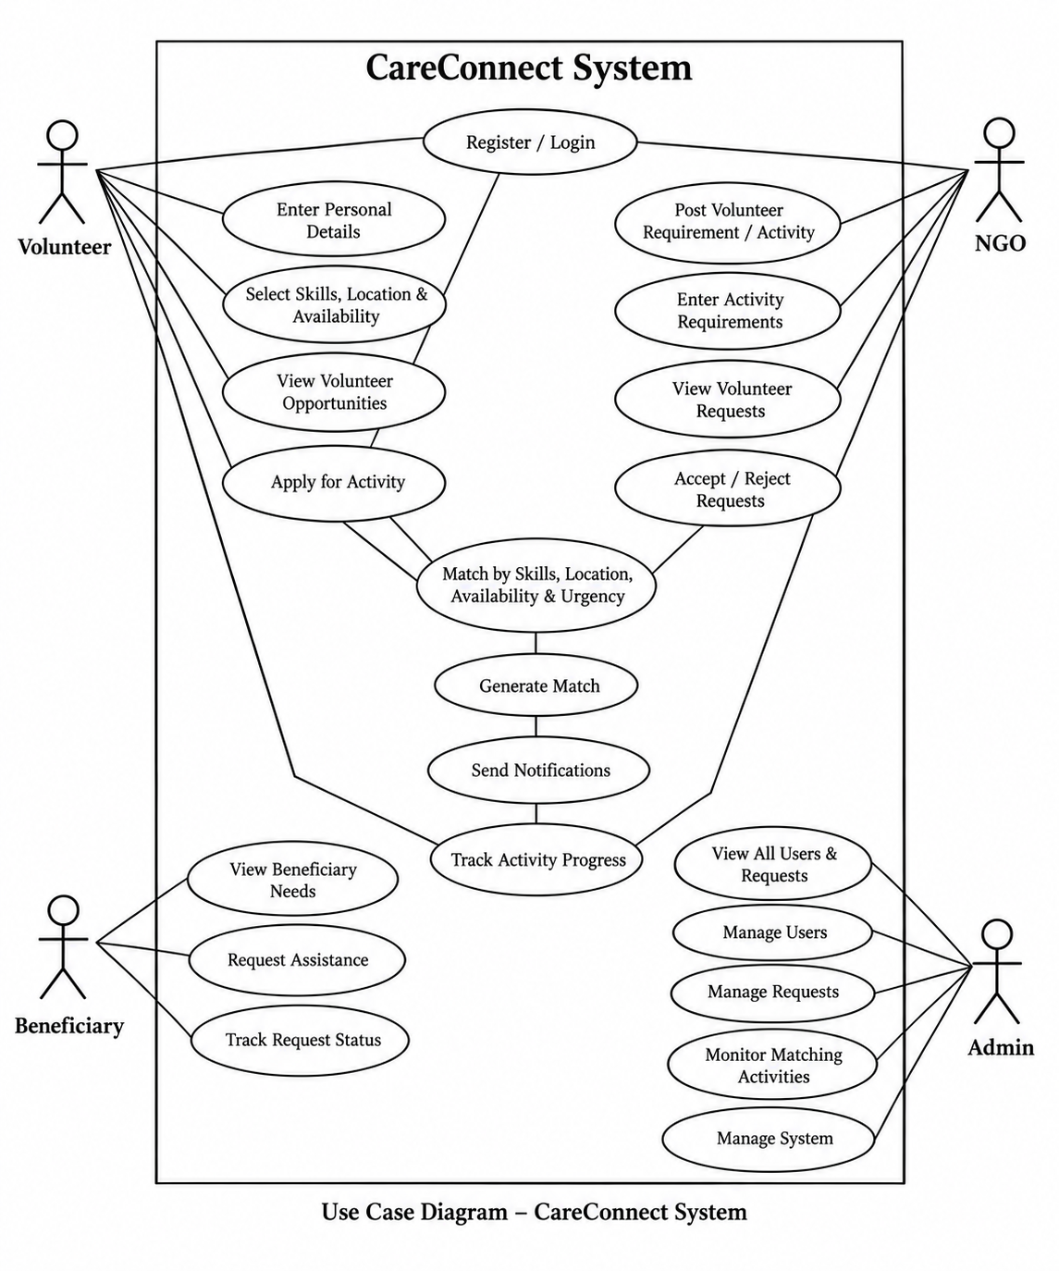
Use Case Diagram
Who does what in the system
Four actors: Volunteer, NGO, Beneficiary and Admin
Volunteers register, set skills, location and availability, view and apply for activities
NGOs post requirements, view volunteer requests and accept or reject them
The system matches by skills, location, availability and urgency, then sends notifications
Admins manage users, requests and monitor matching
Notes:
Use Case Diagram: Who does what in the system. Four actors: Volunteer, NGO, Beneficiary and Admin. Volunteers register, set skills, location and availability, view and apply for activities. NGOs post requirements, view volunteer requests and accept or reject them. The system matches by skills, location, availability and urgency, then sends notifications. Admins manage users, requests and monitor matching.

Slide 4
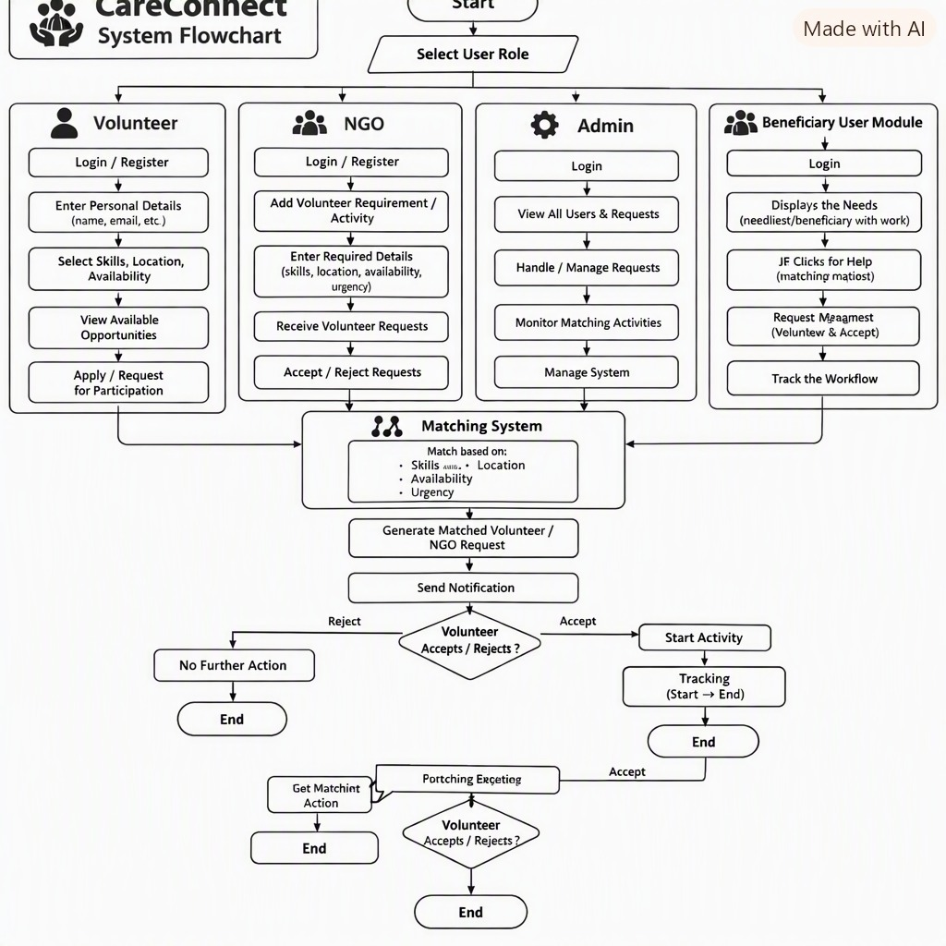
System Flowchart
End-to-end process
Start by selecting a user role
Each role has its own path: Volunteer, NGO, Admin, Beneficiary
All paths feed the Matching System (skills, location, availability, urgency)
A matched request triggers a notification
Volunteer accepts: activity starts and is tracked. Rejects: no further action
Notes:
System Flowchart: End-to-end process. Start by selecting a user role. Each role has its own path: Volunteer, NGO, Admin, Beneficiary. All paths feed the Matching System (skills, location, availability, urgency). A matched request triggers a notification. Volunteer accepts: activity starts and is tracked. Rejects: no further action.

Slide 5
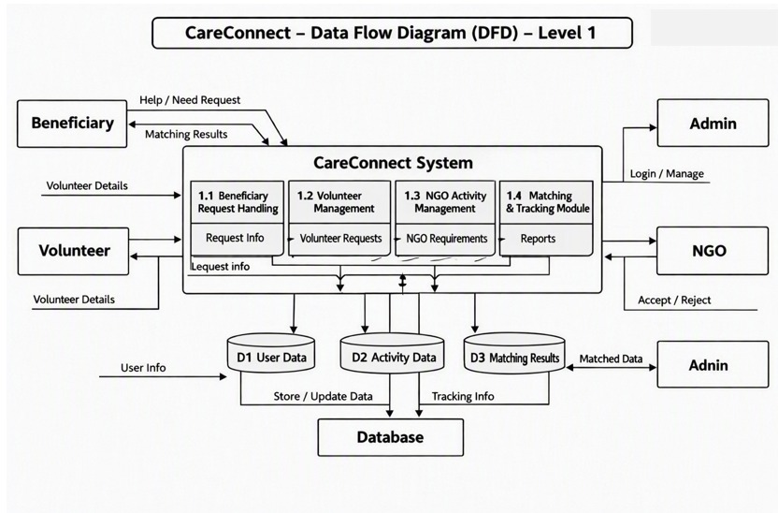
Data Flow Diagram – Level 1
How data moves through CareConnect
External entities: Beneficiary, Volunteer, NGO, Admin
Four processes: Beneficiary Request Handling, Volunteer Management, NGO Activity Management, Matching & Tracking
Three data stores: D1 User Data, D2 Activity Data, D3 Matching Results
All stores are backed by the central database
Notes:
Data Flow Diagram – Level 1: How data moves through CareConnect. External entities: Beneficiary, Volunteer, NGO, Admin. Four processes: Beneficiary Request Handling, Volunteer Management, NGO Activity Management, Matching & Tracking. Three data stores: D1 User Data, D2 Activity Data, D3 Matching Results. All stores are backed by the central database.

Slide 6
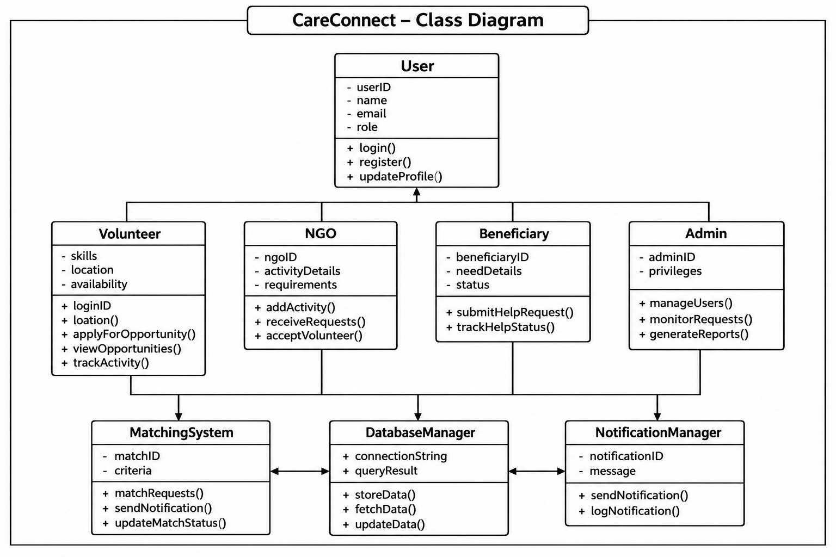
Class Diagram
Object structure
User is the base class (userID, name, email, role)
Volunteer, NGO, Beneficiary and Admin inherit from User
Supporting classes: MatchingSystem, DatabaseManager, NotificationManager
Each role class has its own operations, such as applyForOpportunity() and submitHelpRequest()
Notes:
Class Diagram: Object structure. User is the base class (userID, name, email, role). Volunteer, NGO, Beneficiary and Admin inherit from User. Supporting classes: MatchingSystem, DatabaseManager, NotificationManager. Each role class has its own operations, such as applyForOpportunity() and submitHelpRequest().

Slide 7
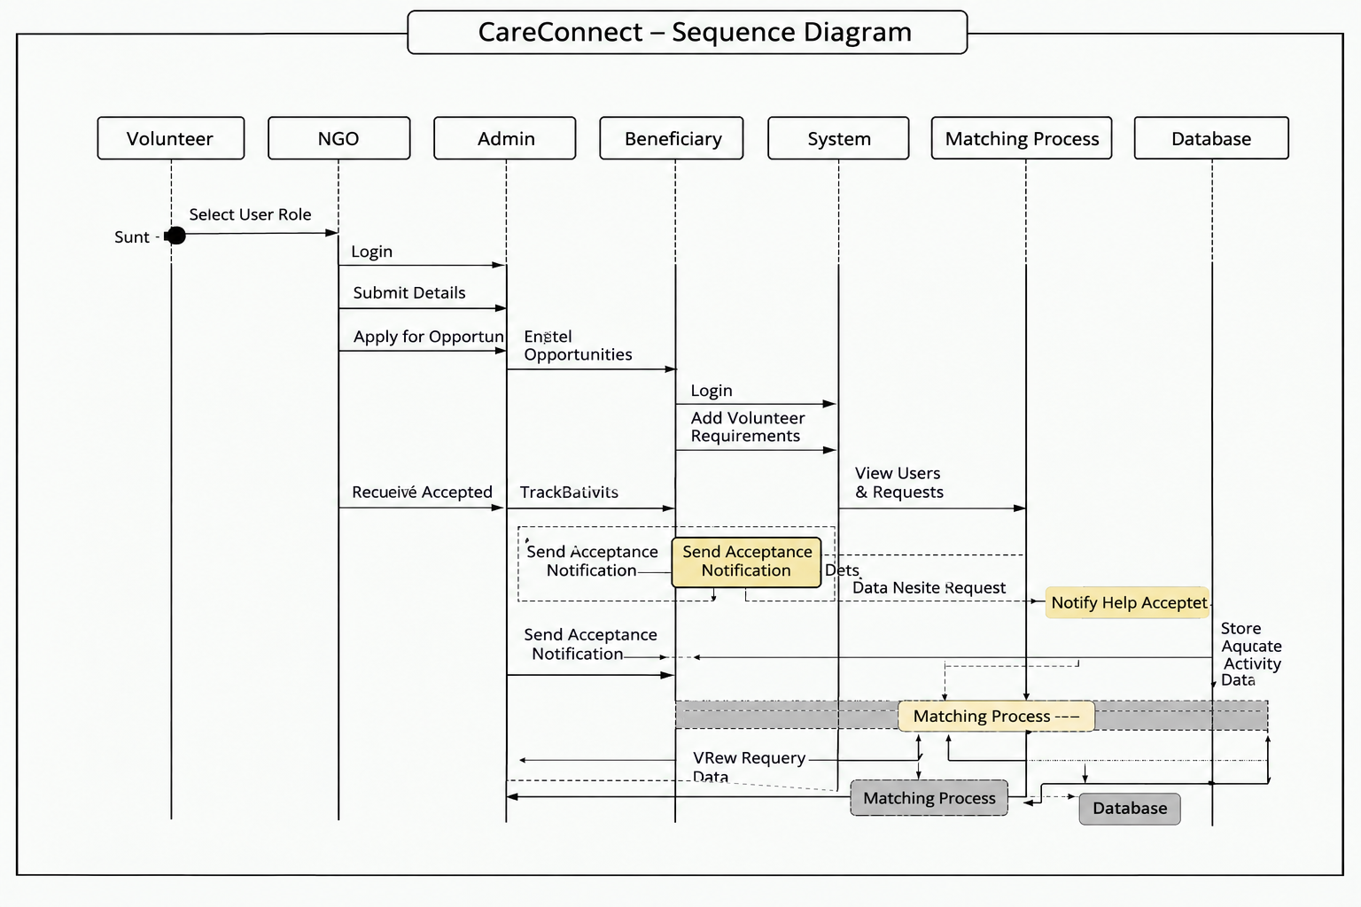
Sequence Diagram
Interaction over time
Participants: Volunteer, NGO, Admin, Beneficiary, System, Matching Process, Database
Flow: select role, login, submit details, apply for opportunities
Requirements and requests go through the Matching Process
Acceptance notifications are sent and activity data is stored in the database
Notes:
Sequence Diagram: Interaction over time. Participants: Volunteer, NGO, Admin, Beneficiary, System, Matching Process, Database. Flow: select role, login, submit details, apply for opportunities. Requirements and requests go through the Matching Process. Acceptance notifications are sent and activity data is stored in the database.

Slide 8
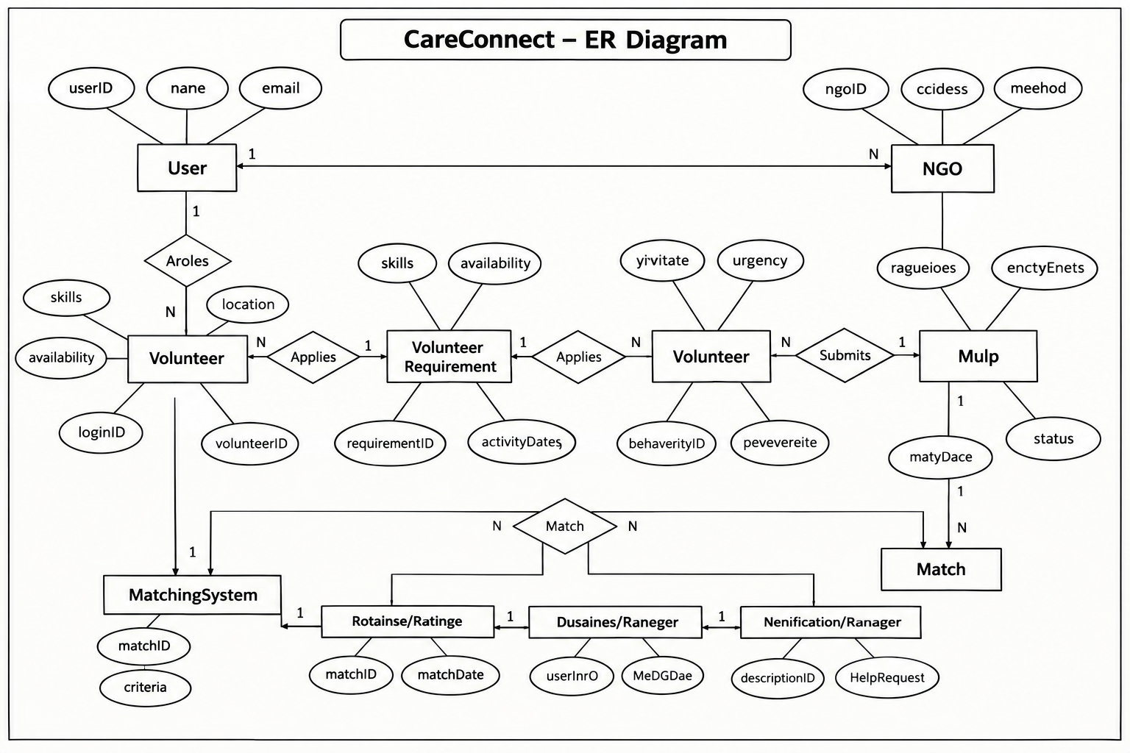
ER Diagram
Data model
Core entities: User, NGO, Volunteer, Volunteer Requirement, Match
Relationships: Applies, Submits and Match link volunteers, requirements and requests
Key attributes include skills, availability, location, urgency and status
MatchingSystem records matchID, criteria and matchDate
Notes:
ER Diagram: Data model. Core entities: User, NGO, Volunteer, Volunteer Requirement, Match. Relationships: Applies, Submits and Match link volunteers, requirements and requests. Key attributes include skills, availability, location, urgency and status. MatchingSystem records matchID, criteria and matchDate.

