Slide 1

Project Title -Seasonal Agriculture Performance Analysis
Student Name: Vaishnavi Dixit
College Name- Fairfield Institute of Management and Technology
AICTE STU ID :STU6a3f56b799e411782535863

Slide 2

PROBLEM STATEMENT
Agricultural activities are influenced by seasonal variations in environmental conditions, farming practices, resource availability and market conditions. As a result, agricultural performance may differ from one season to another. However, raw agricultural data does not clearly explain how agricultural performance changes across seasons or what patterns can be observed in different seasonal conditions. The problem is to analyze the given agricultural dataset and investigate seasonal differences in agricultural performance by identifying meaningful patterns, trends, relationships and variations within the available data.

Slide 3
Project Description This project focuses on analyzing seasonal patterns in agricultural performance using a real-world style dataset covering 4,000 farm records across multiple Indian states, districts, and crops, spread across the three major agricultural seasons — Kharif, Rabi, and Zaid. The dataset combines four categories of information for each farm: environmental conditions (rainfall, temperature, humidity, sunlight hours), soil and input conditions (soil pH, soil moisture, nitrogen/phosphorus/potassium levels, fertilizer and pesticide usage, irrigation method, seed quality), production outcomes (yield per hectare, total production), and economic outcomes (market price, cost, revenue, and profit), along with resource-efficiency metrics like water usage and water efficiency, and a disease/pest risk indicator. The goal was not to describe the dataset generically, but to specifically investigate how these factors change from season to season, and whether those seasonal differences are meaningful rather than random. Approach followed: Data Cleaning – Missing values in Rainfall, Soil Moisture, and Yield were identified and filled using the median value within each season, since imputing season-wise preserves the seasonal character of the data rather than distorting it with a single overall average. Duplicate records were also checked. Exploratory Data Analysis (EDA) – Using Python libraries (Pandas, NumPy, Matplotlib, Seaborn), the dataset was explored to compare yield, profit, rainfall, temperature, humidity, water usage, water efficiency, fertilizer/pesticide usage, and disease/pest risk across the three seasons using boxplots, bar charts, and violin plots. Deeper Pattern Analysis – Crop-wise and state-wise seasonal comparisons were built using pivot tables and heatmaps, to check whether seasonal patterns are consistent across all crops/regions or vary in unexpected ways. Correlation Analysis – A correlation heatmap was built across key numeric variables (rainfall, temperature, soil moisture, fertilizer, yield, water usage/efficiency, disease risk, and profit) to understand relationships between environmental/input factors and outcomes. Statistical Testing – A one-way ANOVA test was applied to Yield and Profit to statistically confirm whether the seasonal differences observed visually are actually significant, rather than due to chance. Outcome:The analysis shows that while resource usage and environmental factors vary noticeably across seasons, ANOVA testing revealed that yield differences across seasons were not statistically significant (p = 0.212), whereas profit differences across seasons were highly statistically significant (p < 0.00001). This suggests that season affects economic outcomes more directly than it affects raw yield, likely due to seasonal variation in cost, market price, and resource efficiency

Slide 4

WHO ARE THE END USERS?
Farmers – to understand which season suits their crop best, plan irrigation and fertilizer use more efficiently, and anticipate disease/pest risk ahead of time.
Agricultural Officers / Extension Workers – to guide farmers with data-backed seasonal recommendations rather than only traditional practice.
Government Agricultural Departments & Policymakers – to plan seasonal resource allocation (water, subsidies, support schemes) based on evidence of where seasonal performance is weak.
Agri-tech Companies & Researchers – to build on this kind of seasonal analysis for crop advisory apps, yield prediction models, or precision farming tools.
Financial Institutions / Crop Insurance Providers – to assess seasonal risk patterns (e.g. disease risk, profit volatility) when designing loan or insurance products for farmers.

Slide 5

Technology Used
Python – core programming language for the entire analysis
Pandas – data loading, cleaning, and manipulation (handling missing values, grouping, pivot tables)
NumPy – numerical operations and aggregations
Matplotlib – base plotting library for charts
Seaborn – statistical visualizations (boxplots, bar charts, violin plots, heatmaps)
SciPy (stats module) – ANOVA test for statistical significance of seasonal differences
Jupyter Notebook / Google Colab – development environment for writing and running the analysis
Microsoft PowerPoint – for presenting the final findings

Slide 6
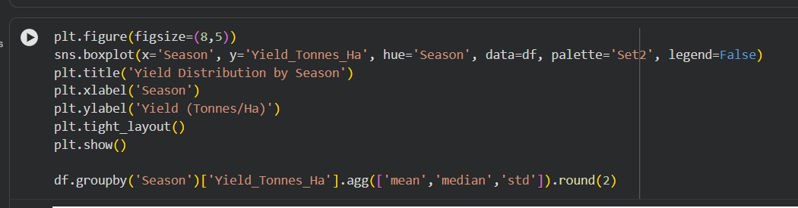
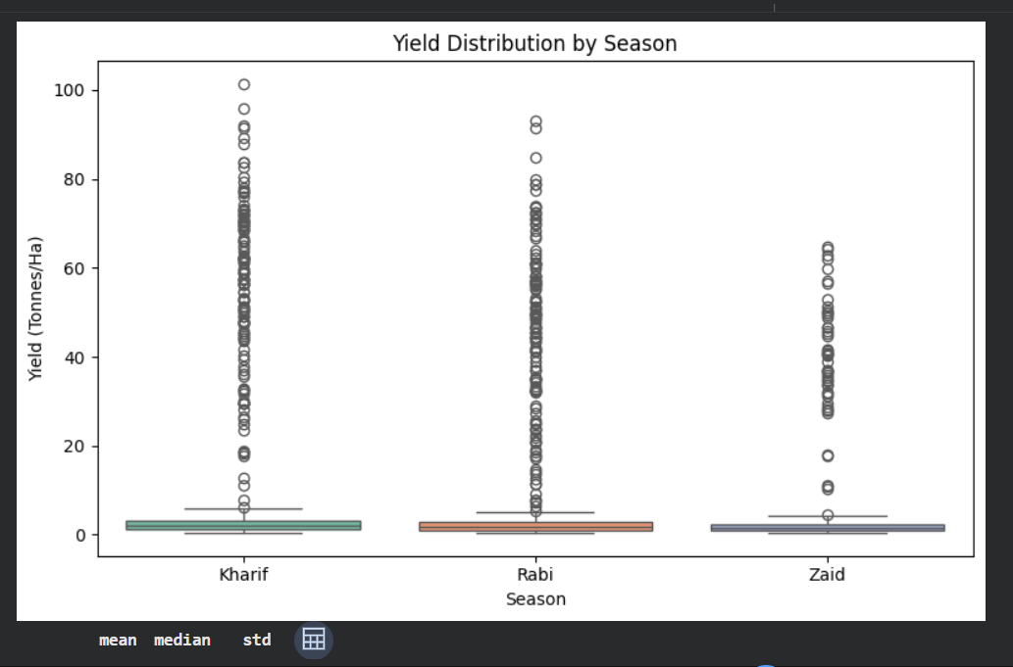
RESULTS
Yield varies noticeably across Kharif, Rabi, and Zaid

Slide 7
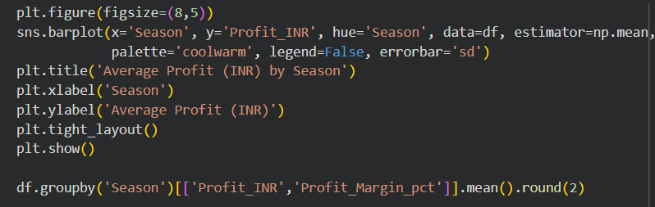
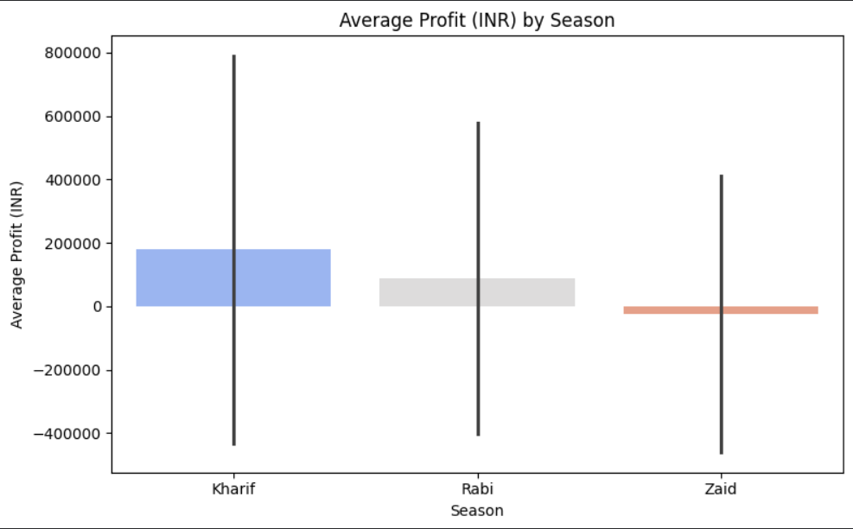
RESULTS
Average profit differs by season, showing economic impact of seasonal conditions

Slide 8
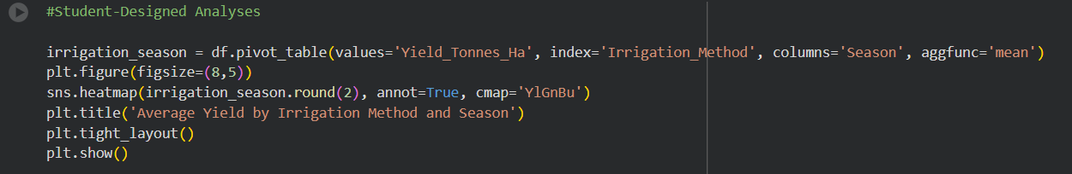
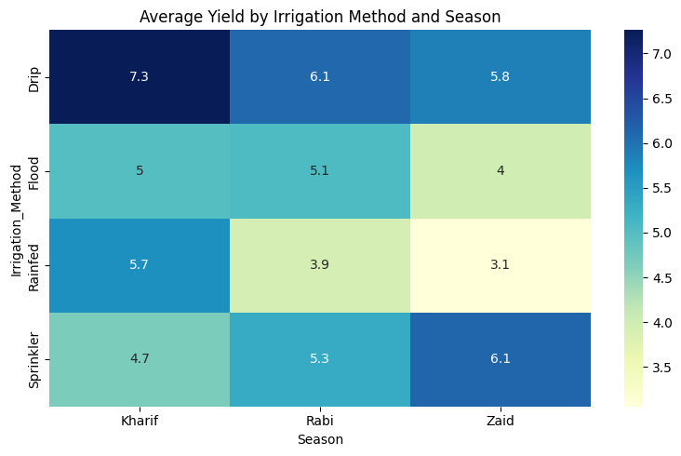
RESULTS
Irrigation method influences yield differently across seasons

Slide 9
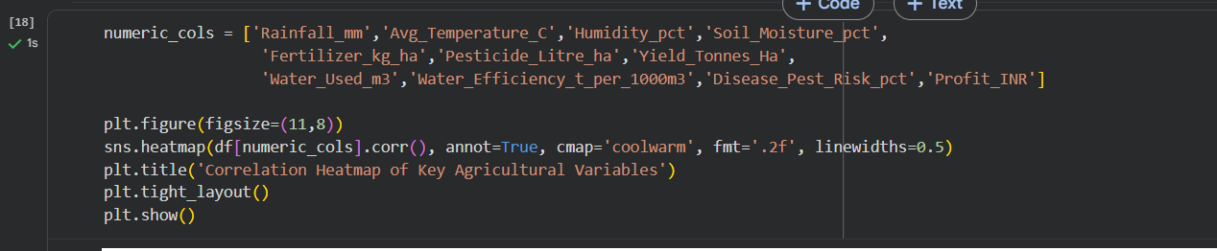
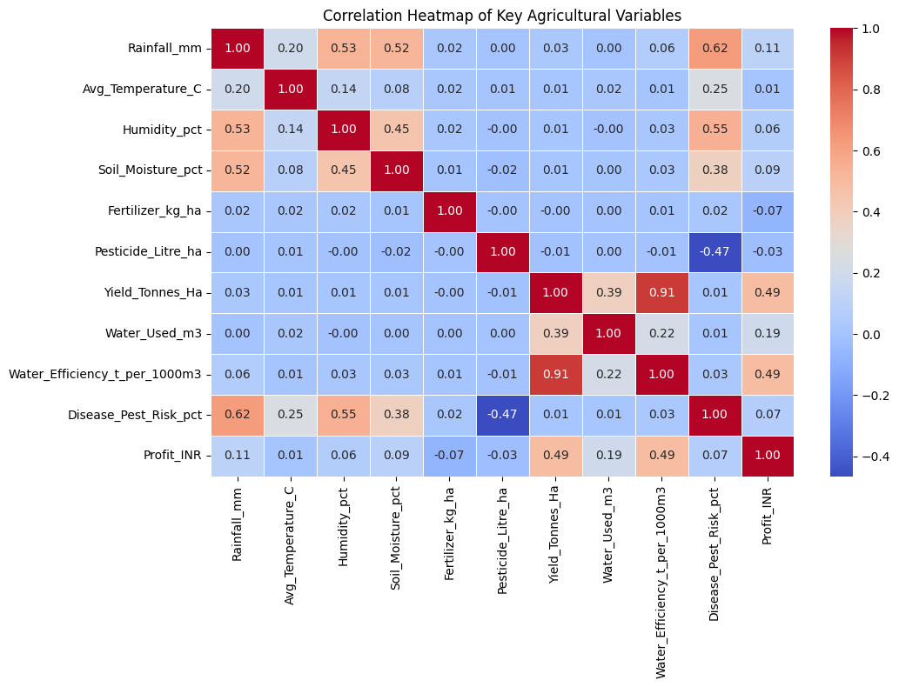
RESULTS
Relationships between rainfall, water use, fertilizer, and yield

Slide 10
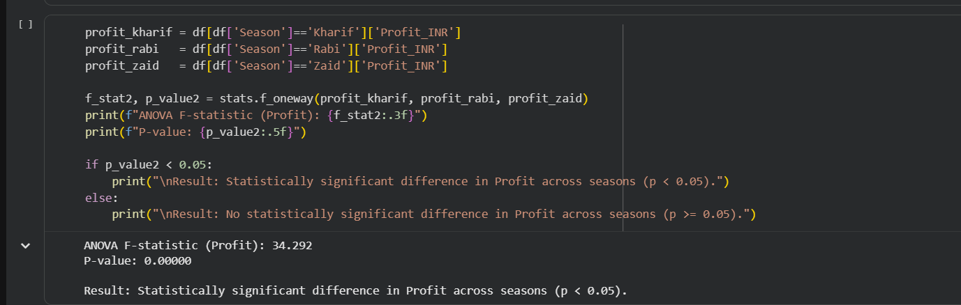
RESULTS
Statistical test confirms seasonal profit differences are significant

Slide 11
Future scope
Predictive Modeling – Build a machine learning model (e.g., regression) to predict yield or profit for a given season, crop, and region based on environmental and input conditions, rather than only analyzing historical patterns.
Multi-Year Data – Extend the analysis with data across multiple years to study long-term seasonal trends and the impact of climate variability, not just a single snapshot.
Real-Time Weather Integration – Combine live weather/forecast data with this analysis to give farmers season-specific recommendations in advance rather than after the fact.
Interactive Dashboard – Convert this analysis into an interactive dashboard (e.g., using Power BI or a Streamlit app) so farmers and officials can explore seasonal patterns for their specific state, district, or crop without needing to read code.
Recommendation System – Develop a simple advisory tool that suggests the best crop-season combination for a given region based on historical yield and profit performance.

Slide 12
GitHub Link
https://github.com/vaishnavi007dixit/Seasonal-Agriculture-Performance-Analysis

Slide 13

VOIS Course completion certificate - Course name- Data Visualization

Slide 14
Thank you
.
.

