Slide 1


UPI Transaction Analytics & Performance Insights
Excel Data Analytics & Interactive Dashboard
Presented By : Vaishnavi Dilip Nagpure

Slide 2
Introduction
Project Scope
What This Analysis Covers
This project analyzes 250,000 UPI transactions drawn from a structured dataset representing real-world digital payment activity across India. The dataset spans multiple merchant categories, sender banks, and geographic regions, providing a rich foundation for behavioral and performance analysis.
Transaction Patterns - Identify how, when, and where UPI transactions occur — by hour, category, and region.
Performance Metrics - Measure platform reliability through success rates, failure rates, and transaction volume benchmarks.
Objective: Enable data-driven decision-making by combining KPIs, charts, and interactive slicers into a single analytical view.

Slide 3
Key Metrics & KPIs
Five headline indicators summarize the scale, financial impact, and health of the UPI platform under analysis.
250K
₹327.9M
₹1,311
Total Transactions
Total Transaction Value
Avg. Transaction Value
95%
0.2%
Success Rate
Fraud Rate

Slide 4





Interactive Slicers
The analytical dashboard is designed for dynamic exploration. Slicers allow users to filter the dashboard interactively and analyze specific segments of the transaction data.
Transaction Status
Merchant Category
Sender State
Failed / Successful transactions
Compare different merchant segments
Analyze transactions geographically
Device Type
Is Weekend
Android, iOS and Web
Compare weekday and weekend activity
Purpose
Slicers allow users to filter the dashboard interactively and analyze specific segments of the transaction data.

Slide 5
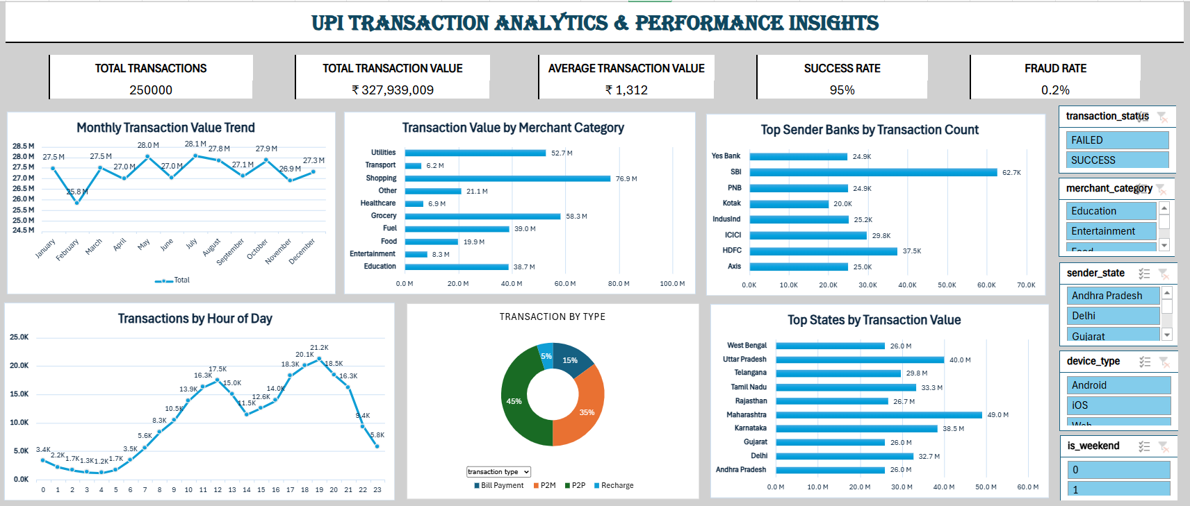
Interactive Dashboard
UPI Transaction Analytics Dashboard

Slide 6
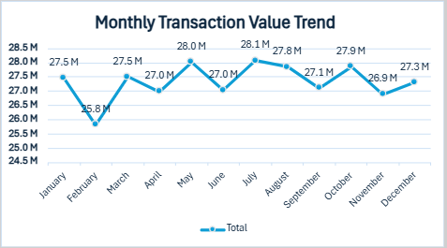
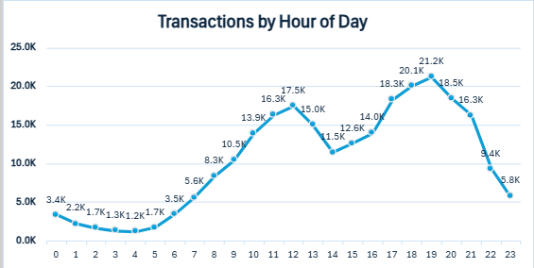
Transaction Trends & Behavior
Two temporal patterns stand out: monthly transaction value varies across the year, while hourly transaction activity builds through the day and peaks in the evening.
Monthly Transaction Value Trend
Transactions by Hour of Day
Shows month-wise movement in transaction value, revealing seasonal patterns and peak activity periods.
Reveals how transaction activity changes throughout the day, identifying peak usage hours for infrastructure planning.

Slide 7
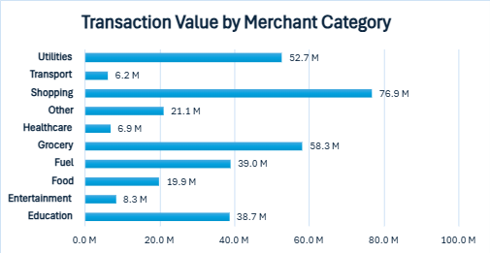
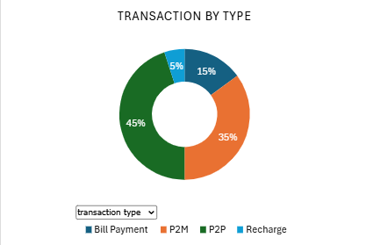

Category & Transaction Type Analysis
Transaction value is concentrated in Shopping, while transaction volume remains led by P2P Transfers, with P2M Payments and Bill Pay & Recharge making up the remainder.
Transaction Value by Merchant Category
Transaction Volume by Type
Compares transaction value across merchant categories, showing where user spending is concentrated.
Shows the proportion of different transaction types, defining the platform's current usage identity.

Slide 8
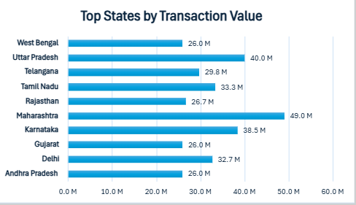
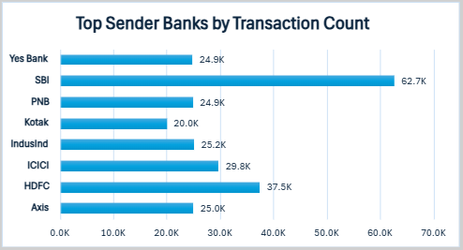
Bank & Geographic Insights
Two key views of UPI activity : The banks driving the most transactions and the states generating the highest transaction value.
Top Sender Banks by Transaction Count
Top States by Transaction Value
Compares transaction counts across sender banks, signaling user adoption and platform penetration by bank.
Compares transaction value across states, reflecting geographic concentration of high-value activity and market potential.

Slide 9






SUMMARY
Key Findings & Conclusion
Key Findings
250K
₹327.94M
95%
0.2%
Total Transactions
Total Transaction Value
Success Rate
Fraud Rate
Shopping
45%
Dominates Categories
P2P Transfers
The combination of KPIs, pivot tables, charts, and slicers equips stakeholders to identify trends, detect anomalies, and make data-driven decisions that enhance platform reliability and long-term growth.

Slide 10

Thank You

