Slide 1
EQUAL STARS: PAVING THE PATH TO EQUALITY FOR CHILDREN

Slide 2

INTRODUCTION
Welcome to Equal Stars: Paving the Path to Equality for Children. In this presentation, we will explore innovative approaches to ensure equal opportunities for all children.
Join us on this journey of creativity and inspiration!

Slide 3
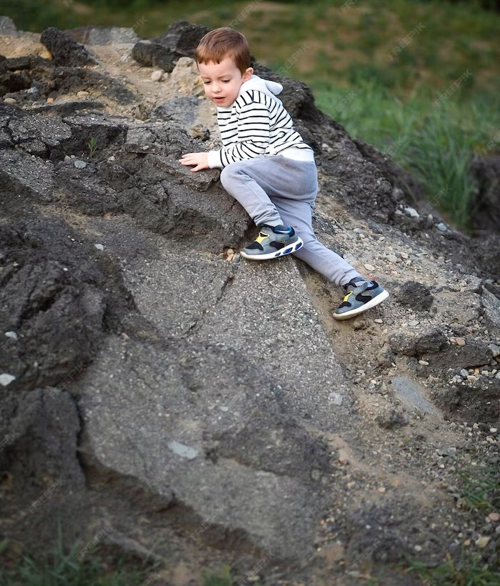
CHALLENGES FACED
Children face numerous challenges on their path to equality, including discrimination, inequality in education, and limited access to resources. Overcoming these obstacles is crucial to create a fair and inclusive society.

Slide 4

INNOVATIVE SOLUTIONS
Embracing innovation is key to paving the path to equality for children. By leveraging technology, promoting inclusive education, and fostering diversity, we can empower every child to reach for the stars.

Slide 5
CONCLUSION
Together, we can create a world where every child has an equal chance to shine. Let's continue to champion equality, inclusivity, and empowerment for children. Together, we can make a difference and build a brighter future!

