Slide 1
UNSHACKLING INNOCENCE: EMPOWERING CHILDREN WITH THE RIGHT TO FREEDOM FROM TRAFFICKING AND BONDED LABOUR

Slide 2
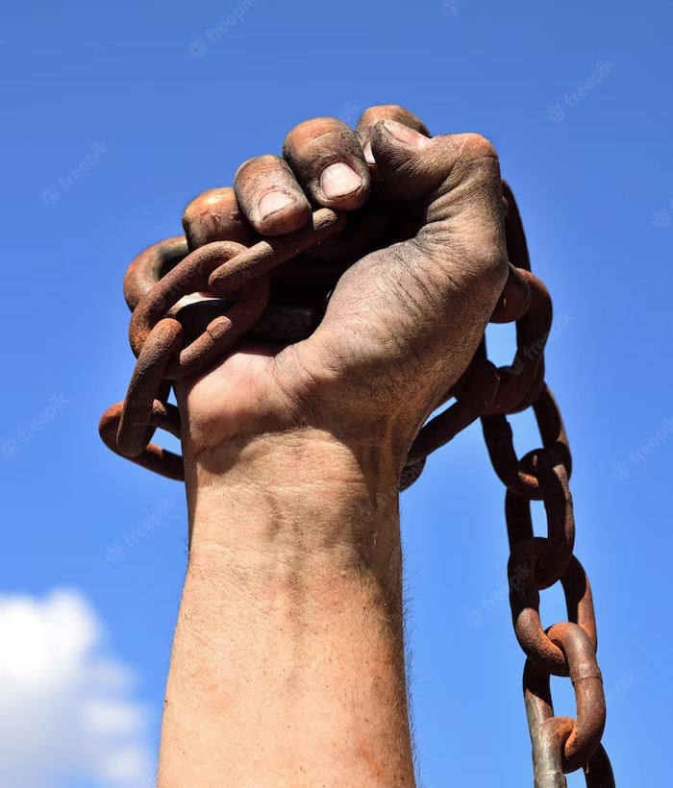
INTRODUCTION
Unshackling Innocence: Empowering Children with the Right to Freedom from Trafﬁcking and Bonded Labour

Slide 3

EXTENT OF THE PROBLEM
Millions of children worldwide are trapped in the horrors of trafﬁcking and bonded labour.
This pervasive issue denies them their basic rights, steals their childhood, and hinders their development. It is our responsibility to break the chains and provide them with a brighter future.

Slide 4

EMPOWERING THROUGH EDUCATION
Education is the key to unlocking freedom for children. By providing quality education, we equip them with knowledge, skills, and conﬁdence to resist exploitation. It is crucial to invest in education as a powerful tool to combat child trafﬁcking and bonded labour.

Slide 5

TOGETHER TOWARDS CHANGE
It is time for collective action. Governments, NGOs, communities, and individuals must join forces to end child trafﬁcking and bonded labour. Let us work together to create a world where every child can experience the joy of childhood, free from exploitation and bondage.

Slide 6
CONCLUSION
Unshackling Innocence is our collective responsibility. By empowering children with the right to freedom from trafﬁcking and bonded labour, we can create a future where every child can thrive. Together, let us continue to raise awareness, advocate for change, and take action to protect and uplift the most vulnerable among us.

