Slide 1
BIOMETRIC PATTERN ANALYSIS USING SPATIO-FREQUENCY DOMAIN APPROACH FOR DATABASE SECURITY
GUIDED BY
Dr. P. ANANDHAKUMAR
HEAD & PROFESSOR
DEPARTMENT OF CT
MIT CAMPUS, ANNA UNIVERSITY

Slide 2
OBJECTIVE
To provide an improved solution for security of biometric templates.

Slide 3
LITERATURE SURVEY
ON THE VULNERABILITY OF BIOMETRIC SECURITY SYSTEM
EXISTING MECHANISMS | ADVANTAGES | DISADVANTAGES
HANDHELD TOKENS ( ID ) | NEW ONES CAN BE ISSUED INCASE OF MISSING IDs | CAN BE STOLEN, FAKED, SHARED EASILY
KNOWLEDGE BASED ( PASSWORD, PIN ) | NEW ONES CAN BE ISSUED INCASE OF MISSING IDs | CAN BE HACKED EASILY BY BRUTE FORCE
BIOMETRICS | WILL NEVER BE LOST/SHARED | CAN BE FAKED

Slide 4
FINGERPRINT COMBINATION FOR PRIVACY PROTECTION
IEEE Transactions On Information Forensics And Security, Vol. 8, No. 2, February 2013
Extract the minutia position from one fingerprint and orientation from the other and reference points from both the fingerprint.
Generate a better new virtual identity.
Feature fusion of complex inputs are difficult.

Slide 5
ON MIXING FINGERPRINTS
IEEE Transactions on Information Forensics and Security, Vol. 8,No.1,January2013
Each fingerprint pattern is decomposed into two different components, viz., the continuous and spiral component.
Obscure the information present in an individual’s fingerprint image.
Can be processed by conventional fingerprint algorithms
Poor performance in pre-aligning and mixing different pairs.

Slide 6
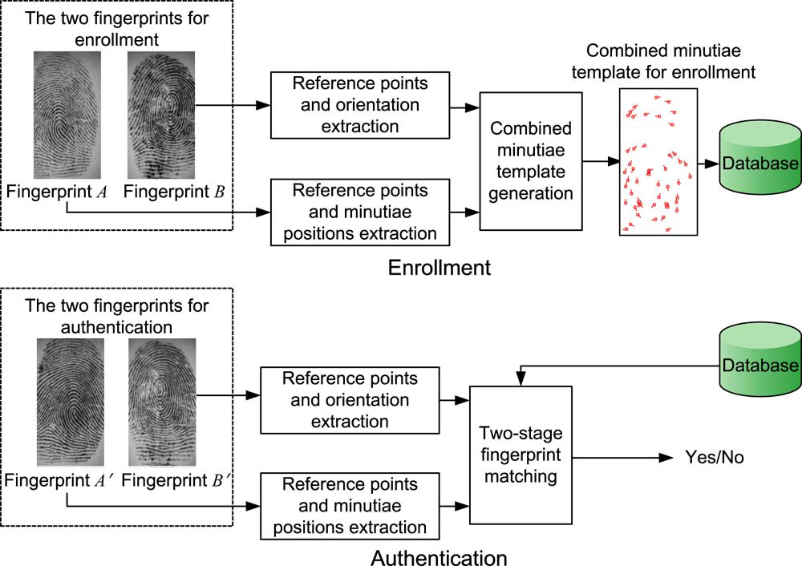
EXISTING SYSTEM (BASE PAPER: FINGERPRINT COMBINATION FOR PRIVACY PROTECTION IEEE Transactions On Information Forensics And Security, Vol. 8, No. 2, February 2013)
Fig 1

Slide 7
LIMITATIONS OF THE EXISTING SYSTEMS
Information leakage is possible
Limited privacy protection
Low performance
ISSUES TO BE ADDRESSED :
Non reversibility
Increased security
Accuracy
Efficiency of the protection system

Slide 8
PROPOSED SYSTEM
Fingerprint analysis requires comparison of several features of the print pattern and minutia points.
Minutiae points are extracted from the image; subjected to different shuffling algorithms.
Artificial minutia points are now inserted at selected points to improve the efficiency of the protection system.

Slide 9

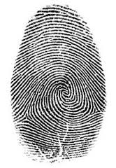
Left Right
Two different fingerprints
Enrollment Phase
PROPOSED SYSTEM
Left Right
Data base
Combined Minutiae Template
Apply SNL approach
Inserting artificial minutiae points
Tree based shuffling mechanism
The new virtual identity
Authentication Phase
Check Template
Alignment
Tree based shuffling mechanism
Combined Minutiae Template
Apply SNL approach
Inserting artificial minutiae points
Matching Process
Left Right
Fig 2

Slide 10
APPLYING SNL APROACH
Based on the Snake and Ladder game the pixel values of the image are aligned .when a snake is encountered pixel value goes down, whereas pixel value moves upon seeing a ladder.
e.g. Snake(16,20) = LCM(16, 20) = 80
Hence 80 times the value of upper level pixel will come down. The generated gap will be filled by the other pixels.

Slide 11
Ladder(8,2) = BIT. COMPLEMENT(8,2)
= BIT. COMPLEMENT(1000, 2)
= 12
Hence 12 times the value of lower level pixel will go up. The generated gap will be filled by the other pixels.
Different number of snakes and ladders will be inserted in each level to increase the template protection.

Slide 12
Four stages of Security Enhancement in our approach:
(A) INTERMIXING OF PIXELS
All the pixel values of the image are shuffled to form
a new encrypted image.
(B) APPLYING SNL ALGORITHM
Based on the Snake and Ladder game the pixel values of the image are aligned i.e when a snake is encountered pixel value goes down; whereas pixel value moves up on seeing a ladder.
(C) INSERTION OF ARTIFICIAL MINUTIAE POINTS
Later on artificial minutiae points are inserted to enhance the security.
(D) TREE BASED SHUFFLING MECHANISM
Shuffling of pixels by considering the matrix as a tree.

Slide 13
(A) INTERMIXING OF PIXELS
76 | 48 | 52 | 200
11 | 07 | 71 | 66
100 | 180 | 20 | 40
67 | 150 | 220 | 30
67 | 11 | 66 | 220
48 | 20 | 30 | 52
180 | 100 | 07 | 150
76 | 40 | 200 | 71
COMBINED MINUTIAE TTEMPLATE

Slide 14
(B) APPLYING SNL ALGORITHM
67 | 11 | 66 | 220
48 | 20 | 30 | 52
180 | 100 | 07 | 150
76 | 40 | 200 | 71
Shift 67 down | 11 | 66 | 220
48 | 20 | Shift 30 up | 52
180 | 100 | 07 | Shift 150 down
Shift 76 up | 40 | 200 | 71

Slide 15
(C) INSERTION OF ARTIFICIAL MINUTIAE POINTS
33 | 11 | 66 | 220
48 | 20 | 250 | 52
180 | 100 | 07 | 110
00 | 40 | 200 | 71
33+a | 11+a | 66+a | 220+a
48+b | 20+b | 250+b | 52+b
180+a | 100+a | 07+a | 110+a
00+b | 40+b | 200+b | 71+b

Slide 16
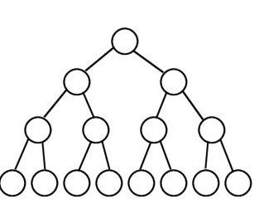
(D) TREE BASED SHUFFLING MECHANISM
221 | 10 | 3 | 8
105 | 48 | 62 | 45
6 | 29 | 24 | 47
50 | 20 | 200 | 30
LEVEL 0-00
10
3
8
LEVEL 1-01
105
48
62
45
LEVEL 2-10
6
29
24
47
50
20
200
30
LEVEL 3-11

Slide 17
ALGORITHM
Based on the value of the pixel in the first row-first column, shuffling operation for that particular matrix is performed.
Obtain the value of the pixel in the first row-first column.
for each iteration
obtain the level of the node with 1st 2 MSB
(here 221=11011101=> level 3)
if ( level= 0)
say x is the value of last 6 LSBs mod 8
if( x=0 )
left left left swap
if( x=1 )
left left right swap
if( x=2 )
left right left swap

Slide 18
if( x= 3)
left right right swap
if( x=4 )
right left left swap
if( x=5 )
right left right swap
if( x=6 )
right right left swap
if( x=7 )
right right right swap
if( level = 1 )
node to be swapped= last 6 LSBs mod 2
say x is the value of last 6 LSBs mod 4
if( x=0 )
left left swap
if( x=1 )
left right swap

Slide 19
if( x=2 )
right right swap
if( x=3 )
right left swap
if( level =2 )
node to be swapped=last 6 LSBs mod 4
say x is the value of last 6 LSBs mod 2
if( x=0 )
left swap
if( x=1 )
right swap
if( level=3 )
node to be swapped=last 6LSBs mod 8
swap with its sibling
Remove fisrt 2 MSBs
Say y is the pixel value mod 8
do the swapping operations for level 0 ( selecting one of the eight possibilities using y value )

Slide 20
WORKING
Iteration 2: pixel value : 011101=> level-1 , node=13%2=1st node.
13%4=1=>left right swapping
i.e swap the node with its left child and then with the right child of the left child
Iteration 1: pixel value : 11011101=> level-3 , node=29%8=5th node. Swap with its sibling
10
10
3
8
3
62
105
48
62
45
105
48
50
45
47
20
24
50
30
6
29
200
6
29
24
47
20
8
200
30

Slide 21
Iteration 3: pixel value : 1101=> level-3 , node=1%8=1stnode. Swap with its sibling
Final shuffling: 221%8=3
So perform left right right swapping
10
3
3
62
48
62
105
48
50
45
47
50
45
105
29
24
47
20
8
200
20
6
30
29
6
24
10
8
200
30

Slide 22
Now traverse the tree in root right left fashion and fill in the matrix.
221 | 10 | 3 | 8
105 | 48 | 62 | 45
6 | 29 | 24 | 47
50 | 20 | 200 | 30
221 | 3 | 62 | 45
30 | 200 | 50 | 8
20 | 48 | 47 | 10
24 | 105 | 6 | 29

Slide 23
IN WHAT WAY DOES THE PROPOSED SYSTEM OUT PERFORM THE EXISTING APPROACH
NO INFORMATION LEAKAGE :
Almost entire features of the original finger print is revealed in the existing approach; whereas in the proposed system, a triple layer security is provided to the templates thus hiding the original data.
LIMITED PRIVACY PROTECTION:
Can be easily hacked if the attacker has the combined minutiae template ( stored in database ) and either fingerprint A or fingerprint B; whereas the proposed protection system is non-invertible in nature.

Slide 24
AUTHENTICATION PHASE
MATCHING ALGORITHM
INPUT: INPUT IMAGE AND FINGERPRINT DATABASE
OUTPUT: BEST SIMILARITY SCORE
Begin
Initialize count1 to the size of the registered image along x direction
Initialize count2 to the size of the input image along x direction
For i=1 to count1
T1 = alignment algorithm 1 ( registered image )
For j=1 to count 2
If minutiae feature of input image at jth position and that of registered image at ith position is same
T2 = alignment algorithm 1 ( input image )
For alpha = -5 to +5 /*threshold for theta*/
T3 = alignment algorithm 2 ( T2 )
similarity score = score calculation ( T3 , T1 )
Obtain the best similarity score out of all the transformations
End
End
End
Return similarity score
End

Slide 25
ALIGNMENT
3,3 - ridge
 | 4,2 bifurcation
 | 5,5- ridge
 |  | 6,4 bifurcation
For image 1, ref point 3,3
x-xref=3-3=0 ;y-yref=3-3=0;(0,0)
x-xref=4-3=1; y-yref=2-3=-1;(1,-1)
for image 2, ref point 5,5
x-xref=5-5=0;y-yref=0;(0,0)
x-xref=6-5=1;y-yref=4-5=-1;(1,-1)

Slide 26
SIMILARITY SCORE CALCULATION
SCORE CALCULATION ALGORITHM
INPUTCOMBINED MINUTIAE TEMPLATE AFTER APPLYING TREE BASED SHUFFLING MECHANISM AND REGISTERED TEMPLATE
OUTPUT: SIMILARITY SCORE
: Initialize number counter, count 1 to the size of the registered image along x direction
Initialize number counter, count 2 to the size of the input image along x direction
Initialise the threshold for distance as T
Initialise the threshold for theta as TT
Initialize the number of matched points, n=0
For i=1 to count 1
For j=1 to count 2
d = sqrt ( ( xi – xj )^2 + ( yi – yj )^2 )
If ( d < T )
ϴ = ϴi - ϴj
If ( ϴ < TT )
Increment n
End
End
Sm= sqrt( n * n / count 1 * count 2 )
Return Sm

Slide 27
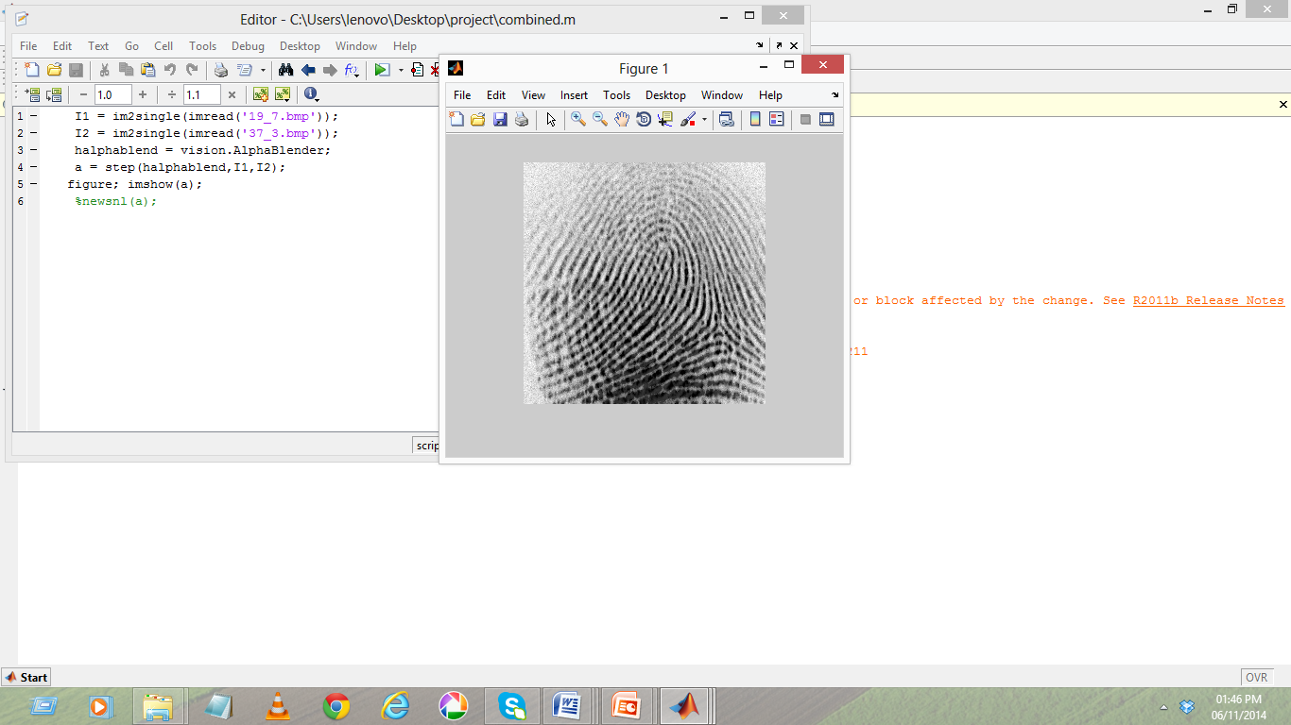
IMPLEMENTATION DETAILS
Fig 3
Combined minutiae template

Slide 28
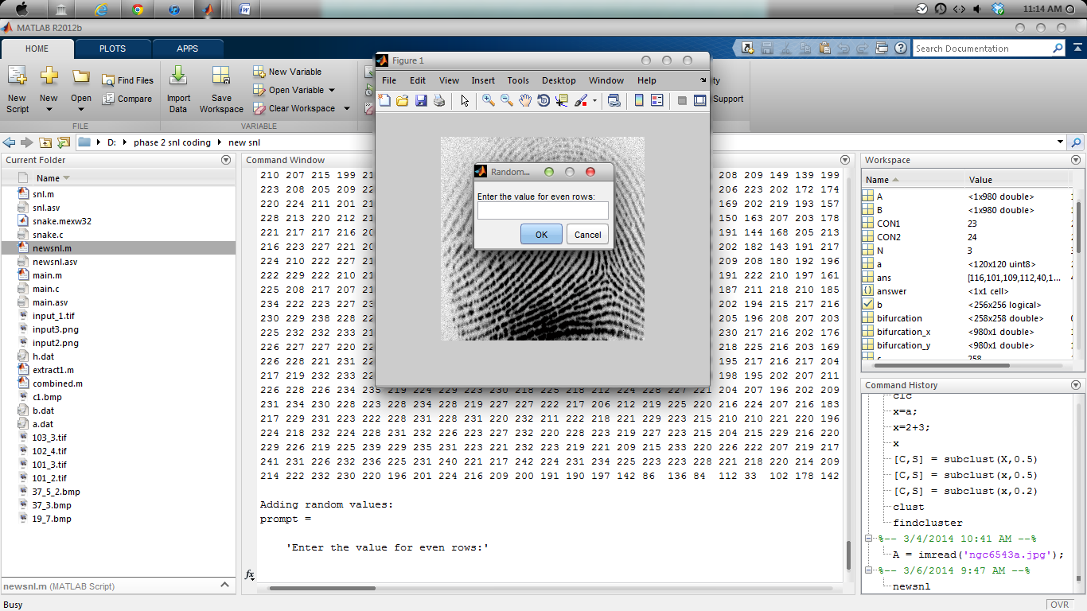
Fig 4
Fingerprint after SNL algorithm

Slide 29
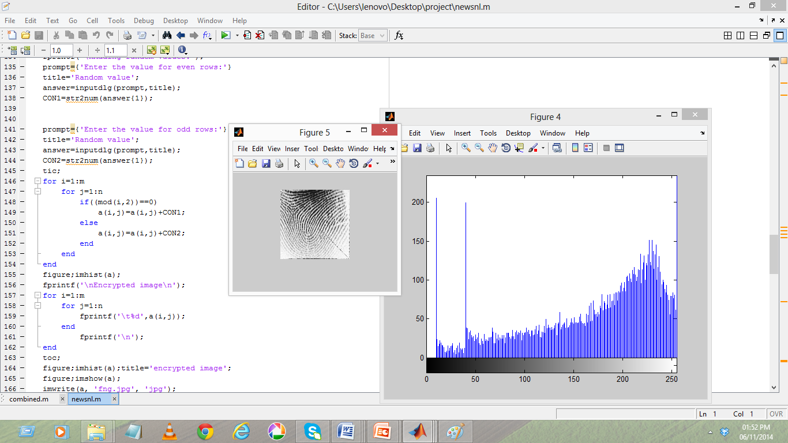
Fig 5
Fingerprint after artificial minutiae points insertion

Slide 30
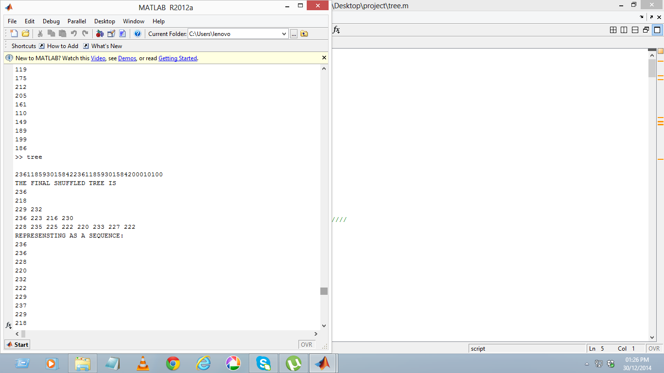
Fig 6
Tree based shuffling mechanism

Slide 31
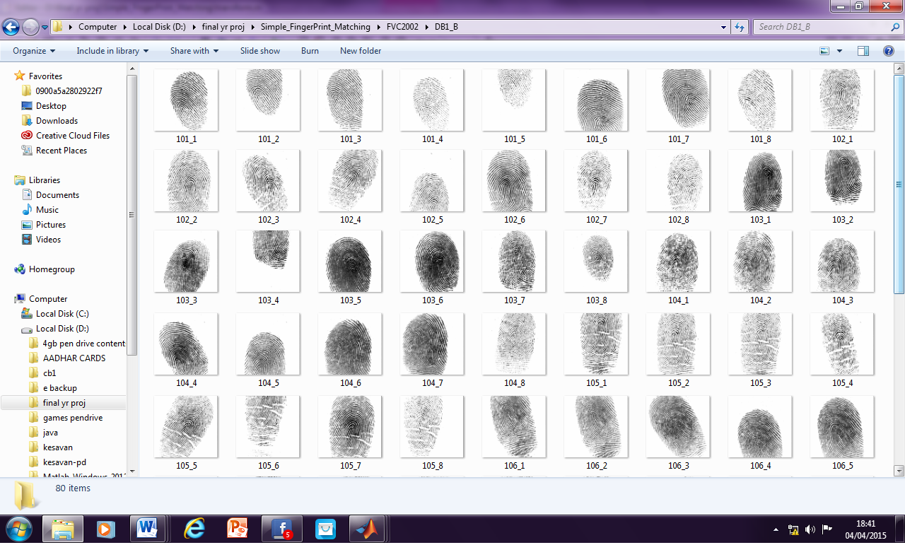
Fig 7
Fingerprint database

Slide 32
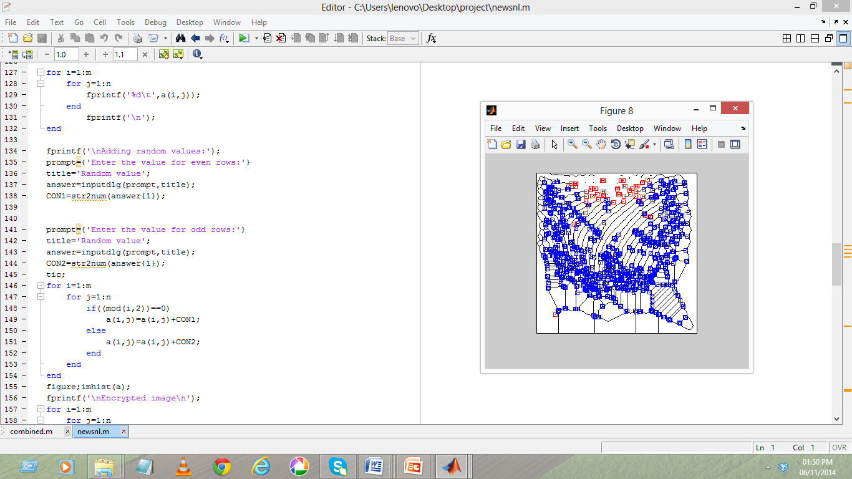
Fig 8
Minutiae feature extraction from query fingerprint

Slide 33
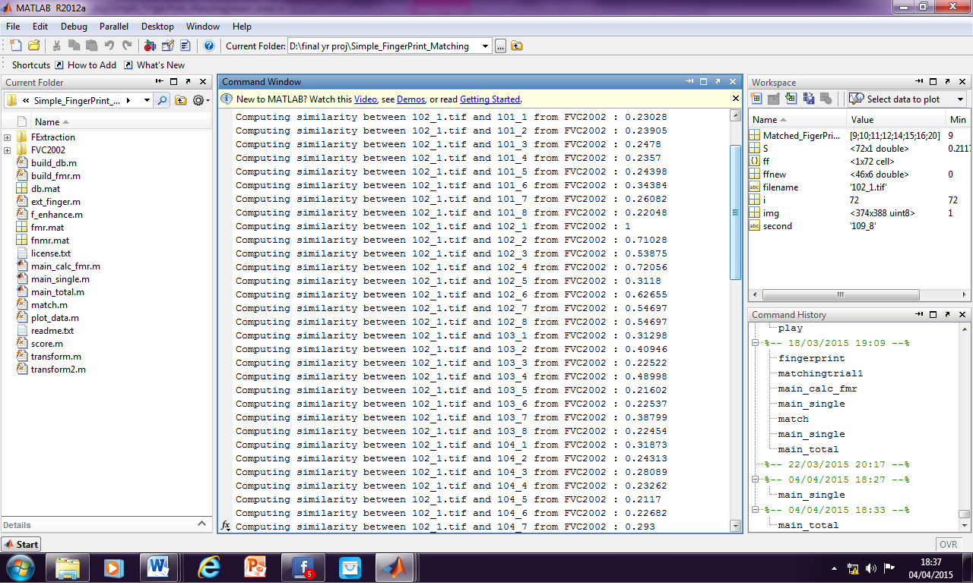
Fig 9
Similarity score calculation

Slide 34
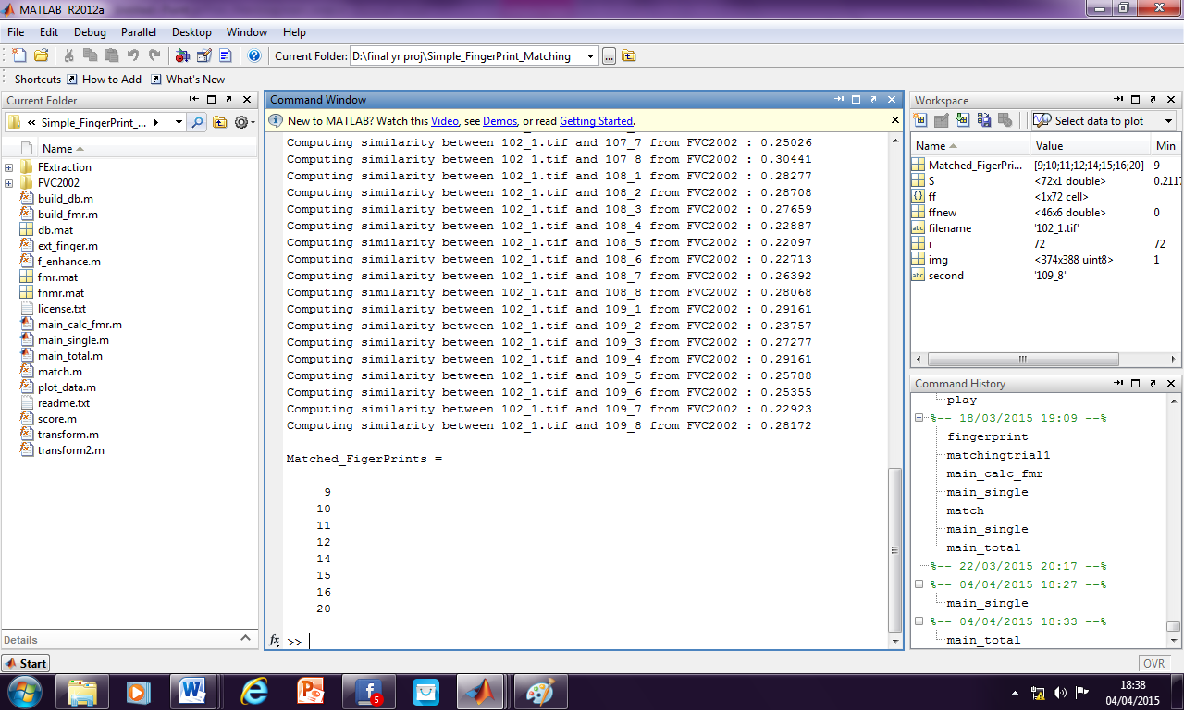
Fig 10
Matching of fingerprints

Slide 35
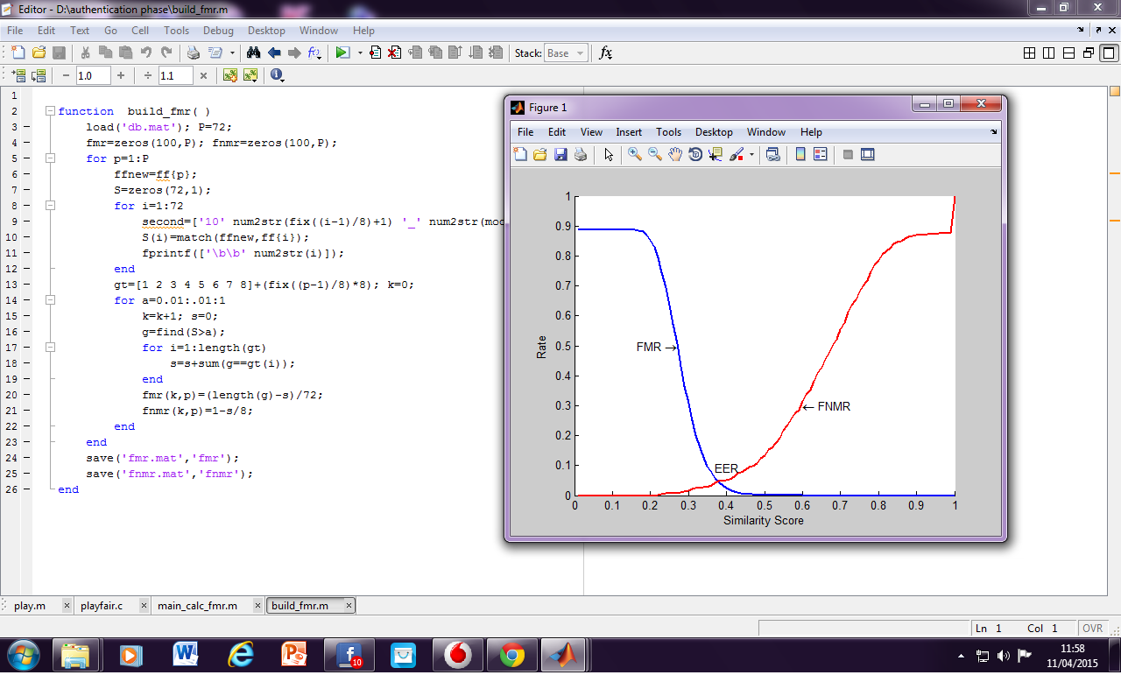
Fig 11
FMR, FNMR and EER

Slide 36
REFERENCES
Maneesh Upmanyu, Anoop M. Namboodiri, Kannan Srinathan, and C. V. Jawahar,” Blind Authentication: A Secure Crypto-Biometric Veriﬁcation Protocol” IEEE Transactions On Information Forensics And Security, Vol. 5, No. 2, June 201
Emanuele Maiorana, Member, IEEE, Patrizio Campisi, Senior Member, IEEE, Julian Fierrez, Javier Ortega-Garcia, Senior Member, IEEE, and Alessandro Neri, Member, IEEE,” Cancelable Templates for Sequence-Based Biometrics with Application to On-line Signature Recognition”, IEEE Transactions On Systems, Man, And Cybernetics—part A: Systems And Humans, Vol. 40, No. 3, May 2010
Abhishek Nagar, Student Member, IEEE, Karthik Nandakumar, Member, IEEE, and Anil K. Jain, Fellow, IEEE,” Multibiometric Cryptosystems Based on Feature-Level Fusion”, IEEE Transactions On Information Forensics And Security, Vol. 7, No. 1, February 2012
4. Asem Othman and Arun Ross,” On Mixing Fingerprints”, IEEE Transactions On Information Forensics And Security, Vol. 8, No. 1, January 2013

Slide 37
Sheng Li and Alex C. Kot, Fellow, IEEE,” Privacy Protection of Fingerprint Database”, IEEE Signal Processing Letters, Vol. 18, No. 2, February 2011
Jeroen Breebaart, Ileana Buhan, Koen de Groot, Emile Kelkboom,” Evaluation Of A Template Protection Approach To Integrate Fingerprint Biometrics In A Pin-based Payment Infrastructure”, Electronic Commerce Research and Applications, Elsevier, Volume 10, Issue 6, November–December 2011, Pages 605-614
Sheng Li, Student Member, IEEE, and Alex C. Kot, Fellow, IEEE,” Fingerprint Combination for Privacy Protection”, IEEE Transactions On Information Forensics And Security, Vol. 8, No. 2, February 2013
Jucheng Yang, Member, IEEE, “A Fingerprint Recognition Scheme Based on Assembling Invariant Moments for Cloud Computing Communications”, IEEE Systems Journal, Vol. 5, No. 4,December 2011

