Slide 1
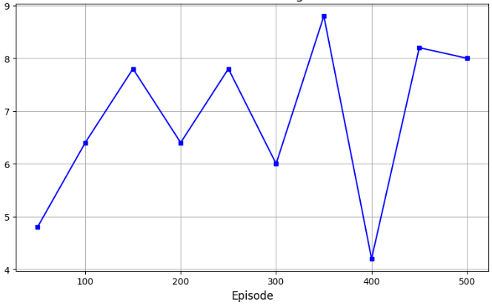
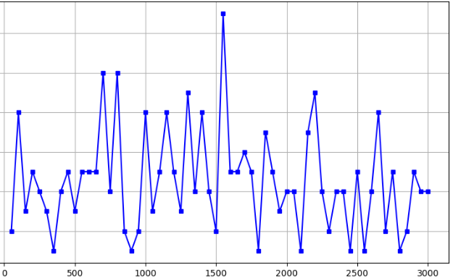



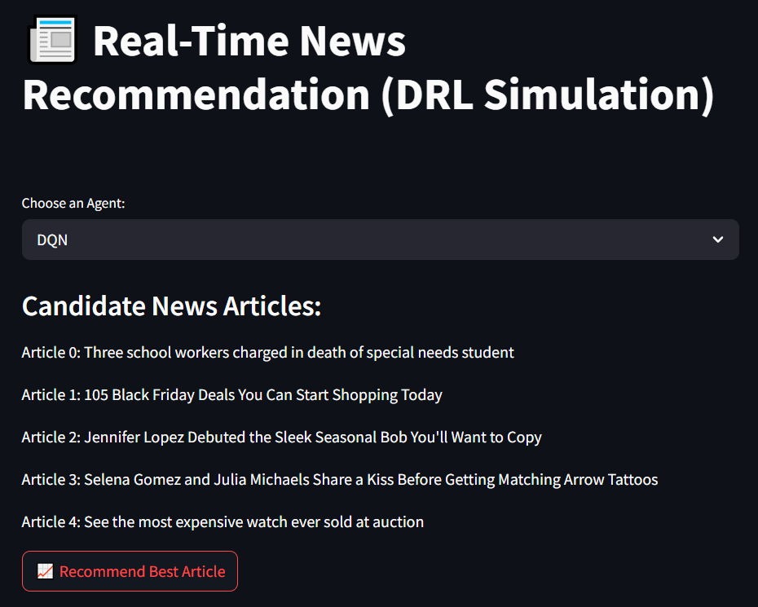

Real-Time Adaptive News Recommendation using Reinforcement Learning
Lalasa Mynalli and Vaishnavi Gawale | University at Buffalo under the guidance of Prof. Alina Vereshchaka
Introduction
We propose a real-time news recommendation system based on Reinforcement Learning (RL). We explore deep RL techniques to dynamically select the most relevant article from multiple candidates, based on real-time feedback. Such adaptive systems can be particularly impactful for children by recommending age-appropriate, educational content and for disabled individuals by prioritizing accessible and inclusive news articles, ensuring better information reach and digital inclusion.
Implementation Methods
Deep Q-Network (DQN)
The Deep Q-Network (DQN) algorithm models the action-value function Q(s,a) which estimates the expected reward of acting a in state s. It learns by minimizing the following loss:
2. Advantage Actor Critic(A2C
The Advantage Actor Critic (A2C) algorithm simultaneously learns a policy π(a∣s) and a value function V(s). The advantage function A(s,a) measures how much better an action is compared to the average expected outcome.
Figure 2 : Evaluation CTR - DQN
Figure 3 : Evaluation CTR - A2C
Which article to show
a 10-year-old
OR
a businessman?
Results
The DQN model achieved an evaluation CTR of 8.2% over 500 episodes. Training rewards showed a gradual upward trend, with the evaluation CTR stabilizing after approximately 300 episodes.
The A2C model achieved a higher evaluation CTR of approximately 9% after training for 3000 episodes..
Overall, A2C slightly outperformed DQN in terms of both CTR and training stability, highlighting its advantage for sequential decision-making tasks like personalized news recommendation.
Conclusion
Our project demonstrates that RL algorithms like DQN and A2C can successfully personalize news recommendations, improving user engagement.
These models dynamically adapt to user behavior, especially important for providing appropriate content to children and enhancing accessibility for disabled users. .
Evaluation
The performance of our news recommendation models was assessed using the Click-Through Rate (CTR), a standard metric for recommender systems.
CTR measures the proportion of recommended articles that were clicked by users, and is calculated as:
Future Scope
In the future, we plan to extend this work by integrating richer user context (e.g., time, location, device type) and exploring more advanced reinforcement learning techniques. Use Transformers or RNNs to model user sequential click patterns. Fine-tune BERT-like embeddings for article representation instead of static embeddings. Bandit-style hybrid recommendation using a combination of RL + supervised learning.
Dataset: MIND Small
We use the Microsoft News Dataset a benchmark dataset for news recommendation tasks. It contains user click histories, news article metadata, and impressions (candidate articles shown to users). Each article is associated with category, subcategory, and titles.
RL Framework Setup
Used an RL OpenAI Gym environment::
State: Concatenation of the user embedding & embeddings of 5 candidate news articles.
Action: The agent selects one article out of the 5 candidates to recommend.
Reward: A reward of 1 is received if the user clicks on the recommended article, otherwise 0.
Summary
Model | Evaluation CTR (%) | Training CTR (%)
DQN | 8.2 | Less Stable
A2C | 9 | More Stable
References
SmallMIND Dataset: https://github.com/yusanshi/SmallMIND
Sutton, R. S., & Barto, A. G. (2018). Reinforcement Learning: An Introduction.
Deep Q-Learning (Mnih et al., 2015)
Advantage Actor-Critic (Mnih et al., 2016)
Figure 4 : UI-based Model
Email : lalasamy@buffalo.edu
vgawale@buffalo.edu

