Slide 1

Project Title:
Gold price prediction for the next 30 days
Name of the team | P_259 Group6
Mentor | Snehal and Kishore
Team Members | SAHANA B S GUNDU RAKESH KAADHULURI KIRAN KUMAR GOUD RUTUJA MHAMUNKAR RITIK PARATE SEJAL HADKE
Meeting Days | Two meetings every week
Meeting Duration | 1 Hour

Slide 2

Business Objective:
Understanding the underlying structure in your dataset and coming up with a suitable forecasting model which can effectively forecast gold prices for next 30 days

Slide 3
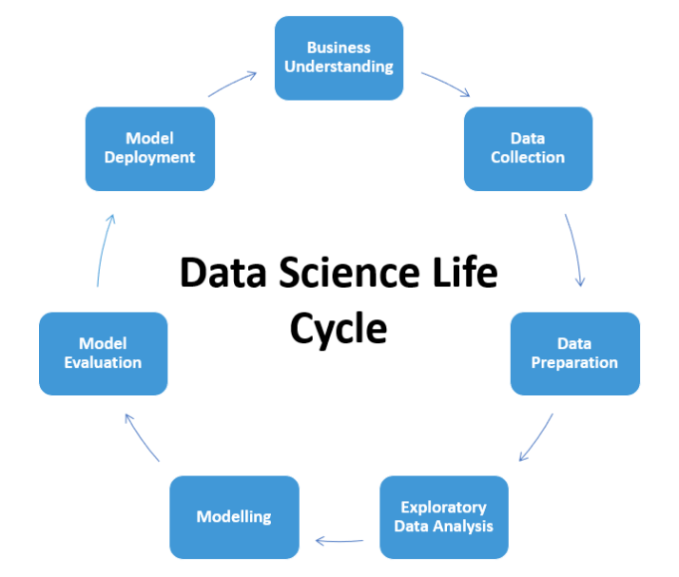
Project Architecture / Project Flow

Slide 4
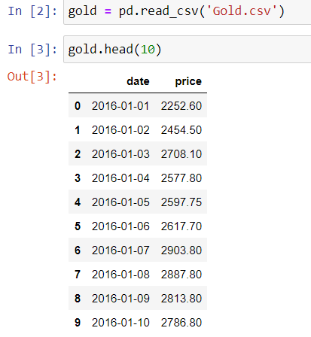

Data Set Details
2182 observations and 2 features
Date is objective type data need to convert into date time format

Slide 5

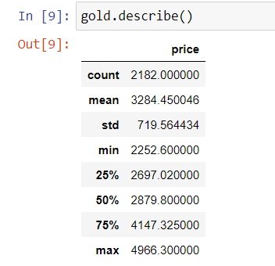
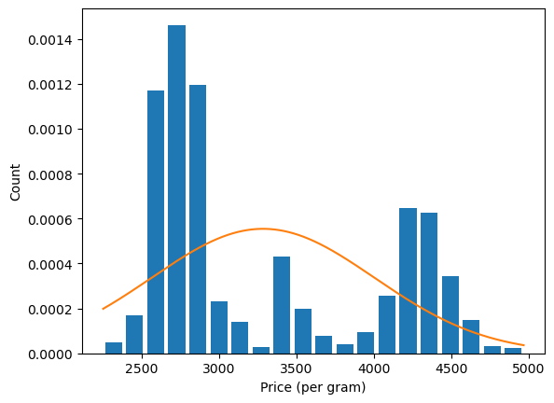
Exploratory Data Analysis(EDA)
Date is objective type data converted into date time format
Changed index in order to make it proper time serious data
We also check on Null Values, Duplicated values and outliers in the Dataset.

Slide 6
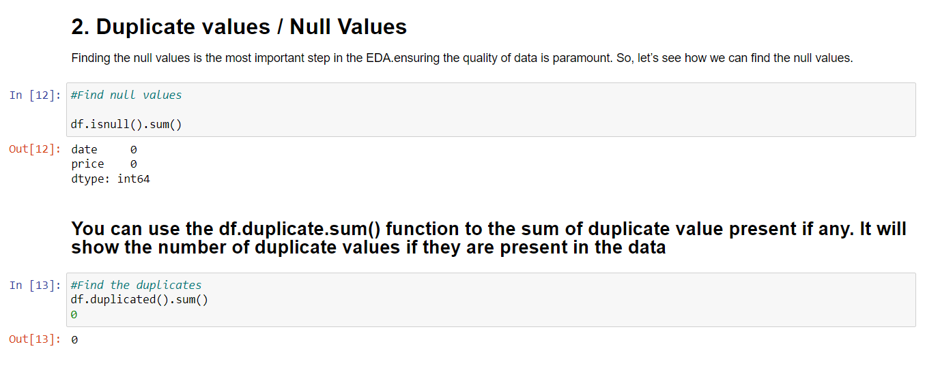
Exploratory Data Analysis(EDA)
There area no duplicated and Null values present in the Dataset.

Slide 7
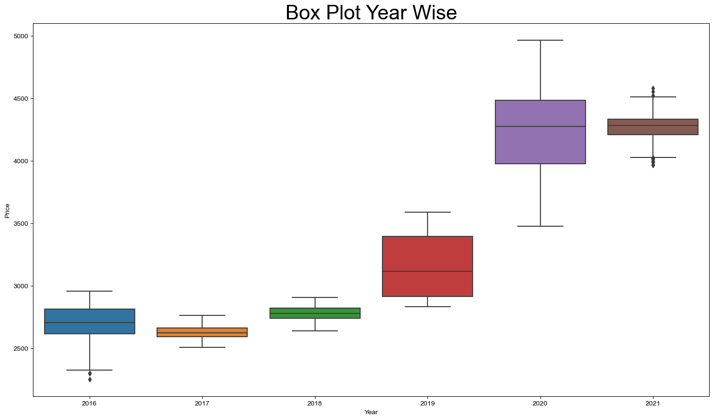
Exploratory Data Analysis(EDA)
There are very few outliers present as we can see in the boxplot in 2016 and 2021.
Therefore we then remove these outliers using Pandas filtering.

Slide 8

Year wise Boxplot after removing all the outliers

Slide 9
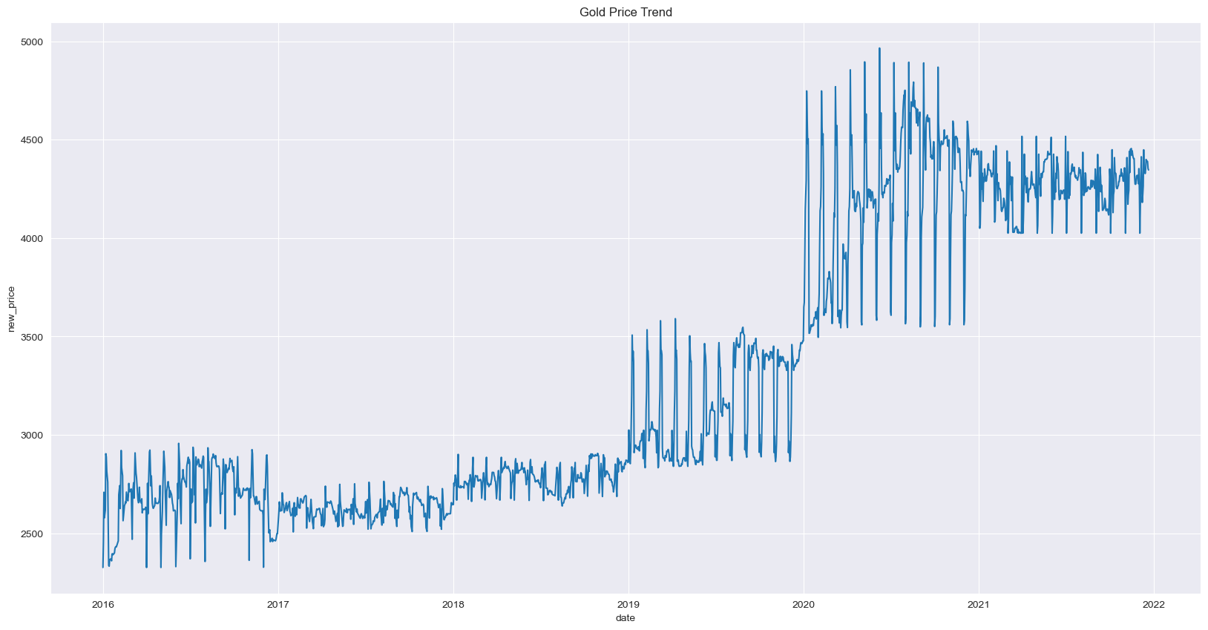
EDA - Visualization
Insight: Seasonality can be observed little bit

Slide 10
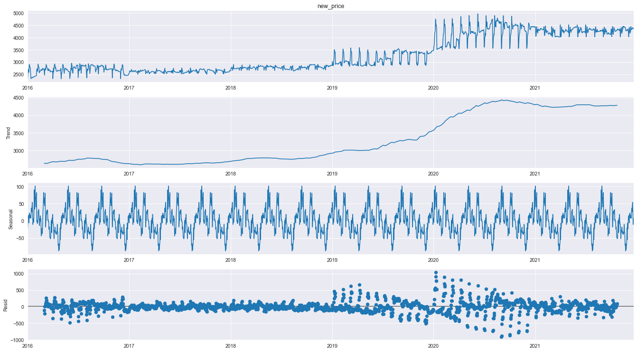
EDA Visualization
Time Series Decomposition
Trend - Slow moving changes in a time series, Responsible for making series gradually increase or decrease over time.
Seasonality - Seasonal Pattern in the series. The cycles occur repeatedly over a fixed period of time.
Residuals - The behavior of the time series that cannot be explained by the trend and seasonality components. Also called random errors/white noise.

Slide 11
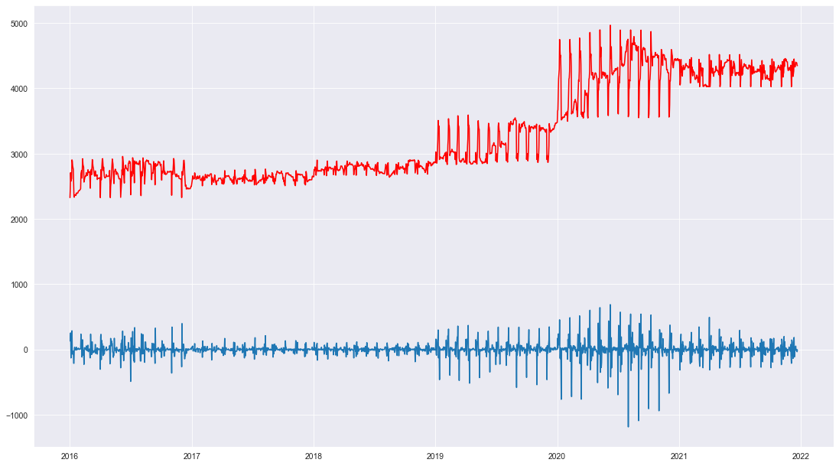
Testing For Stationarity

Slide 12
Model Building
In this project, We have to build a model to forecast the future price of the Gold based on the past few years of the data available over internet.
We have tried different models like linear, LSTM, Arima, but every model came with there own advantages and disadvantages.
Therefore we worked on another model called FBProphet model for forecasting.

Slide 13
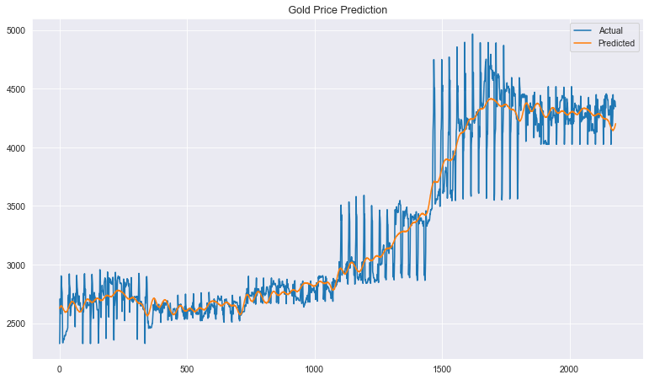
FB Prophet Model
Predictions of FBProphet Model on Gold Dataset

Slide 14
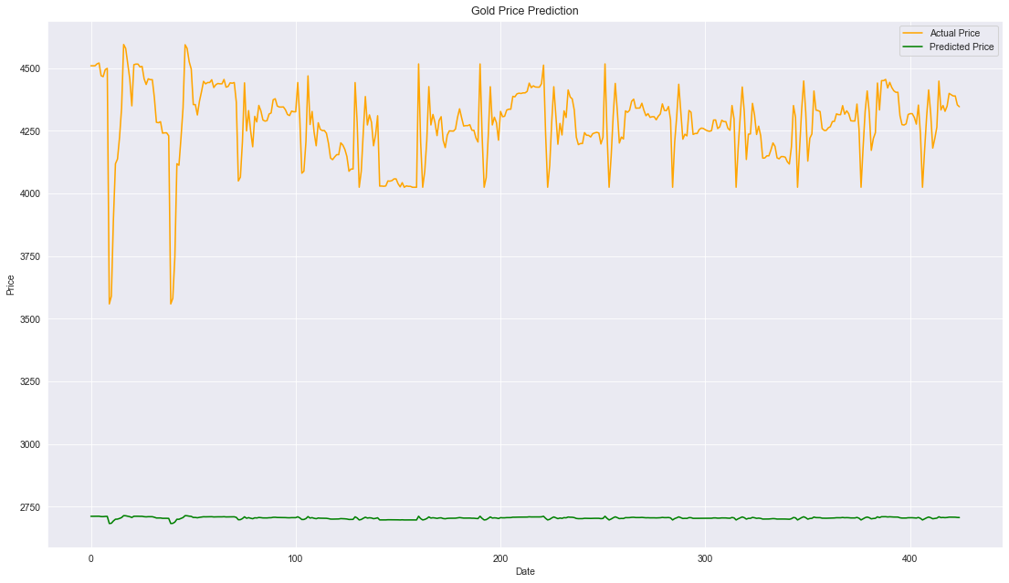
LSTM Model
Predictions of LSTM Model on Gold Dataset

Slide 15
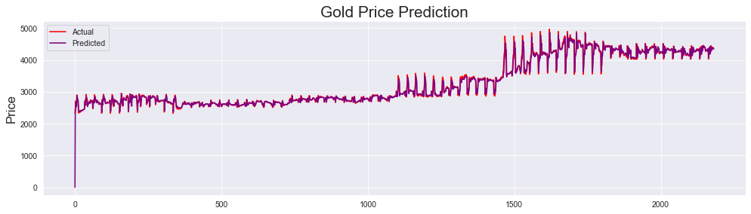
ARIMA Model
Predictions of ARIMA Model on Gold Dataset

Slide 16
R2 Score Comparison For All The Models
Model Name | R2 Score | MAE Value | RMSE Value
Arima | 0.97 | 57.22 | 14022.37
LSTM | -119.13 | 1549.82 | 2500049.65
FBProphet | 0.95 | 111.61 | 28354.73

Slide 17
Deployment
For the final deployment we have FINALIZED THE PROPHET MODEL as deployment model as it is most suitable for the task.
Using streamlit (is an open-source app framework in python language) for deployment of our code. It helps us create beautiful web apps for data science and machine learning in a little time.

Slide 18
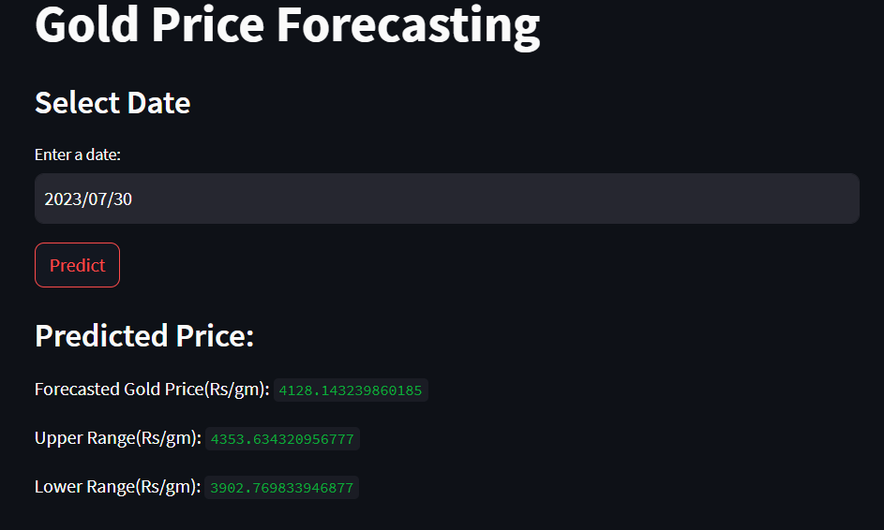
WebApp Screenshots

Slide 19
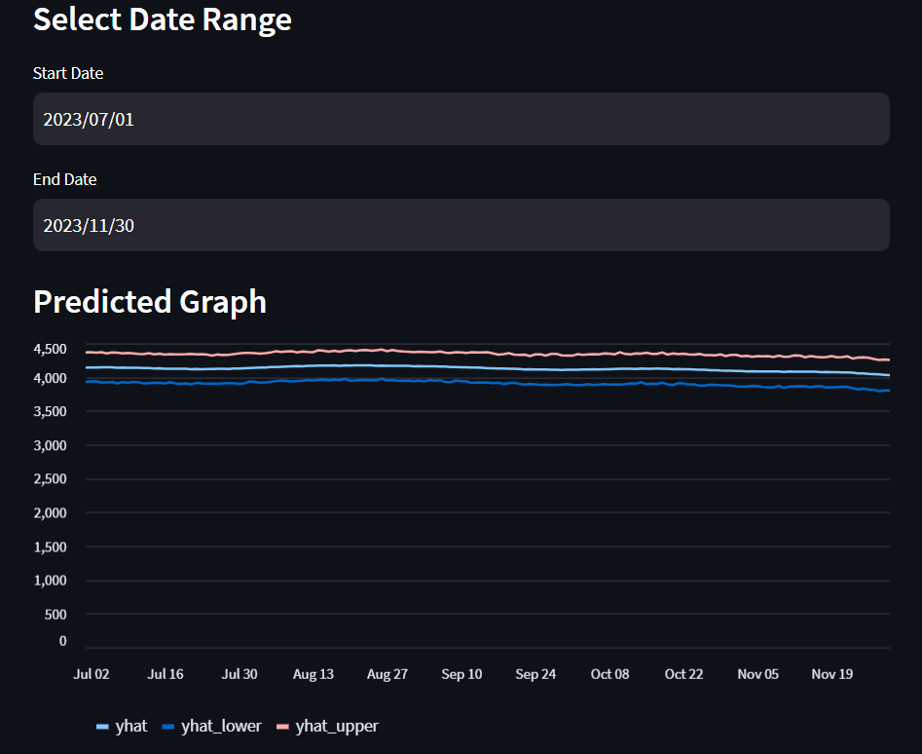
Selecting the date range for forecasting

Slide 20
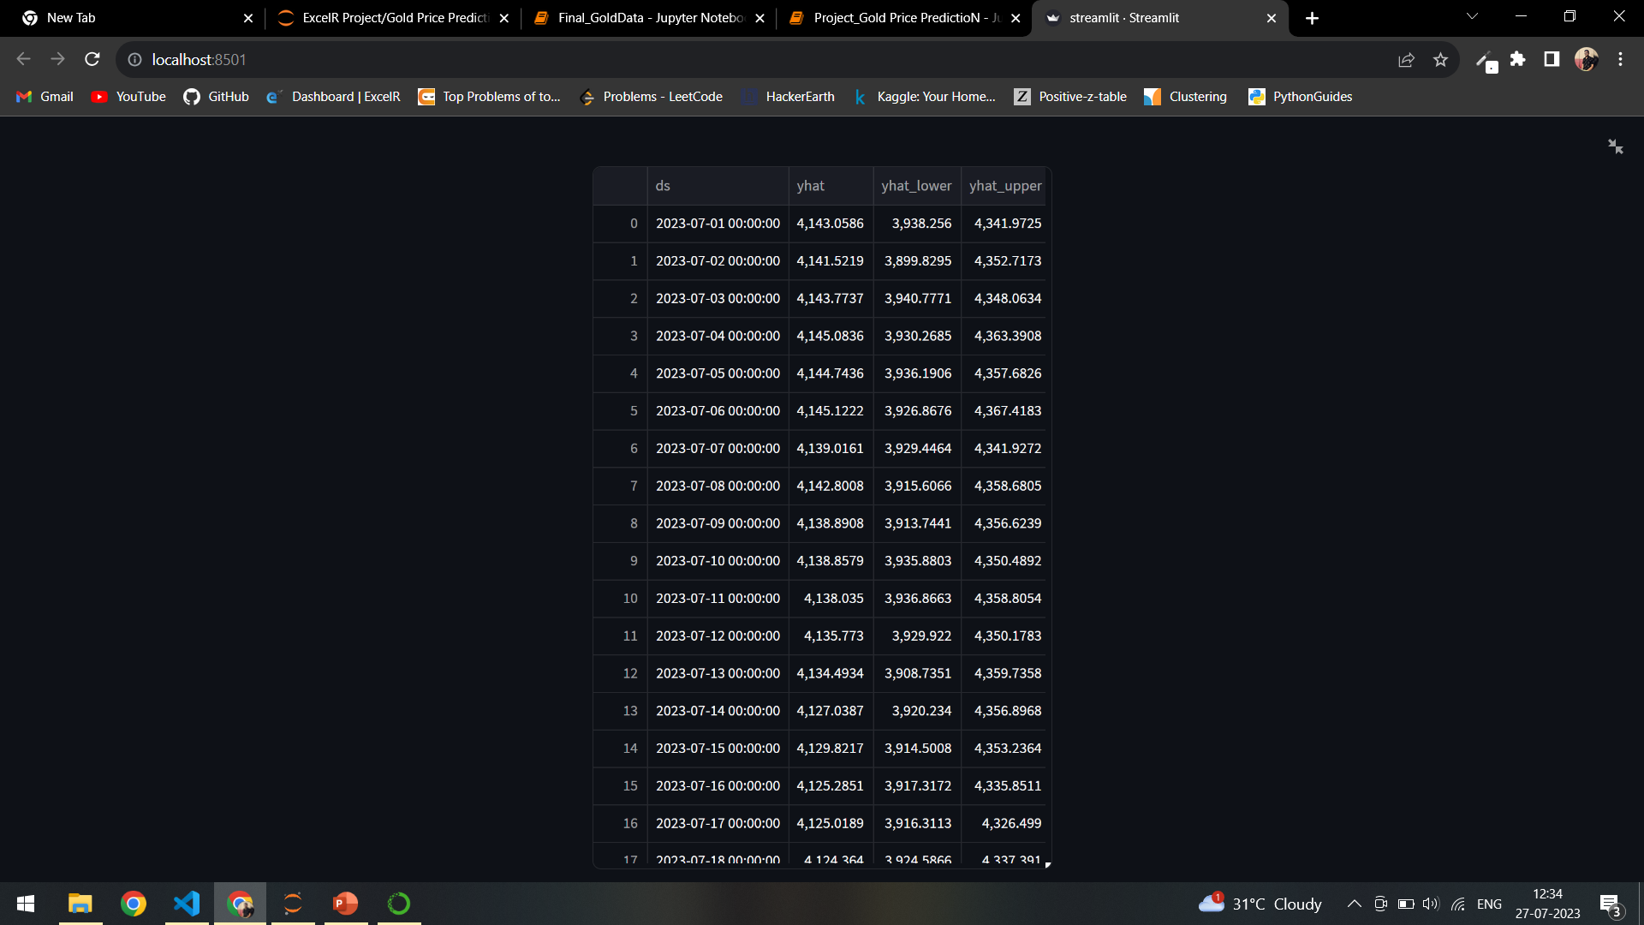
Forecasted price Table

Slide 21
THANK YOU.
Any Questions?

