Slide 1
Module 4 : Network Layer

Slide 2
Network Layer
Majorly focuses on getting packets from the source to the destination, routing error handling, and congestion control.
Addressing: Maintains the address at the frame header of both source and destination and performs addressing to detect various devices in the network.
Packeting: This is performed by Internet Protocol. The network layer converts the packets from its upper layer.
Routing: It is the most important functionality. The network layer chooses the most relevant and best path for the data transmission from source to destination.
Inter-networking: It works to deliver a logical connection across multiple devices.
Nita Patil

Slide 3
Network Layer Design Issues
Store and Forward packet switching
The host sends the packet to the nearest router. This packet is stored there until it has fully arrived once the link is fully processed by verifying the checksum then it is forwarded to the next router till it reaches the destination.
This mechanism is called “Store and Forward packet switching.”
Nita Patil

Slide 4
Network Layer Design Issues
2. Services provided to the Transport Layer
Through the network/transport layer interface, the network layer transfers its patterns services to the transport layer.
But before providing these services to the transfer layer, the following goals must be kept in mind:-
Offering services must not depend on router technology.
The transport layer needs to be protected from the type, number, and topology of the available router.
The network addresses for the transport layer should use uniform numbering patterns, also at LAN and WAN connections.
Nita Patil

Slide 5
Network Layer Design Issues
Based on the connections there are 2 types of services provided :
Connectionless – The routing and insertion of packets into the subnet are done individually. No added setup is required.
Connection-Oriented – Subnet must offer reliable service and all the packets must be transmitted over a single route.
Nita Patil

Slide 6
Network Layer Design Issues
3. Implementation of Connectionless Service
Packets are termed as “datagrams” and corresponding subnets as “datagram subnets”. When the message size that has to be transmitted is 4 times the size of the packet, then the network layer divides into 4 packets and transmits each packet to the router via. a few protocols. Each data packet has a destination address and is routed independently irrespective of the packets.
Nita Patil

Slide 7
Network Layer Design Issues
4. Implementation of Connection-Oriented service:
To use a connection-oriented service, first, we establish a connection, use it, and then release it. In connection-oriented services, the data packets are delivered to the receiver in the same order in which they have been sent by the sender.
Nita Patil

Slide 8
Network Layer Design Issues
It can be done in either two ways :
Circuit Switched Connection – A dedicated physical path or a circuit is established between the communicating nodes and then the data stream is transferred.
Virtual Circuit Switched Connection – The data stream is transferred over a packet switched network, in such a way that it seems to the user that there is a dedicated path from the sender to the receiver. A virtual path is established here. While, other connections may also be using the same path.
Nita Patil

Slide 9
Network Layer Design Issues
Connection-oriented service: In connection-Oriented service we have to establish a connection between sender and receiver before communication. Handshake method is used to establish a connection between sender and receiver. Connection-Oriented service include both connection establishment as well as connection termination phase. Real life example of this service is telephone service, for conversation we have to first establish a connection.
Nita Patil

Slide 10
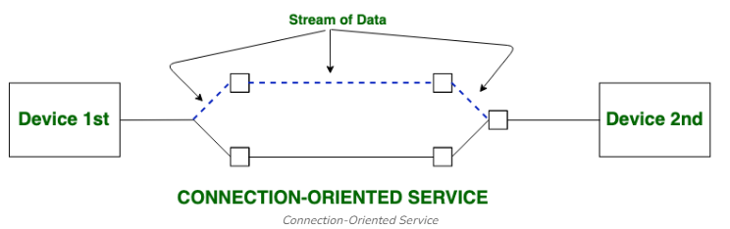
Network Layer Design Issues
Nita Patil

Slide 11
Network Layer Design Issues
Connection-less service: In Connection-Less service no need of connection establishment and connection termination. This Service does not give a guarantee of reliability. In this service, Packets may follow the different path to reach their destination. Real life examples of this service is postal system, Online gaming, real-time video and audio streaming etc.
Nita Patil

Slide 12
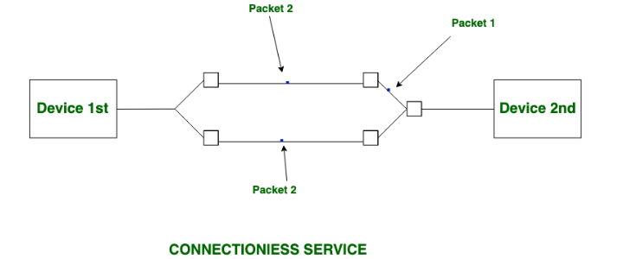
Network Layer Design Issues
Nita Patil

Slide 13
The Internet Protocol (IP)
The Internet Protocol is the corner-stone of the TCP/IP architecture. All computers in the Internet understand IP.
The main tasks of IP are:
The addressing of the computers, and the fragmentation of packets.
There are two types of Internet Protocol:
Internet Protocol version 4 (IPv4): currently used version of Internet
Protocol.
Internet Protocol version 6 (IPv6): the upcoming replacement for IPv4. It contains some major improvements and new features.
Nita Patil

Slide 14
IPv4 Address:
An IPv4 address is a 32-bit address that uniquely and universally defines the connection of a device (for example, a computer or a router) to the Internet.
Connectionless protocol
Fragments (divides) packets where necessary
Addressing via 32 bit Internet addresses
However, it contains no functions for end-to-end message reliability or flow control. IP makes the ‘best effort’ to forward packets to the next destination, but does not guarantee delivery because it is connectionless.
Nita Patil

Slide 15
Cont…
The IP address can be classify into two classes:
Public address:
This address considered as any valid address assigned to any user, and the organization who is responsible for registering IP ranges called Internet Service Providers (ISPs), and this address will be unique.
Private Address:
Any number or address assigned to a device on a private TCP/IP Local Area Network that is accessible only within the Local Area Network.
Nita Patil

Slide 16
Internet Protocol Version 6 (IPv6)
Maintains good features of IPv4, discards bad ones.
Not compatible with IPv4
Compatible with all other Internet protocols including TCP, UDP, ICMP, DNS, etc.
Main features:
Long addresses (128 bits) ⇒ supports billions of hosts.
Simplified, fixed size header ⇒ routers can process packets faster.
Support for authentication and privacy
Better support for type of service.
Nita Patil

Slide 17
Internet addresses
Each network interface connected to the Internet has a unique
address consisting of two parts:
Network address, address of the network within the Internet (used by gateways for routing IP packets between networks).
Host address, address of the computer within the network (used for delivering packets to a particular network interface within the network).
Nita Patil

Slide 18
Internet address format
The 32-bit IP address is separated into four 8-bit octets, allowing each octet to have a value ranging from 0 to 255.
Furthermore, the IP address is logically separated into two distinct components: the network ID and the host ID. The network ID is used to identify the subnet upon which the host resides. The host ID is used to identify the host itself within the given subnet.
IP addresses can be displayed in three typical formats:
Binary notation is the format that systems on the network use to process the address. An example of binary notation is 11000000.10101000.00000001.01100100.
Hexadecimal notation is the format typically used when identifying IPv6 addresses. An example of hexadecimal notation of an IPv4 address is C0.A8.01.64
Nita Patil

Slide 19
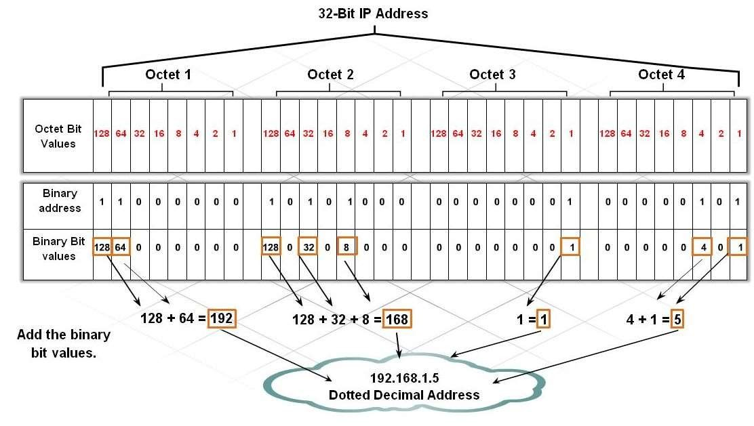
Cont…
Dotted-decimal notation is the format that is typically used for displaying the IP address in a human-readable format. An example of dotted-decimal notation is 192.168.1.100
Figure 3: Structure of IP Address

Slide 20
Classes of IP addresses
Different networks have different sizes. Basically, there are many small
networks and few large networks.
To provide efficient use of 32-bit address space, IPv4 defined several
address classes and associated address formats:
Class A: allows 128 networks, 16 million hosts each.
The IP address start from 1.0.0.0 to 127.255.255.255, and the mask address is
255.0.0.0
Class B: allows 16,382 networks, 65,534 hosts each.
The IP address start from 128.0.0.0 to 191.255.255.255, and the mask address is 255.255.0.0
Nita Patil

Slide 21
Classes of IP addresses
Class C: allows 2 million networks, 254 hosts each.
The IP address start from 192.0.0.0 to 223.255.255.255, and the
mask address is 255.255.255.0
Class D: multicast networks The IP address start from 224.0.0.0 to 239.255.255.255.
Class E: reserved for future use. From 240 to 255 and the
255.255.255.255 used for broadcast to all the subnet.
Nita Patil

Slide 22
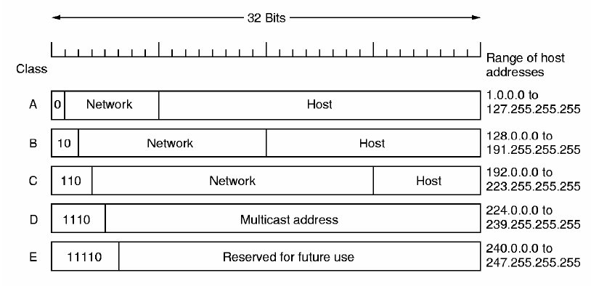
Cont..
One of the benefits of classful addresses is that they provide a hierarchy to the network through the use of the network ID. This translates into an efficient routing environment because it is easy for a router to determine what networks can be grouped together and treated as a single routing entry.
Nita Patil

Slide 23
Strategies to Conserve Addresses
Several strategies have been developed and implemented to help the Internet community on how provides a good managing of IP addresses. These strategies help reduce the load on Internet routers and help administrators use globally unique IP addresses more efficiently. There are two common strategies, which are:
Private Addressing
Classless Inter-Domain Routing (CIDR)
Nita Patil

Slide 24
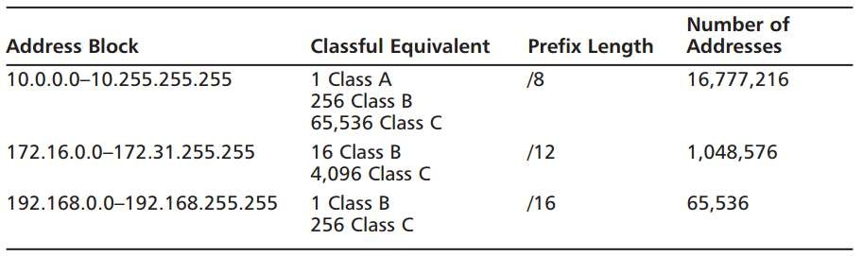
Private Address
It means If the internetwork is limited to one organization, the IP addresses need only be unique within that organization. Only networks that interface with public networks such as the Internet need public addresses. Using public addresses on the outside and private addresses for inside networks is very effective.
Private Addresses:-
RFC1918 designates three ranges of IP addresses as private:
10.0.0.0 through 10.255.255.255
172.16.0.0 through 172.31.255.255
192.168.0.0 through 192.168.255.255
Nita Patil

Slide 25
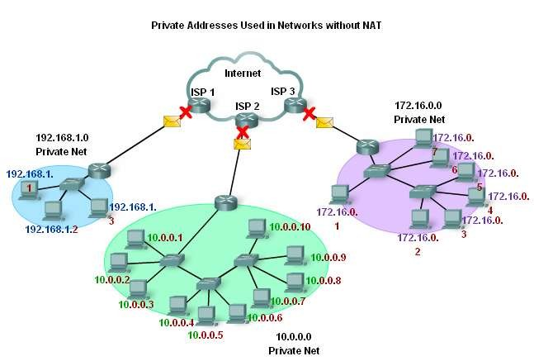
Cont…
Nita Patil

Slide 26
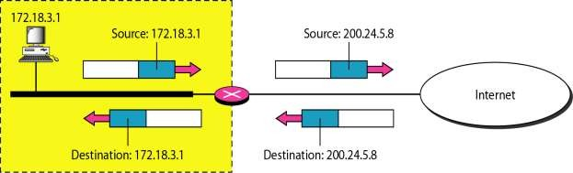
Cont...
There are two ways to convert the private address to public address:
1. Network Address Translation (NAT).
This technique has been used to convert the private address to public address, the NAT allowing us to access the internet and get services. The basic idea, is that technique used pool of public addresses and assign for each private address one public address. Thus, this way is inefficient due to the fact, that there are cost and delay associated with this operation. The table and the figure below show how the NAT make the mapping.
Private Address | Public Address
192.68.5.1 | 200.1.1.2
192.68.5.2 | 200.1.1.3
192.68.5.3 | 200.1.1.4
Nita Patil

Slide 27
Cont..
2. Port Address Translation (PAT).
It’s another technique used to convert the private address to public. During PAT, each computer on LAN is translated to the same IP address (public), but with a different port number assignment. This way is much better than the NAT because we can use one public address to translate any private address, therefore we saved the cost. The table below shows the process of the PAT
Private Address | Port address | Public Address | Port Number
192.68.1.3 | 50133 | 200.0.1.2 | 1
192.68.1.5 | 63887 | 200.0.1.2 | 2
The port address will be any random number in the allowed range, that the device created it when wants to access the internet.
The packet will contain the port number that assign to the device that wants to access the internet and through this port number, the router when get the response message will translate it and make map this message to it is private address based on the port number.
Nita Patil

Slide 28
Addressing without Subnets
If we have a class B with a Flat Network, the number of host will be more than 2¹⁶=65536 hosts,
So the problem is here, that managing this network with this number of host is too tricky and the performance of this network will get down because of the heavy load. In other words, any single broadcast can slowdown the network.
Therefore, the solution is the subnetting. Subnetting means divide or separate the single network into multiple networks that can reduce the loading from one network.
The advantage of using subnetting is:-
Reduce the traffic and increase the performance.
The smaller network can easier to manage.
Nita Patil

Slide 29
Subnetting
As the number of distinct local networks grows, managing them become a serious headache. Every time a new network is installed the system administrator must contact NIC to get a new network number.
The solution to the problem is to allow a network to be split into several independent parts for internal use but still act like a single network to the outside world. In the internet literature these parts are called subnets.
Nita Patil

Slide 30
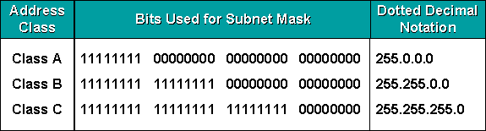
Subnet masks:-
A mask is a 32-bit binary number that is expressed in dotted decimal notation. By default, a mask contains two fields, the network field and the host field. These correspond to the network number and the locally administered part of the network address. When an administrator subnets, they are adjusting the way they view the IP address. Table 1: Default masks for classful addressing
Nita Patil

Slide 31
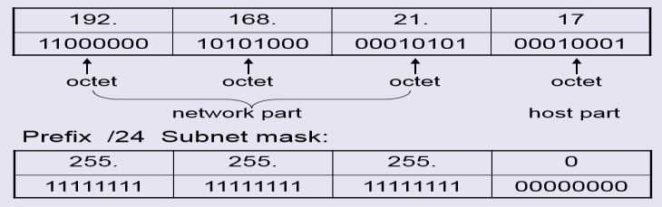
Cont…
Routers and hosts still assume class subnet masks by default:
Class A | /8 | 255.0.0.0
Class B | /16 | 255.255.0.0
Class C | /24 | 255.255.255.0
⚫
The figure below gives an example to class C mask address:
The first three octets represent the network part and the last octet represent the
host part.
Nita Patil

Slide 32
Cont...
There three important things that should be taken into our account when we thinking about subnetting:-
Network address – the first one
Broadcast address – the last one
Host addresses – everything in between
As well as, to find the number of hosts per subnet. We can use formal 2^{x} -2,
where (x) is the number of unmasked bits (0’s) .
Nita Patil

Slide 33
Cont...
For example, in 11000000, the number of zeros gives us 2⁶ – 2 =62 hosts. In this example, there are 62 hosts per subnet and we make subtract because the first IP address reserve for the network address and the last one for the network broadcast.
While when we want to find number of networks, we can use this formal 2^{y} Where Y represent the number of masked bits, (1’s). For example, in
11000000, the number of ones gives us 2² =4
Nita Patil

Slide 34
Reserved and Restricted Addresses
In any subnet, there are certain addresses that cannot be assigned to an individual device because they have a special purpose. The subnet address is the first address in a range that identifies the subnet. The broadcast address is the last address in the range, and all hosts on the subnet receive traffic if anything is sent to it.
Assume that a subnet address is 172.31.9.0 with a mask of 255.255.255.0. The subnet address is 172.31.9.0, and the broadcast address is 172.31.9.255.
Nita Patil

Slide 35
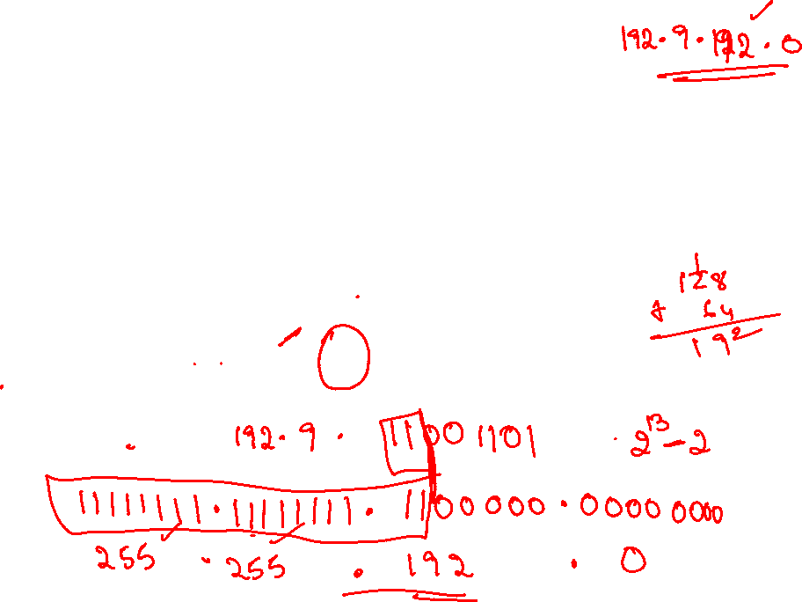
Classless Inter-Domain Routing (CIDR)
Classless Inter Domain Routing (CIDR) is a method for assigning IP addresses without using the standard IP address classes like Class A, Class B or Class C. In CIDR , an IP address is represented as A.B.C.D /n, where "/n" is called the IP prefix or network prefix. The IP prefix identifies the number of significant bits used to identify a network.
Example, 192.9.205.22 /18 means, the first 18 bits are used to represent the network and the remaining 14 bits are used to identify hosts.
Nita Patil

Slide 36
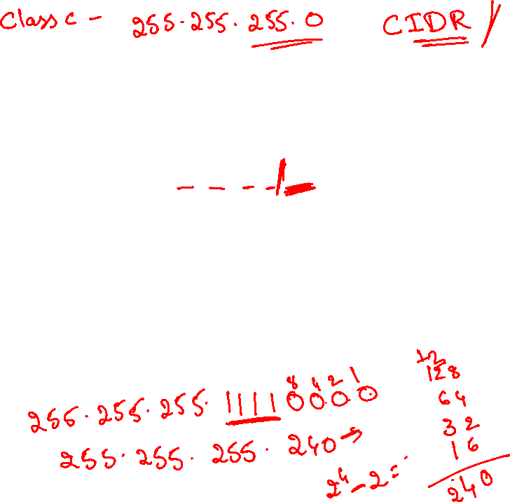
It’s basically the method that ISPs (Internet Service Providers) use to allocate an amount of addresses to a company, a home—a customer. They provide addresses in a certain block size
When you receive a block of addresses from an ISP, what you get will look something like this: 192.168.10.32/28. This is telling you what your subnet mask is. The slash notation (/) means how many bits are turned on (1s).
The Class A default subnet mask, which is 255.0.0.0. This means that the first byte of the subnet mask is all ones (1s), or 11111111. When referring to a slash notation, you need to count all the 1s bits to figure out your mask. The 255.0.0.0 is considered a /8 because it has 8 bits that are 1s—that is, 8 bits that are turned on
Nita Patil

Slide 37
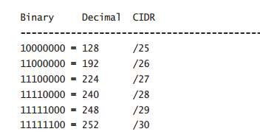

Subnetting Class C Addresses
In a Class C address, only 8 bits are available for defining the hosts
that subnet bits start at the left and go to the right without skipping bits. This means that the only Class C subnet masks can be the following:
The Fast Way Method: Subnetting a Class C Address
start by using the second subnet mask available with a Class C address, which borrows 2 bits for subnetting 192 = 11000000
The 1s represent the subnet bits, and the 0’s represent the host bits available in each subnet. 192 provides 2 bits for subnetting and 6 bits for defining the hosts in each subnet.
Nita Patil

Slide 38

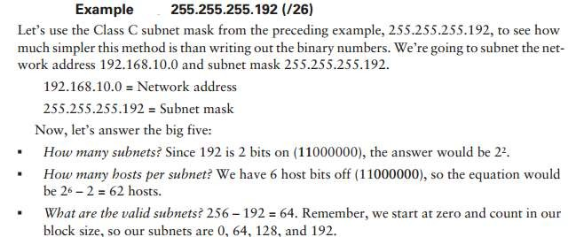
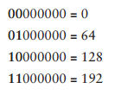
Nita Patil

Slide 39

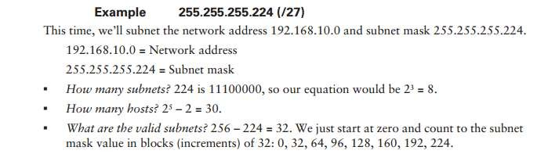
Nita Patil

Slide 40

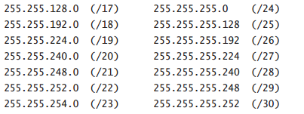
Subnetting Class B Addresses
Class B subnet masks first. Notice that we have a lot more possible subnet masks than we do with a Class C network
We know the Class B network address has 16 bits available for host addressing. This means we can use up to 14 bits for subnetting (because we have to leave at least 2 bits for host addressing).
The process of subnetting a Class B network is pretty much the same as it is for a Class C, except that you just have more host bits. Use the same subnet numbers for the third octet with Class B that you used for the fourth octet with Class C, but add a zero to the network portion
Nita Patil

Slide 41
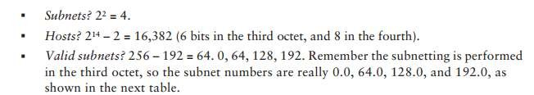


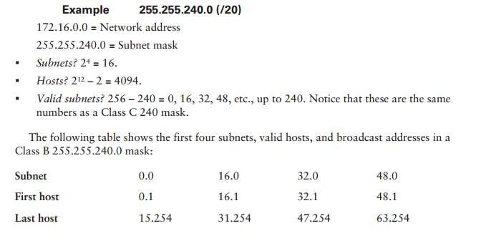
Example 255.255.192.0 (/18)
172.16.0.0 = Network address
255.255.192.0 = Subnet mask
Nita Patil

Slide 42

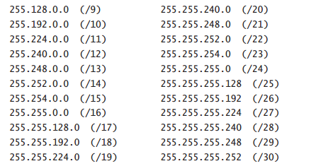
Subnetting Class A Addresses
Class A subnetting is not performed any differently from Classes B and C, but there are 24 bits to play with instead of the 16 in a Class B address and the 8 in a Class C address. Let’s start by listing all the Class A subnets.
You must leave at least 2 bits for defining hosts. And I hope you can see the pattern by now. Remember, we’re going to do this the same way as a Class B or C subnet.
Nita Patil

Slide 43

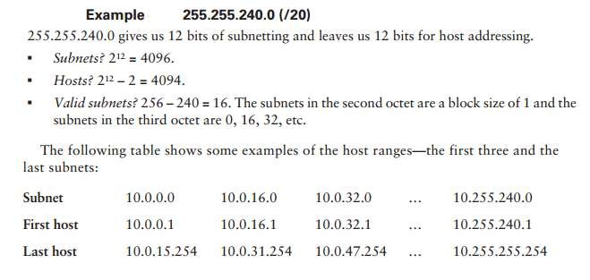
Nita Patil

Slide 44
Address Blocks
To overcome address depletion and give more organizations access to the Internet, classless addressing was designed and implemented. In this scheme, there are no classes, but the addresses are still granted in blocks
In classless addressing, when an entity, small or large, needs to be connected to the Internet, it is granted a block (range) of addresses. The size of the block (the number of addresses) varies based on the nature and size of the entity. For example, a household may be given only two addresses; a large organization may be given thousands of addresses. An ISP, as the Internet service provider, may be given thousands or hundreds of thousands based on the number of customers it may serve.
The addresses in a block must be contiguous, one after another
The number of addresses in a block must be a power of 2 (1,2,8..)
The first address must be evenly divisible by the number of addresses
Nita Patil

Slide 45
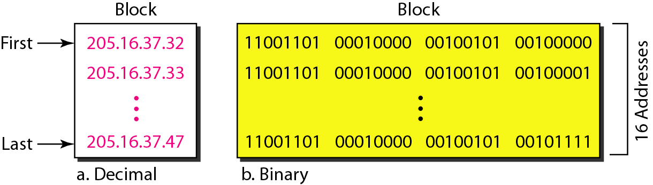
Cont…
We can see that the restrictions are applied to this block. The addresses are contiguous. The number 4 of addresses is a power of 2 =16, and the first address is divisible by 16. The first address, when converted to a decimal number, is 3,440,387,360, which when divided by 16 results in 215,024,210
Nita Patil

Slide 46
Mask and Address Blocks
In IPv4 addressing, a block of addresses can be defined as
x.y.z.t /n in which x.y.z.t defines one of the addresses and the /n defines the mask.
The first address in the block can be found by setting the rightmost 32 − n bits to 0s
The last address in the block can be found by setting the rightmost 32 − n bits to 1s
The number of addresses in the block can be found by using the formula 2^{32−n}
Nita Patil

Slide 47
Mask and Address Blocks
Example: 205.16.37.39/28
The binary representation is 1100110 00010000 00100101 00100111
If we set 32 − 28 rightmost bits to 0, we get 11001101 00010000 00100101 00100000
→ 205.16.37.32 (First address)
If we set 32 − 28 rightmost bits to 1, we get 11001101 00010000 00100101 00101111
→ 205.16.37.47 (Last address)
The value of n is 28, which means that number of addresses is 2³²⁻²⁸ or 16
Nita Patil

Slide 48
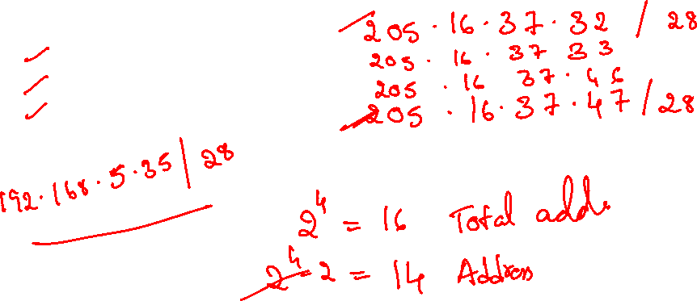
Cont…
Another way to find the first address, the last address, and the number of addresses is to represent the mask as a 32-bit binary (or 8-digit hexadecimal) number. This is particularly useful when we are writing a program to find these pieces of information.
Example 205.16.37.39/28 can be represented as 11111111 11111111 11111111 11110000 (twenty-eight 1’s and four 0’s). Find
The first address
The last address
The number of addresses
Nita Patil

Slide 49
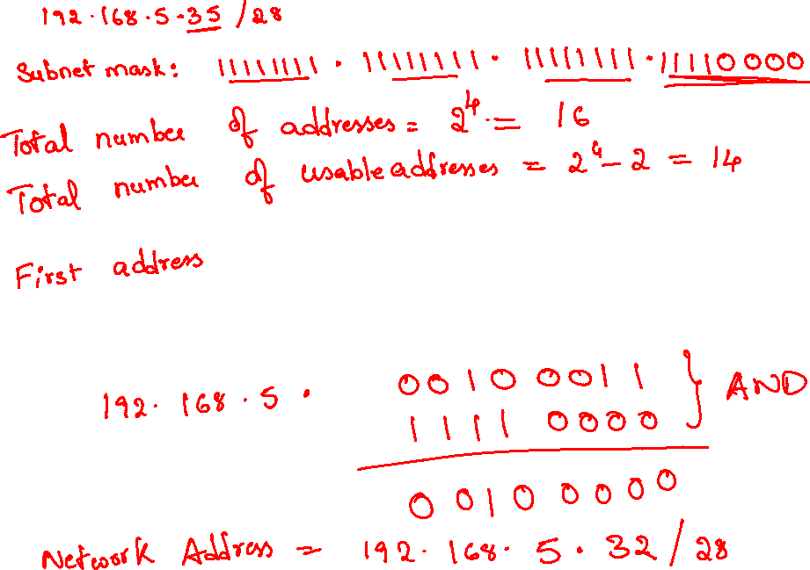

Nita Patil

Slide 50
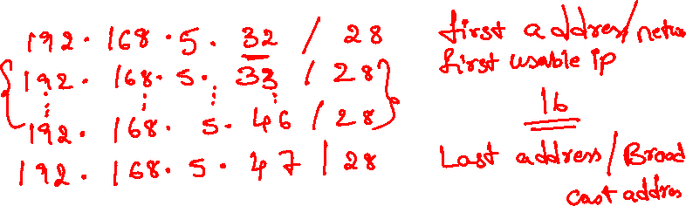
Nita Patil

Slide 51
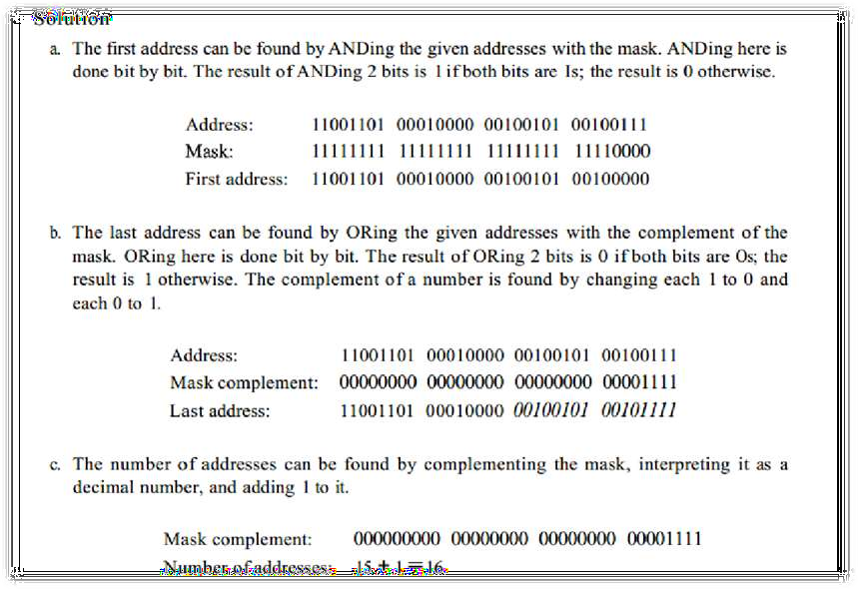


Cont…
Nita Patil

Slide 52
Network Addresses
A very important concept in IP addressing is the network address. When an organization is given a block of addresses, the organization is free to allocate the addresses to the devices that need to be connected to the Internet. The first address in the class, however, is normally (not always) treated as a special address. The first address is called the network address and defines the organization network. It defines the organization itself to the rest of the world.
As well as, we will see that the first address is the one that is used by routers to direct the message sent to the organization from the outside the organization network is connected to the Internet via a router. The router has two addresses. One belongs to the granted block; the other belongs to the network that is at the other side of the router. We call the second address x.y.z.t/n because we do not know anything about the network it is connected to at the other side. All messages destined for addresses in the organization block (205.16.37.32 to 205.16.37.47) are sent, directly or indirectly, to x.y.z.t/n. We say directly or indirectly because we do not know the structure of the network to which the other side of the router is connected
Nita Patil

Slide 53
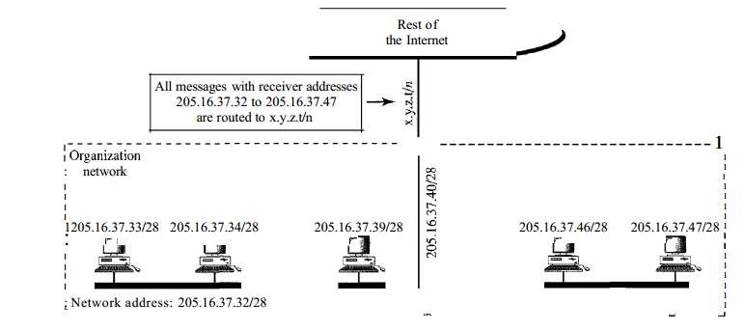

Nita Patil

Slide 54
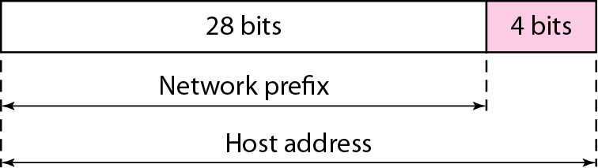
Two-Level Hierarchy: No Subnetting
An IP address can define only two levels of hierarchy when not subnetted. The n left- most bits of the address x.y.z.tJn define the network (organization network); the 32 - n
Rightmost bits define the particular host (computer or router) to the network.
The two common terms are prefix and suffix. The part of the address that defines the network is called the prefix
Nita Patil

Slide 55

Three-Levels of Hierarchy: Subnetting
An organization that is granted a large block of addresses may want to create clusters of networks (called subnets) and divide the addresses between the different subnets. The rest of the world still sees the organization as one entity.
However, internally there are several subnets. All messages are sent to the router address that connects the organization to the rest of the Internet; the router routes the message to the appropriate subnets.
The organization, however, needs to create small sub-blocks of addresses, each assigned to specific subnets. The organization has its own mask; each subnet must also has its own
Nita Patil

Slide 56
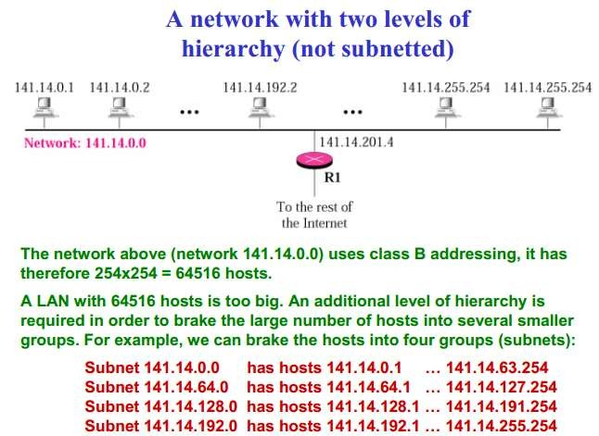

Nita Patil

Slide 57
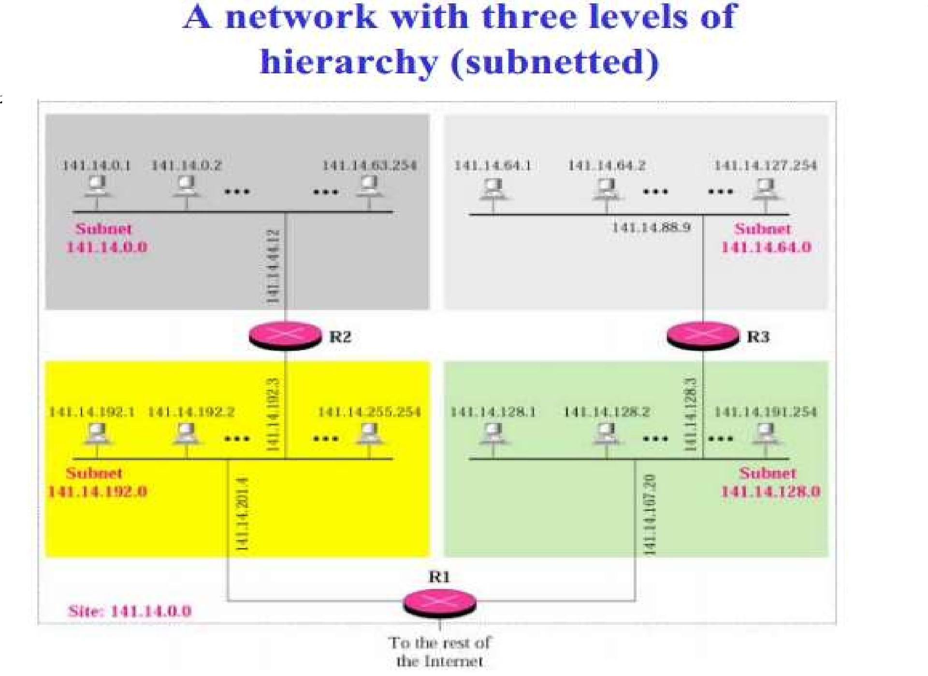




Nita Patil

Slide 58
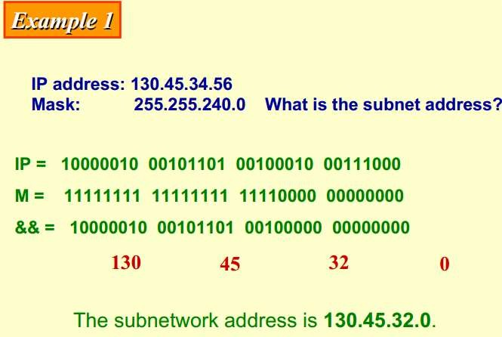
Nita Patil

Slide 59
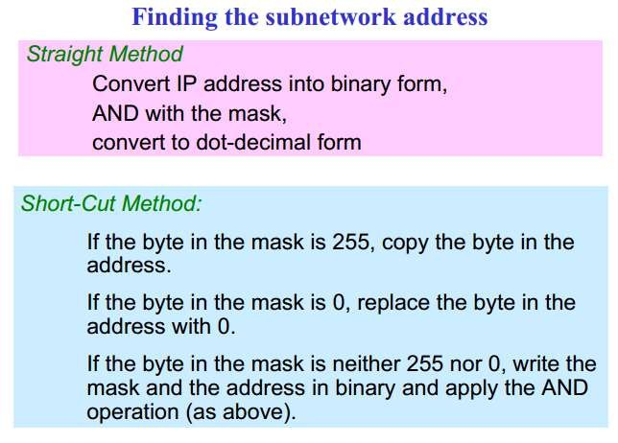
Nita Patil

Slide 60
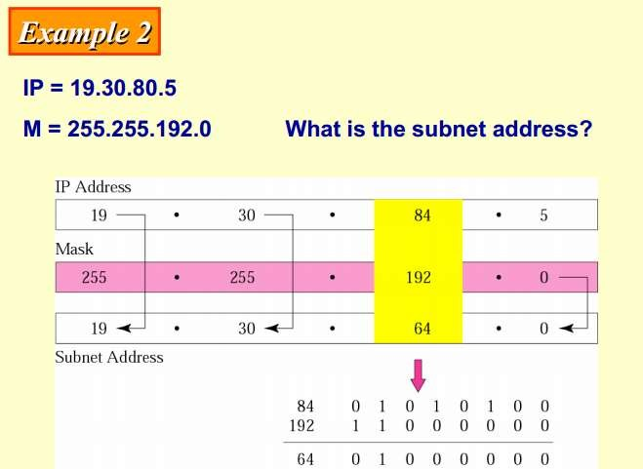
Nita Patil

Slide 61

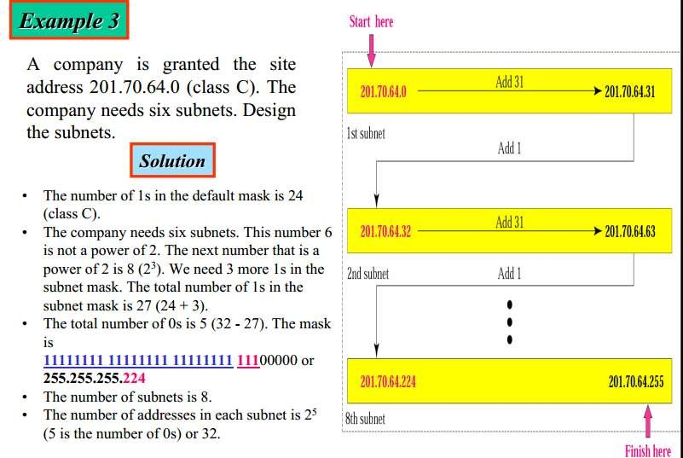

Nita Patil

Slide 62
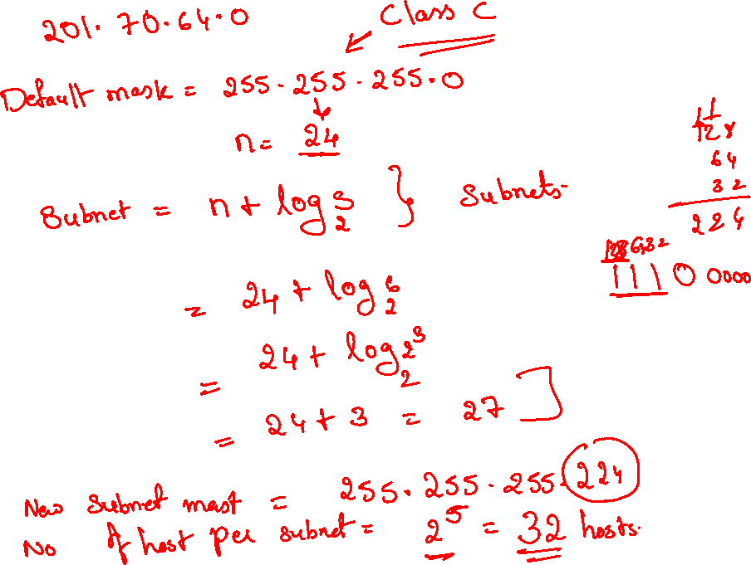
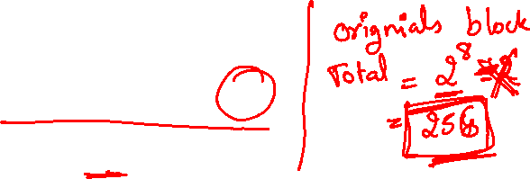

Slide 63
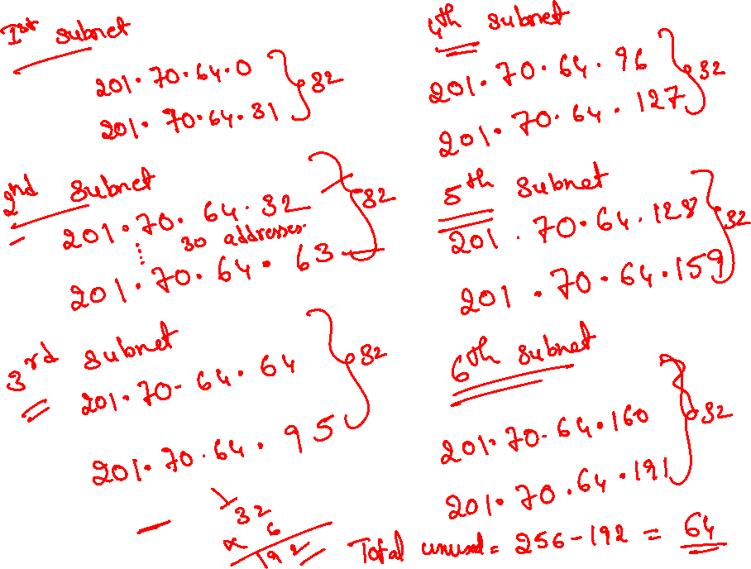

Slide 64
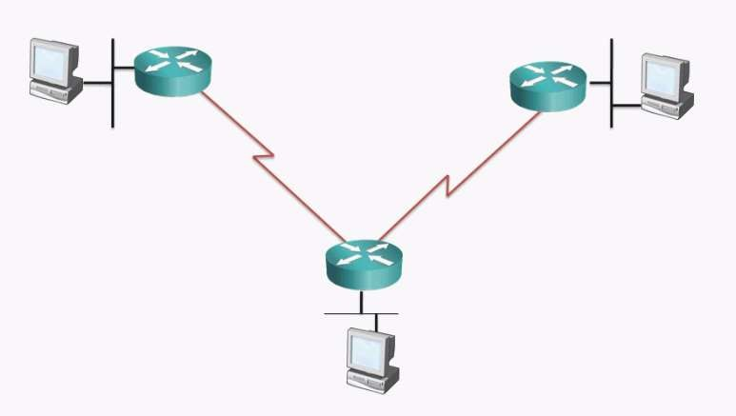





Example 4
An organization has purchased the Class C Address 216.21.5.0 and would like
to use it to address the following 5 networks.

Slide 65
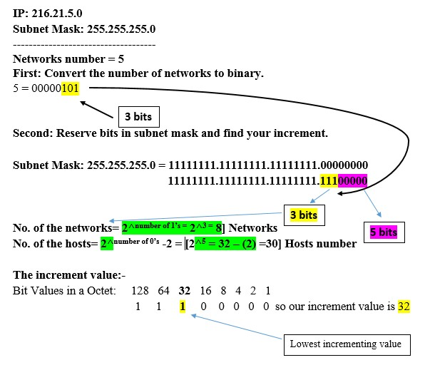
Cont…
Nita Patil

Slide 66
Cont…
Third: Use increment to find the network ranges.
No. | Subnet address | First valid address | Last valid Address | Broadcast address
1 | 216.21.5.0 | 216.21.5.1 | 216.21.5.30 | 216.21.5.31
2 | 216.21.5.32 | 216.21.5.33 | 216.21.5.62 | 216.21.5.63
3 | 216.21.5.64 | 216.21.5.65 | 216.21.5.94 | 216.21.5.95
4 | 216.21.5.96 | 216.21.5.97 | 216.21.5.126 | 216.21.5.127
5 | 216.21.5.128 | 216.21.5.129 | 216.21.5.158 | 216.21.5.159
6 | 216.21.5.160 | 216.21.5.161 | 216.21.5.190 | 216.21.5.191
7 | 216.21.5.192 | 216.21.5.193 | 216.21.5.222 | 216.21.5.223
8 | 216.21.5.224 | 216.21.5.225 | 216.21.5.254 | 216.21.5.255
Nita Patil

Slide 67
Cont…
216.21.5.33--62
216.21.5.1--30
216.21.5.129--158
216.21.5.97--126
216.21.5.65--94
Nita Patil

Slide 68

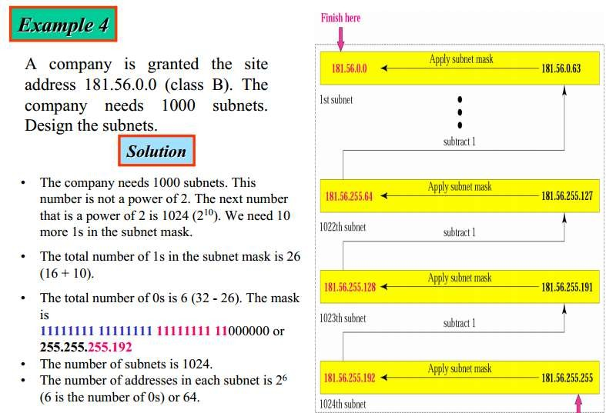
Example 5
Nita Patil

Slide 69

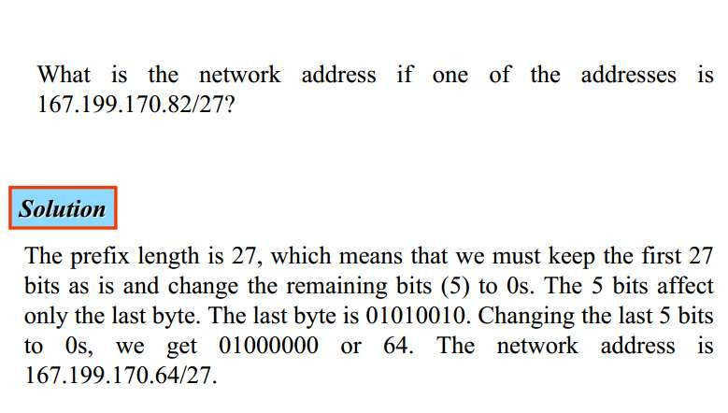
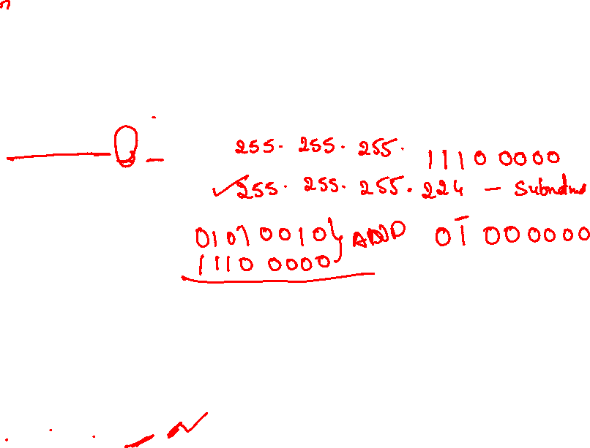
Example 6
Nita Patil

Slide 70

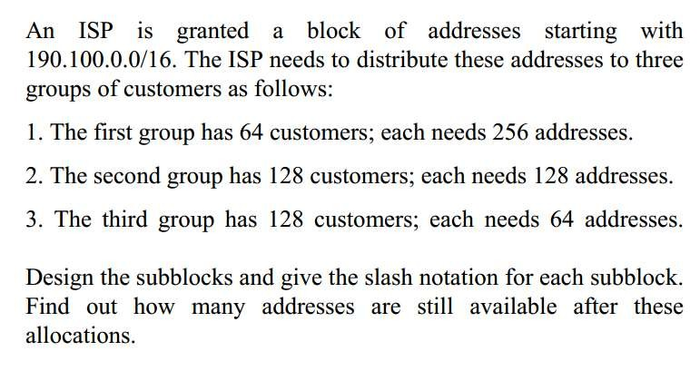

Example 7
Nita Patil

Slide 71

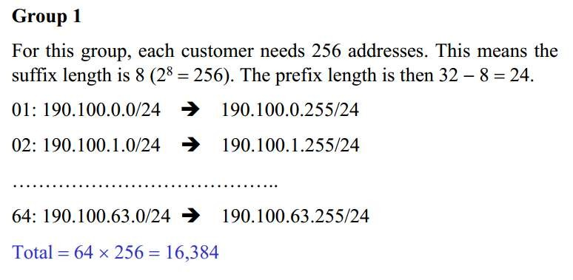

Nita Patil

Slide 72

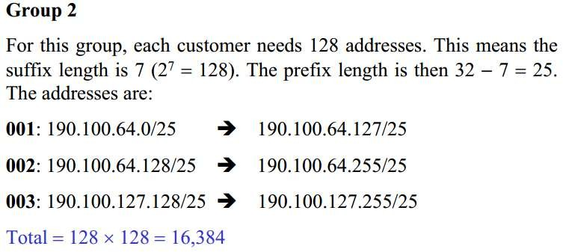

128:
Nita Patil

Slide 73

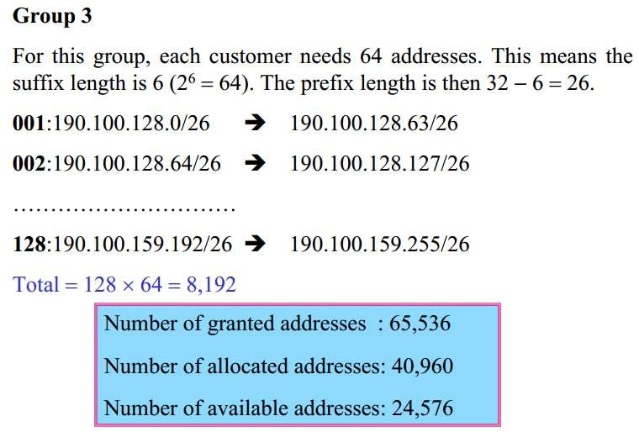

Number of granted address : 65,534 Number of allocated address : 40,960 Number of available address : 24,574
Nita Patil

Slide 74
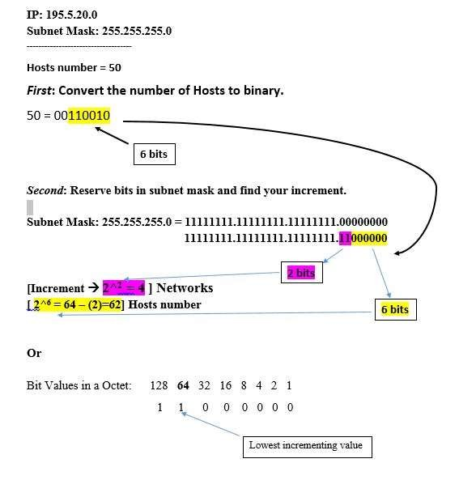
Example 8
An organization has purchased the Class C Address 195.5.20.0 and would to
create networks of 50 hosts each.
Nita Patil

Slide 75
Cont..
Third: Use increment to find the network ranges.
No | Subnet | First valid address | Last valid address | Broadcast Address
1 | 195.5.20.0 | 195.5.20.1 | 195.5.20.62 | 195.5.20.63
2 | 195.5.20.64 | 195.5.20.65 | 195.5.20.126 | 195.5.20.127
3 | 195.5.20.128 | 195.5.20.129 | 195.5.20.190 | 195.5.20.191
4 | 195.5.20.192 | 195.5.20.193 | 195.5.20.254 | 195.5.20.255
Nita Patil

Slide 76


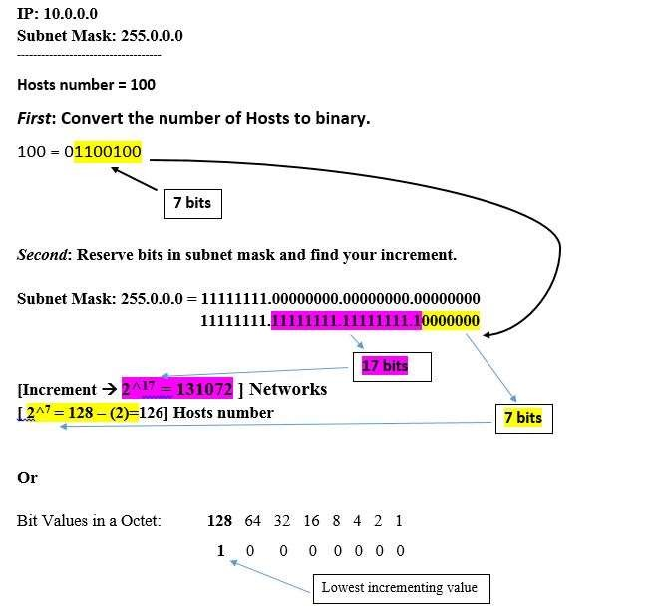
Example 9
Example: An organization has purchased the Class A Address 10.0.0.0 and
would to create networks of 100 hosts each.
Nita Patil

Slide 77
Cont…
No | Subnet | First valid address | Last valid address | Broadcast Address
1 | 10.0.0.0 | 10.0.0.1 | 10.0.0.126 | 10.0.0.127
2 | 10.0.0.128 | 10.0.0.129 | 10.0.0.254 | 10.0.0.255
3 | 10.0.1.0 | 10.0.1.1 | 10.0.1.126 | 10.0.1.127
4 | 10.0.1.128 | 10.0.1.129 | 10.0.1.254 | 10.0.1.255
Nita Patil

Slide 78
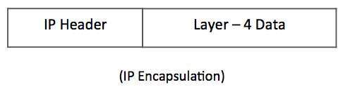
IPv4 Packet Structure
Internet Protocol being a layer-3 protocol (OSI) takes data Segments from layer-4 (Transport) and divides it into packets. IP packet encapsulates data unit received from above layer and add to its own header information.
Nita Patil

Slide 79
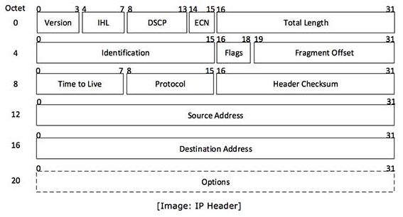
IPv4 Packet Structure
The encapsulated data is referred to as IP Payload. IP header contains all the necessary information to deliver the packet at the other end.
Nita Patil

Slide 80
IPv4 Packet Structure
The encapsulated data is referred to as IP Payload. IP header contains all the necessary information to deliver the packet at the other end.
Nita Patil

Slide 81
IPv4 Packet Structure
Version − Version no. of Internet Protocol used (e.g. IPv4).
IHL − Internet Header Length; Length of entire IP header.
DSCP − Differentiated Services Code Point; this is Type of Service.
ECN − Explicit Congestion Notification; It carries information about the congestion seen in the route.
Total Length − Length of entire IP Packet (including IP header and IP Payload).
Identification − If IP packet is fragmented during the transmission, all the fragments contain same identification number to identify original IP packet they belong to.
Flags − As required by the network resources, if IP Packet is too large to handle, these ‘flags’ tells if they can be fragmented or not. In this 3-bit flag, the MSB is always set to ‘0’.
Nita Patil

Slide 82
IPv4 Packet Structure
Fragment Offset − This offset tells the exact position of the fragment in the original IP Packet.
Time to Live − To avoid looping in the network, every packet is sent with some TTL value set, which tells the network how many routers (hops) this packet can cross. At each hop, its value is decremented by one and when the value reaches zero, the packet is discarded.
Protocol − Tells the Network layer at the destination host, to which Protocol this packet belongs to, i.e. the next level Protocol. For example protocol number of ICMP is 1, TCP is 6 and UDP is 17.
Nita Patil

Slide 83
IPv4 Packet Structure
Header Checksum − This field is used to keep checksum value of entire header which is then used to check if the packet is received error-free.
Source Address − 32-bit address of the Sender (or source) of the packet.
Destination Address − 32-bit address of the Receiver (or destination) of the packet.
Options − This is optional field, which is used if the value of IHL is greater than 5. These options may contain values for options such as Security, Record Route, Time Stamp, etc.
Nita Patil

Slide 84
ARP
ARP stands for “Address Resolution Protocol”. It is a network protocol used to determine the MAC address (hardware address) from any IP address.
In other words, ARP is used to mapping the IP Address into MAC Address. When one device wants to communicate with another device in a LAN (local area network) network, the ARP protocol is used.
This protocol is used when a device wants to communicate with another device over a local area network or ethernet.
ARP is a network layer protocol. This is a very important protocol in the TCP/IP protocol suite.
Nita Patil

Slide 85
ARP
When data is sent to a local host, the data travels between networks via IP address. But to reach that host in LAN, it needs the MAC address of that host. In this situation the address resolution protocol plays an important role.
Important ARP Terms
ARP Cache :- After receiving the MAC address, ARP passes it to the sender where it is stored in a table for future reference. And this is called ARP Cache which is later used to obtain the MAC address.
ARP Cache Timeout :- This is the time in which the MAC address can remain in the ARP cache.
ARP request :- Broadcasting a packet over the network to verify whether we have arrived at the destination MAC address.
ARP response/reply :- It is a MAC address response that the sender receives from the receiver which helps in further communication of data.
Nita Patil

Slide 86
ARP
Types of ARP
There are four types of ARP protocol they are as follows:-
Proxy ARP
Gratuitous ARP
Reverse ARP
Inverse ARP
1. Proxy ARP
This is a technique through which proxy ARP in a network can answer ARP queries of IP addresses that are not in that network. That is, if we understand it in simple language, the Proxy server can also respond to queries of IP-address of other networks.
Through this we can fool the other person because instead of the MAC address of the destination device, the MAC address of the proxy server is used and the other person does not even know.
Nita Patil

Slide 87
ARP
2. Gratuitous ARP
This is an arp request of a host, which we use to check duplicate ip-address,also can be used it to update the arp table of other devices. That is, through this we can check whether the host is using its original IP-address, or is using a duplicate IP-address.
This is a very important ARP. Which proves to be very helpful in protecting us from the wrong person, and by using it we can check the ip-address.
3. Reverse ARP
A networking protocol, which we can be used through client computer. That is, it is used to obtain information about one’s own network from the computer network.
That is, to know the IP address of our computer server, we use Reverse ARP, which works under a networking protocol.
Nita Patil

Slide 88
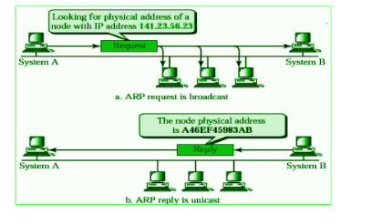
ARP
4. Inverse ARP (InARP)
Inverse ARP, it is the opposite of ARP, that is, we use it to know the IP address of our device through MAC Address, that is, it is such a networking technology, through this we convert MAC Address into IP address. It is mainly used in ATM machines.
How ARP Protocol Works?
Nita Patil

Slide 89

Message Format of ARP
Messages are sent to find the MAC address through ARP(address resolution protocol). These messages are broadcast to all the devices in the LAN.
Nita Patil

Slide 90
Message Format of ARP
Hardware Type: The size of this field is 2 bytes. This field defines what type of Hardware is used to transmit the message. The most common Hardware type is Ethernet. The value of Ethernet is 1.
Protocol Type: This field tells which protocol has been used to transmit the message. substantially the value of this field is 2048 which indicates IPv4.
Hardware Address Length: It shows the length of the tackle address in bytes. The size of Ethernet MAC address is 6 bytes.
Protocol Address Length: It shows the size of the IP address in bytes. The size of IP address is 4 bytes.
Nita Patil

Slide 91
Message Format of ARP
OP law: This field tells the type of message. If the value of this field is 1 also it’s a request message and if the value of this field is 2 also it’s a reply message.
Sender Hardware Address: This field contains the MAC address of the device transferring the message.
Sender Protocol Address: This field contains the IP address of the device transferring the message.
Target Hardware Address: This field is empty in the request message. This field contains the MAC address of the entering device.
Target Protocol Address: This field contains the IP address of the entering device.
Nita Patil

Slide 92
RARP
Reverse ARP is a network protocol a client machine uses in a local area network to request its Internet Protocol address(IPv4) from the gateway router’s ARP table. The network administrator creates a table in the gateway router, which maps the MAC address to the corresponding IP address. When a new machine is set up or any machine which doesn’t have a memory to store the IP address, needs an IP address for its use. So the machine sends a RARP broadcast packet which contains its own MAC address in both the sender and receiver hardware address fields.
Nita Patil

Slide 93
RARP
How does RARP Work?
The RARP is on the Network Access Layer and is employed to send data between two points in a network. Each network participant has two unique addresses IP address (a logical address) and MAC address (the physical address). The IP address gets assigned by software and after that the MAC address is constructed into the hardware. The RARP server that responds to RARP requests, can even be any normal computer within the network. However, it must hold the data of all the MAC addresses with their assigned IP addresses. If a RARP request is received by the network, only these RARP servers can reply to it. This implies that the packet is transferred to all the participants at the identical time. The client broadcasts a RARP request with an Ethernet broadcast address and with its own physical address. The server responds by informing the client its IP address.
Nita Patil

Slide 94
ICMP
ICMP is used for reporting errors and management queries. It is a supporting protocol and is used by network devices like routers for sending error messages and operations information. For example, the requested service is not available or a host or router could not be reached.
Uses of ICMP
ICMP is used for error reporting if two devices connect over the internet and some error occurs, So, the router sends an ICMP error message to the source informing about the error. For Example, whenever a device sends any message which is large enough for the receiver, in that case, the receiver will drop the message and reply to the ICMP message to the source.
Nita Patil

Slide 95
ICMP
How Does ICMP Work?
ICMP is the primary and important protocol of the IP suite, but ICMP isn’t associated with any transport layer protocol as it doesn’t need to establish a connection with the destination device before sending any message as it is a connectionless protocol.
The working of ICMP is just contrasting with TCP, as TCP is a connection-oriented protocol whereas ICMP is a connectionless protocol. Whenever a connection is established before the message sending, both devices must be ready through a TCP Handshake.
ICMP packets are transmitted in the form of datagrams that contain an IP header with ICMP data. ICMP datagram is similar to a packet, which is an independent data entity.
Nita Patil

Slide 96

ICMP Packet format
Nita Patil

Slide 97
ICMP
In the ICMP packet format, the first 32 bits of the packet contain three fields:
Type (8-bit): The initial 8-bit of the packet is for message type, it provides a brief description of the message so that receiving network would know what kind of message it is receiving and how to respond to it. Some common message types are as follows:
Type 0 – Echo reply
Type 3 – Destination unreachable
Type 5 – Redirect Message
Type 8 – Echo Request
Type 11 – Time Exceeded
Type 12 – Parameter problem
Code (8-bit): Code is the next 8 bits of the ICMP packet format, this field carries some additional information about the error message and type.
Nita Patil

Slide 98
ICMP
Checksum (16-bit): Last 16 bits are for the checksum field in the ICMP packet header. The checksum is used to check the number of bits of the complete message and enable the ICMP tool to ensure that complete data is delivered.
The next 32 bits of the ICMP Header are Extended Header which has the work of pointing out the problem in IP Message. Byte locations are identified by the pointer which causes the problem message and receiving device looks here for pointing to the problem.
The last part of the ICMP packet is Data or Payload of variable length. The bytes included in IPv4 are 576 bytes and in IPv6, 1280 bytes.
Nita Patil

Slide 99
IGMP
IGMP is an acronym for Internet Group Management Protocol. IGMP is a communication protocol used by hosts and adjacent routers for multicasting communication with IP networks and uses the resources efficiently to transmit the message/data packets. Multicast communication can have single or multiple senders and receivers and thus, IGMP can be used in streaming videos, gaming, or web conferencing tools. This protocol is used on IPv4 networks and for using this on IPv6, multicasting is managed by Multicast Listener Discovery (MLD).
Nita Patil

Slide 100
IGMP Messages
IGMP Membership Query: The Sent by routers to determine which multicast groups have members on a particular network segment. This query helps routers maintain accurate multicast group membership information.
IGMP Membership Report: Sent by hosts to indicate their interest in joining a multicast group. This report informs the router of the presence of a host that wants to receive multicast traffic.
IGMP Leave Group: Sent by hosts to indicate that they are leaving a multicast group. This message informs the router that the host no longer wants to receive traffic for that group.
IGMP V3 Membership Report (in IGMPv3): This allows hosts to specify the exact multicast group addresses they want to join or leave and can include source-specific multicast (SSM) information.
Nita Patil

Slide 101
IGMP
Working of IGMP
IGMP works on devices that are capable of handling multicast groups and dynamic multicasting. These devices allow the host to join or leave the membership in the multicast group. These devices also allow to add and remove clients from the group. This communication protocol is operated between the host and the local multicast router. When a multicast group is created, the multicast group address is in the range of class D (224-239) IP addresses and is forwarded as the destination IP address in the packet.
Nita Patil

Slide 102

IGMP
Nita Patil

Slide 103
Congestion Control
What is Congestion?
Congestion in a computer network happens when there is too much data being sent at the same time, causing the network to slow down.
Just like traffic congestion on a busy road, network congestion leads to delays and sometimes data loss.
When the network can’t handle all the incoming data, it gets “clogged,” making it difficult for information to travel smoothly from one place to another.
Nita Patil

Slide 104
Effects of Congestion Control in Computer Network
Improved Network Stability
Reduced Latency and Packet Loss
Enhanced Throughput
Fairness in Resource Allocation
Better User Experience
Mitigation of Network Congestion Collapse
Nita Patil

Slide 105
Congestion Control Algorithm
Congestion Control is a mechanism that controls the entry of data packets into the network, enabling a better use of a shared network infrastructure and avoiding congestive collapse.
There are two congestion control algorithms:
Leaky Bucket Algorithm
Token Bucket Algorithm
Nita Patil

Slide 106

Congestion Control Algorithm
Leaky Bucket Algorithm
This algorithm is used to control the rate at which traffic is sent to the network and shape the burst traffic to a steady traffic stream.
The disadvantage is large area of network resources such as bandwidth is not being used effectively.
Nita Patil

Slide 107
Congestion Control Algorithm
Leaky Bucket Algorithm
Similarly, each network interface contains a leaky bucket and the following steps are involved in leaky bucket algorithm:
When host wants to send packet, packet is thrown into the bucket.
The bucket leaks at a constant rate, meaning the network interface transmits packets at a constant rate.
Bursty traffic is converted to a uniform traffic by the leaky bucket.
In practice the bucket is a finite queue that outputs at a finite rate.
Nita Patil

Slide 108

Congestion Control Algorithm
Leaky Bucket Algorithm
Nita Patil

Slide 109
Congestion Control Algorithm
Token Bucket Algorithm
The leaky bucket algorithm has a rigid output design at an average rate independent of the bursty traffic.
In some applications, when large bursts arrive, the output is allowed to speed up. Hence, require more flexible algorithm, preferably one that never loses information.So, a token bucket algorithm finds its uses in network traffic shaping or rate-limiting.
It is a control algorithm that indicates when traffic should be sent. This order comes based on the display of tokens in the bucket.
The bucket contains tokens. Each of the tokens defines a packet of predetermined size. Tokens in the bucket are deleted for the ability to share a packet.
When tokens are shown, a flow to transmit traffic appears in the display of tokens.
Nita Patil

Slide 110

Flow Characteristics of Token Bucket Algorithm
Four types of characteristics are attributed to a flow: reliability, delay, jitter, and bandwidth.
Nita Patil

Slide 111
Flow Characteristics of Token Bucket Algorithm
Types of Characteristics for Quality of Service :
Reliability
It implies packet reached or not, information lost or not.
Lack of reliability means losing a packet or acknowledgement, which entails re-transmission.
Reliability requirements may differ from program to program.
For example, it is more important that electronic mail, file transfer and internet access have reliable transmissions than telephony or audio conferencing.
Nita Patil

Slide 112
Flow Characteristics of Token Bucket Algorithm
Delay
It denotes source-to-destination delay. Different applications can tolerate delay in different degrees. Telephony, audio conferencing, video conferencing, and remote login need minimum delay, while delay in file transfer or e-mail is less important.
Jitter
Jitter is the variation in delay for packets belonging in same flow. High jitter means the difference between delays is large; low jitter means the variation is small. For example, if packets 0,1,2,3s arrive at 6,7,8,9s it represents same delay. Jitter would signify that packets departed at 0,1,2,3s reach destination at 4,6,10,15s. Audio and video applications don’t allow jitter.
Nita Patil

Slide 113
Flow Characteristics of Token Bucket Algorithm
Bandwidth
Different applications need different bandwidths. In video conferencing we need to send millions of bits per second to refresh a color screen while the total number of bits in an e-mail may not reach even a million.
Nita Patil

Slide 114
Techniques to Improve QoS
Scheduling
Packets from different flows arrive at a switch or router for processing. A good scheduling technique treats the different flows in a fair and appropriate manner. Three scheduling techniques are:
FIFO Queuing
Priority Queuing
Weighted Fair Queuing
Traffic Shaping
It is a mechanism to control the amount and the rate of the traffic sent to the network.
Nita Patil

