Slide 1
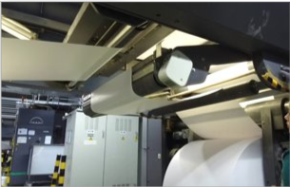
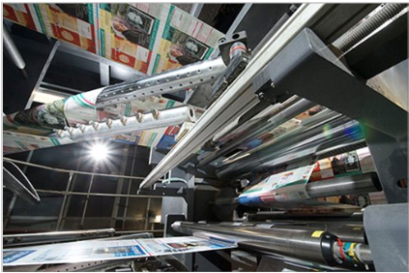
Time Series Classification
for Paper Web Breaks In Print Industry
Master's Thesis
Vaishnavi Sreekumar
University of Applied Sciences Heidelberg | May 2026
Supervisors: Prof. Dr. Achim Gottscheber · Dr. Paul Glaysher
Notes:
Good morning. I am Vaishnavi Sreekumar and this is my master's thesis titled Time Series Classification for Paper Web Breaks, in collaboration with Bertelsmann Marketing Services.
So Lets first understand what a paper web break is,
when a paper roll passes through a printing press — as shown in the picture here — and it tears that’s the web break, and its cause needs to be identified. Currently this is done manually by domain experts. My thesis works on automating that.

Slide 2
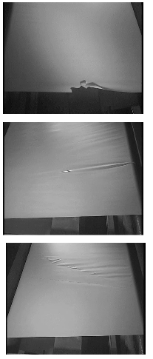
The Problem
3 - 5%
2
€335 - €743
Cost per stoppage as per industry benchmark per incident
Break rates per 100 rolls componds across a production year
causes:
machine vs paper
When a break happens was it the machine or the paper?
Getting paper classification wrong means blaming the supplier with real commercial consequences.
Getting machine classification wrong means not resolving machine problems timely, resulting in recurring breaks.
Notes:
Let me start with why this matters commercially.
Every time a break happens the press stops for 20 to 40 minutes. That costs between 335 and 743 euros per incident, and it happens 3 to 5 times per 100 rolls — so it adds up fast. The classification matters because if it's the paper's fault you complain to the supplier. If it's the machine's fault you fix the press preventing further stoppages. Getting it wrong in either direction has real consequences. The question is — can we build something reliable enough to automate this?

Slide 3
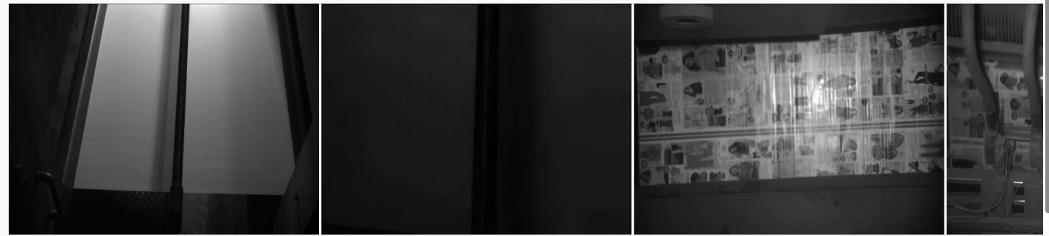
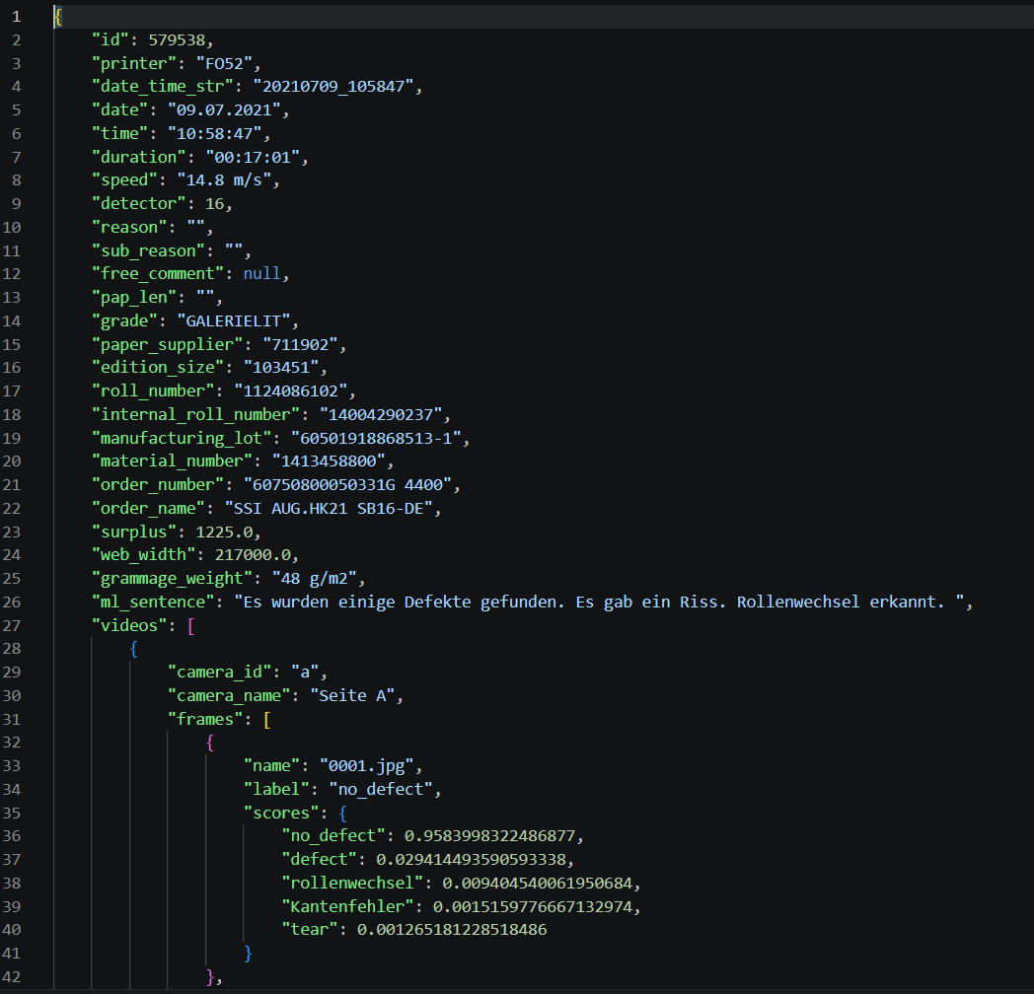
A Recorded Web Break Event
© 2026 Bertelsmann Marketing Services. Confidential.
Notes:
To answer that, let's look at what we're working with. This is a short clip of a recorded web break event at bertelsmann.
When every break happens the entire event is recorded, saved as a JSON file as shown here, where its broken into frames — around 1500 per event out of which only the 300 frames before the break are the discriminative ones— and each frame gets scored across 5 defect channels by the camera as in the right bottom image, which is our time series data and there are 2 cameras so it becomes 10 channels in total.

Slide 4
The Dataset
14,073
11,822
2,251
Total Events
Machine-Caused
Paper-Caused
JSON files, one per break
84% of dataset
16% minority class
300, 10
AUC
3-Fold
Frames per Event, channels per frame
Evaluation Metric
Cross-Validation
pre-break window
primary
stratified
Notes:
Our dataset has 14,073 such events from a single Bertelsmann facility, collected from July 2021 to December 2024. 84% are machine-caused, only 16% are paper-caused. Accuracy is not very useful as a metric here — a model that always predicts machine-caused gets 84% accuracy. We use AUC instead, which measures how well the model separates the two classes across all thresholds. And to keep that 84/16 split consistent across evaluation we use stratified 3-fold cross-validation.

Slide 5
Three Research Questions
RQ1
Can deep learning architectures classify web break causes from raw time series under heavy imbalance?
RQ2
Do foundation models and LLMs transfer to this specialised industrial task?
RQ3
Does converting the raw time series into a tabular feature representation with domain understanding outperform deep learning models?
Notes:
In this thesis There are Three questions that drove our investigation — can deep learning classify this from the raw signal, can pre-trained models transfer their knowledge to this task, and does a tabular feature representation outperform end-to-end learning?
To test this

Slide 6
Overview: Four Families, Nine Models
Deep Learning
Foundation Model
LLM
Gradient Boosting
Model
AUC
CNN-FCN
0.68
Chronos-2
GPT-4o
XGBoost
0.66
F1: 0.22
0.86 ★
InceptionTime
0.73
ConvTimeNet
0.70
RNN : LSTM-FCN
0.70
Attention based: TST
0.67
Prototype based : TapNet
0.77
AUC = ROC-AUC (primary metric, mean across 3 folds) · ★ = best result · GPT-4o evaluated on F1 only; no probability output
Notes:
we cover six deep learning architectures, Chronos-2 and GPT-4o for pre-trained models, and XGBoost for tabular feature engineering.
XGBoost achieves the best overall AUC of 0.86. About AUC, If AUC is 0.5 model has not learned anything and if its nearing 1 that’s the perfect model. TapNet, the best deep learning model, reaches 0.77.
The model families weren't chosen arbitrarily — each one directly addresses the limitation of the one before it.

Slide 7
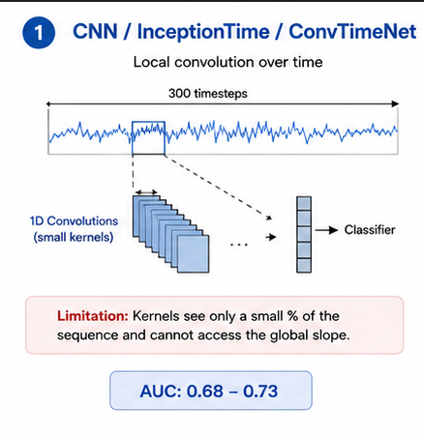
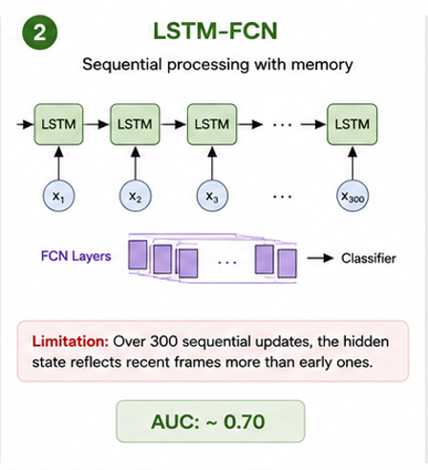
Notes:
Convolutional models only look at small percent of frames at a time out of 300 so they miss the global slope entirely. 0.68-0.73.
LSTM reads all 300 frames sequentially, but by the time it reaches the end the early frames are mostly forgotten. 0.70.

Slide 8
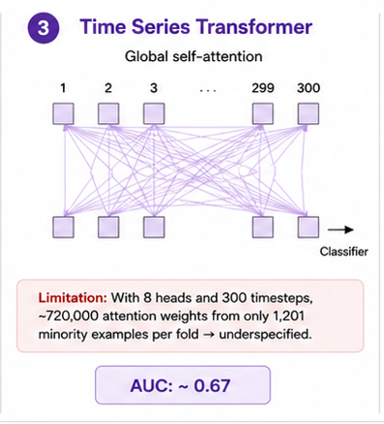
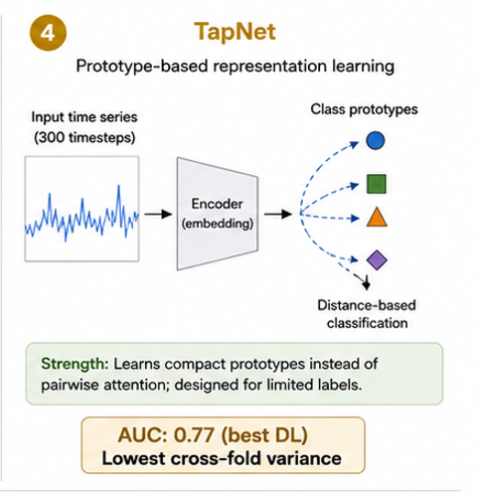
Notes:
The Transformer fixes that — every frame attends to every other simultaneously. But with such less minority class examples and 720,000 attention weights to learn, it's too underspecified. 0.67, worse than the LSTM.
TapNet solves the data problem — instead of learning all those pairwise weights it just learns one prototype per class. Much simpler, and it actually matches the signal structure. Best deep learning result at 0.77.

Slide 9
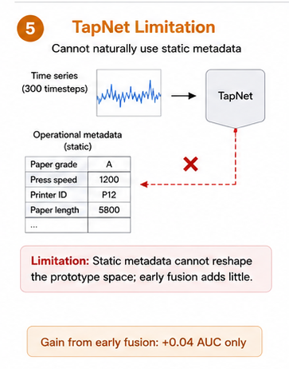
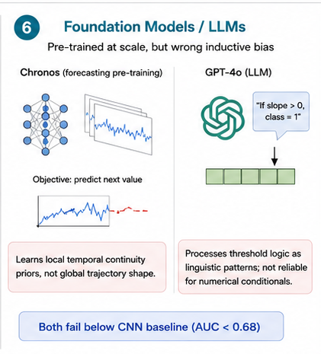
Notes:
But TapNet hits a wall — it can't naturally use operational metadata. And with every raw time series data we also have metadata like Paper grade, press speed, printer identity — these are static values, not sequences. Forcing them via a workaround like early fusion only gains 0.04.
And, to check whether large language models or pre trained models transfer their learnings to our specific task we tested chronos and gpt40 on our data and the result is they don't help. Naturally Chronos was trained to forecast, not classify. GPT-4o can't execute numerical threshold logic — it treats rules as language patterns. Both fall below the CNN baseline.

Slide 10
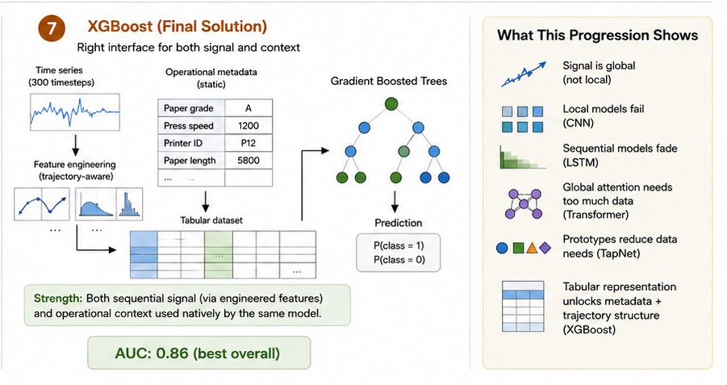
Notes:
XGBoost on the other hand, solves it cleanly — we convert the time series into engineered features, put the metadata right along with these signal features and gradient boosted trees handle exactly this kind of mix natively. So we get the best overall auc.
So what this progression shows is basically our data signal is global not local so local models like convolutional fails, lstms fades over our sequence, attention nased ones need more data, prototype based models like tapnet has reduce data needs but has no way to add metadata fioelds and the tabular representation unlocks metadata plus signal structure.

Slide 11
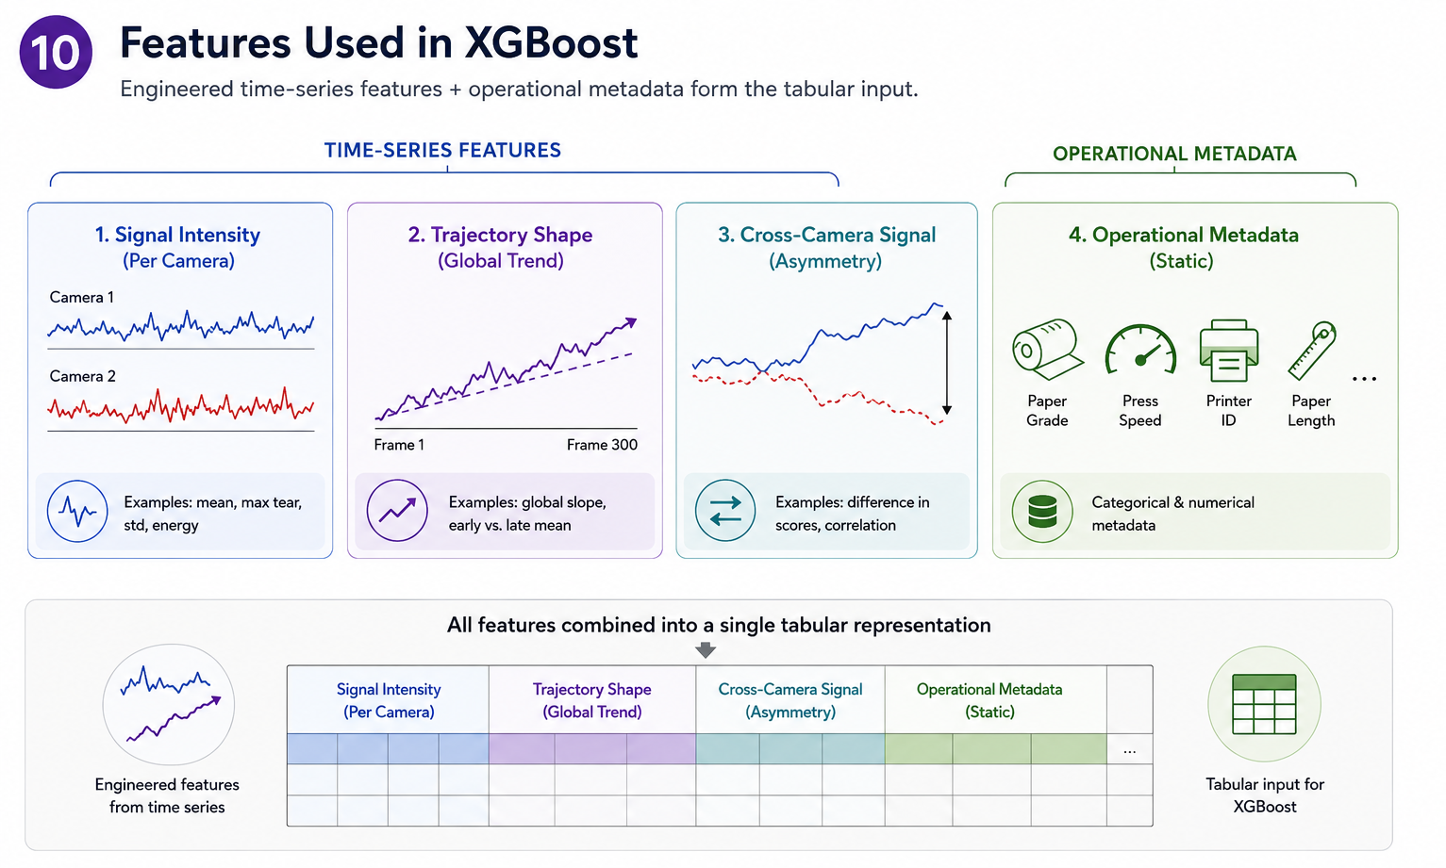
Notes:
Now, what goes into that tabular representation?
The signal intensity like the Camera features — slope, mean, max across all 300 frames. The slope is the key one — it directly captures gradual deterioration that no conv model could ever see because you need the full 300 frames to compute it.
Then the trajectory shape that’s the temporal features — early window versus late window mean, the delta between them, peak sharpness. Basically what captures the signal shape.
Then the cross-camera tear difference . Paper breaks happen asymmetrically, one side tears before the other. Machine faults hit both cameras uniformly.
And that’s captured by this cross camera signal.
And finally the operational metadata — grade, speed, printer, paper length — passed in directly. XGBoost splits on paper grade in the very first node with zero learning overhead. That's where the AUC comes from.
68 features total, each one encoding something a domain expert already knows.

Slide 12
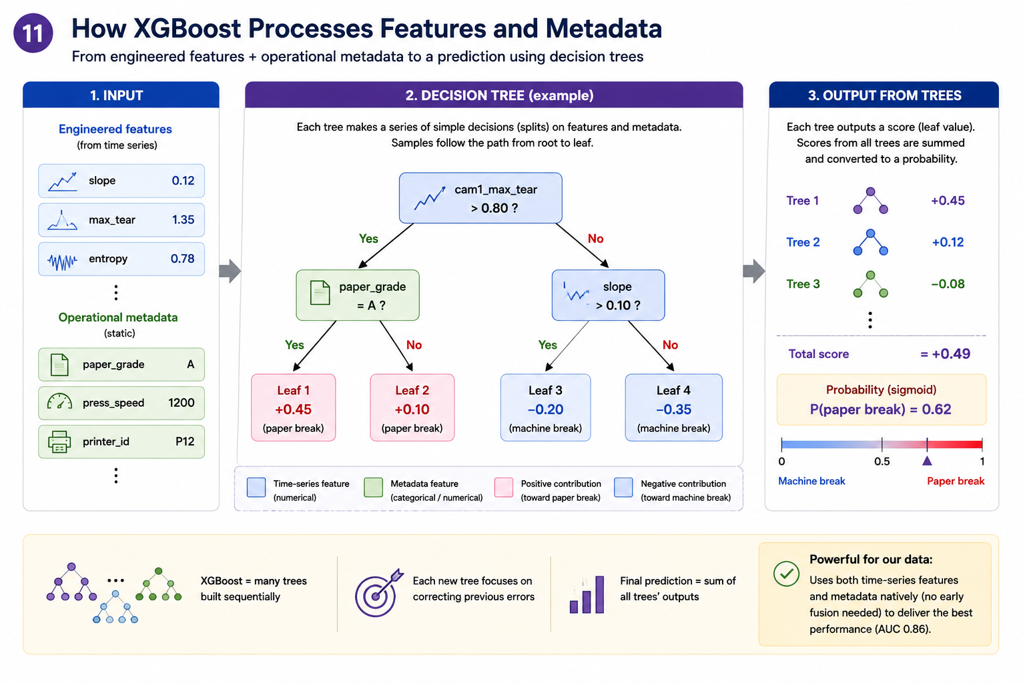
Notes:
What does XGBoost actually do with these 68 features?
These features act as an input to the model and It builds a sequence of simple yes/no decision trees. At the very top, it asks — is the tear signal high? And I didn't tell it to do that — the model found it from the data.
If the tear is above 0.80 then check if paper grade is A if yes it’s a paper break add some points if tear is not higher than 0.80 check if slope of tear is higher than 0.10 If ys it’s a machine break so minus a few points, this addition of points for paper tear necause its labelled as 1 and machine is labelled as 0.
Around 250 such trees are used and the final prediction is just the sum of all those votes.
The model is using all the engineered features and metadata encoded and training on our labelled data in this way.

Slide 13
What Drives the Model - Feature Importance
Categorical metadata
(grade, printer)
Camera time-series
features
Numeric metadata
(speed, pap_len...)
grade_unknown and cam1_max_tear rank equal at importance 0.031 - confirming both metadata and camera signal drive the model.
Notes:
This is a feature importance chart.of paper caused events, It shows we can see the cam1 max tear importance is 0.31 and the grade unknown importance is also 0.31. One is metadata, one is camera signal. Both matter independently. Neither alone is enough.

Slide 14
Conclusion: Three Questions, Three Answers
RQ1 - Deep Learning
Partially works
TapNet 0.77 - best DL, limited by metadata access
RQ2 - Pre-trained Models
Do not transfer
Chronos 0.66 / GPT-4o below CNN - architectural mismatch
RQ3 - Domain Knowledge
Wins decisively
XGBoost 0.86 - representation beats algorithm
0.81
TapNet - No Metadata
TapNet - With Metadata
+0.04
0.77
0.81
XGBoost - No Metadata
XGBoost - With Metadata
+0.07
0.79
0.86
0.86 goes into production today. The ceiling is making it scale.
Notes:
So now we finally have answers to three research questions.
Deep learning can partially solve this right now. Foundation models cannot transfer their learnings And domain knowledge, when encoded correctly, outperforms end-to-end learning by a decisive margin.
Here's the key finding though — without metadata, XGBoost was 0.79 and TapNet was 0.77. Almost the same. The moment you add metadata that was just sitting in the event file, XGBoost jumps to 0.86. TapNet only goes to 0.81. Same information, but XGBoost has a native mechanism for it which tapnet lacks.
But all three answers point to the same thing: the bottleneck was never the algorithm. It was the representation. The signal was in the data the whole time a rising tear score, a cross-camera asymmetry, a paper grade that predicts break behavior directly.
And XGBoost was able to learn that but its is not the ceiling.It goes into prod today but the celieng is to make the model scale.

Slide 15
From Research to Production
Zone 1
Zone 2
Zone 3
New Break
Event
XGBoost
0.86 AUC
High confidence
MACHINE
Uncertain
REVIEW
High confidence
PAPER
300 frames
10 channels
+ metadata
Auto-label
no intervention
Human expert
decides
Flag supplier
auto-report
Probability with confidence score
Two configurable thresholds divide the probability space - calibrated per deployment context.
Deployment pathway:
XGBoost in production today. TapNet is the long-term candidate when minority class volume grows and a metadata-native architecture is available, the deep learning path becomes viable and scalable to other industries as well.
Notes:
Talking about the deployment of the model. This is the current system. When a break happens the event is given to our model which classifies the break with confidence scores, there are three color coded zones, green means the cause is machine and model is highly coinfident on that, red means the cause is paper and model is again highly confident on that, and yellow means model has classified but is not very sure is uncertain and this uncertain event is the one our operators review.
Curerently as we saw in previous slide everything is captured automatically metadata, camera footage, all of it already there. But at the bottom there's a manual placeholder — the operator has to review the footage and decide the cause. That judgment is time consuming and not consistent across shifts,
This manual step is the gap my thesis closes. My model reads the exact same data this system already produces and outputs a probability score before the operator even opens the event. Right now, Two in three paper-caused breaks get correctly flagged. One in nine machine-caused breaks gets wrongly flagged — that's the false positive rate we're operating at.
To talk about the next steps from here,
XGBoost naturally goes into production now for this bertelsmann facility. But as more confirmed labels accumulate and metadata-native deep learning architectures mature, TapNet becomes the natural successor — and at that point the approach scales beyond this facility, beyond printing, to any industrial setting where you have time series and operational context together.
That's the thesis. Thank You, and I would be Happy to take questions now.

Slide 16
Thank You

Slide 17
Appendix

Slide 18
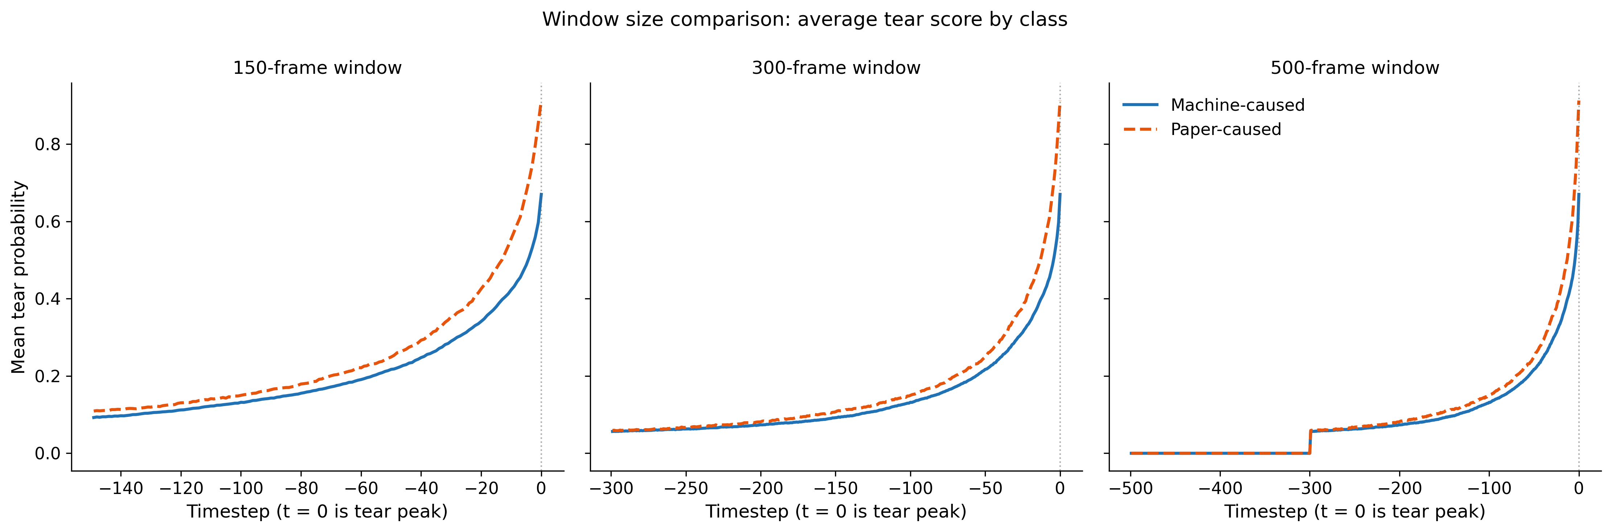
Why the 300 frame window?
Notes:
The orange is a paper caused break events and blue is machine caused, we can see in the 500 frame window the separation in the two classes start only after 300 before that both events exactly show the same pattern.

Slide 19
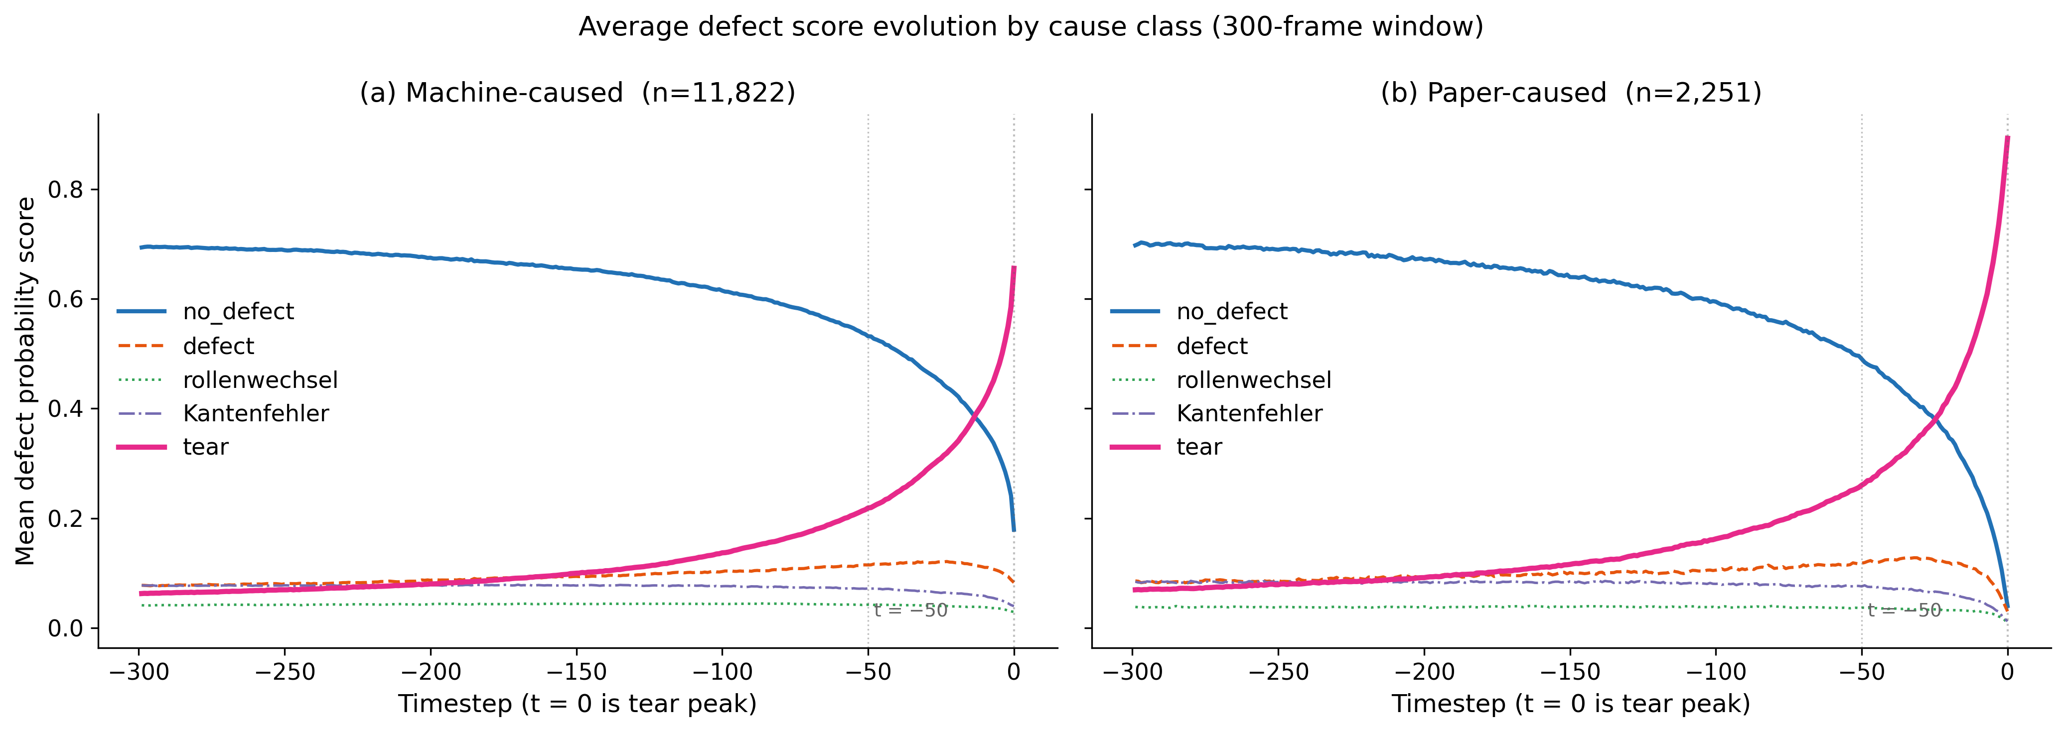
The Signal
Notes:
Machine-caused breaks show a gradual progressive decline in no defect across the full 300 frames, with a slow exponential tear build-up beginning well before rupture, consistent with incremental mechanical deterioration. Paper-caused breaks maintain stable no defect scores until approximately 50 frames before the peak, then change sharply, consistent with sudden failure at a localised paper weakness. These distinct signatures are the core signal that classification models in this thesis are trained to detect,

Slide 20
A9 | Class-Specific Temporal Signatures - What the Signal Looks Like
These two patterns are the entire basis for classification. Every model must somehow capture this distinction from the (300,10) input.
Machine-Caused Break (84% of events)
Frames t=-299 to t=-50: no_defect score high and stable (~0.8-0.9)
Frames t=-50 to t=-1: no_defect gradually declines. tear score begins slow exponential rise.
Frame t=0 (tear peak): tear probability peaks sharply at 0.8-0.9
Signal character: GRADUAL, continuous deterioration across full 300 frames
Paper-Caused Break (16% of events)
Frames t=-299 to t=-50: no_defect score high and stable (~0.85-0.95), near-identical to machine-caused
Frames t=-50 to t=-1: SUDDEN drop in no_defect. tear score spikes sharply.
Frame t=0 (tear peak): tear probability peaks sharply at 0.8-0.9, similar to machine
Signal character: SUDDEN failure at a localised material weakness in final 50 frames
Classification Challenge:
The two classes diverge only in HOW tear scores build up, not in the magnitude of the final tear peak. Both classes reach ~0.85 tear probability at t=0.
The discriminative window is t=-300 to t=-50. A model that only sees local patterns (CNN: 8-frame kernel) cannot reliably distinguish gradual buildup from stable baseline.
Features Capturing Machine Pattern
slope_no_defect_cam1 (strongly negative)
slope_tear_cam1 (positive across 300 frames)
cam1_tear_mean_first50 (non-zero)
cam1_tear_variance (gradual = low variance)
cam1_entropy_mean (gradually increasing)
Features Capturing Paper Pattern
slope_no_defect_cam1 (near-zero until t=-50)
cam1_tear_mean_last50 (very high)
cam1_tear_mean_first50 (near-zero)
cam1_peak_sharpness (sudden spike vs baseline)
late50_minus_early50 (large positive delta)
Window Size Justification
300 frames chosen after testing 150, 300, 500
500 frames: no signal beyond t=-300 (flat)
150 frames: misses early onset at t=-300 to t=-150
Per-frame separation: 150=0.045, 300=0.026, 500=0.016
300 maximises signal-to-noise ratio

Slide 21
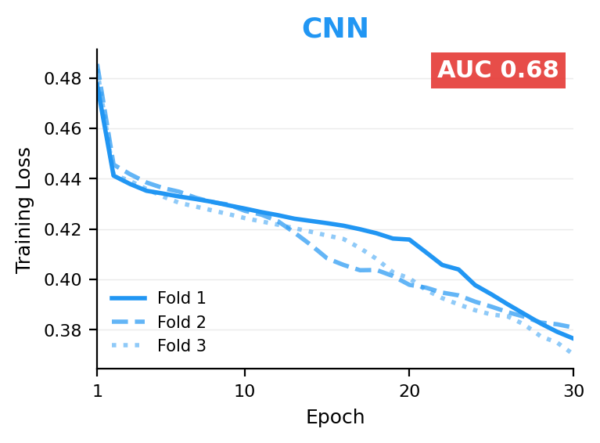
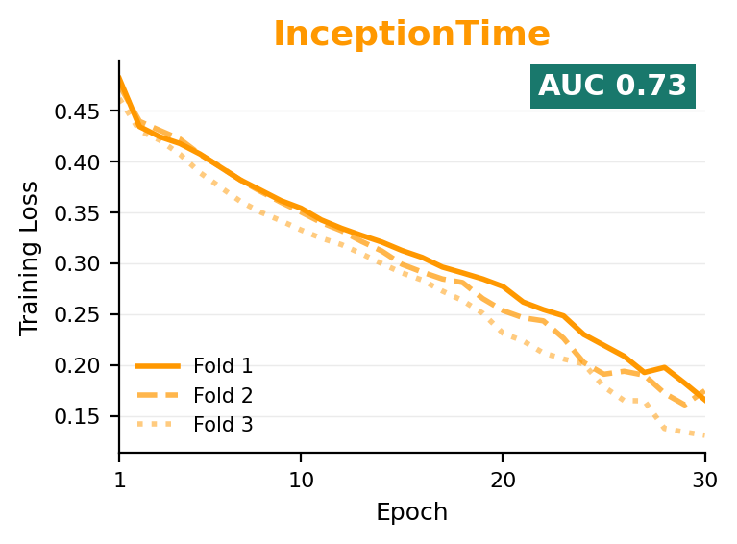
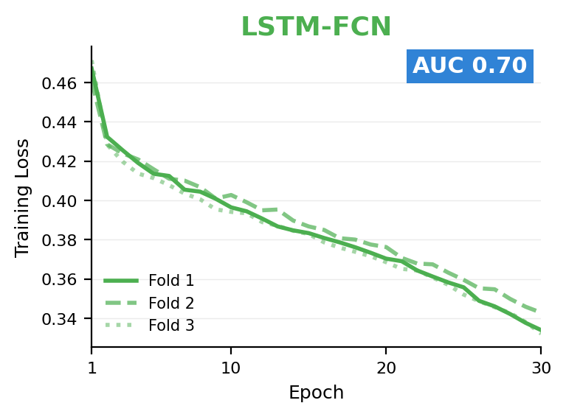
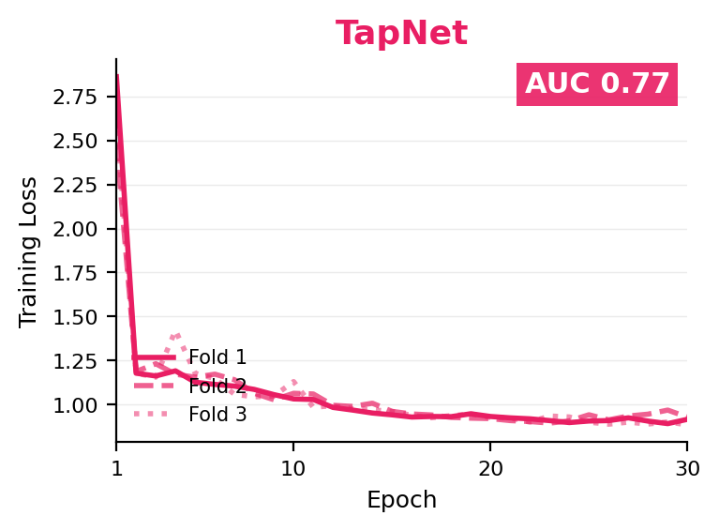
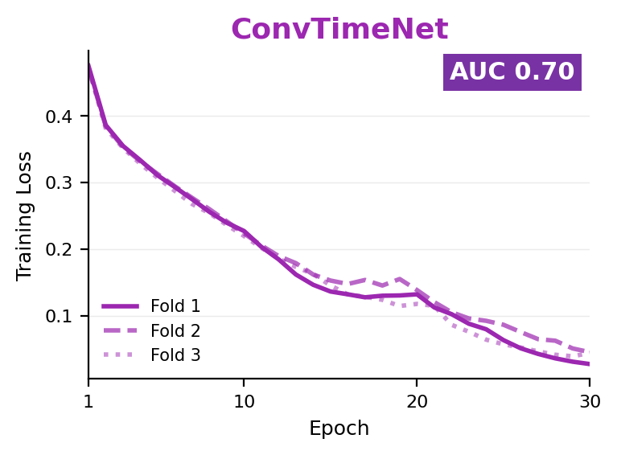
Training Loss per Epoch : All Five Models
TST not shown as fastai suppressed per-epoch logging with no_bar() and no_logging().
Notes:
[30 seconds]
Before the results, the training loss curves are worth a moment — because they reveal the difference between learning and memorising.
The most striking comparison is ConvTimeNet versus TapNet. ConvTimeNet's loss collapses to near zero by epoch 25 — best training performance of any model. Test AUC is only 0.70. It memorised the training data. TapNet's loss oscillates throughout all 30 epochs — worst apparent convergence. Test AUC is 0.77 — the best deep learning result.
These two curves make one point that carries through the entire thesis: under class imbalance, training loss is not a reliable indicator of generalisation quality. A model can converge perfectly and fail. A model can oscillate and succeed. The only meaningful measure is AUC on held-out test data.

Slide 22
A1 | Why AUC? Metric Justification
Why ROC-AUC Works
AUC is fixed, it tells you how good the model's ranking is, full stop. That never changes regardless of business context.
But FPR, FNR, precision, recall, F1 all of those shift the moment you move the threshold. If the facility decides supplier relationships matter more, they push the threshold higher so fewer machine breaks get wrongly flagged, FPR drops but FNR goes up. If catching every paper break matters more, they push the threshold lower, FNR drops but FPR goes up.
Same model. Same AUC. Completely different operational behaviour depending on what the business prioritises.
So AUC answers the research question which model is best. The threshold answers the business question how do we want to deploy it. They're two separate decisions and that's why you keep them separate.
Key insight: AUC = 0.86 means the model ranks a randomly chosen paper-caused event higher than a randomly chosen machine-caused event 86% of the time regardless of threshold.
AUC Formula: AUC = P(score(paper event) > score(machine event)) for randomly drawn events from each class

Slide 23
A2 | Class Imbalance: Full Handling Strategy
1. Loss Weighting
• TapNet: class weight = 5.25x on paper events
• TST: inverse frequency weights from fold
• CNN, InceptionTime, ConvTimeNet, LSTM-FCN: sktime does not expose loss — handled via threshold only
• XGBoost: scale_pos_weight = #machine / #paper †5.25
• Effect: minority gradient contribution matches majority
2. Threshold Calibration
• Default threshold 0.5 inappropriate under imbalance
• Grid search: 91 thresholds from 0.05 to 0.95
• Criterion: maximize paper F1 on validation set
• Applied to test set without refitting
• Observed range: 0.08 (CNN) to 0.67 (TapNet fold 3)
• XGBoost thresholds stayed above 0.50 — natural separation
3. Why Not SMOTE?
• SMOTE interpolates between minority samples
• Synthetic time series = physically unrealisable trajectories
• No meaningful middle-ground between machine and paper break signatures
• Risk of leaking test class distribution into training
• Decision: address imbalance through loss + threshold only

Slide 24
A4 | Full Model Hyperparameters
All models share: 30 epochs, batch size 64, 3-fold stratified CV, StandardScaler preprocessing, early stopping on validation AUC.
Deep Learning Models
CNN-FCN (sktime FCNClassifier defaults)
Conv blocks: 128/256/128 filters, kernels 8/5/3, BatchNorm+ReLU, GAP, Softmax
Loss: unweighted cross-entropy | Optimizer: Adam
InceptionTime (sktime InceptionTimeClassifier)
Single network (not ensemble), 6 Inception modules, kernel sizes 10/20/40, bottleneck k=1, residual every 3rd
Loss: unweighted cross-entropy | Optimizer: Adam
ConvTimeNet (sktime ConvTimeNetClassifier)
Patch size=16, stride=8, d_model=64, d_ff=128, depthwise kernel=3, GELU activation
LSTM-FCN (sktime LSTMFCNClassifier defaults)
LSTM units=8, dropout=0.8. Squeeze-excitation and dim-shuffle omitted (sktime simplification)
TST (tsai library)
d_model=64, n_heads=4, n_layers=3, dropout=0.2, d_k=16, d_ff=256
Loss: weighted CE (pos_weight=5.25) | One-cycle LR=1e-3, wd=1e-2 | fastai optimizer
TapNet (sktime TapNetClassifier defaults)
RDP groups=3 (dim=6), LSTM=128 units, dropout=0.8, CNN filters=256/256/128 k=8
FC layers: 500 then 300 (embedding space). Loss: weighted CE (pos_weight=5.25)
XGBoost + Foundation + LLM
XGBoost (xgboost native library)
n_estimators=500, max_depth=5, learning_rate=0.05
subsample=0.8, colsample_bytree=0.8
Early stopping: 30 rounds on validation AUC
scale_pos_weight = #machine/#paper † 5.25 per fold
Feature dim: ~80-90 after one-hot encoding
Chronos-2 (chronos-forecasting library)
Backbone: T5 encoder-decoder (small variant)
Group attention: all 5 channels jointly encoded
Config 1: backbone frozen, MLP head trained only
Config 2: full backbone fine-tuned end-to-end
Eval: 30/6/6 month temporal split
GPT-4o (OpenAI API)
Input: run-length encoded defect sequences + metadata
v3: 5-shot (5 examples/class), temperature=0, batch=5
v5: 12-shot + XGBoost decision rules, batch=10
Eval: 100-event stratified holdout (89 machine, 11 paper)
No probability output — discrete labels only

Slide 25
A5 | All Models — Per-Fold AUC Breakdown
Stability = low std. All folds stratified (84/16 split). Each fold: 4,691 test events (3,941 machine + 750 paper).
Model Pipeline Fold 1 Fold 2 Fold 3 Mean AUC Std
CNN-FCN Deep Learning 0.68 0.67 0.68 0.68 ±0.0052
TST Deep Learning 0.67 0.69 0.67 0.67 ±0.0089
ConvTimeNet Deep Learning 0.68 0.70 0.71 0.70 ±0.0131
LSTM-FCN Deep Learning 0.71 0.70 0.70 0.70 ±0.0033
InceptionTime Deep Learning 0.73 0.74 0.71 0.73 ±0.0138
TapNet Deep Learning 0.76 0.77 0.77 0.77 ±0.0019
XGBoost TS-only Feature Eng. (ablation) 0.79 0.79 0.79 0.79 ±0.0026
TapNet + metadata Deep Learning + meta 0.82 0.80 0.81 0.81 ±0.0072
XGBoost full Feature Eng. 0.86 0.86 0.86 0.86 ±0.0009
Not in table — different evaluation protocols:
Chronos (foundation model): Test AUC = 0.66 — evaluated on 30/6/6 month temporal split, not 3-fold CV. Single-camera (300,5) input only.
GPT-4o (LLM): No AUC reported — discrete labels only (no calibrated probability). Evaluated on 100-event stratified holdout. v3 paper F1=0.22, v5 paper F1=0.12.
ConvTimeNet: AUC reported only — sktime implementation does not expose internal probability outputs needed for per-threshold metrics.

Slide 26
A6 | Confusion Matrices at F1-Optimised Threshold (Fold 1)
Each fold: 3,941 machine-caused + 750 paper-caused test events. Threshold selected per fold on validation set.
CNN (thr=0.27)
InceptionTime (thr=0.12)
LSTM-FCN (thr=0.25)
TST (thr=0.40)
True Machine
2,588
False Paper
1,353
True Machine
3,498
False Paper
443
True Machine
3,111
False Paper
830
True Machine
3,223
False Paper
718
False Machine
286
True Paper
464
False Machine
430
True Paper
320
False Machine
387
True Paper
363
False Machine
428
True Paper
322
FPR=0.34 Paper F1=0.36 AUC=0.68
FPR=0.11 Paper F1=0.42 AUC=0.73
FPR=0.21 Paper F1=0.37 AUC=0.71
FPR=0.18 Paper F1=0.36 AUC=0.67
TapNet (thr=0.58)
TapNet+meta (thr=0.55)
XGBoost TS-only (thr=0.59)
XGBoost full (thr=0.61)
True Machine
3,181
False Paper
760
True Machine
3,334
False Paper
607
True Machine
3,280
False Paper
661
True Machine
3,557
False Paper
384
False Machine
321
True Paper
429
False Machine
297
True Paper
453
False Machine
316
True Paper
434
False Machine
301
True Paper
449
FPR=0.19 Paper F1=0.44 AUC=0.76
FPR=0.15 Paper F1=0.50 AUC=0.82
FPR=0.17 Paper F1=0.47 AUC=0.79
FPR=0.10 Paper F1=0.57 AUC=0.86
Reading the matrix: Columns = predicted class | Rows = actual class | Diagonal = correct predictions | Off-diagonal = errors
FPR (False Positive Rate) = machine events incorrectly flagged as paper = spurious supplier complaints. Most critical operational metric.
Paper F1 = harmonic mean of paper precision & paper recall at the given threshold. Selected to maximise F1 on validation fold.

Slide 27
A7 | Full Feature Engineering Reference - 68 Numerical Features
All features derived from same (300,10) preprocessed time series. After one-hot encoding: 80-90 total features per fold.
Statistical Features (30 total = 15 per camera)
Per camera, per defect channel (5 channels x 3 stats = 15):
Mean across 300 timesteps — average defect state during pre-break window
Std deviation across 300 timesteps — trajectory variability
Maximum value — peak intensity of each defect category
Channels: no_defect, defect, rollenwechsel, Kantenfehler, tear
Temporal Features (10 total = 5 per camera)
Linear slope of tear score over 300 frames
Linear slope of no_defect score over 300 frames
Mean tear score — last 50 timesteps
Mean tear score — first 50 timesteps
Difference: late50_mean – early50_mean (key discriminator)
Rationale: machine breaks show early tear buildup; paper breaks concentrate in last 50 frames
Uncertainty & Variability Features (18 total = 9 per camera)
Mean Shannon entropy of 5-category score distribution (300 timesteps)
Std deviation of per-timestep Shannon entropy
Variance of each 5 defect score channels (5 features)
Mean absolute difference between consecutive tear scores
Peak sharpness: max_tear – mean_tear_last50
Rationale: sudden paper breaks have higher tear sharpness and entropy spike near peak
Cross-Camera + Auxiliary + Metadata (10 + continuous)
Cross-camera: cam1_mean_tear – cam2_mean_tear
Cross-camera: cam1_max_tear – cam2_max_tear
Auxiliary: padding_fraction_cam1, padding_fraction_cam2, cam2_present flag
Metadata numeric (5): speed, grammage_weight, web_width, pap_len, detector
Metadata categorical (3 one-hot): printer, paper_grade, paper_supplier
Categorical encoding fitted on training fold only. Unseen test categories → ignored.

Slide 28
A8 | XGBoost Decision Tree : How One Tree Decides
Tree 0 from fold 1 ensemble (~250 trees). Split thresholds in standardised units (StandardScaler). Green leaf = paper score, Red = machine score.
cam1_max_tear < 0.579
YES (low tear peak)
Root Split (Most Important Feature)
NO (high tear peak)
cam2_mean_rollen < -0.658
cam1_early_tear_mean < -0.323
pap_len < -0.136
grammage_wt < -0.207
Machine -0.094
Paper +0.057
Paper +0.067
Machine -0.085
Machine -0.097
Paper +0.084
Machine -0.049
How to Read This Tree:
Root: cam1_max_tear (maximum tear score from camera 1 across 300 frames) is the single most discriminative feature. This mirrors the feature importance chart.
Left branch (low tear peak): XGBoost interrogates camera 2 roll-change signal and early-window tear mean — searching for indirect evidence of machine vs paper origin when the tear peak itself is ambiguous.
Right branch (high tear peak): XGBoost immediately examines paper length (pap_len) and grammage weight — metadata refinements that distinguish paper-caused tears from machine-induced ones once a prominent tear is confirmed.
Leaf scores: Each leaf contributes a small positive (toward paper) or negative (toward machine) score. Final probability = sigmoid of sum across all ~250 trees.
Key insight: Camera features dominate upper tree levels; metadata appears at depth 2+ as secondary refinements. Exactly mirrors the joint importance finding.

Slide 29
A10 | Why Early Fusion Fails : Architectural Mechanism
Same 8 metadata fields. XGBoost gains +0.07 AUC. TapNet gains +0.04 AUC. Why 1.6x difference?
XGBoost: How Metadata Is Used
Step 1: Metadata stored as pre-computed tabular features (speed, grammage, printer ID, etc.)
Step 2: XGBoost performs direct categorical splits
IF paper_grade = “XLNT Light” THEN score +0.05
IF speed < -1.1 (std) THEN score -0.09
Step 3: Split tested in O(n) time with minimal parameters
Required learning: Zero additional gradient steps. Categorical splits are exact and deterministic.
Why it works: paper_grade encodes tensile properties of the paper. printer encodes machine-specific break rate priors. These are direct causal factors — the model can use them immediately.
TapNet: Early Fusion (What Actually Happens)
Step 1: 8 metadata fields repeated across all 300 timesteps, concatenated to (300, 10) → (300, 18)
Step 2: LSTM processes 300-step sequence of 18-dim vectors. Metadata is constant across time — identical value at every timestep.
Step 3: LSTM forget gate progressively attenuates early timestep signals over 300 steps. Constant metadata channels may be suppressed as non-temporal.
Step 4: Self-attention must learn which of 18 channels matter for which time pairs — a far larger hypothesis space than before.
Required learning: Gradient descent over 300 timesteps from 7,505 training events. Model must discover metadata relevance implicitly.
Why it’s less efficient: Constant channels across time violate the temporal assumption of LSTM/attention. No inherent mechanism to treat metadata as event-level context rather than time-varying signal.
Core Insight:
The gap is not about information content — both models receive identical metadata. It is about the integration mechanism.
Gradient boosted trees exploit structured categorical context natively through direct splits. Deep learning models must learn this through gradient descent a substantially less data-efficient process, especially under 5.25:1 class imbalance.
Solution: If deep learning is required (e.g. for scalability), a metadata-native architecture (cross-attention between metadata tokens and time series embeddings) would be more effective than raw channel concatenation.

Slide 30
A11 | LLM Failure — Why Providing Rules Made It Worse
v5 gave GPT-4o the exact XGBoost thresholds. Paper recall dropped from 45% to 18%. Paper F1 dropped from 0.22 to 0.12. This is the diagnostic slide.
Configuration v3 (Baseline)
5 examples per class, standard few-shot prompting
System prompt: classify as machine or paper based on encoded sequence + metadata
Result: Machine recall 66%, Paper recall 46%, Paper F1 0.22, Accuracy 64%
89 machine events: 59 correct, 30 wrong (FPR 0.34)
11 paper events: 5 correct, 6 missed
Configuration v5 (Domain-Enriched, Should Be Better)
12 examples per class + XGBoost decision boundaries in prompt
System prompt included exact thresholds: cam1_max_tear > 0.579, slope_no_defect < -0.003...
Result: Machine recall 78%, Paper recall 18%, Paper F1 0.12, Accuracy 71%
89 machine events: 69 correct, 20 wrong
11 paper events: 2 correct, 9 missed — WORSE than v3
What the Result Proves:
The bottleneck is NOT encoding. v5 gave GPT-4o the exact numerical decision rules. It still got worse. If encoding loss were the problem, providing the pre-computed thresholds would have fixed it.
The bottleneck IS architectural. GPT-4o processes the domain rules as linguistic patterns, not executable conditionals. More rules → stronger majority-class prior reinforcement less paper detection.
Failure 1: Majority Prior
LLM trained on text reflects natural language priors. More examples of machine-caused descriptions → stronger association with that label.
Adding quantitative rules reinforces majority-class language patterns rather than enabling threshold logic.
Failure 2: No Numerical Computation
GPT-4o represents numbers as token sequences, not floats. Comparing “0.579” to “0.723” requires token-level reasoning, not floating point comparison.
The model cannot reliably determine if a serialised number is above or below a threshold.
Failure 3: Encoding Loss
Run-length encoding discards all continuous probability information. “no_defect x180” loses the distinction between score=0.51 and score=0.99.
However v5 showed this is SECONDARY — even with exact rules, performance worsened.

Slide 31
A12 | Cross-Validation Justification : Why Stratified K-Fold, Not Temporal
Two options were considered. The choice reflects the nature of the classification task, not a convenience decision.
Option A: Temporal Train/Test Split
Train on early months → Test on recent months
Why we rejected it:
1. Distributional drift over 3.5 years: Press configurations changed. Paper suppliers changed. Camera calibration evolved. A temporal test would conflate temporal adaptation with classification generalisation.
2. Class imbalance instability: Paper-caused break rate varies across time periods. A temporal split may produce radically different class distributions in train vs test, making AUC comparisons unreliable.
3. Task nature: We are classifying individual break events, not forecasting future events. Each event is self-contained (300-frame window + metadata). Temporal ordering of events carries no information relevant to cause classification.
Option B: Stratified 3-Fold CV (Chosen)
Events randomly split into 3 folds preserving 84/16 ratio
Why it’s appropriate:
1. Each fold has same class distribution: Ensures the 750 paper-caused test events are equally represented in all three folds. Std deviation directly measures result stability.
2. Three independent test sets: Mean AUC is more reliable than a single temporal holdout. Standard deviation across folds is a genuine stability estimate.
3. Task-appropriate: The classification question is “given this break event, what caused it?” — not “predict future break causes.” Temporal ordering of the event file is irrelevant to the label.
4. Industry standard: Stratified K-fold is the standard evaluation protocol for event-level classification in the TSC literature (UCR/UEA benchmarks).
Exception: Chronos uses temporal split (30/6/6 months)
Chronos was pre-trained on time series data assembled in chronological order. Using stratified K-fold would evaluate it on events that pre-date its training window — a form of temporal leakage specific to pre-trained models with time-ordered pre-training data.
Consequence: Chronos AUC (0.66) is not directly comparable to other models’ 3-fold CV AUC. This is why it is labelled separately throughout the thesis and summary table.

Slide 32
A13 | Chronos Failure : Pre-training Objective Mismatch
Chronos AUC = 0.66. Fine-tuning produced identical result. This is not a data size problem — it is a pre-training objective mismatch.
What Chronos Was Pre-trained On:
28 real-world datasets + 1M synthetic series (KernelSynth)
Objective: autoregressive next-token prediction
Given t=1...n, predict t=n+1
Learned priors: local continuity, smoothness, periodicity, short-range predictability
Tokenisation: continuous values → discrete bins (like word tokens)
What Web Break Classification Requires:
Global trajectory classification over 300 frames
Objective: label the entire sequence (machine vs paper)
Discriminative signal: slope of no_defect over FULL 300 frames; timing of tear onset relative to sequence start
Required: long-range global structure, NOT local continuity
These two properties are ORTHOGONAL to forecasting quality
The Mismatch (Concrete Example):
A gradual machine-caused break and a paper-caused break with stable early frames are BOTH locally smooth and locally predictable.
They have similar forecasting quality but opposite class labels. Chronos’s learned representations distinguish them by short-range predictability, exactly the wrong axis for this task.
Why Fine-tuning Didn’t Help:
Validation AUC: Frozen=0.68, Fine-tuned=0.71 (fine-tuned looks better on validation)
Test AUC: Frozen=0.66, Fine-tuned=0.66 (identical on test)
Interpretation: Fine-tuning learned the statistics of the 6-month validation period, not generalisable classification features. The 0.05 val-to-test gap indicates overfitting to the temporal distribution of the validation split.
The very low threshold required by fine-tuned model (0.06 vs 0.16) shows probability scores compressed toward zero — calibrated to validation, not test.
Conclusion: 8,563 training events is insufficient to overcome the forecasting pre-training prior. More data (or classification-specific pre-training) would be needed.

Slide 33
A14 | Dataset Quality : Labelling, Missingness, Scope
14,073 events from one Bertelsmann facility, July 2021 – December 2024. Three quality dimensions to understand.
Label Quality
Source: Domain experts at Bertelsmann facility reviewed each break event and assigned cause label post-hoc
Strength: Reflects actual operational diagnosis process. Same information operators use.
Limitation: Label noise exists — ambiguous breaks where cause is unclear may be mislabelled. Industry reports suggest 20-50% of breaks have no clearly recordable cause. These were INCLUDED in training (labelled as machine-caused by default).
Impact: Label noise imposes a ceiling on achievable AUC that cannot be quantified without a gold-standard label. AUC 0.86 may represent the practical ceiling given annotation quality.
Metadata Missingness
Always present (100%): printer, web_width, detector
High coverage (>98%): speed, grammage_weight
Moderate (>94%): paper_supplier, grade, pap_len
Lower (~89-91%): roll_number, order_number, ml_sentence
Handling: Missing numeric fields imputed with training fold median. Missing categoricals encoded as “unknown” category.
Risk: If missingness correlates with class (e.g. paper-caused breaks more likely to have missing grammage), imputation may introduce bias. Not quantified in this study.
Scope & Generalisation
Single facility: All 14,073 events from one Bertelsmann plant in Germany.
Risk: XGBoost features like printer identity and paper_supplier encode facility-specific priors. A model trained here may not transfer to a facility with different printers or different supplier relationships.
Mitigant: Time-series-derived features (slopes, peaks, timing) encode physical break signatures that should generalise across facilities.
External validity: Camera system (Azure Custom Vision) is facility-specific. Different camera hardware or defect scoring models would produce different probability distributions.
Deployment Prerequisites (from thesis Section 6.9.3):
1. Prospective validation on post-Dec 2024 events | 2. Threshold calibration on live data | 3. Shadow mode operation for 1+ month | 4. Scheduled retraining pipeline with minimum AUC gating

Slide 34
A15 | Failure Cases: Where XGBoost Gets It Wrong
Mean FPR=0.12 (384 machine events mislabelled/fold). Mean FNR=0.37 (301 paper events missed/fold). Understanding error patterns is critical for deployment trust.
Error Type 1: False Positives (FPR 0.12)
Machine event → incorrectly labelled Paper-caused
Consequence: Spurious supplier complaint. Commercial impact.
Likely causes of error:
• Machine break with atypically sharp late tear spike (mimics paper signature)
• Paper grade / supplier with high paper-caused prior — metadata overrides time-series signal
• Single-camera event where cross-camera corroboration unavailable
• Edge defect (Kantenfehler) present — feature cam2_kantenfehler_max ranks in top 30
Error Type 2: False Negatives (FNR 0.37)
Paper event → incorrectly labelled Machine-caused
Consequence: Missed defect. Defective material may recur.
Likely causes of error:
• Paper-caused break with gradual buildup — lap joint that slowly deteriorates (looks machine-like)
• Paper grade with no prior history of paper-caused breaks — XGBoost assigns low paper prior
• Low cam1_max_tear (weak tear signal) — model relies on metadata favouring machine
Mitigation: Confidence-Based Routing
Events near p=0.5 go to human review rather than auto-label. Estimated 10-15% of events fall in uncertain zone (p between 0.35 and 0.65).
Operator presented with: probability score, defect trajectory, top contributing features. This handles precisely the hard cases above.
Hard Case: Splice Failures
Splice failures look like sudden paper tears but occur at roll transition. Camera signal ambiguous. Operator notes are only reliable discriminator.
Hard Case: Interaction Failures
Break caused by BOTH machine tension AND marginal paper quality. Label assigns one cause but reality is dual-causal. XGBoost sees ambiguous feature signal.
Hard Case: Unseen Supplier
New paper supplier not in training data. One-hot encoder outputs zero vector. Model falls back to time-series features only — performance degrades for this supplier until retrained.

