Slide 1
Optimizing crop production
321008_vaishnavi Bhavsar
321023_Deepika Gujar
3210 _Atharwa Borawke

Slide 2
Group members :
name | Gr number | Roll number
Vaishnavi Bhavsar | 21910446 | 321008
Deepika gujar | 21911076 | 321023
Atharva Borawke | 21911120 | 321011

Slide 3
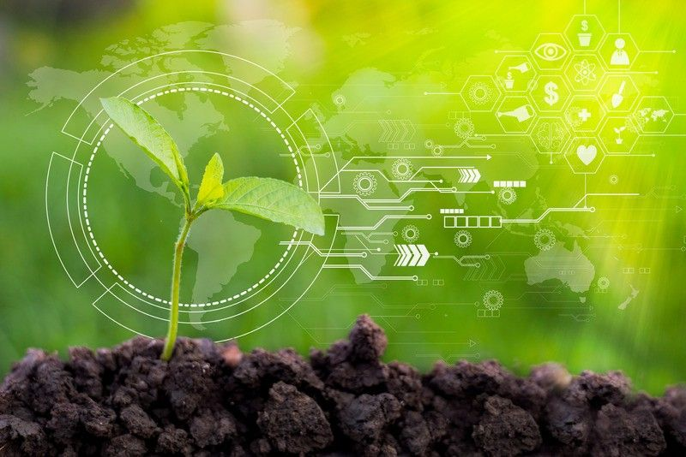
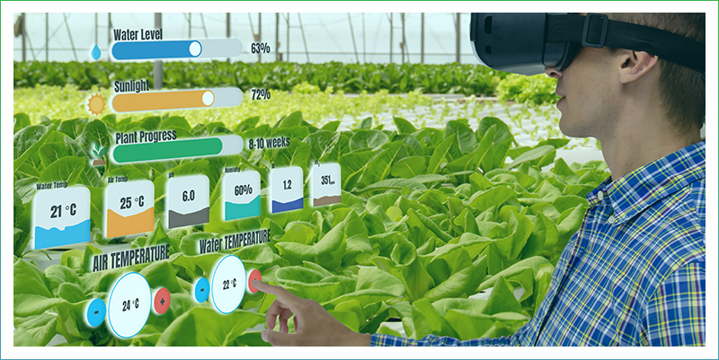
Introduction:
Agriculture is the leading hold up and the paramount territory of the Indian wealth.
This project is intended for Precision Farming.
We have to optimize productivity
By understanding requirements of climatic and soil conditions for crops.
Helps us to cope up with weather Unpredictability.

Slide 4
Experimental setup
Dataset: crop recommendation data
source: Kaggle
Attributes:- nitrogen, phosphorus, potassium, Temperature, Humidity, PH, Rainfall, label.
Total attributes: - 8
Sample 2200

Slide 5
project flow
Data
Dataset Introduction
Attributes and Types
Importing Libraries and Data (pandas, NumPy, seaborn, ipywidgets, sklearn, DecisionTreeClassifer)
Data Cleaning
Data Analysis and Labeling
Value counting
Statistic
Average (mean)
Min & max threshold
Comparing values requirement
Finding Some interesting patterns in dataset
Comparing the crops which require above and below-average conditions
Clustering analysis
Elbow method
Models
Logistic Regression Model
Checking accuracy
Report for accuracy
Decision Tree Model
Checking accuracy
Report for accuracy
Result
Comparing results
Conclusion
Research Papers
References

Slide 6
model building process:- upload dataset
Libraries imported
Loading dataset split data in training and testing(80:20) create an object of the model predicting data evaluate model

Slide 7

models
Logistic regression model
Design tree model
accuracy 0.97
macro avg 0.97
weighted avg 0.97
accuracy 0.99
macro avg 0.99
weighted avg 0.99

Slide 8
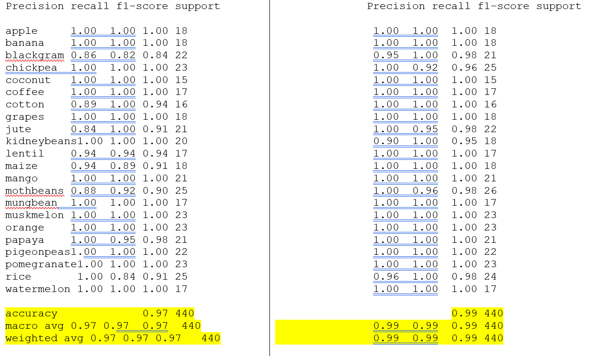
results
Logistic regression accuracy result Decision tree accuracy result

Slide 9
Advantages from optimizing crop production
This will help farmers to earn more profit
It gives the knowledge and idea about the soil fertility
This model could predict the crops which we can get on a particular farm just by knowing the attributes or parameters in the dataset
This model could predict crops season wize or according to climatic conditions
It makes prediction very easy and saves the effort of farmer in other direction

Slide 10
Conclusion
This will help them in improving their crop production both qualitatively and quantitatively
This will also help them to maintain the quality and nutritional contents of the soil.
The system is to plan and grow a recommendation model to create the recommendations for crops relied on geological and climatic attributes using machine learning procedures

Slide 11
Future scope
As concerning future scores when the farmers sow a particular crop, there might face some issues or diseases in the crop before harvesting. In that case, they can upload photographs of the crop and the soil report. Then the AI model can identify the problems and provide them with probable solutions
We can also provide IOT solutions through APIs or virtual agents which can help the farmers connect with raw material dealers, who can provide them with the materials required for instance seeds and fertilizers according to the crop recommended to them by the model

Slide 12
Thank you

