Slide 1
WELCOME…..

Slide 2

PROJECT TITLE - HOME AUTOMATION SYSTEM
SUBMITTED BY - VAISHNAVI PRAKASH KORGAONKAR
SUBMITTED TO - EMERTXE INFORMATION & TECHNOLOGY
GITHUB - https://github.com/vaishnavi6607/IoT_Internship

Slide 3
OUTLINE
INTRODUCTION
REQUIREMENTS
LANGUAGE
INTERNET OF THINGS
ARDUINO UNO
PROJECT OVERVIEW
CONCLUSION
PROJECT DEMO

Slide 4


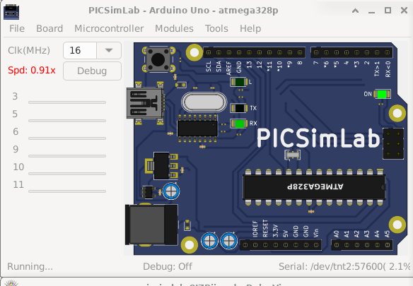
REQUIREMENTS
1) Arduino IDE
3)Blynk Cloud
2) PICSim Lab

Slide 5

LANGUAGE - C & C++
Topics learnt in C & C++
Data Types in C & C++
Conditional loops & operators
Array
Pointer and Function
Recursion
Pillars of OOP

Slide 6
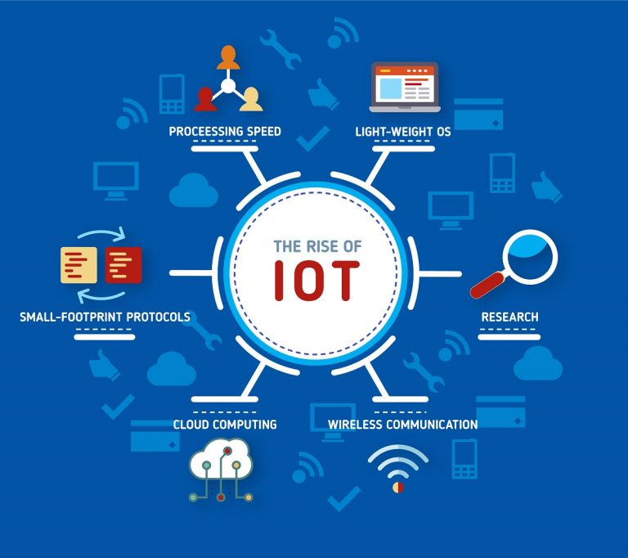
INTERNET OF THINGS (IOT)
IoT is network of interconnected computing devices which are embedded in everyday objects, enabling them to send and receive data.
APPLICATIONS OF IOT –
Smart Agriculture
Smart Vehicles
Smart Home
Smart Pollution Control
Smart Healthcare

Slide 7


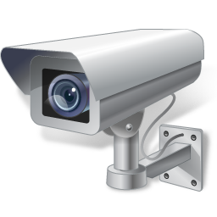
EMBEDDED SYSTEM
Any combination of hardware and software which is intended to do specific task can be called as an Embedded System.
Categories of Embedded System
Stand-alone
Real Time
Networked
Mobile

Slide 8
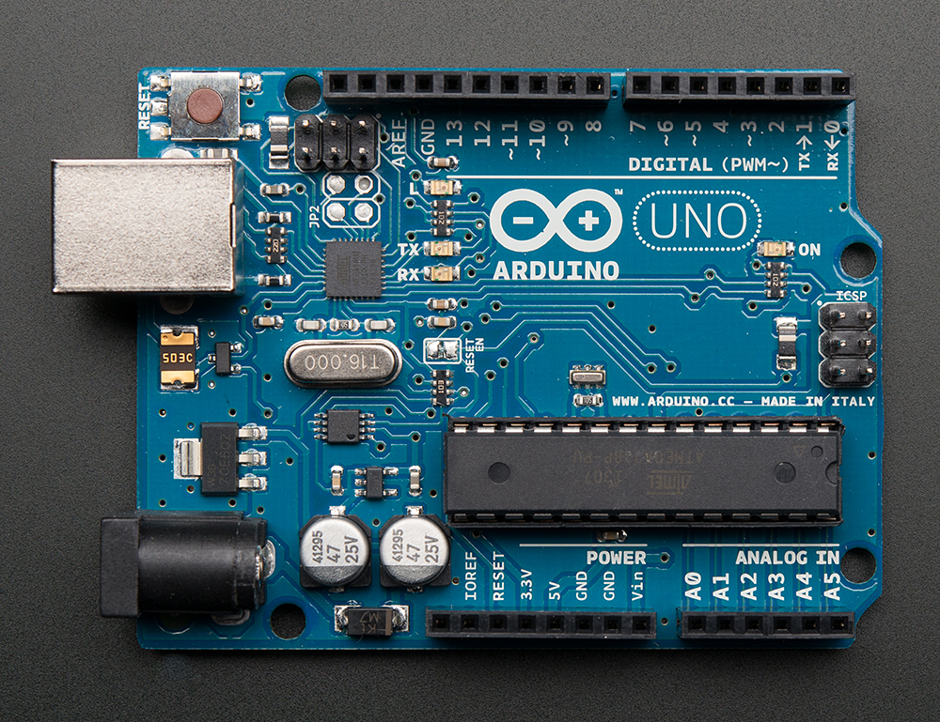
ARDUINO UNO
Digital pins
Analog pins
Power pins
ADC
Oscillator
PWM pins

Slide 9
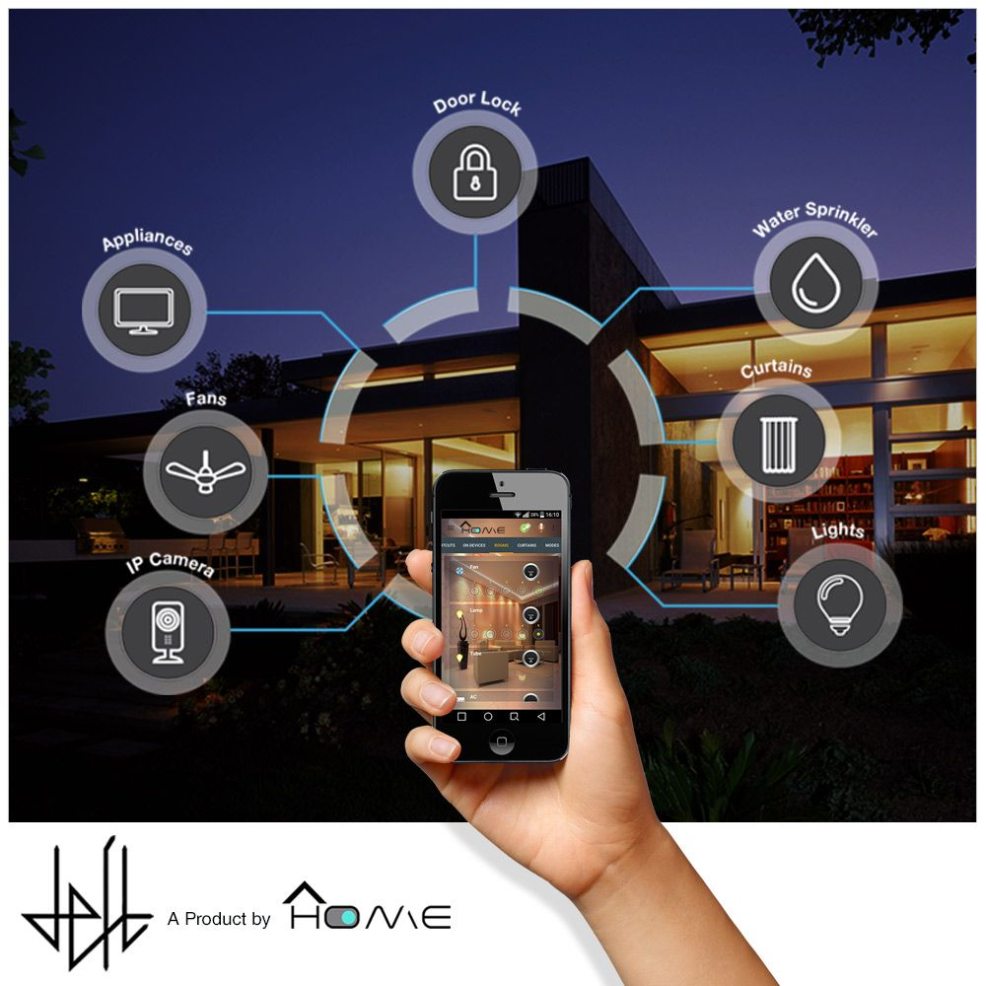
PROJECT OVERVIEW
TITLE - Home Automation
AIM - To understand the requirements of “Home Automation using Arduino (picsim lab ) and Blynk application” and to implement it.

Slide 10
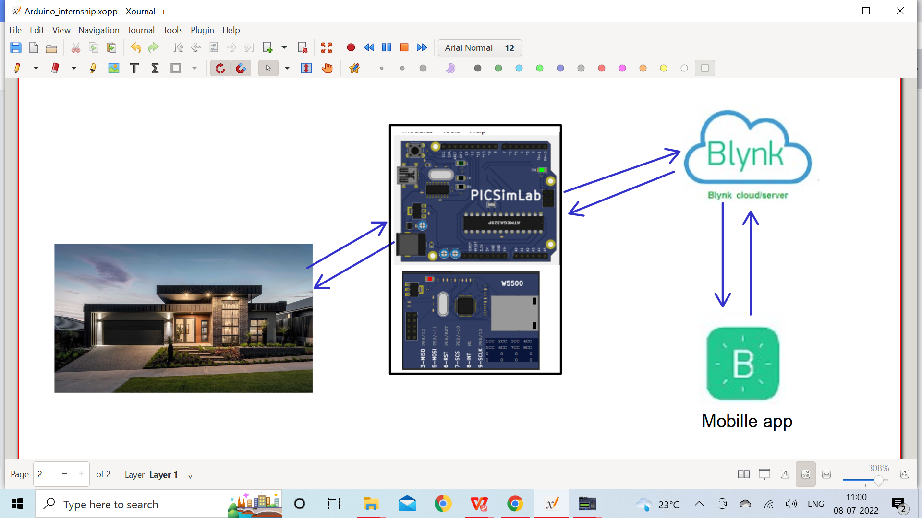
WHY HOME AUTOMATION ?
Energy savings
Convenience
Improved Comfort
Increased efficiency
Increased accessibility

Slide 11
PROJECT REQUIREMENTS
REQUIREMENTS
FUNCTIONAL REQUIREMENTS
1)Garden light control
2)Temperature control system
3)Water tank inlet & outlet valve control
USER INTERFACE
BLYNK Application

Slide 12
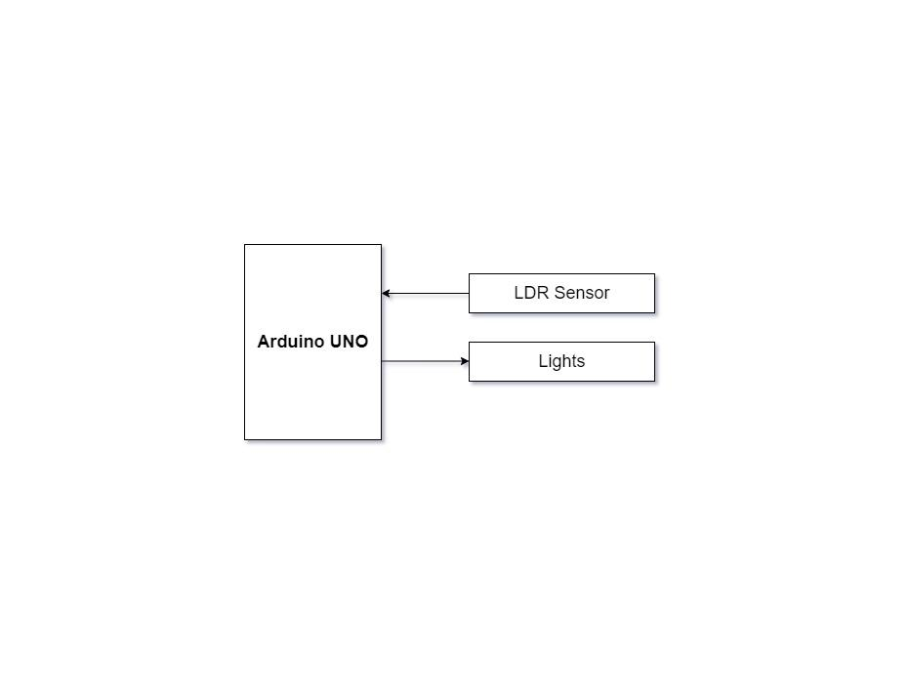
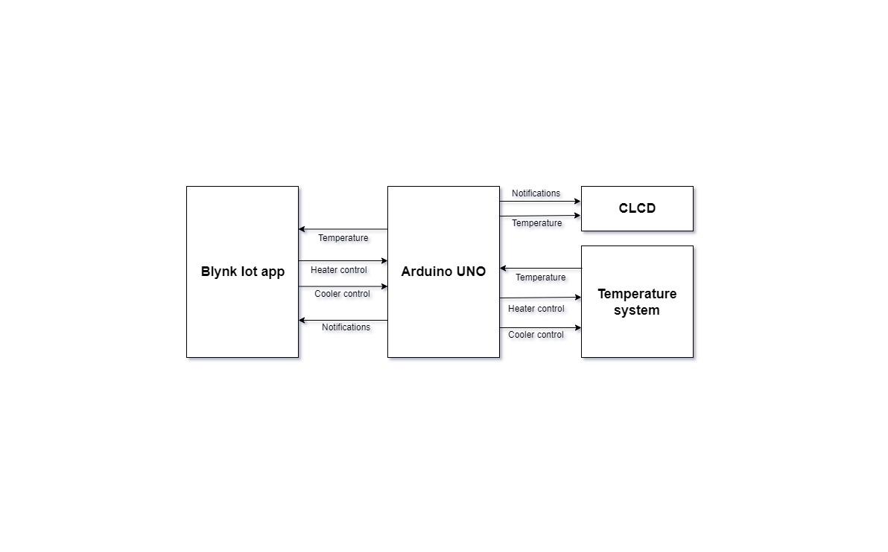
FUNCTIONAL REQUIREMENTS
GARDEN LIGHT CONTROL
TEMPERATURE CONTROL SYSTEM

Slide 13
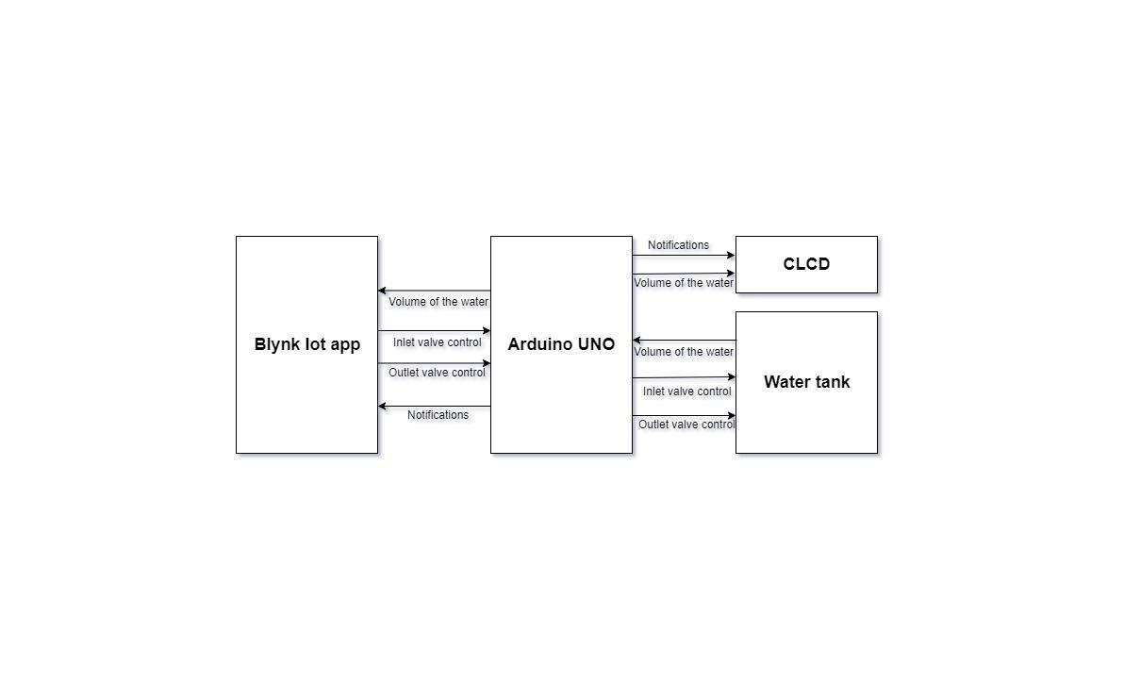
FUNCTIONAL REQUIREMENTS
WATER TANK INLET AND OUTLET CONTROL

Slide 14
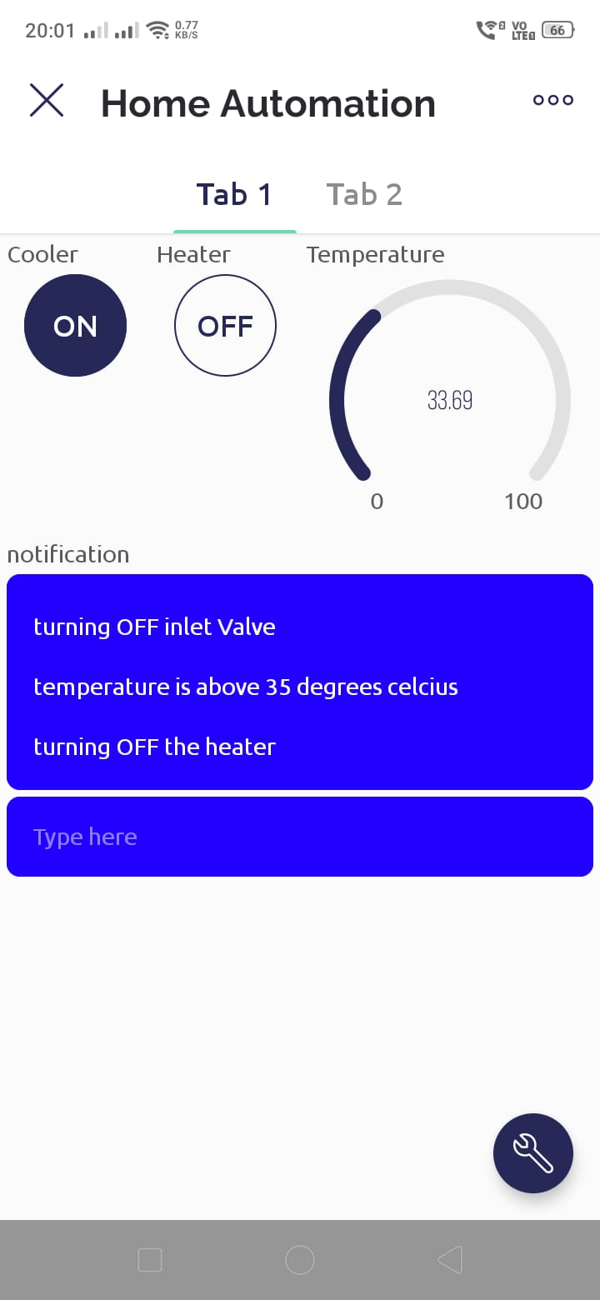
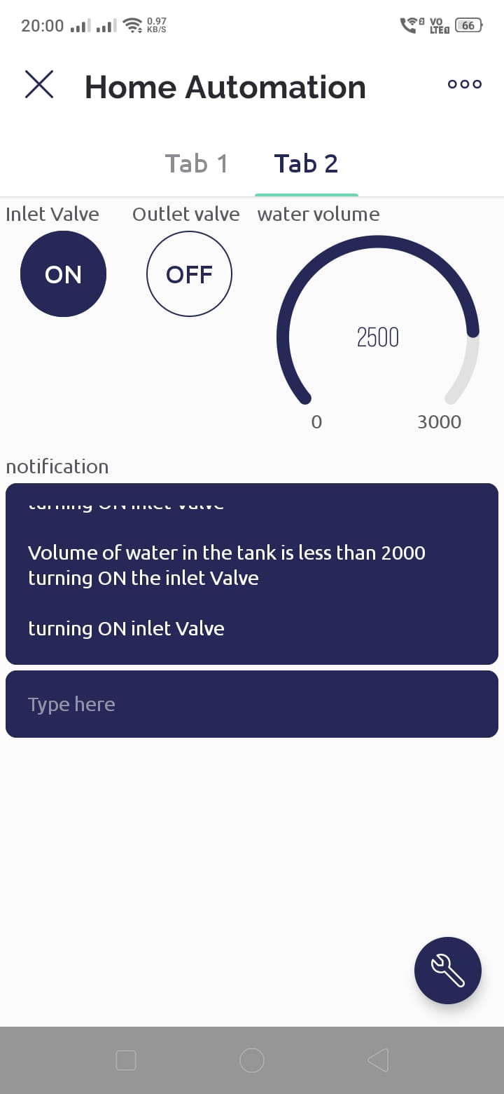
USER INTERFACES
BLYNK APPLICATION

Slide 15
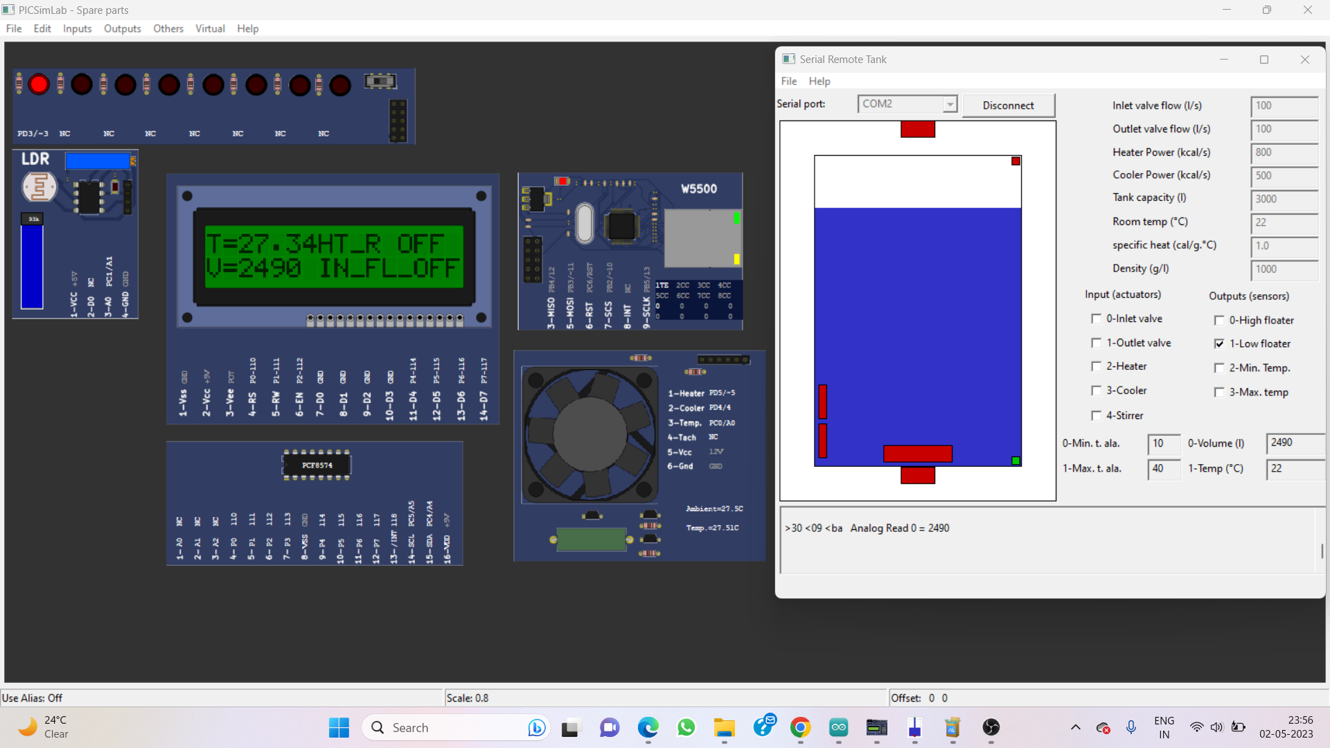
SIMULATION IMAGE

Slide 16
CONCLUSION
Using BLYNK Iot application & PICSim lab simulator, we simulated home automation system ,where LED ,temperature system and serial tank represents lights ,heater ,cooler and water tank in real life.
CLCD acts like a dashboard used for displaying the events and status of devices
Widgets from BLYNK app act likes button to control those devices.
Gauge widgets represents the varying readings of temperature and water
Thus, the project provides solution for Home Automation using IoT.

Slide 17
PROJECT DEMO

Slide 18
THANK YOU !!

