Slide 1

BOOK MY CAMPUS
Venue Booking System
-DevDynamos
COEP Technological University
A Unitary Public University of Govt. of Maharashtra
Formerly College of Engineering Pune

Slide 2
Drawbacks of current system
Clash of Events of different clubs
Miscommunication between clubs/events organisers or faculties.
Faculties may not be available.
Cancellation and Re-Scheduling
Hectic Process
lash of Events of different clubs.
COEP Technological University
A Unitary Public University of Govt. of Maharashtra
Formerly College of Engineering Pune

Slide 3
OBJECTIVES OF BOOK MY CAMPUS
Efficient Venue Management
User-Friendly Interface
Administrator Control
Real-time Availability Updates
Report Generation
Permission Generation
lash of Events of different clubs.
COEP Technological University
A Unitary Public University of Govt. of Maharashtra
Formerly College of Engineering Pune

Slide 4
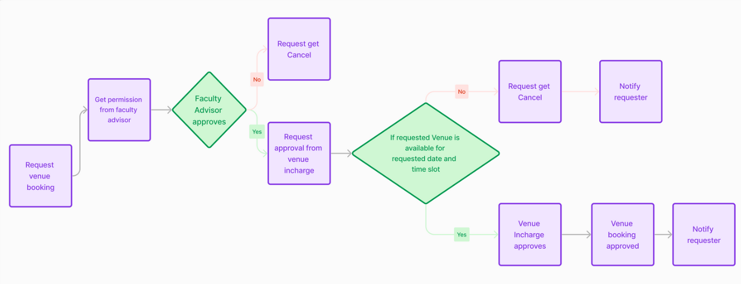
TECH STACKS
FLOW DIAGRAM
For Frontend:
Next.js
Node.js
For Backend:
Firebase
Email.js
lash of Events of different clubs.
COEP Technological University
A Unitary Public University of Govt. of Maharashtra
Formerly College of Engineering Pune

Slide 5
PROPOSED SOLUTION
Club members can request for venue permission
Visibility of each venue along with time slot through a calendar interface
Allows for easy approval & rejection of booking request for venue incharge
Easy visibility of all booked slots according to venue
Report and permission letter generation
lash of Events of different clubs.
COEP Technological University
A Unitary Public University of Govt. of Maharashtra
Formerly College of Engineering Pune

Slide 6
FUTURE SCOPE
Integration of booking system for government duties.
Digital sign on permission letter
Feedback and Rating System
lash of Events of different clubs.
COEP Technological University
A Unitary Public University of Govt. of Maharashtra
Formerly College of Engineering Pune

Slide 7
MEMBERS
Vedang Khedekar
Sandesh Sahane
Vipul Chaudhari
Shriya Kale
Vaishnavi Badgujar
Sanchit Rajmane
lash of Events of different clubs.
COEP Technological University
A Unitary Public University of Govt. of Maharashtra
Formerly College of Engineering Pune

