Slide 1
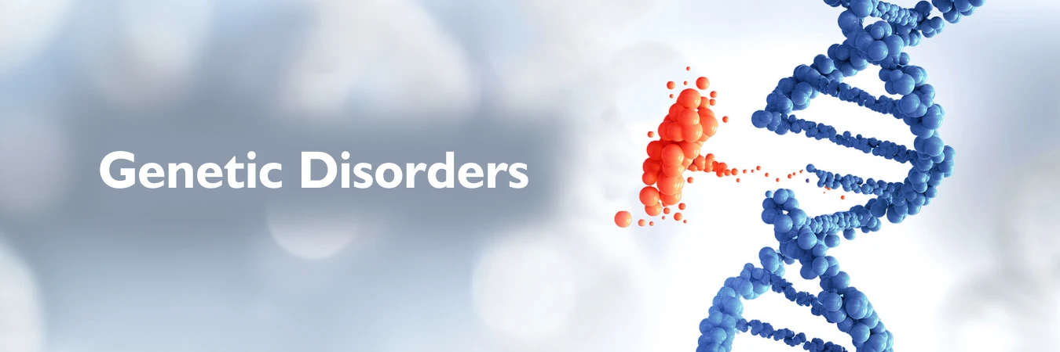
GENETIC DISORDER PREDICTION
Name: Vaishnavi Shivalingala
Class BSC-HDS III
Rno:107222546037

Slide 2
Abstract
Genetic disorders are hard to predict because of their complex genetic causes. This study used machine learning models—Decision Tree, Random Forest, Support Vector Machine, Adaboost, XGBoost, CatBoost, and Extra Trees Classifier—to improve prediction accuracy. We used VIF analysis to remove highly related features and tuned model settings for better results. The models were tested on five train-test splits: 60-40, 65-35, 70-30, 75-25, and 80-20. Feature selection helped improve accuracy, with CatBoost and Extra Trees giving the best results. This work shows how careful feature selection and tuning can lead to better predictions for genetic disorders.
Objective
This project aims to build an accurate ML model for genetic disorder classification. After exploring and cleaning the data, VIF was used to remove highly correlated features. Models like Decision Tree, Random Forest, SVM, AdaBoost, XGBoost, Extra Trees, and CatBoost were tested. All models (except CatBoost) were fine-tuned for better accuracy. Performance was compared before and after VIF across different splits. CatBoost gave the best results and was used for final predictions. This study supports early diagnosis through machine learning.

Slide 3

CONTENT
• Introduction 04
• Literature Review 05
• Data Pre-Processing 07
• Exploratory Data Analysis 10
• Data Modelling & Evaluation 19
• Summary 32
• Future Scope 33

Slide 4
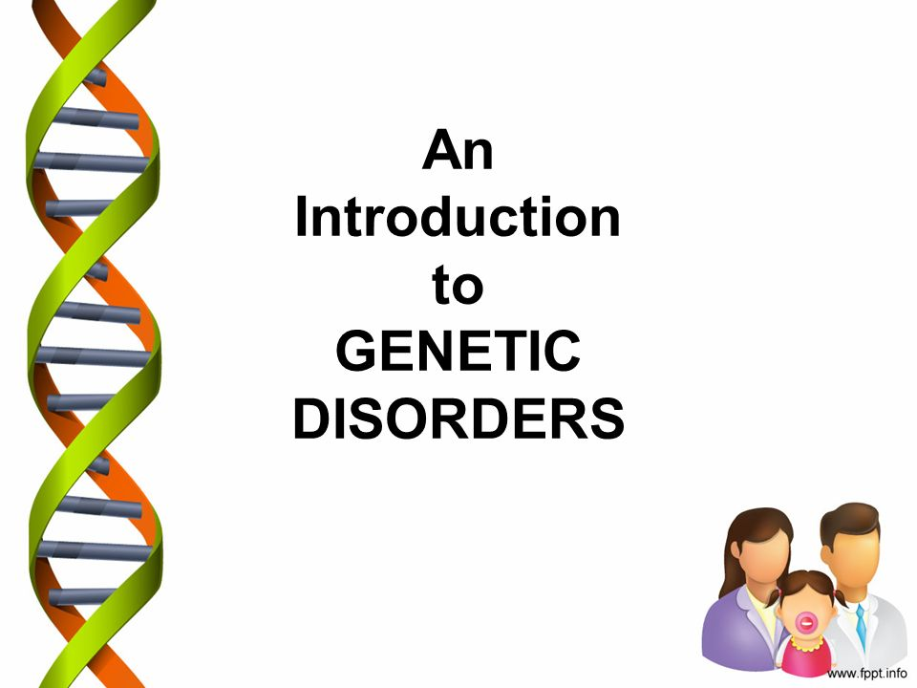
INTRODUCTION
Genetic Disorder Prediction helps find patterns in genetic data to identify people who might have certain disorders. Using machine learning, we can better understand the factors that cause these conditions and make more accurate predictions. This helps doctors diagnose earlier, give better treatment, and improve patient care. By using the right features and models, we make the predictions more reliable and useful in real life.

Slide 5
Literature Review
Paper 1:
Genetic Disorder Prediction Using K-Nearest Neighbors Algorithm
This research focuses on predicting genetic disorders using the K-Nearest Neighbors (KNN) algorithm. A web application is developed where users can input genetic and family health data to check if an offspring might inherit a genetic disorder. The project uses machine learning to analyze the data and make predictions. Streamlit, a Python tool, is used to build a simple and user-friendly interface. This system helps in early detection of genetic disorders, enabling timely precautions and treatment, which can improve patient outcomes and the accuracy of the model is 94.4%
Reference: Shreya Mahajan, Saylee Mahajan ,Genetic Disorder Prediction Using K-Nearest Neighbors Algorithm, IJFMR Volume 5, Issue 6, November-December 2023. DOI 10.36948/ijfmr.2023.v05i06.10405,

Slide 6
Paper 2:
Exon Hunter: a comprehensive approach to gene finding
We introduce Exon Hunter, a gene-finding system that integrates multiple sources of information—genomic sequences, expressed sequence tags (ESTs), and protein databases from related species—using a hidden Markov model (HMM) framework. Unlike traditional systems, Exon Hunter combines these data sources through a quadratic programming method, allowing partial probabilistic statements to handle missing or incomplete information effectively. Additionally, we propose a novel approach to model the length distribution of intergenic regions within HMMs. On standard test datasets, Exon Hunter outperformed existing systems like ROSETTA, SLAM, and TWINSCAN, with over two-thirds of genes predicted completely correctly. Accuracy got:66%
Reference: Brejová, B., Brown, D. G., Li, M., & Vinar, T. (2005). ExonHunter: a comprehensive approach to gene finding. Bioinformatics (Oxford, England), 21 Suppl 1, i57–i65.

Slide 7
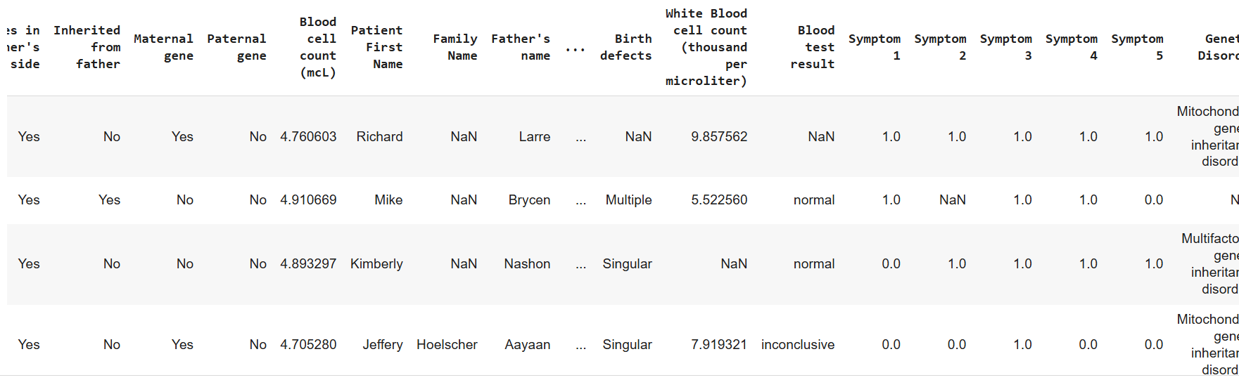
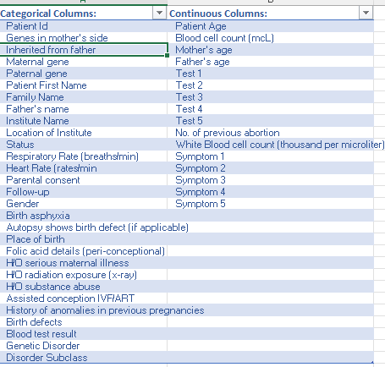
Data Pre-Processing
Data
Data Set: This dataset contains both Train and Test Data (22083 rows × 45 columns in Train data and 9463 rows × 43 columns in Test data)
Source: https://www.kaggle.com/datasets/aibuzz/predict-the-genetic-disorders-datasetof-genomes

Slide 8
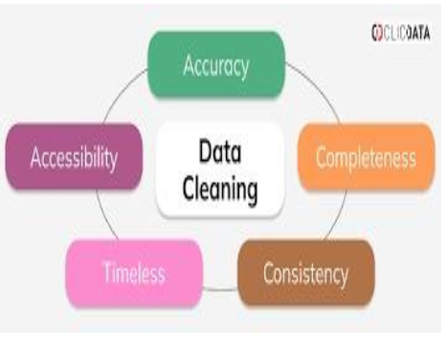
Data Cleaning
Data cleaning is a crucial step in preparing data for
machine learning, ensuring accuracy and
consistency for model training
The following columns were removed from the dataset due to their minimal impact on the target variable:
White Blood Cell Count(Thousand Per Microliter), Mother’s Age, Blood Cell Count(Mcl), Patient Age, Father’s Age, No.of previous Abortion, Symptom 1, Symptom2, Symptom 3, Symptom 4, Symptom 5, Patient Id, Patient First Name, Family Name, Father’s Name, Institute Name, Location of Institute, Parental Consent, Status
I used Label Encoding to convert categorical data into numerical values by assigning a unique integer to each category. This method was applied to all object-type columns in the dataset, enabling the data to be used in machine learning models.

Slide 9
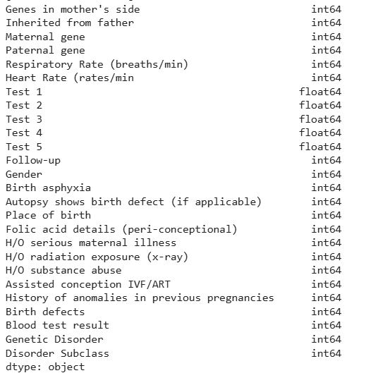
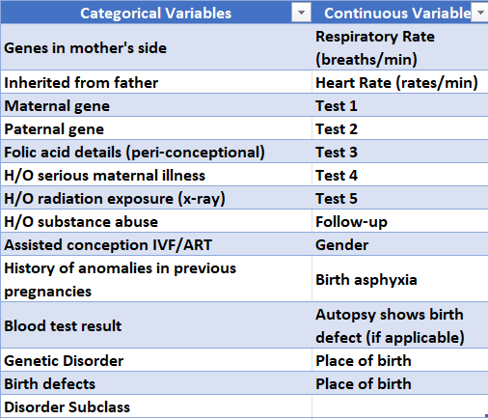
Converted all the categorical Variables into Numerical Variables

Slide 10
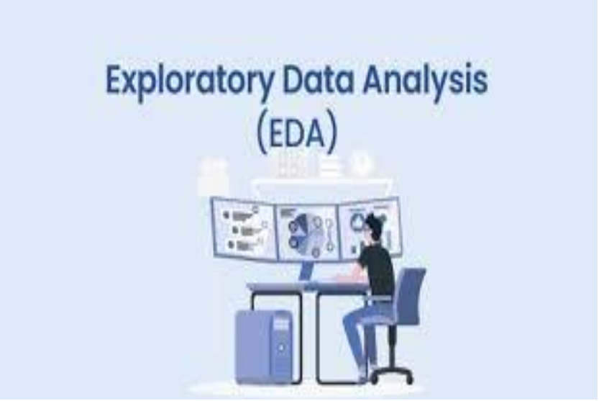
Exploratory
Data
Analysis

Slide 11
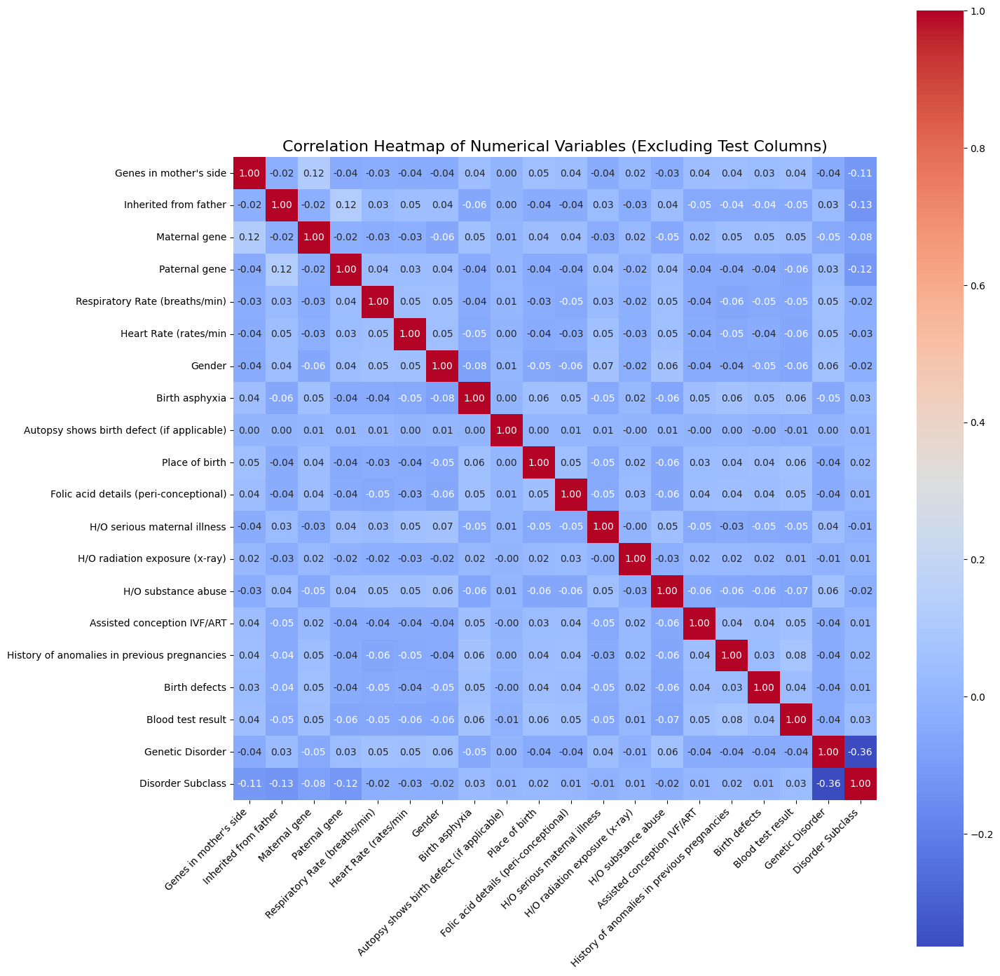
Correlation Matrix
From the correlation heatmap, here are the pairs of terms that are most positively correlated
Genes in mother’s side and Maternal gene (0.12)
Inherited from father and Paternal gene (0.12)
Maternal gene and Genes in mother’s side (0.12)
Maternal gene and Folic acid details (peri-conceptional) (0.11)
Maternal gene and Blood test result (0.05)
Paternal gene and Inherited from father (0.12)
Respiratory Rate (breaths/min) and Heart Rate (rates/min) (0.05)
Gender and Birth defects (0.04)
Autopsy shows birth defect (if applicable) and Birth defects (0.06)
Folic acid details (peri-conceptional) and Maternal gene (0.11)
Folic acid details (peri-conceptional) and H/O serious maternal illness (0.05)
H/O serious maternal illness and Folic acid details (peri-conceptional) (0.05)
H/O substance abuse and Assisted conception IVF/ART (0.06)
Assisted conception IVF/ART and H/O substance abuse (0.06)
History of anomalies in previous pregnancies and Birth defects (0.08)
History of anomalies in previous pregnancies and Genetic Disorder (0.04)
Birth defects and Gender (0.04)
Birth defects and History of anomalies in previous pregnancies (0.08)
Birth defects and Autopsy shows birth defect (if applicable) (0.06)
Birth defects and Blood test result (0.06)
Blood test result and Birth defects (0.06)
Genetic Disorder and History of anomalies in previous pregnancies (0.04)

Slide 12
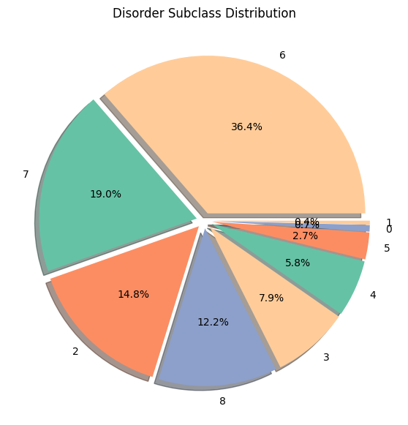
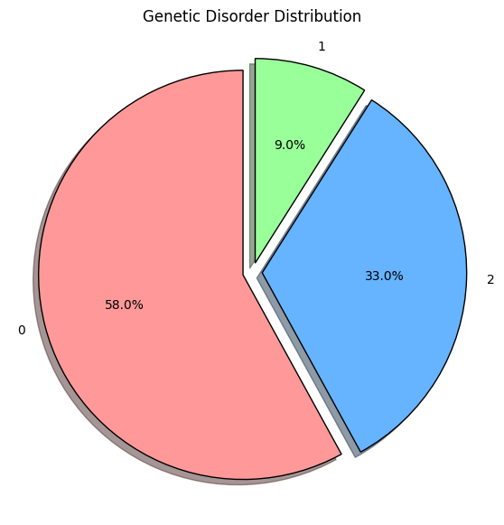
Pie-Chart
Subclass 6 is the most common, representing 36.4% of the data.
Subclass 7 accounts for 19.0%.
Subclass 2 makes up 14.8%.
Subclass 8 contributes 12.2%.
Subclass 3 represents 7.9%.
Subclass 4 has 5.8% of the distribution.
Subclass 5 covers 2.7%.
Subclass 1 is 0.7%, and Subclass 0 is the least common at 0.4%.
Overall, the distribution is imbalanced, with subclasses 6, 7, and 2 making up the majority of the data.
This pie chart shows the distribution of genetic disorders in the dataset:
58% of the cases have no genetic disorder (label 0)
33% have genetic disorder type 2
9% have genetic disorder type 1
majority of samples belonging to the non-disorder category.

Slide 13
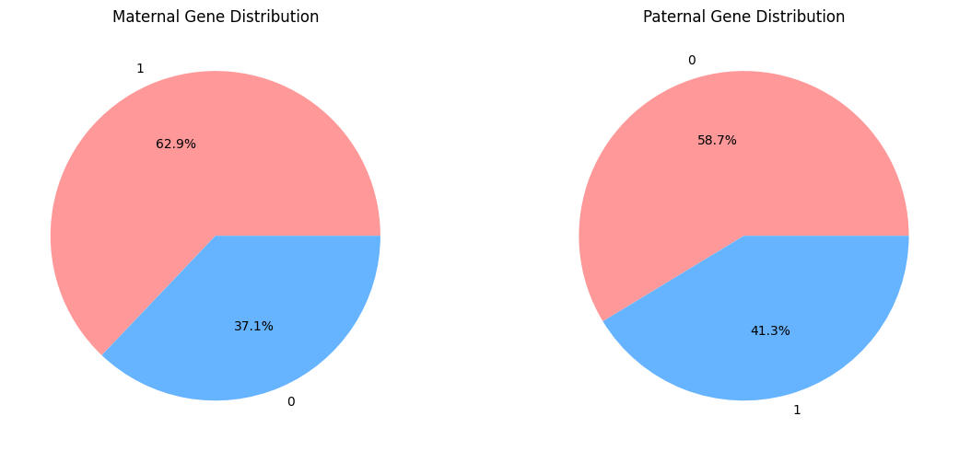
Maternal Gene Distribution:
62.9% of individuals have the maternal gene (label 1)
37.1% do not have the maternal gene (label 0)
Paternal Gene Distribution:
41.3% of individuals have the paternal gene (label 1)
58.7% do not have the paternal gene (label 0)
The maternal gene is more prevalent in the dataset compared to the paternal gene.

Slide 14
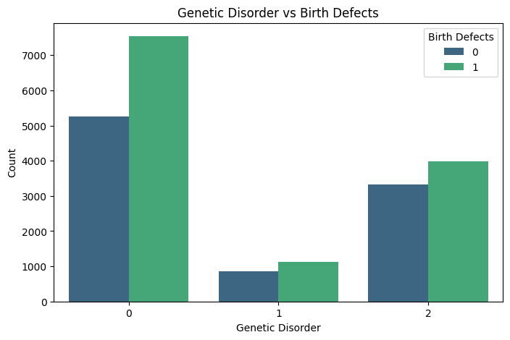
Bar Graph
For Genetic Disorder 0, birth defects (label 1) are more frequent than non-defects (label 0).
Genetic Disorder 1 has the lowest overall count, but still more cases with birth defects.
For Genetic Disorder 2, birth defects are also more common than non-defects.
Across all disorder types, birth defects occur more frequently than non-defects.
Birth defects are not limited to those with genetic disorders—they are also common in individuals without a genetic disorder.

Slide 15
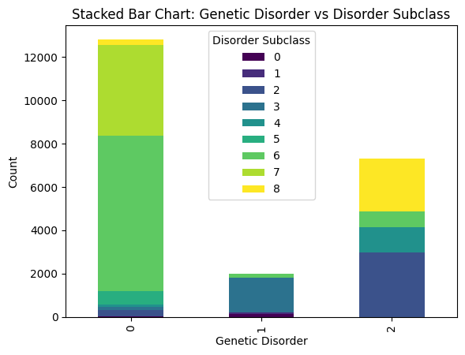
Stacked Bar Chart
Genetic Disorder 0 has the highest count, mostly contributed by subclasses 6 and 7.
Genetic Disorder 1 has a small overall count, mainly made up of subclass 3, followed by smaller contributions from other subclasses.
Genetic Disorder 2 is largely made up of subclass 2, with notable presence from subclasses 4, 5, and 8.
Each genetic disorder type is associated with a distinct pattern of disorder subclasses.
Subclass 6 is dominant in disorder 0, subclass 3 in disorder 1, and subclass 2 in disorder 2.
The chart highlights how different genetic disorders are strongly linked to specific disorder subclasses.

Slide 16
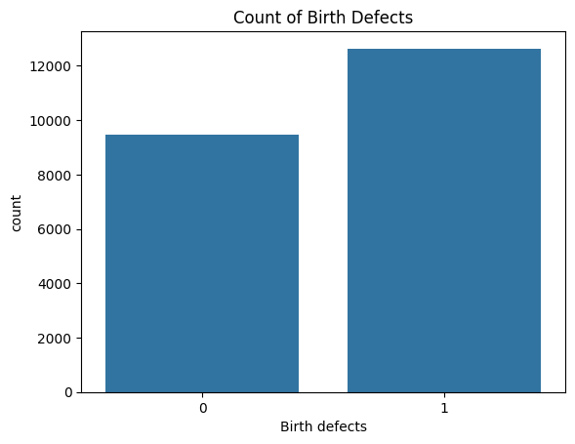
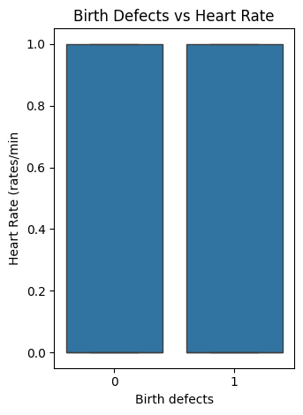
Boxplot
The chart compares the number of individuals with (1) and without (0) birth defects.
Individuals with birth defects (1) are more numerous than those without.
The count for birth defects = 1 is approximately 12,500.
The count for birth defects = 0 is slightly lower, around 9,500.
This indicates that birth defects are more common in the dataset.
The plot compares Heart Rate across individuals with (1) and without (0) birth defects.
Both groups show very similar heart rate values.
There is no significant difference in heart rate based on the presence or absence of birth defects.
This suggests that heart rate is not strongly associated with birth defects in the dataset

Slide 17
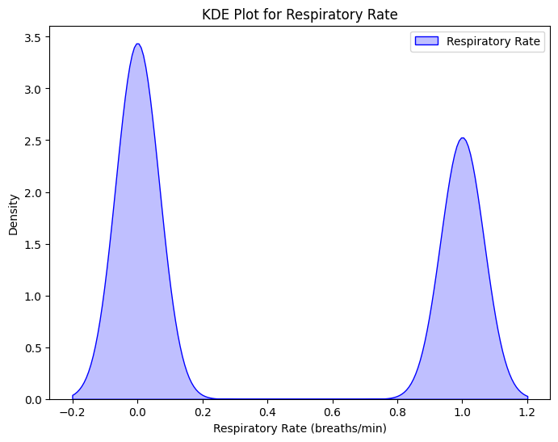
KDE plot
The KDE plot shows the distribution of respiratory rate values.
It has two peaks (bimodal), one near 0 and another around 1, indicating two distinct groups.
Most values are concentrated around these peaks.
Slight negative values may indicate anomalies or data issues.
The density curve highlights where the respiratory rates are most frequent in the dataset.

Slide 18
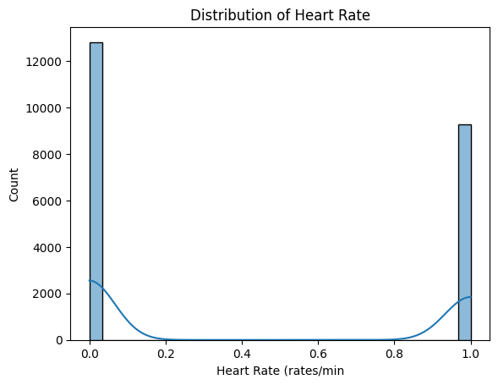
Distribution plot
Heart rate values show two prominent peaks at 0.0 and 1.0.
KDE curve highlights the bimodal nature of the distribution.
Most data points are concentrated at extreme values,
indicating clear group separation.
Helpful for understanding pattern trends in heart rate data.

Slide 19

ML Algorithms
Random Forest
Decision Tree
Support Vector Machine
AdaBoost Classifier
XgBoost Classifier
CatBoost Classifier
ExtraTrees Classifier

Slide 20
Accuracy Table
Split Ratio | Accuracy Before VIF | Accuracy After VIF
60-40 | 88% | 91%
65-35 | 87% | 91%
70-30 | 86% | 91%
75-25 | 92% | 91%
80-20 | 90% | 90%
Random Forest
Split Ratio | Accuracy Before VIF | Accuracy After VIF
60-40 | 86.3% | 91%
65-35 | 86.6% | 90%
70-30 | 86.3% | 90.8%
75-25 | 86% | 90.4%
80-20 | 85.3% | 89.6%
Decision Tree

Slide 21
Split Ratio | Accuracy Before VIF | Accuracy After VIF
60-40 | 83.6% | 83.9%
65-35 | 83.7% | 83.8%
70-30 | 83.6% | 83.7%
75-25 | 84% | 83.5%
80-20 | 83.8% | 83.6%
Support Vector Machine
Split Ratio | Accuracy Before VIF | Accuracy After VIF
60-40 | 85% | 92.1%
65-35 | 84% | 92.2%
70-30 | 85% | 92.4%
75-25 | 85% | 92.4%
80-20 | 85% | 92.4%
Adaboost Classifier

Slide 22
Split Ratio | Accuracy Before VIF | Accuracy After VIF
60-40 | 86% | 92%
65-35 | 87% | 92%
70-30 | 88% | 92%
75-25 | 87% | 92%
80-20 | 89% | 92%
XGBoost Classifier
Split Ratio | Accuracy Before VIF | Accuracy After VIF
60-40 | 91% | 92.1%
65-35 | 91% | 92.1%
70-30 | 92% | 92.4%
75-25 | 91% | 92.3%
80-20 | 92% | 92.3%
CatBoost Classifier

Slide 23
Split Ratio | Accuracy Before VIF | Accuracy After VIF
60-40 | 90% | 90%
65-35 | 91% | 90%
70-30 | 91% | 91%
75-25 | 91% | 91%
80-20 | 90% | 91%
Extra Trees Classifier

Slide 24
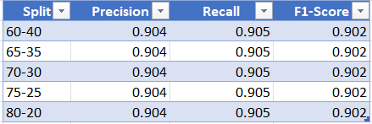
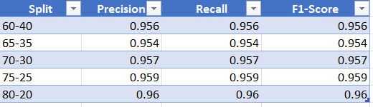
Random Forest
Before VIF
After VIF

Slide 25
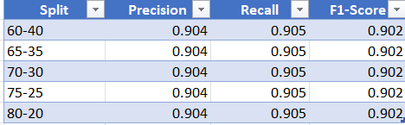

Decision Tree
Before VIF
After VIF

Slide 26
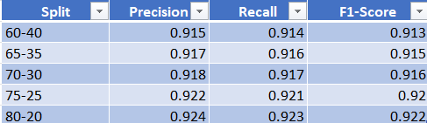
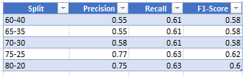
Support Vector Machine
Before VIF
After VIF

Slide 27
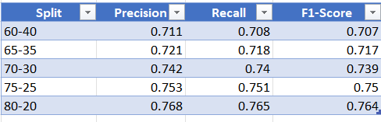
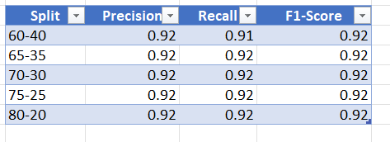
AdaBoost Classifier
Before VIF
After VIF

Slide 28
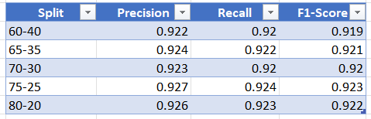
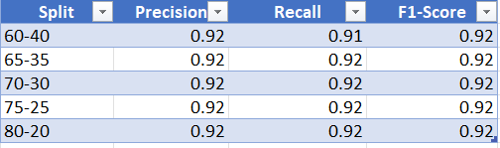
XGBoost Classifier
Before VIF
After VIF

Slide 29
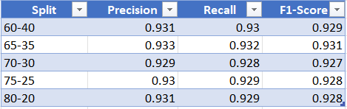
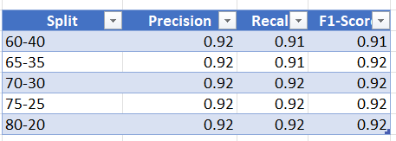
CatBoost Classifier
Before VIF
After VIF

Slide 30
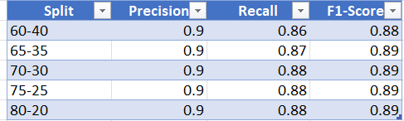
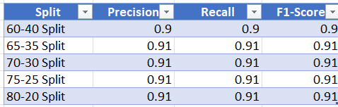
Extra Trees Classifier
Before VIF
After VIF

Slide 31
Comparison Table
Algorithms | 60-40 | 65-35 | 70-30 | 75-25 | 80-20
Random Forest | 88% | 87% | 86% | 92% | 90.1%
Decision Tree | 86.3% | 86.6% | 86.3% | 86% | 85.3%
Svm | 83.6% | 83.7% | 83.6% | 84% | 83.8%
AdaBoost | 85% | 84% | 85% | 85% | 83%
XGBoost | 86% | 87% | 88% | 87% | 89%
CatBoost | 91% | 91% | 92% | 91% | 92%
Extra Tress | 90% | 91% | 91% | 90.1% | 90.1%
Algorithms | 60-40 | 65-35 | 70-30 | 75-25 | 80-20
Random Forest | 91% | 91% | 91% | 91% | 90.2%
Decision Tree | 91% | 90.6% | 90.8% | 90.4% | 89.6%
Svm | 83.9% | 83.8% | 83.7% | 83.5% | 83.6%
AdaBoost | 92.1% | 92.2% | 92.4% | 92.4% | 92.4%
XGBoost | 92% | 92% | 92% | 92% | 92%
CatBoost | 92.1% | 92.1% | 92.4% | 92.3% | 92.3%
Extra Tress | 90% | 90% | 91% | 91% | 91%
Before VIF

Slide 32
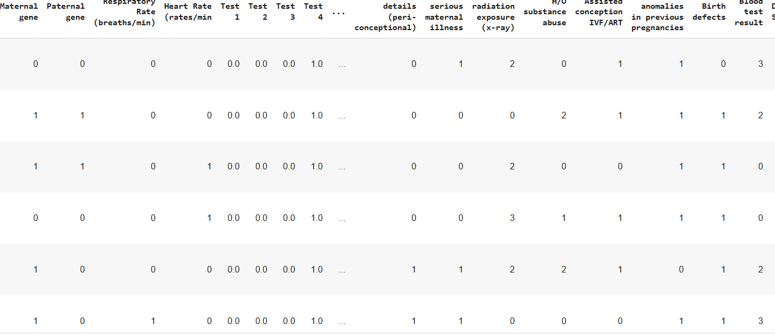
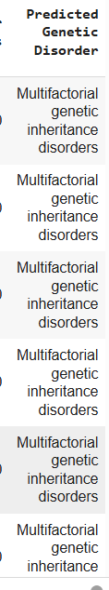
Summary
So, in conclusion among all the algorithms catboost, RandomForest and Extra Tree Classifier showed the highest accuracy i.e. 0.91 to 0.92
And after applying the VIF all the advanced machine learning models like Adaboost,
Xgboost, Catbbost, ExtraTrees Classifier including Random Forest gave the highest accuracy
Used Catboost to predict the Genetic Disorder for test data (Real Time Data)

Slide 33
Future Scope
In the future, the model can be further enhanced by incorporating domain-specific feature engineering and model explainability techniques like SHAP or LIME. Advanced hyperparameter optimization methods such as Optuna can improve performance. Combining top-performing models like CatBoost, Random Forest, XGBoost, and Extra Trees using ensemble or stacking techniques may yield even better results. Additionally, exploring deep learning models like TabNet, addressing class imbalance using techniques like SMOTE or GANs, and adopting stratified k-fold cross-validation can improve model robustness. Finally, the system can be deployed as a real-time clinical decision support tool.

Slide 34
THANK YOU
Done by:
Vaishnavi Shivalingala

