Slide 1
Heart Disease Diagnostic - Analysis
Detailed Project Report
Vaishnavi Abbugari

Slide 2
Project Title : Heart Disease Diagnostic Analysis
Technologies : Business Intelligence
Domain : Healthcare
Project Difficulties level : Advanced

Slide 3
Problem Statement:
Health is real wealth in the pandemic time we all realized the brute effects of covid-19 onall irrespective of any status. You are required to analyze this health and medical data forbetter future preparation.

Slide 4
Do ETL : Extract- Transform and Load data from heart disease diagnostic databaseYou can perform EDA through python.From the database extract various information such as Heart disease rates, Heart disease by gender, by age.You can even compare attributes of the data set to extract necessary information.Make necessary dashboard with the best you can extract from the data.Use various visualization and features and make the best dashboard

Slide 5
Find key metrics and factors and show the meaningful relationships between attributes.
Do your own research and come up with
KPIs(Key Performance Indicators)
KPIs in healthcare industry:
⦁ Healthcare KPIs are quantifiable or measurable factors that reflect upon the goals of an organization. Working without KPIs can create vagueness around performance, and comparing the progress of an organization over different time periods can become very difficult.

Slide 6
Health care KPIs are well-defined performance measures or metrics with which you can observe, analyze, optimize and transform health care facility services. They measure the progress of the facility and show how successful it is.
Average patient weight time: The Average Patient Wait Time is a very useful nurse KPI example for measuring and tracking business objectives around patient satisfaction and capacity management.
min.​

Slide 7
Bed occupancy rate: The bed occupancy rate measures the proportion of hospital beds in use at any one time. Bed occupancy is a good indication of a hospital's ability to provide safe and effective treatments to patients. Therefore, bed occupancy is a great KPI for measuring operational and capacity objectives. Once the KPI is measured and tracked, healthcare providers are able to estimate whether or not more space and beds are needed. KPI Example: Decrease bed occupancy rates to 82% by 10/11/2024.

Slide 8
⦁ Average hospital stay: Just as the name implies, this KPI tracks the average length of time patients stay in the hospital. While this metric is very useful, it's also very general - using average hospital stay as a single KPI to track all the different categories of stay in your facility won't prove to be very helpful. The recovery from heart surgery will almost always be a longer stay than a patient who underwent cataract surgery. Instead, this KPI should be broken up and used for each category. KPI Example: Maintain the average hospital stay for shoulder arthroplasty of 2 days by 31/12/24.

Slide 9
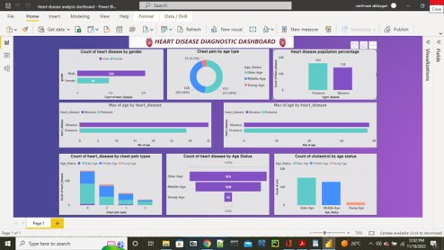
Dashboard

Slide 10
Thank you

